Slide 1

AI Based Reservation System
CVR COLLEGE OF ENGINEERING
(An UGC Autonomous institute, Accredited by NACC with ‘A’ Grade)
Department of Computer Science & Engineering
Team members:
M.PRASHANTH REDDY(17B81A05E7)
G.SAI KOUSHIK(17B81A05H7)
P.SAI KRISHNA(17B81A05H8)
Guide: Dr. K.MADHUSUDHANA

Slide 2
PROBLEM STATEMENT
The Indian Railway system supports 13 million passengers everyday, and yet millions do not avail confirmed tickets for their travel.
Yet large number of people are unable to obtain confirmed ticket before their travel. While some travel (illegally) on wait-listed tickets , others cancel their tickets at the very last moment.
Reservation on wait-list becomes inconvenient.

Slide 3
SOLUTION
In this Project we study the feasibility of making such predictions using the data from past railway travels. Empowered with this knowledge, users could be in a better position to make further decisions—either wait for the ticket to get confirmed, or make alternative travel arrangements.
We obtain our data from a mobile application. Select the features that could affect confirmation of a wait-listed ticket, and design rules to improve the quality of our final data-set.
We then train linear and nonlinear machine learning models and do inference on held-out test data.

Slide 4
Technologies
Front End :
HTML , CSS , JavaScript.
Back End :
Flask , Apache Server,
ML – Time Forecasting Algorithm , Google cloud ,
Google Firebase authentication , Payment gateway.

Slide 5
PHASES
Develop a web application for Railway Reservation System.
Provide Functionality and Flexibility to railway reservation system ,so that they can operate the system easily and efficiently.
Main objective is to provide probability for the confirmation of ticket, so that user can think about alternate way to reach his destination.

Slide 6
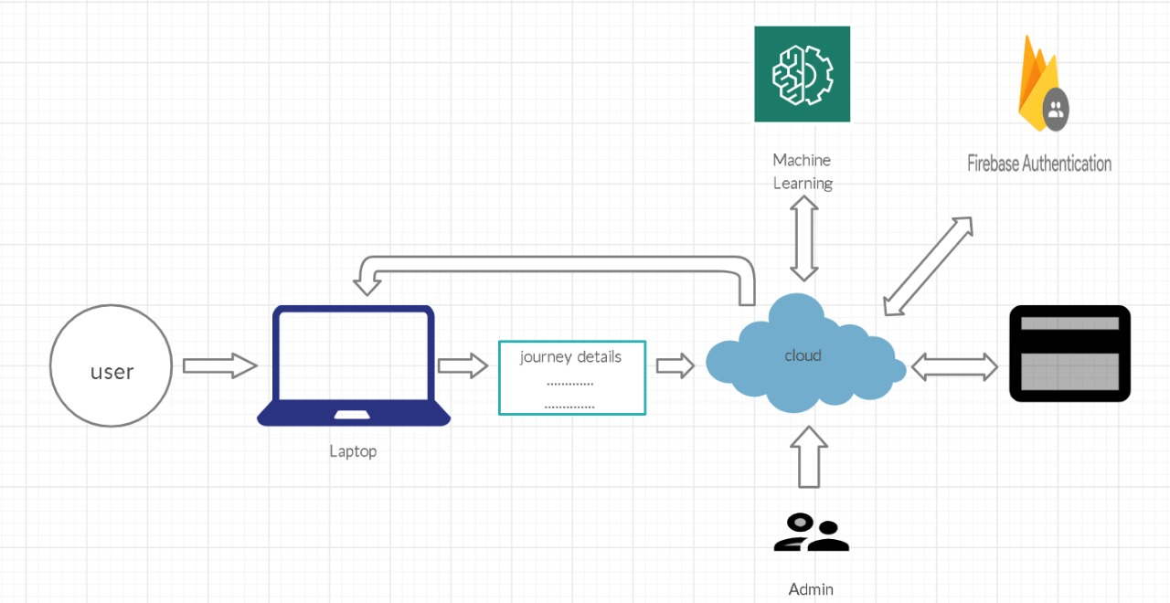
Architecture diagram
Response

Slide 7
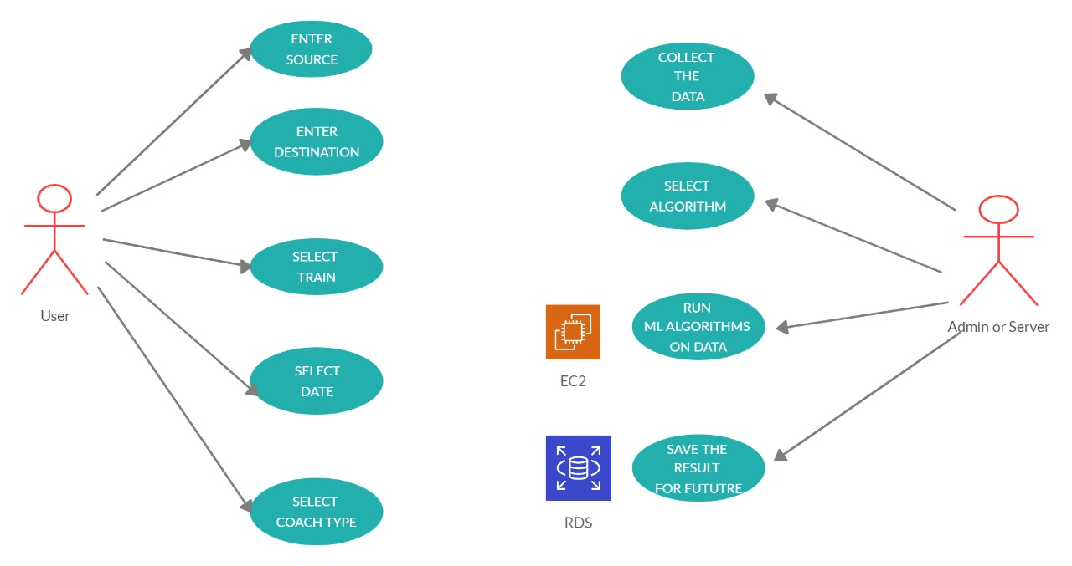
USECASE DIAGRAM

Slide 8
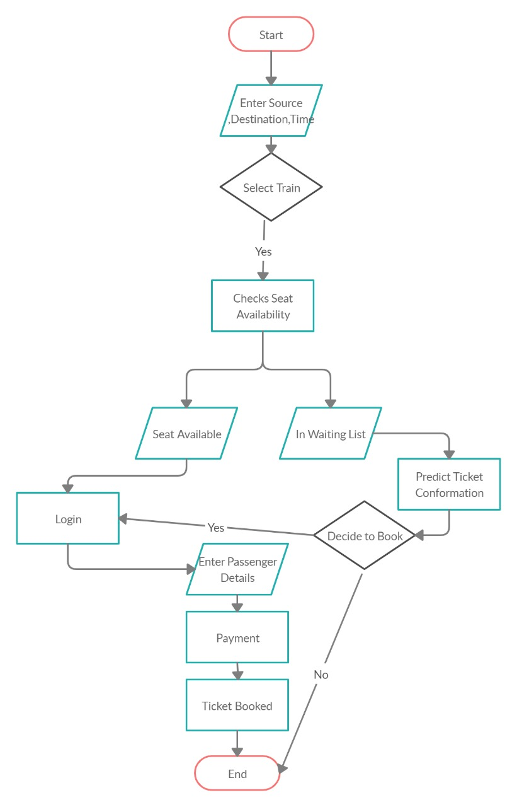
ACTIVITY DIAGRAM FOR CLIENT SIDE

Slide 9
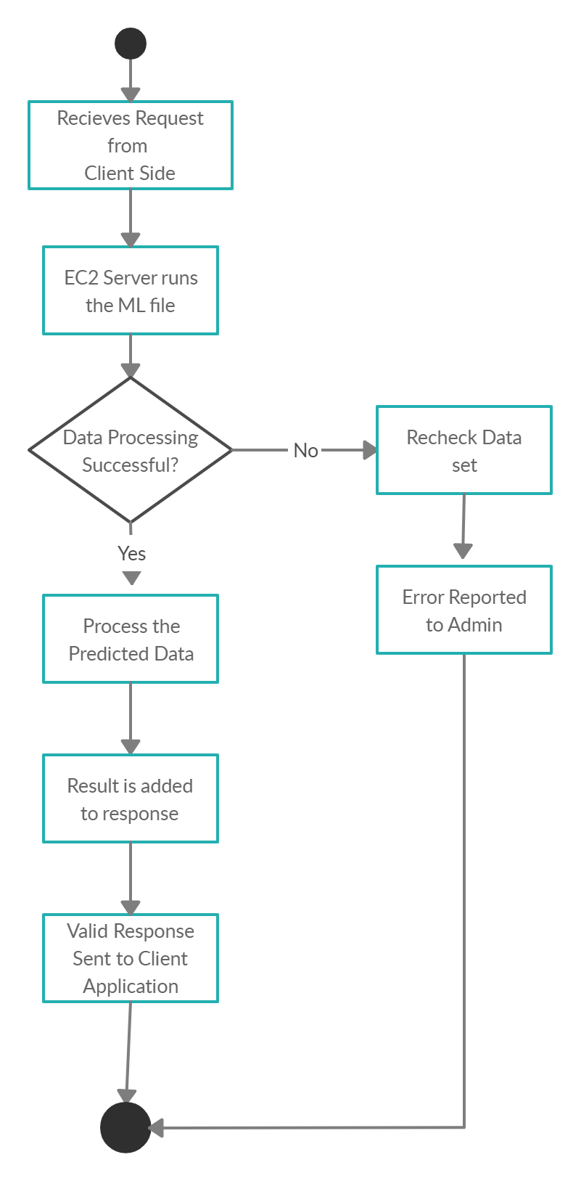
ACTIVITY DIAGRAM FOR SERVER SIDE

Slide 10
G . Sai Koushik
CONTRIBUTION
Collection of all required Data including datasets.
Designing of Webpages by using HTML,CSS and creation of hyperlinks.(homepage , login page , journey details page )

Slide 11
CONTRIBUTION
M . Prashanth Reddy
Building site using FLASK.
Firebase authentication for site.
JS functioning to Link Firebase OAuth Config.

Slide 12
CONTRIBUTION
P . Sai Krishna
Implementation of Machine learning algorithm(Stata ARIMA time series estimation) for provided datasets.
Functioning of FLASK(For Web app & Using Jinja2)
Server setup and running Machine learning script ,To reduce training frequency creating Pkl files(to reduce time and repeatedly re-train the ML [model.py] files).

Slide 13
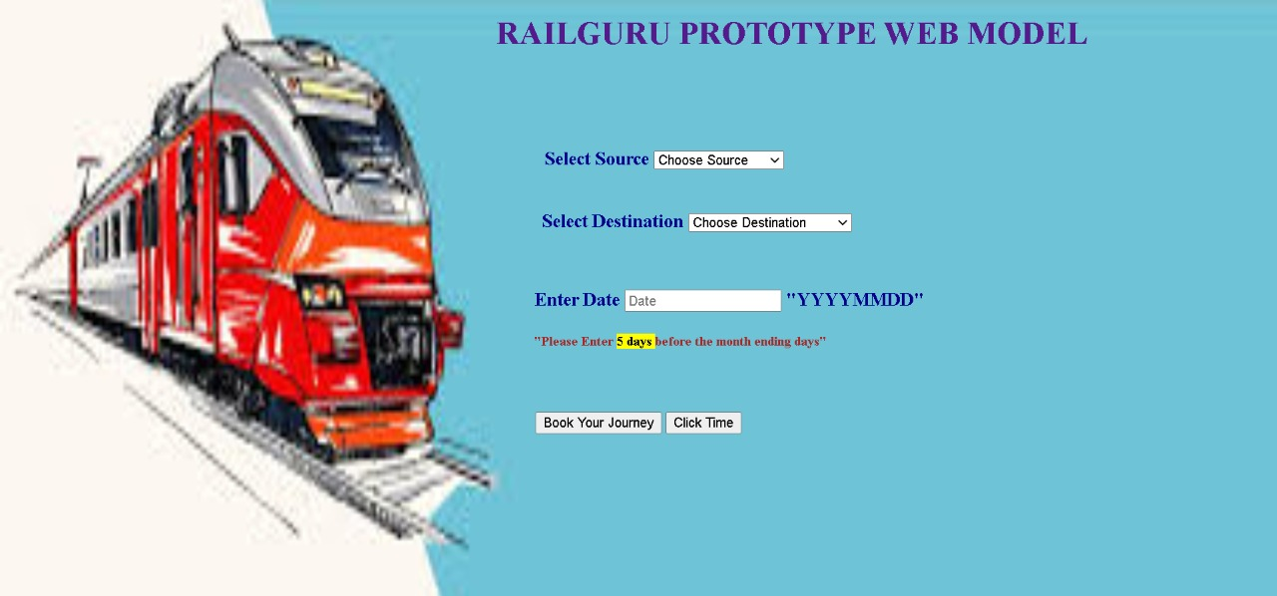

Slide 14
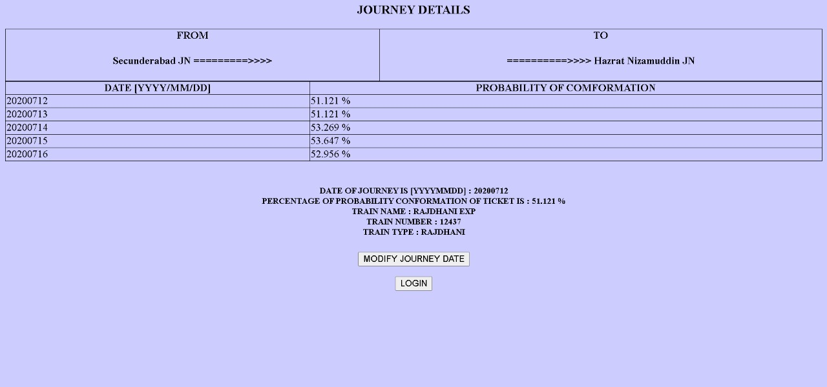

Slide 15
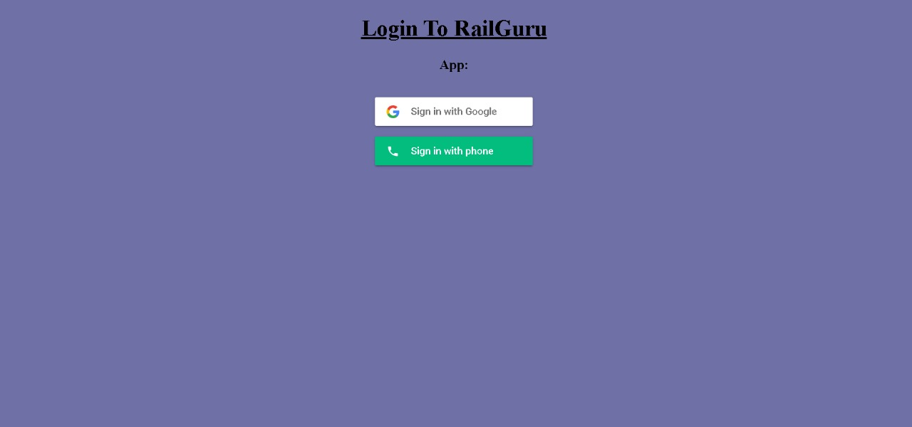

Slide 16
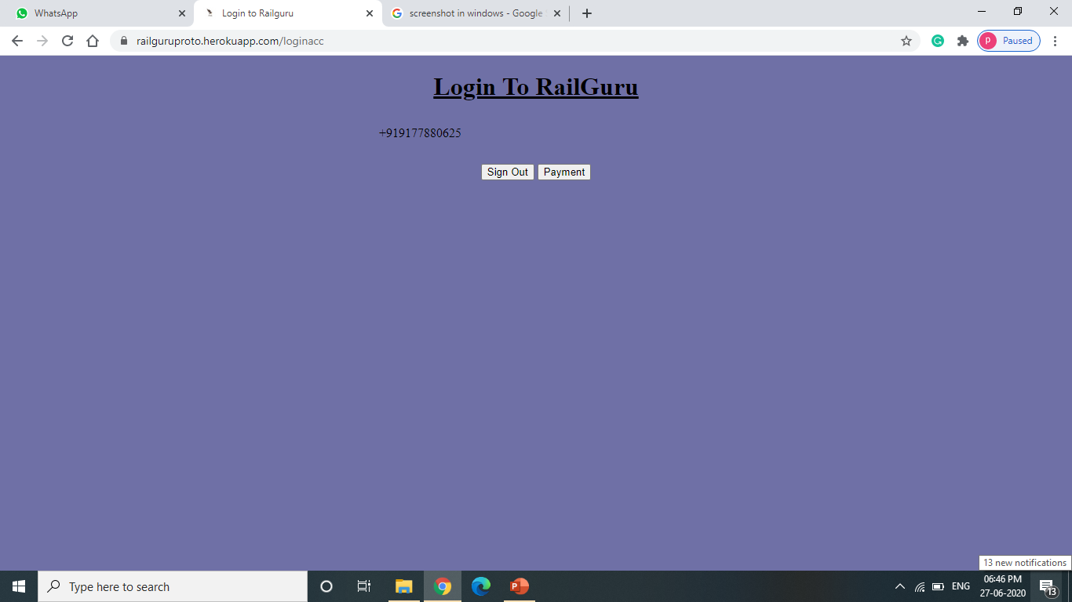

Slide 17
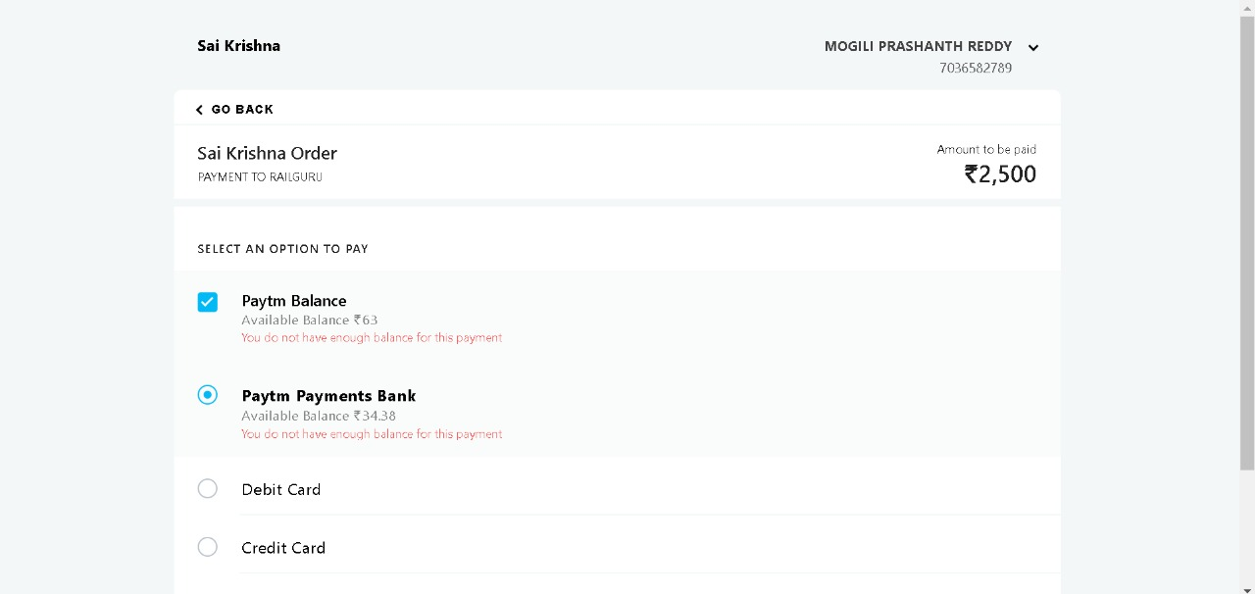

Slide 18
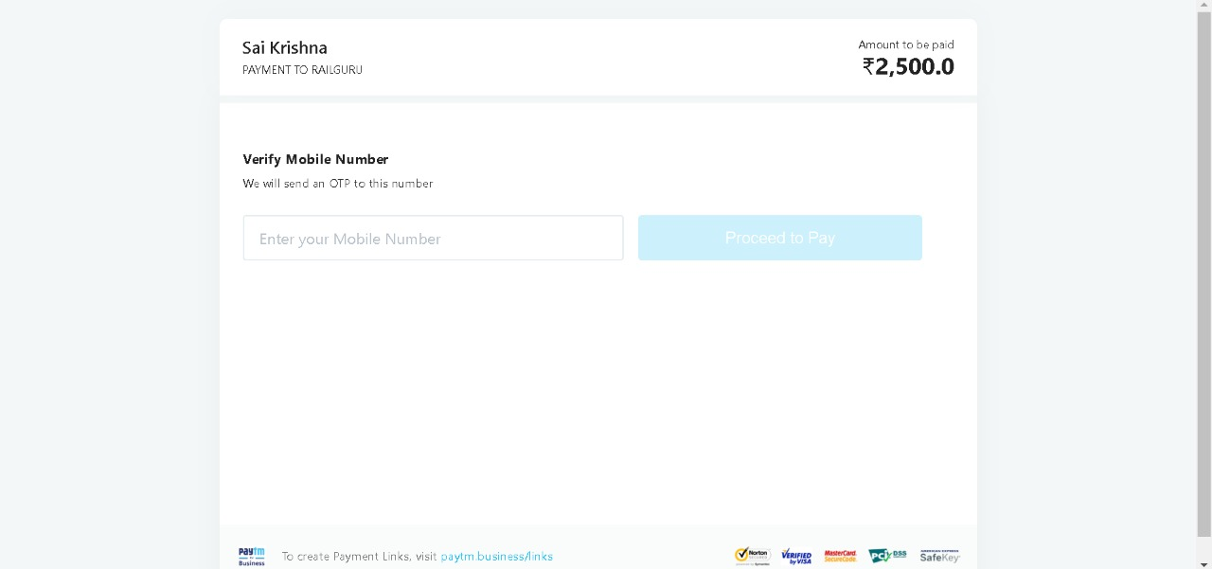

Slide 19
CONCLUSION AND FUTURE SCOPE
With our present model a client can choose his mode of transport by probability of confirmation of his ticket, Project will be updated in near future as per requirements of the passenger convenience.
Planning to implement User Graphical seating Selection.
For offline services trying 'I V R S' (Interactive Voice Response System).
(Trying to Adding Features of Cancel Ticket and Offline Ticket Booking.)
---> 1234@35.209.134.246

Slide 20
WEB APP ADDRESS
Site Address : railguruproto.herokuapp.com
: 35.209.134.246:6442

Slide 21
THANK YOU

