Slide 1

PROJECT ON
Customer Segmentation for Optimized Business Strategies
GIET UNIVERSITY GUNUPUR, 765022
DEPARTMENT 0F COMPUTER SCIENCE AND ENGINEERING
TEAM MEMBERS:
ANKITA JENA(22CSE745)
D SIVAM (22CSE797)
N KOUSHIK MADHAV PATNAIK (22CSE905)
GUIDED BY:
MR SITANSHU KAR
ASSISTANT PROFESSOR
GIET UNVERSITY ,
GUNUPUR

Slide 2
Introduction
What is Customer Segmentation?
- Dividing customers into distinct groups based on similar characteristics.
- Helps businesses understand their audience better.
Importance:
- Targeted marketing
- Improved customer satisfaction
- Optimized resource allocation

Slide 3
Problem Statement
- Businesses struggle to create personalized marketing strategies.
- Ineffective targeting leads to:
• Wasted marketing budget
• Poor customer retention
• Missed growth opportunities

Slide 4
Project Objectives
- Identify distinct customer groups using data-driven techniques.
- Develop actionable strategies to target each segment effectively.
- Enhance customer engagement and boost business profitability.

Slide 5
Methodology
- Data Collection: Demographic, behavioral, and transactional data.
- Data Preprocessing: Cleaning, normalization, handling missing values.
- Segmentation Technique:
• K-Means Clustering Algorithm
• Chosen for its efficiency in handling large datasets.

Slide 6
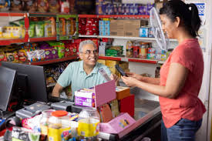
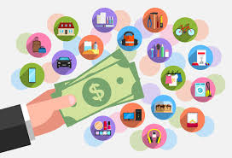
Results & Insights
- Identified Segments (Example):
• Value Shoppers
• Loyal Customers
• Price-Sensitive Buyers
• Occasional Shoppers
- Key Insights:
• Segment-specific preferences
• Spending patterns
• Behavior trends

Slide 7
Business Strategies Based on Segmentation
- Personalized Marketing Campaigns: Target specific segments with tailored messages.
- Product Recommendations: Improve upselling and cross-selling.
- Customer Retention Strategies: Loyalty programs for high-value customers.
- Resource Optimization: Focus efforts on the most profitable segments.

Slide 8
Conclusion & Future Scope
Conclusion:
- Customer segmentation enhances business decision-making.
- Drives growth through personalized strategies.
Future Scope:
- Integration with AI for real-time segmentation.
- Continuous model improvement with new data.

