Slide 1

Webnovel Architect
Neuro-Symbolic Story Intelligence
Turning evolving web novels into living audio dramas using Dynamic Graph RAG (DyG-RAG) — a zero-GPU modular system that thinks in graphs and speaks in character.

Slide 2

The Problem with Static Audiobooks
Why Traditional Pipelines Fail
Serial web novels are living documents. Characters emerge, shift in prominence, and evolve across hundreds of chapters — none of which exist when production begins.
Evolving Context
GPU Barrier
No Memory
Static TTS assignment cannot adapt to sprawling, emergent casts.
High-quality local LLMs and audio synthesis demand expensive hardware, limiting accessibility.
Traditional pipelines treat each chapter in isolation — no persistent character intelligence.

Slide 3
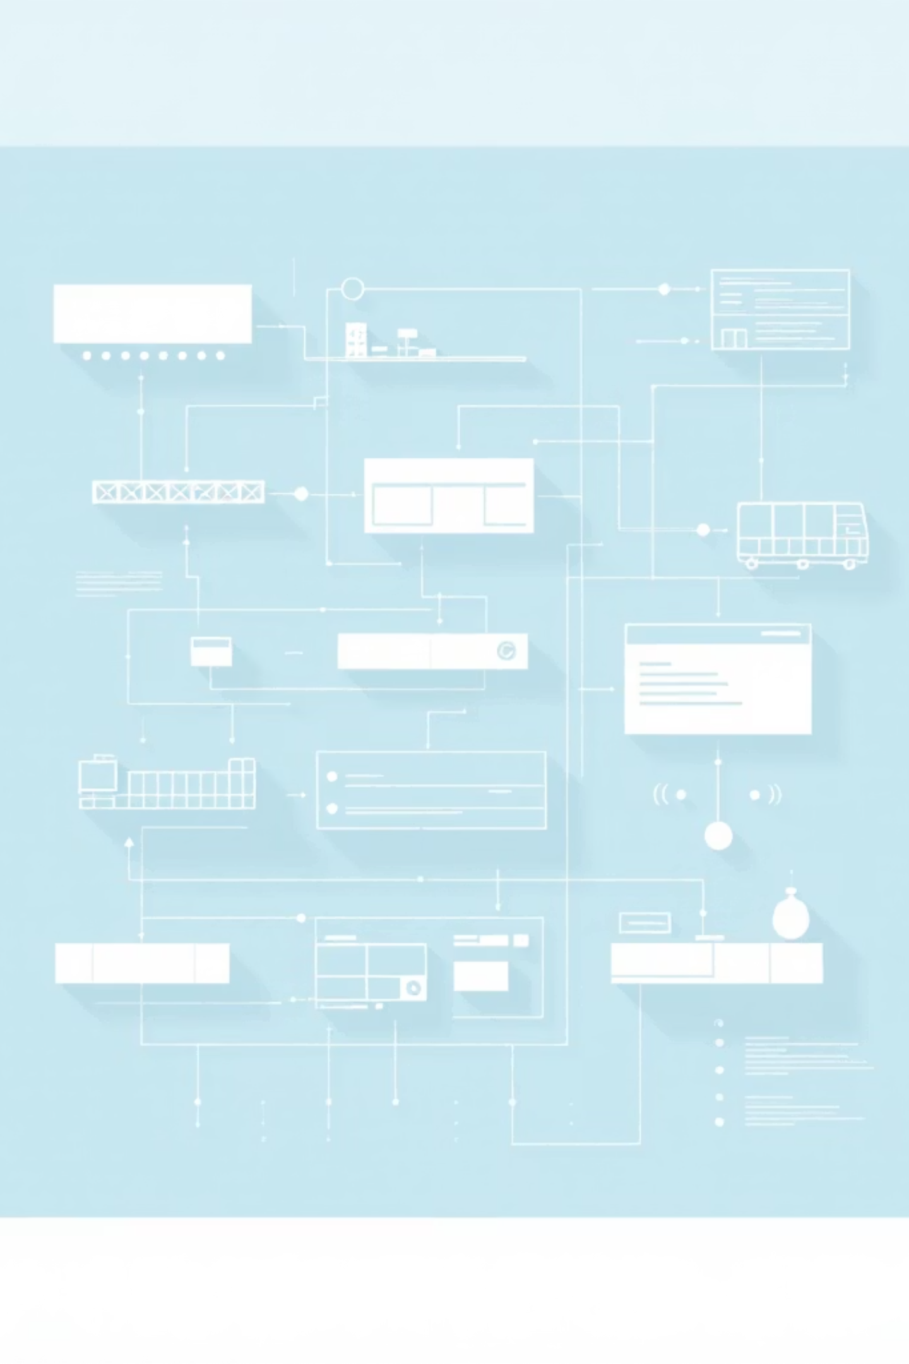

Core Concept & Design Goals
Dynamic Intelligence
Track characters and events across chapters via a persistent, queryable story graph.
Intelligent Casting
PageRank-based "Graduation" assigns premium voices only to narratively important characters.
Zero-GPU Accessibility
Runs on a standard laptop using Kokoro ONNX, EdgeTTS, and LiteLLM API models.
Neuro-Symbolic Hybrid
Neural LLMs extract events; symbolic DAGs (NetworkX) provide persistent, structured memory.

Slide 4
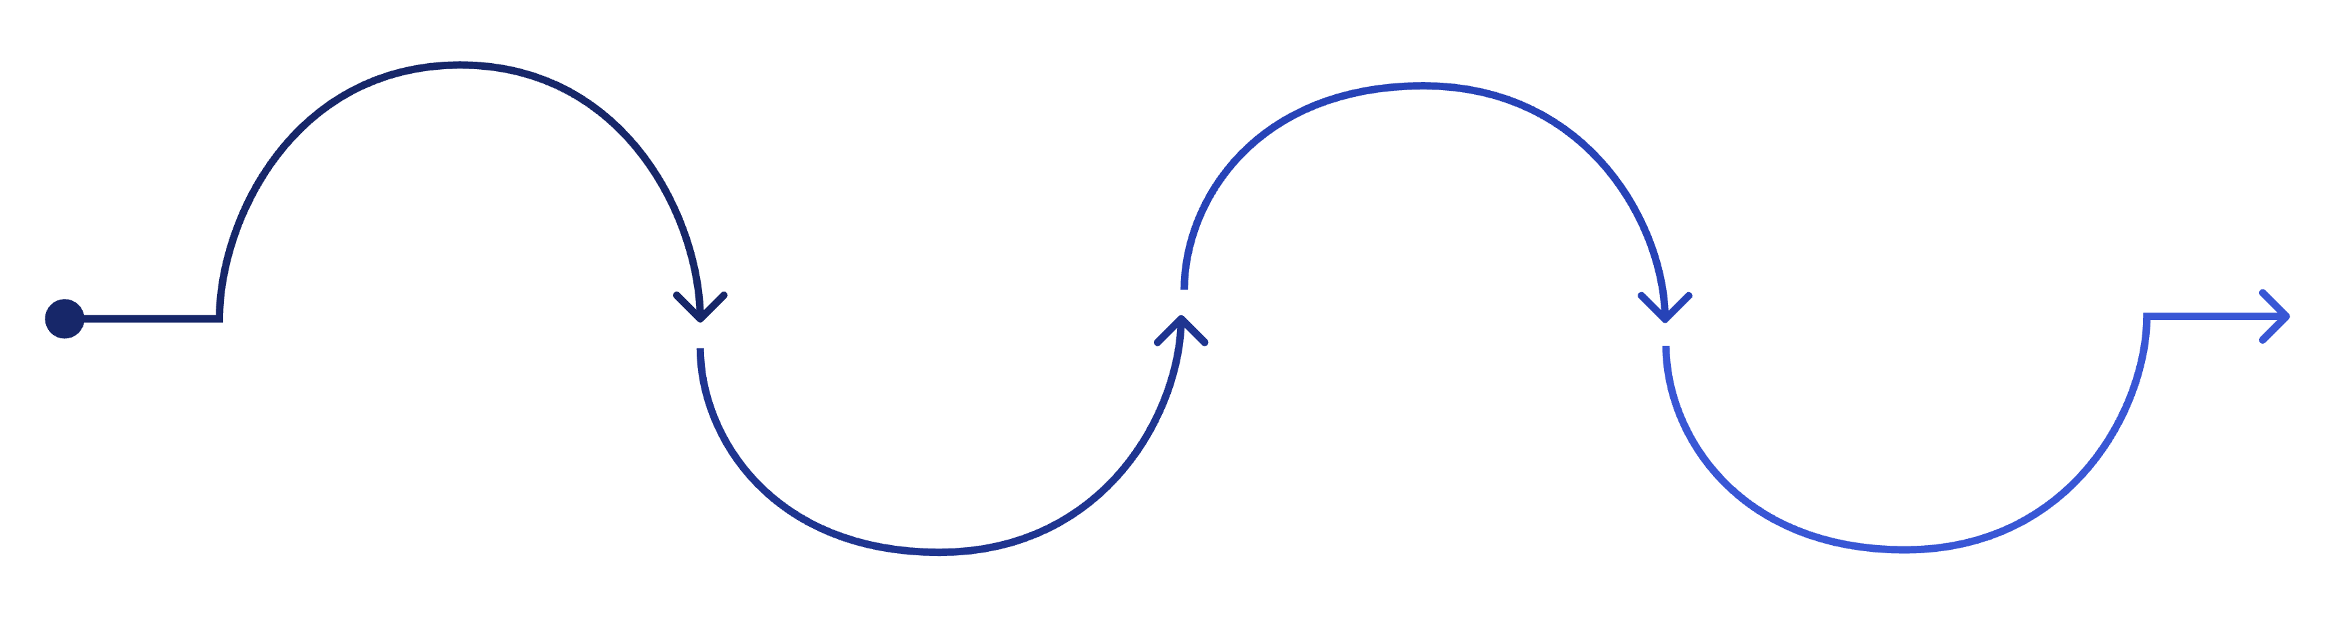
System Architecture
An event-centric DyG-RAG pipeline — four composable modules, each with a single responsibility.
The Brain
The Voice
The Eye
NetworkX story graph persists nodes and edges as JSON
The Director
TTS: Kokoro local for leads, EdgeTTS for background
LLM ingests raw text into entities and events
PageRank reasoning α=0.85; selects central characters
The Adapter Pattern underpins each module — abstract base classes for LLMProvider, TTSProvider, and GraphProvider guarantee extensibility without coupling.

Slide 5
End-to-End Workflow
Ingest
Raw chapter text passed to ingest_chapter_text(), split at 4,000-char context boundaries.
Extract
LiteLLM identifies speakers, emotions, and narrative events — e.g., "Aria confronts Thorne."
Graph Update
Character nodes and event edges are upserted into the NetworkX DAG, encoding the new chapter state.
Graduate
get_character_importance() runs PageRank; scores above 0.15 promote to main cast.
Output
Canonical Markdown wiki profiles and .wav audio files are generated per character tier.

Slide 6
Development Process & SDLC
Hybrid SDLC — Spiral + Agile
Phase 0 — Requirements
Architecture evolves through risk-driven Spiral research loops. Functional milestones are delivered as Agile sprints, enabling continuous demonstration at each phase boundary.
Defined the Neuro-Symbolic problem space; literature review.
Phases 1 & 2 — Prototype
Phase 3 — Graph Core ✅
Regex/heuristic prototype and basic entity wiki.
NetworkX event graph, LLM extraction, PageRank scoring.
Phase 4 — Audio (Current)
Phases 6 & 7 — Validate & Deploy
Kokoro + EdgeTTS dual synthesis integration.
Temporal weighting experiments; demo submission package.
Branching
Testing
Trunk-based development — direct commits to main optimise velocity for a solo research model.
verify_modular.py runs the full mocked chain end-to-end, preventing regressions across every sprint.

Slide 7

Current Status — Phase 4
100%
82M
0.15
α=0.85
Pipeline Complete
Kokoro Params
Graduation Score
PageRank Damping
Ingest → Graph → PageRank → Audio is fully traversable today.
CPU-friendly ONNX model — no GPU required.
PageRank threshold separating main cast from background characters.
Standard damping factor applied across the character–event graph.
In Progress: Voice Management (attribute-based voice ID assignment) · Temporal edge weighting · Alias resolution via spaCy coreference

Slide 8
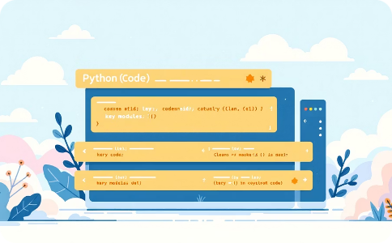


Technology Stack
Core Runtime
Graph & Memory
AI & Synthesis
Python 3.9+ with a Switchboard/Adapter Pattern. Abstract base classes for each provider ensure plug-and-play extensibility across /adapters, /core, and /app.
NetworkX directed acyclic graph with JSON serialisation (story_graph.json). KuzuDB migration planned for 1,000+ chapter scalability.
LiteLLM (Gemini Flash default) for extraction. Kokoro ONNX for premium local TTS; Microsoft EdgeTTS as cloud fallback for background cast.

Slide 9

Challenges & Risks
JSON vs. KuzuDB
JSON persistence enables rapid prototyping and full transparency but will throttle performance beyond ~1,000 chapters. Migration to KuzuDB is scoped but not yet initiated.
Static Graduation Threshold
A hard 0.15 PageRank boundary risks over-promoting characters in dense interaction webs. Adaptive, cast-size-relative thresholds are needed at scale.
No Temporal Decay
Without timestamp-weighted edges, legacy characters retain high PageRank indefinitely — starving newly introduced characters of premium audio resources.
Alias Resolution Gap
"Aria" and "the girl" are treated as separate graph nodes. Absent coreference resolution, the character graph accumulates duplicates over long narratives.

Slide 10
Roadmap & Next Milestones
Conclusion
Voice Assignment Service
Webnovel Architect has crossed the prototype threshold into a fully verifiable Neuro-Symbolic application — 100% of the extraction → graph → scoring → audio pipeline is traversable today.
Map dynamic character qualities to specific Kokoro voice IDs — replacing hardcoded test voices.
The next milestone: production-readiness for 100+ chapter scale via KuzuDB and temporal graph decay.
Temporal Weighting
Live Demo
Attach chapter timestamps to graph edges; introduce PageRank decay so legacy characters naturally fade.
Run python verify_modular.py to traverse the full pipeline end-to-end.
Alias Resolution
Integrate a spaCy coreference pipeline to merge alias nodes and eliminate graph duplication.
KuzuDB Migration
Replace JSON serialisation with KuzuDB to support 100+ chapter production-scale narratives.

