Slide 1


Predicting Employee Attrition for IBM
Data Mining - B9DA103
Koushik Chikkegowda-10515678
Chirag Kumar Pathela- 10513666
Santhosh Vinayaka- 10518683

Slide 2

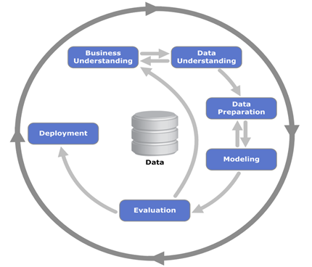
CRISP-DM Methodology
Business Understanding
Data Understanding
Data Preparation
Modelling
Evaluation
Deployment

Slide 3

Business Understanding
Background
Analysis on data drawn from the IBM Watson HR analytics Employee performance and attrition dataset available on Kaggle.
Business Objectives
To predict the employee attrition for IBM.
Which factors affect the attrition in the organization?
How is attrition distributed according to the above identified parameters and what can be done to minimize cost of attrition?

Slide 4
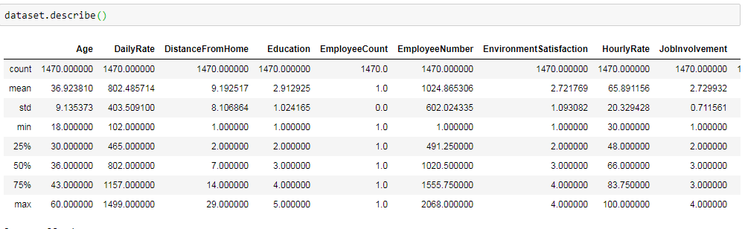
Data Understanding
Data Description
Data has 1470 observations and 35 feature.
Each record in the dataset is at Employee level and describes whether there will be an employee attrition based on various features.

Slide 5
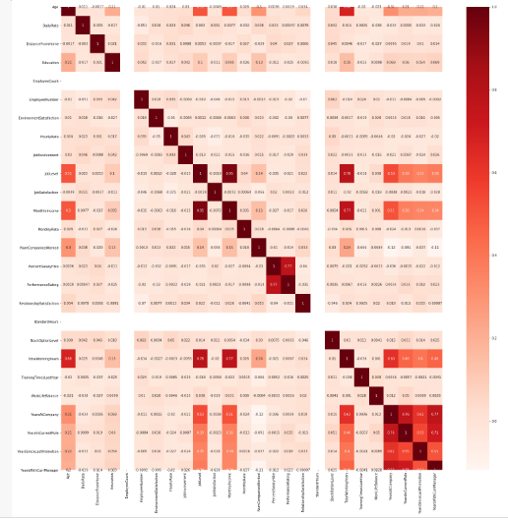
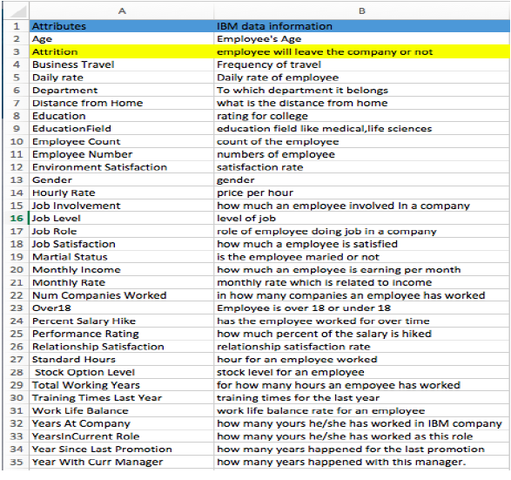
Heat Map
Dataset Attributes

Slide 6
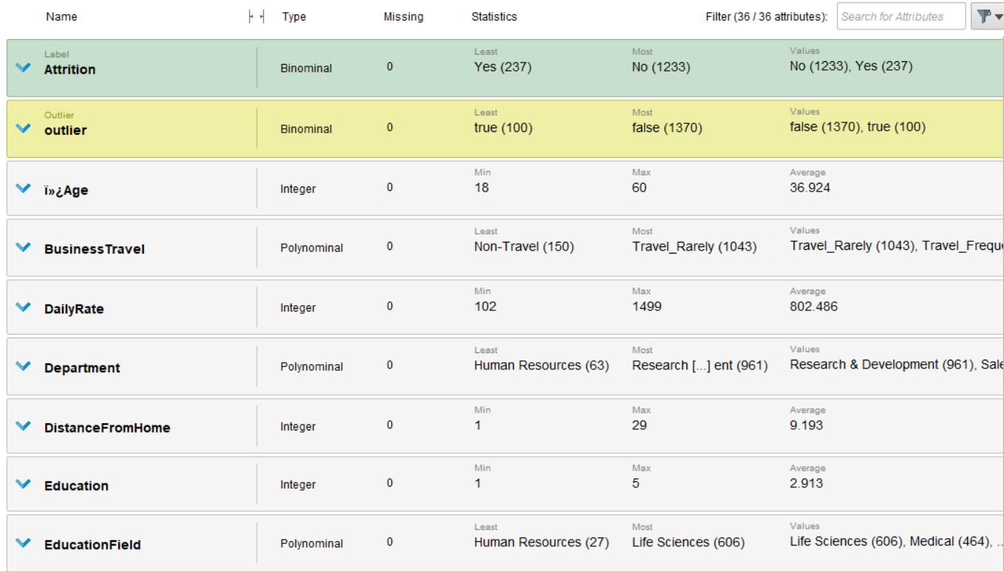
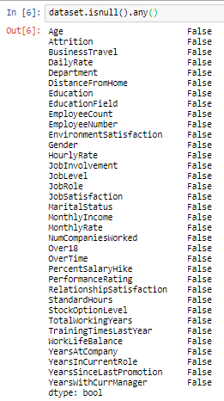
Data Preparation

Slide 7


Data Modeling
Tools used:
Rapid Miner Studio
Jupyter Python

Slide 8
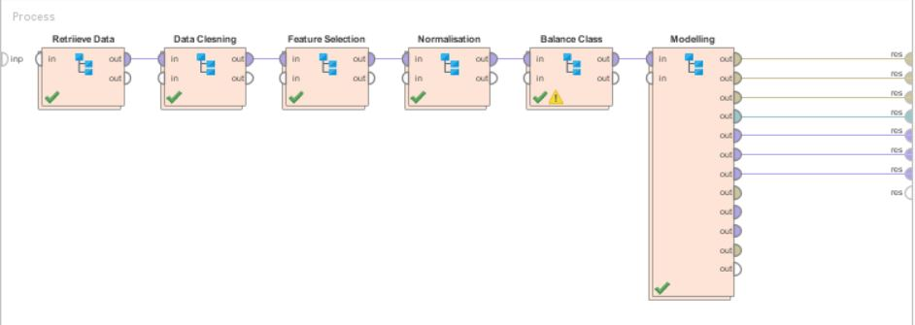
Model Built- Manual

Slide 9
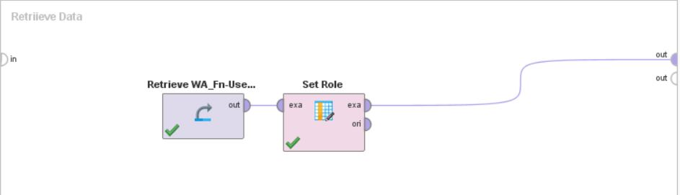
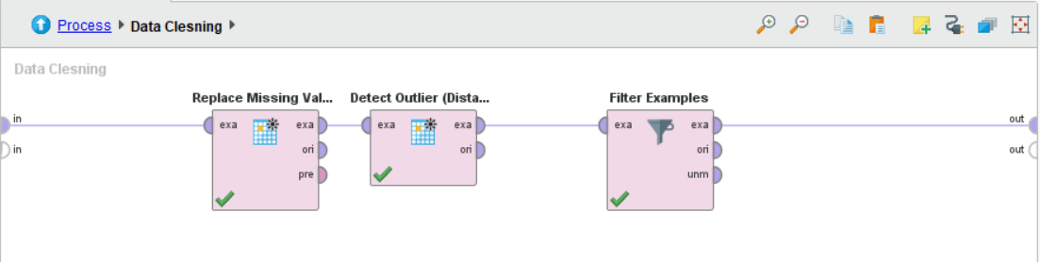
Model Built- Manual (contd).
Retrieve Data
Data Cleansing

Slide 10
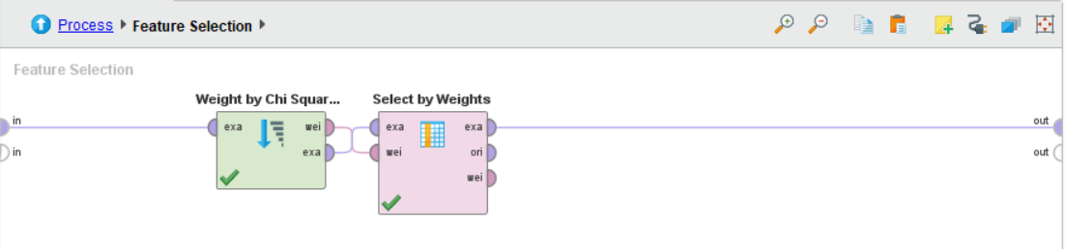
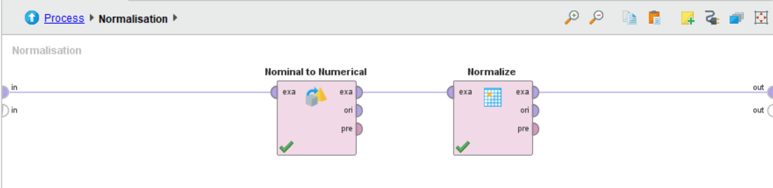
Model Built- Manual(contd.)
Feature Selection
Normalisation

Slide 11
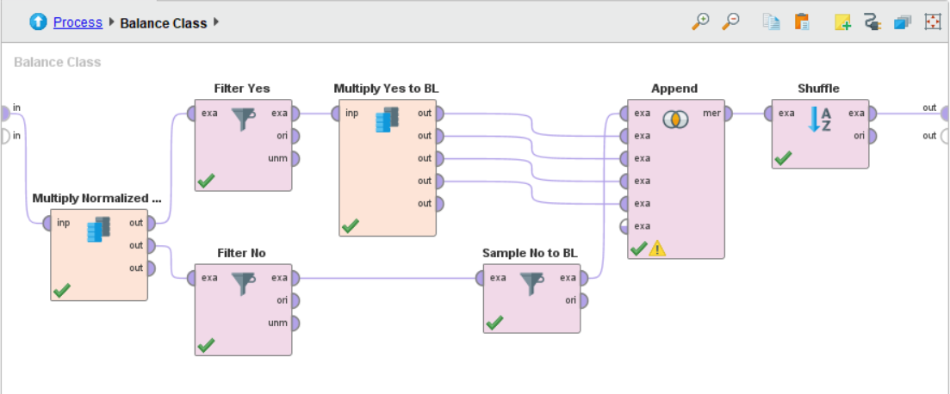
Model Built- Manual(contd.)
Balance Class

Slide 12
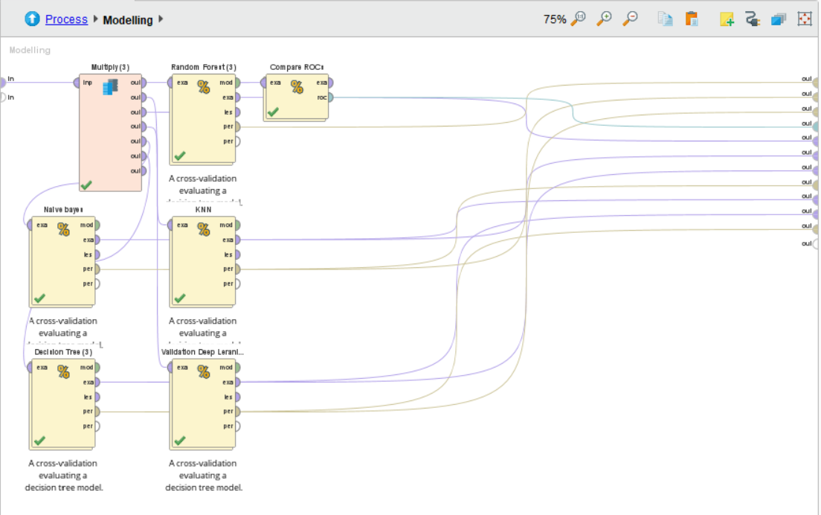
Model Built- Manual(contd.)
Modelling

Slide 13
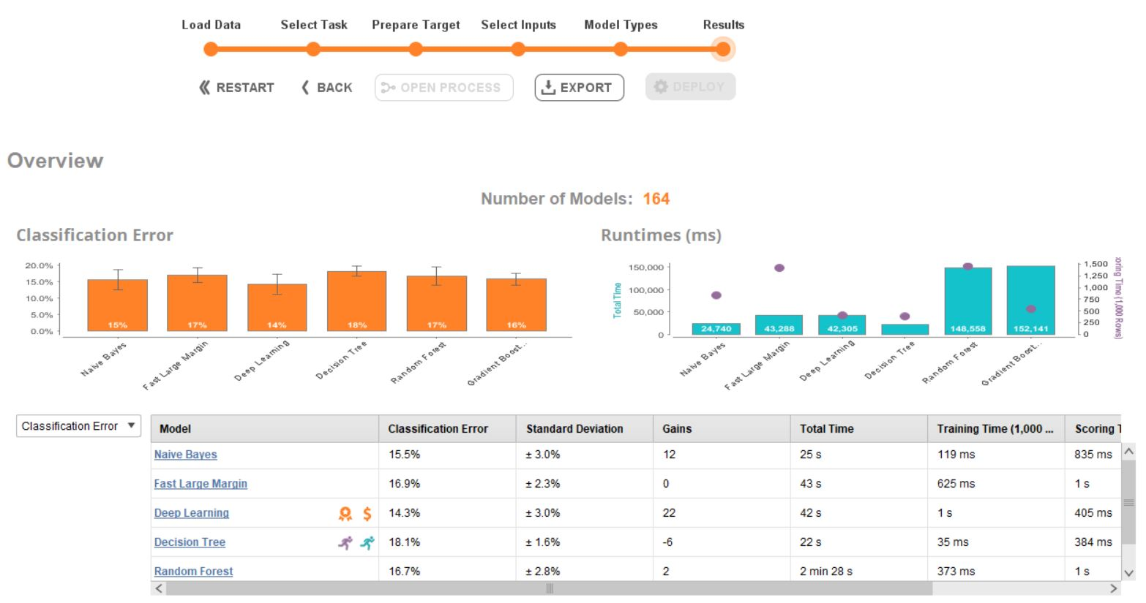
Auto Model

Slide 14
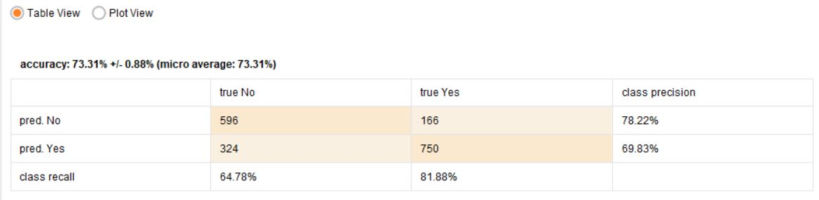

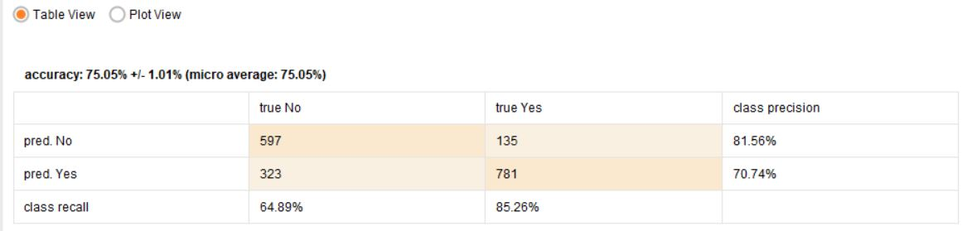
Data Evaluation – Manual
Random Forest
KNN
Deep Learning

Slide 15
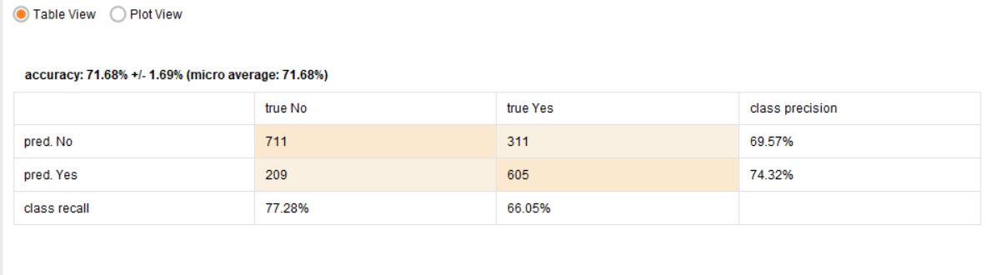
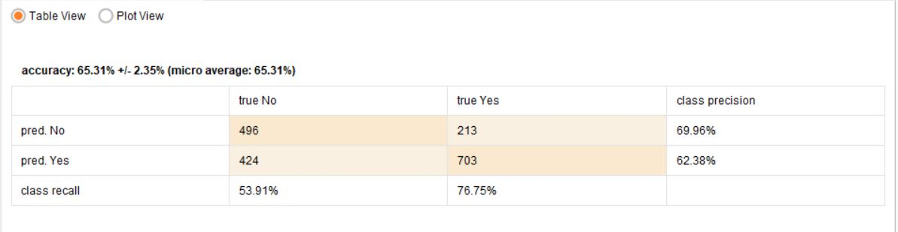
Data Evaluation – Manual (contd.)
Naïve Bayes
Decision Tree

Slide 16
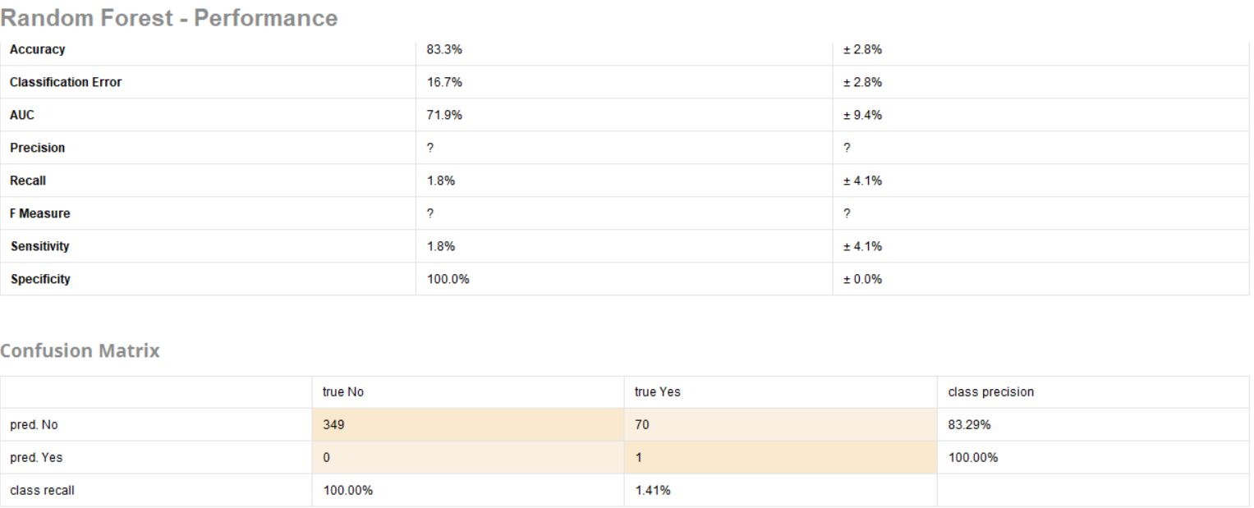
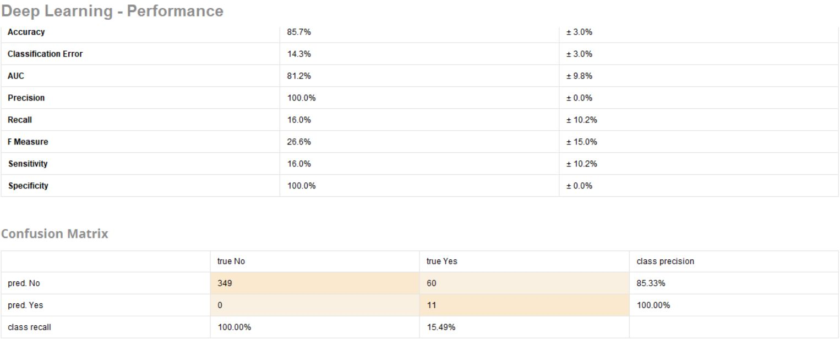
Data Evaluation – Auto Model

Slide 17
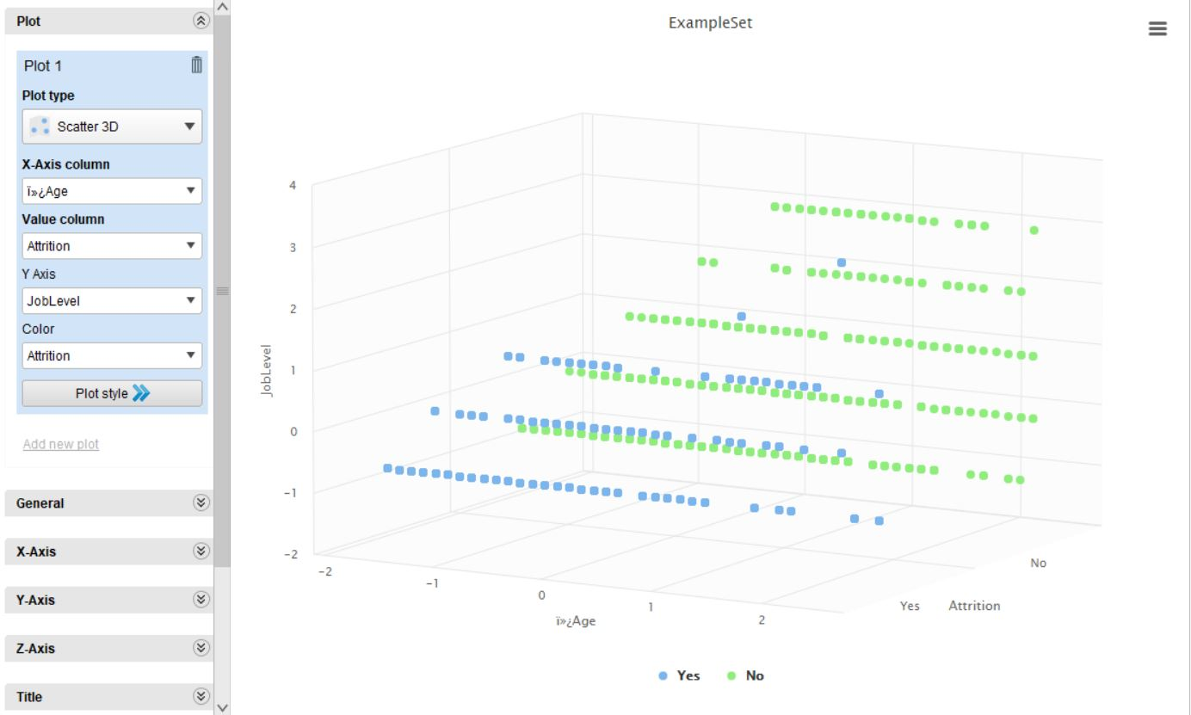
Deployment Results

Slide 18
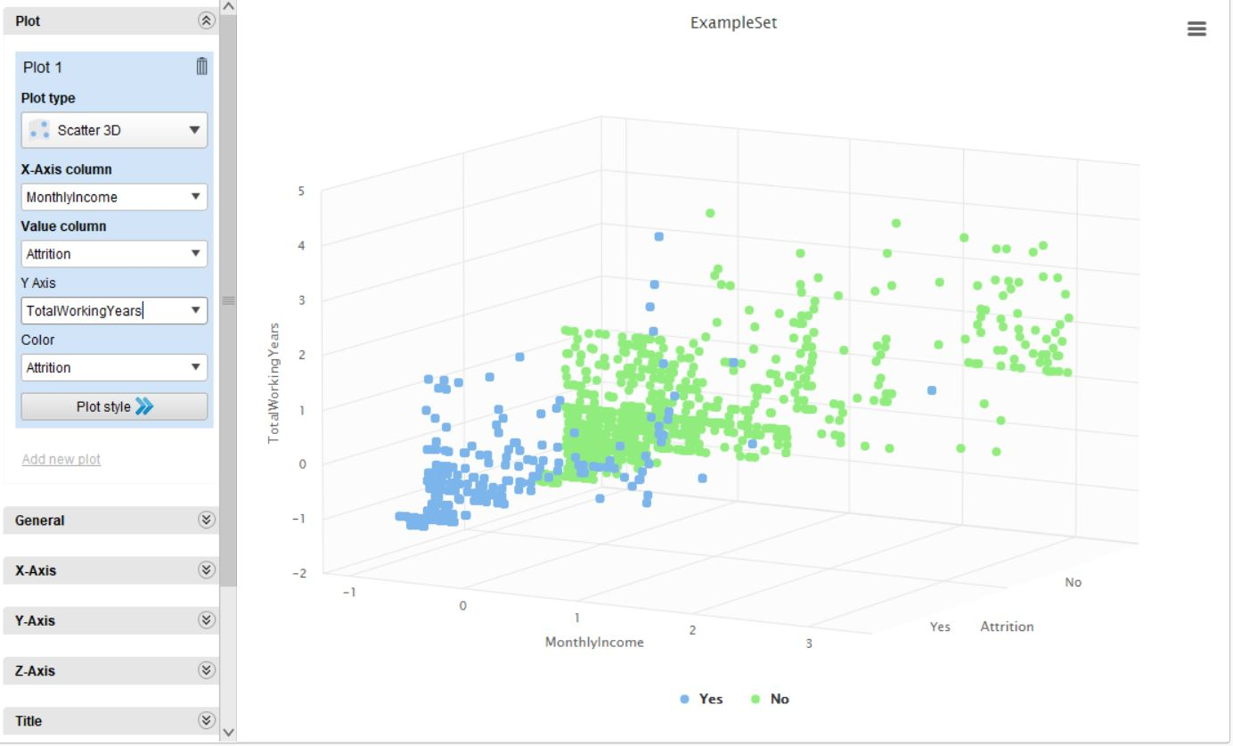
Deployment Results(contd)

Slide 19

Thank You.

