Slide 1
Automatic Detection of Diabetic Retinopathy

Slide 2
Overview:
Introduction
Literature Review/Related Work
Problem Statement
Methodology
Experiments
Results
References

Slide 3
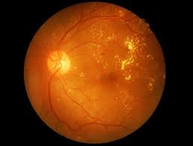
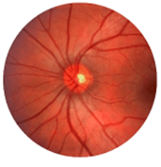
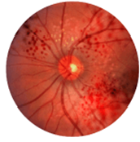
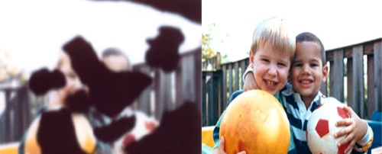
Introduction
Medical Imaging:
Diabetic Retinopathy
Human eye disease.
Caused by diabetes.
Damage blood vessels in eye retina.
Cause permanent blindness.
Diabetic Retinopathy (DR)
Normal Retina
Diabetic Retina
DR Vision
Normal Vision

Slide 4
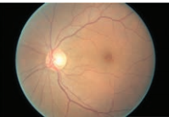
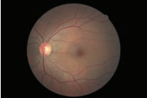
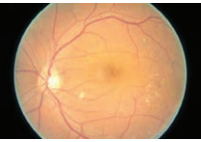
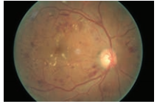
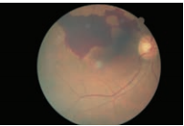
Stages
Different stages of Diabetic
Retinopathy
(a) No DR
(b) Mild DR
(c) Moderate DR
(d) Severe DR
(e) Proliferative DR

Slide 5
Types of DR cont.
Two types:
1. Non-Proliferative Diabetic Retinopathy
This is early stage in which tiny blood vessels leak, making the retina swell.
Mild (Caused minimal swelling).
Moderate (Causes blood vessel to be blocked).
Severe (Block flow of blood to eye).
2. Proliferative Diabetic Retinopathy
Growing new week blood vessels.
Week vessels leak blood
It might block all vision.

Slide 6
Related Work
Author/ Year | Title | Published in | Methodology | Dataset
Mookhia et.al /2013 [1] | Computer-aided diagnosis of diabetic retinopathy | Computers in biology and medicine | Gaussian Mixture Model and CNN (Convolutional Neural Network) | DIARETDBI Diabetic Retinopathy Dataset
Carson Lam et.al /2018 [2] | Automated Detection of Diabetic Retinopathy using Deep Learning | AMIA Summits on Translational Science Proceedings | CNN (Convolutional Neural Network) | KAGGLE and MASSIDOR Diabetic Retinopathy Datasets
Rishab et.al /2017 [3] | Automated identification of diabetic retinopathy using deep learning | Ophthalmology | An artificial intelligence model and CNN | MESSIDOR 2 and E-Ophtha Diabetic Retinopathy Dataset

Slide 7
Related Work
Author/ Year | Title | Published in | Methodology | Dataset
Harry Prat et.al /2015 [4] | Convolutional Neural Networks for Diabetic Retinopathy | Computers in biology and medicine | CNN (Convolutional Neural Network) | DIARETDBI Diabetic Retinopathy Dataset
Deepika vallabha et.al /2017[5] | Automated Detection and Classification of Vascular Abnormalities in Diabetic Retinopathy | Ophthalmology | CNN (Convolutional Neural Network) and Deep Learning Architecture | MASSIDOR Diabetic Retinopathy Datasets
Wan,s et.al/2018[6] | Convolutional neural networks for diabetic retinopathy detection | Computers & Electrical Engineering | Image net and CNN | Kaggle dataset(same amount of images of each class)

Slide 8
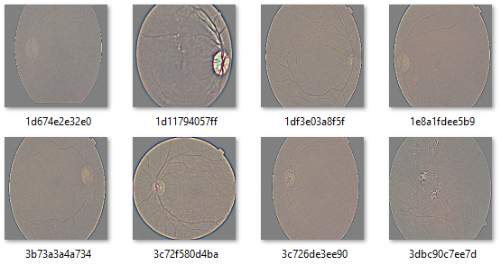
Dataset Description
Labeled left & Right Images

Slide 9
Problem Statement
In last decade, literature related to our research domain has been conducted using handcrafted features and using manually treatment. As technology is evolving, most of the researchers are now focusing on deep architecture-based solutions due to its success in other domains of computer science. In contact to this, deep learning architectures has its own limitations and don't show the better results in domain specific problems. A transfer learning approach has been approached in this contest.

Slide 10
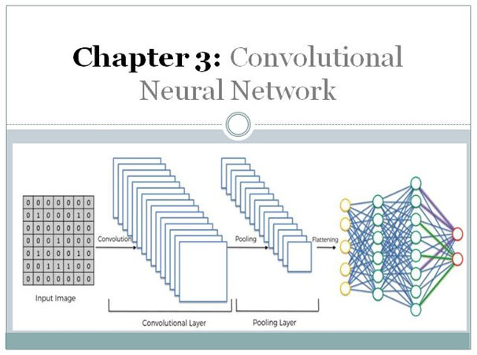
Proposed Methodology
In the proposed CNN Approach, we will use deep learning variant algorithm on Gaussian filtered dataset ‘Kaggle’ for this project. We will train and test dataset on deep learning CNN Model.
Simple CNN Architecture

Slide 11
Proposed Transfer Learning Models
VGG16 Model
VGG19 Model
InceptionV3 Model
Xception Model
ResNet50 Model
VGG8

Slide 12
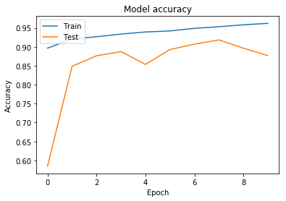
Experiment # 1 (CNN Model Result)
In This experiment Total 8 convolutional layers were used. 4 maxpool layers were used.3 Dense layers were used. Loss was binary cross entropy. Optimizer was of ‘adam’. Training accuracy is 90% and Validation accuracy is 84%.

Slide 13
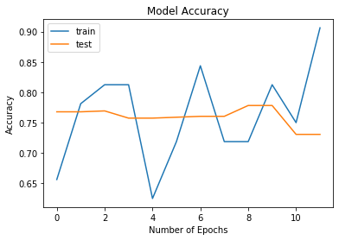
Experiment # 2 (VGG16 Model Result)
Categorical Classification is done with VGG16 Model and the accuracy is good and with 90% of validation accuracy model is consider to show more promising results as compare to other models.

Slide 14
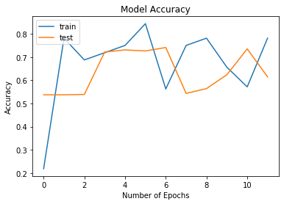
Experiment # 3 (ResNet50 Model Result)
Categorical Classification is done with ResNet50 Model and the accuracy is good 75% with 61% of validation accuracy model is consider to show more promising results.

Slide 15
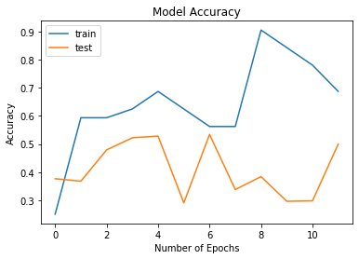
Experiment # 4 (Xception Model Result)
After Training the model on Data We have got 68% training Accuracy and 50% Validation Accuracy as the training accuracy is 68% which is good as model is not over trained.

Slide 16
Experiment # 5 (InceptionV3 Model Result)
After Training the model on Data We have got 78% training Accuracy and 62% Validation Accuracy as the training accuracy is 62% which is good as model is not over trained.

Slide 17
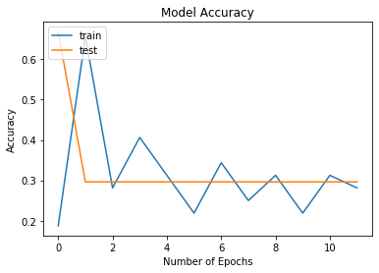
Experiment # 6 (VGG19 Model Result)
After Training the model on Data We have got 30% training Accuracy and 29% Validation Accuracy as the training accuracy is 30% which is very bad as model is not fit for selected dataset.

Slide 18
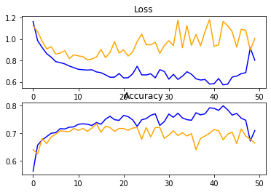
Experiment # 7 (InceptionV3 Model Result)
After Training the model on Data We have got 74% training Accuracy and 69% Validation Accuracy as the training accuracy is 74% which is good.

Slide 19
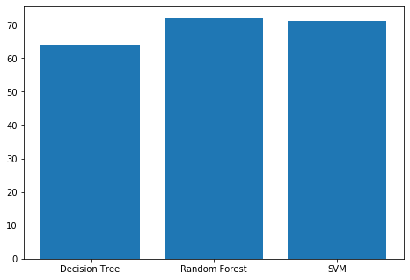
Experiment # Basic ML Techniques (InceptionV3 Model Result)
Results Comparison
 | Decision Tree | Random Forest | SVM
Accuracy | 64% | 72% | 71%
macro avg | 40% | 34% | 42%
weighted avg | 64% | 64% | 68%

Slide 20
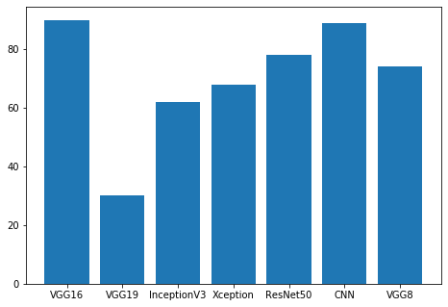
Model’s Comparison
All the developed Models such as VGG16, VGG19, InceptionV3, Xception Model, ResNet, Keras CNN and VGG8 are compared below and it is clear from the figure VGG 16 has the highest accuracy.

Slide 21
Conclusion
In this report pre-trained deep learning are used to perform diabetic retinopathy classification from Gaussian filtered images of eye retina from kaggle. Best transfer learning techniques are used for this task. We showed the performance of different transfer learning models and their result for proposed dataset. The deep transfer learning models selected are Vgg8, vgg16, InceptionV3, Xception Model, ResNet50, CNN and vgg19. The overall performance of these techniques showed that vgg16 Model achieved highest accuracy with less training time and computational complexity.

Slide 22
Future work
In detecting Diabetic retinopathy transfer learning models performs well as compare to other t approaches discussed in report and in literature as they are fast learning algorithm and shows promising results on less data. it all depends on data we are feeding to our model. In our data there are less samples of level 4 and level 2 and have many outliers. We also have less resources to process the image with this much dimension. In the future with the help of more powerful machines this work be done more accurately by machines.

