Slide 1
KV
Secured Storage
SWE 681 - Final Project
Koushik Rama Vu Khanh Pham

Slide 2
AGENDA
01
BACKGROUND
04
FUTURE PLAN
About the Team
Project Goal & Motives
Limitations
Plan Improvements
02
RESEARCH & ANALYSIS
05
DEMO DEMONSTRATION
Threat
Solution
Functions
Test Runs & Results
03
SYSTEM ARCHITECTURE
06
CLOSING
Operation Results
Questions
Thank You

Slide 3
01
Background

Slide 4
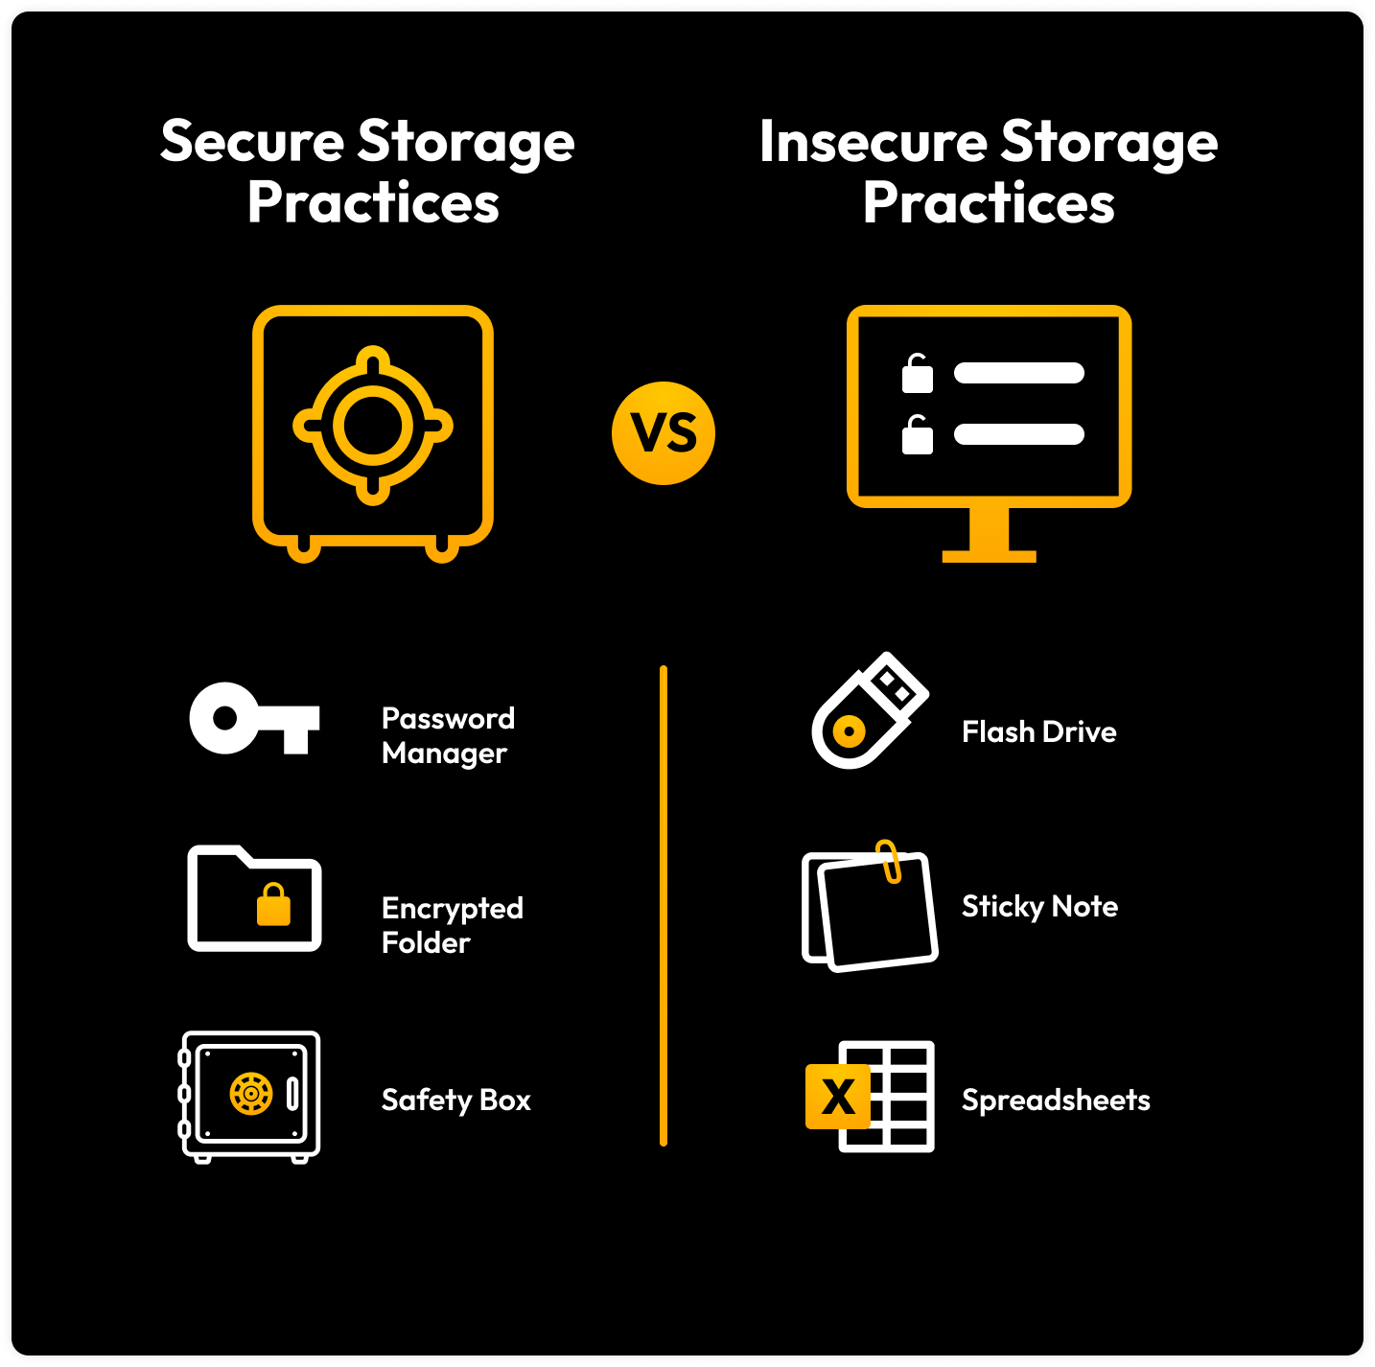
About Team Project Goals
Programmers
Cybersecurity
Cryptography

Slide 5
Project Motivations - Problem
The global average cost of a data breach reached $4.45 million in 2023, a 15% increase over 3 years. - IBM’s "Cost of a Data Breach Report 2023"
80% of Breaches Involve Compromised Passwords. - Verizon’s "2023 Data Breach Investigations Report (DBIR)"
Reasons:
Plaintext storage
Weak hashing (MD5/SHA-1)
Reused salts
Fast algorithms.

Slide 6
02
Research

Slide 7

Threats
MULTICS Breach (1966): Exposed plaintext passwords, prompting Unix’s hashing shift.
Rainbow Tables (1980s): Showed unsalted hashes were vulnerable.
Collision Attack (MD5, 2004): Showed weak compression function and fast finalization negatively impact system security.
Notes:
Why MD5 Broke: Cryptographic Flaws
Weak Compression Function:
MD5’s internal operations (e.g., modular additions, bitwise functions) were not sufficiently nonlinear, allowing attackers to control hash propagation [2].
Fast Finalization:
The final mixing step was too simple, enabling collision shortcuts [3].
No Salt or Iterations:
Designed for speed, not resistance to brute-force or rainbow tables.

Slide 8

What can we do to prevent these threats?
Weak Hashing Algorithms like MD5/SHA-1 can no longer be used in the current decade because they are easily broken
Extend the time required for hashing as much as possible, so it delays and increases the computational cost to crack it.
Use a stronger and secure algorithm (SHA-256, etc.)
Lets see what are the possible modern solutions for this.

Slide 9
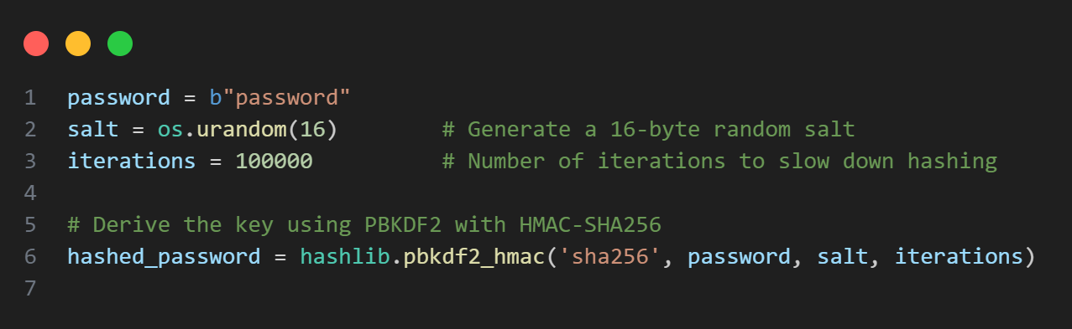
Contemporary Solutions
1. PBKDF2 (Password-Based Key Derivation Function 2)
Uses HMAC (usually with SHA-256)
Supports configurable iteration count
Slows down brute-force attacks
Used in: LastPass, Django, AWS Cognito, etc.
2. bcrypt
Based on the Blowfish cipher
Built-in salt and work factor (cost parameter)
Slower by design (good for password hashing)
Used in: OpenBSD, GitHub, Laravel, WordPress

Slide 10
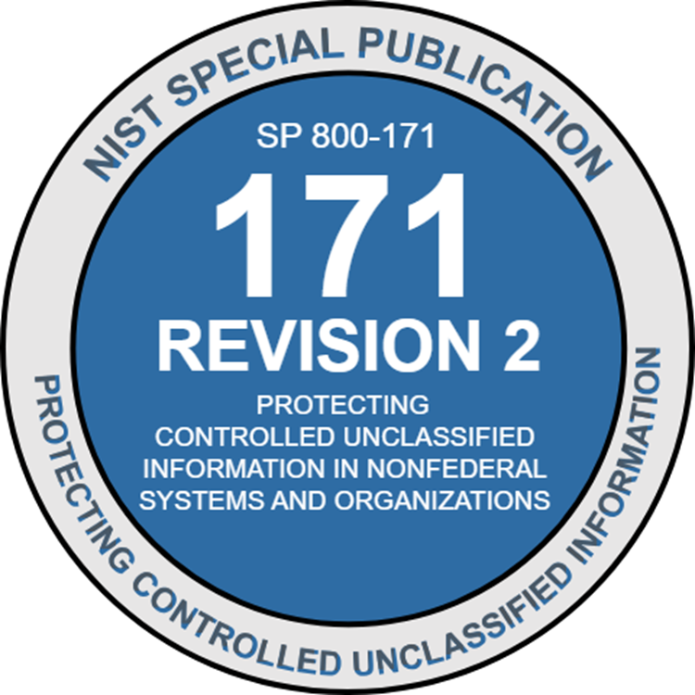
Proposed Solution - PBKDF2 Framework
Our Implementation in this project is a modified version of the PBKDF2
PBKDF2 allows full control over iteration counts and output lengths.
PBKDF2 utilizes hashing algorithms such as SHA-256 - a well-credited hash function—instead of Blowfish, which is much older and less standard; combined with salt, it can provide sufficient security.

Slide 11
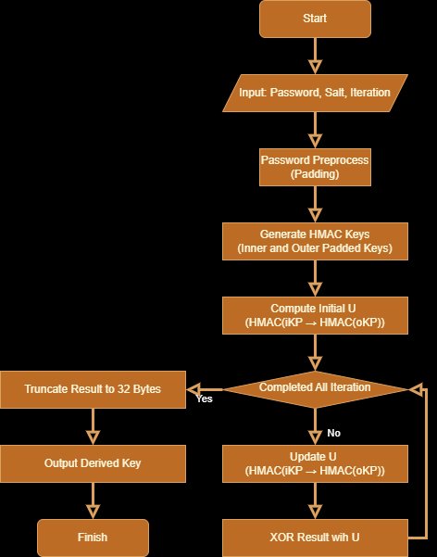
PBKDF2_hmac_sha256 Framework
PBKDF (Password-Based Key Derivation Function):
SHA-256
Salt
HMAC
Deliberately slow to resist brute-force and rainbow table attacks.
Notes:
Input Parameters
password (bytes): User-provided password (e.g., "uPassword000").
salt (bytes): Randomly generated salt (e.g., os.urandom(16)).
iterations (int): Security parameter (e.g., 100,000).
Preprocess Password
Check Password Length:
If len(password) > SHA-256 block size (64 bytes):
Hash password with SHA-256 to shorten it.
Pad Password:
Add \x00 bytes to extend password to 64 bytes (SHA-256 block size).
Generate HMAC Keys
Inner Key (iKP): password XOR 0x36 (for HMAC inner padding).
Outer Key (oKP): password XOR 0x5c (for HMAC outer padding).
Initial Iteration
Construct Initial Message:
msg = salt + block_number (where block_number = 1 packed as 4-byte big-endian).
Compute First U:
U = HMAC(iKP, msg) → HMAC(oKP, U).
Iteration Loop
U is the intermediate hash value computed in each iteration of PBKDF2.
It is generated by applying HMAC (e.g., HMAC-SHA256) to the password, salt, and previous U value.
Each U is XORed (⊕) with the previous results to produce the final key. For i = 1 to iterations-1:
Update U:
U = HMAC(iKP, U) → HMAC(oKP, U).
XOR with Result:
result = result XOR U.
Final Output
Truncate result to 32 bytes (SHA-256 hash size).
Return derived key (e.g., derived_key.hex()).

Slide 12

03
System Architecture Design

Slide 13




Tools and Technologies Used
Backend - Python, Flask
Libraries used: psycopg2, hmac
Front end - React based application
Database - Postgresql

Slide 14
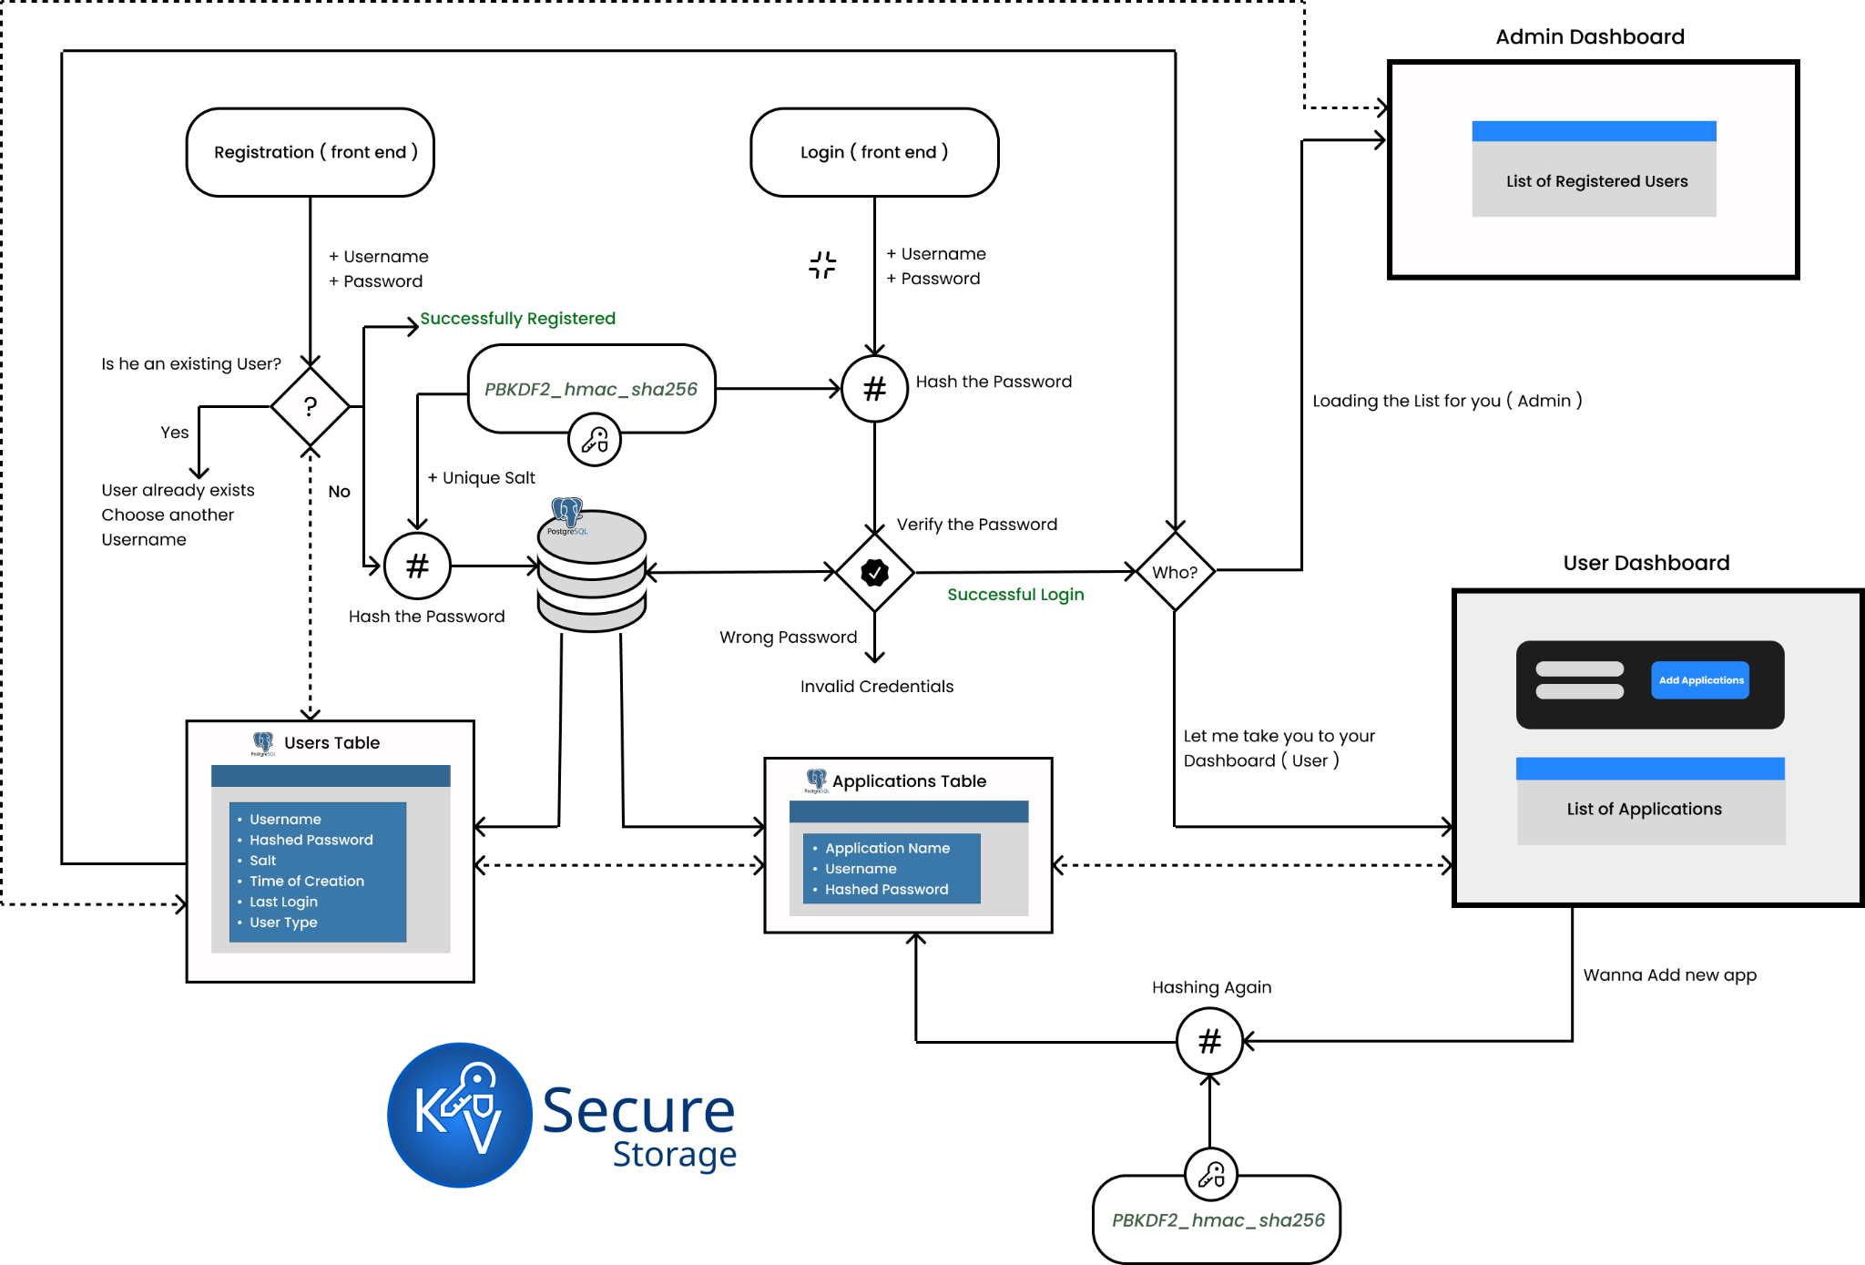
Notes:
"Alright, now I’d like to walk you through the system flowchart that illustrates how our secure password storage and login system operates behind the scenes.
We’ll begin at the top left with user registration. When a user signs up, they enter a username and password on the front end. This information is securely sent to our backend server for processing.
The first critical operation we perform is applying PBKDF2 with HMAC-SHA256 to the password. Here’s what happens under the hood:
First, we generate a random salt unique to that user.
Then, we combine the password and salt and run them through our PBKDF2-HMAC-SHA256 function with a high number of iterations—typically around 100,000.
This process generates a secure derived key—a hash that’s computationally expensive to reverse or guess.
This derived key, along with the salt and other user metadata, is stored in our Users Table in the database.
Now, let’s switch gears and look at what happens during user login. When a user submits their credentials, we retrieve the stored salt associated with their username from the database.
We then take the input password, combine it with the stored salt, and re-run the PBKDF2-HMAC-SHA256 function. The output is a new derived key. If this new hash matches the one stored in our Users Table, the login is considered successful.
Following a successful login, we proceed to display the user’s dashboard, which includes access to their applications. The Applications Table stores data related to those apps, and may also include permission levels or other session-specific metadata.
Let me highlight a few key strengths of this system:
By using unique salts, we ensure that identical passwords produce completely different hashes—this nullifies rainbow table attacks.
The slow hashing through PBKDF2 increases the time required for brute-force attempts, making attacks computationally expensive.
And finally, this modular flow—separating registration, hashing, storage, and login validation—makes our system both scalable and secure.
So in essence, what looks like a simple login box on the front end is backed by a well-structured, highly secure process underneath. Every login request is verified rigorously, and every password is stored in a form that’s extremely difficult to crack.
This concludes the walkthrough of our secure storage system. Up next, we’ll take a look at the actual PBKDF2 implementation and why we chose to build it ourselves rather than relying on a library."

Slide 15

Results
Performance: Relatively efficient - couple seconds as most.
Security: The passwords are securely stored in their hash form and are unique.
Accuracy: 100%

Slide 16
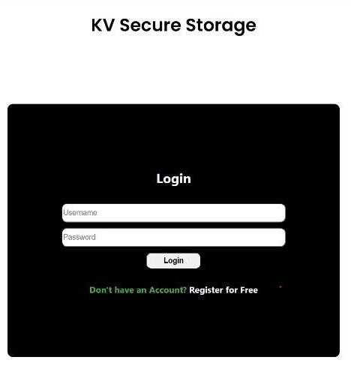
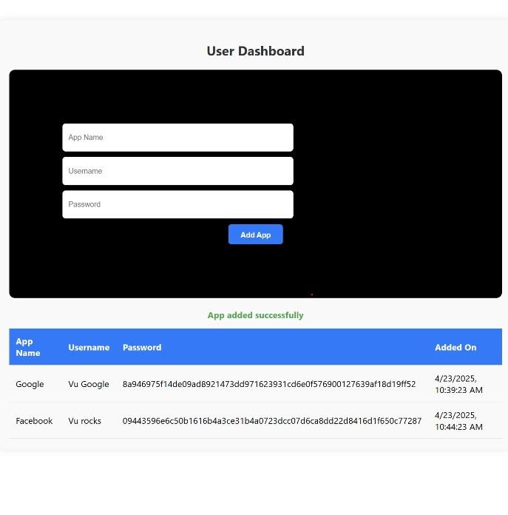

Slide 17
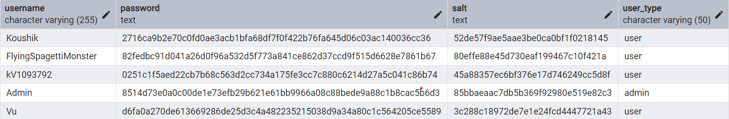

Slide 18
04
Future Plan

Slide 19

Limitations & Plan Improvements
Limitation:
Lack of variety: Currently only use SHA-256
Weak salt generation
Fixed output length
No Memory Hardness
No Parallelism
Suggestions:
Implement variety of hashing algorithm through modular approach
Apply the next Gen features of Bcrypt and Argon2.

Slide 20
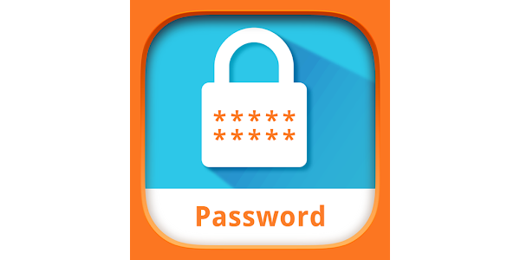



Final Goals
A full length passwords manager
Complete Vault Encryption
Implement Secure Storage
Local Server
Cloud
Autofill and Password Retrieval
Browser Extensions
APIs
2FA

Slide 21
05
Application Demo

Slide 22
06
Closing

Slide 23
Question?

Slide 24
Citations
[1] IBM Security, Cost of a Data Breach Report 2023. Armonk, NY: IBM, 2023. [Online]. Available: https://www.ibm.com/reports/data-breach
[2] Verizon, 2023 Data Breach Investigations Report (DBIR). Basking Ridge, NJ: Verizon, 2023. [Online]. Available: https://www.verizon.com/business/resources/reports/dbir/
[3] Verizon, 2022 Data Breach Investigations Report (DBIR). Basking Ridge, NJ: Verizon, 2022.
[4] D. Stempel and A. Finkel, “Yahoo says 3 billion accounts affected in 2013 breach,” Reuters, Oct. 3, 2017. [Online]. Available: https://www.reuters.com/article/us-yahoo-cyber/yahoo-says-3-billion-accounts-affected-in-2013-breach-idUSKCN1C82O1

Slide 25
Citations
[5] National Institute of Standards and Technology (NIST), Secure Hash Standard (SHS), FIPS PUB 180-4, Aug. 2015. [Online]. Available: https://doi.org/10.6028/NIST.FIPS.180-4
[6] NIST, Post-Quantum Cryptography Standardization, 2022. [Online]. Available: https://csrc.nist.gov/projects/post-quantum-cryptography
[7] H. Dobbertin, "Cryptanalysis of MD5 Compress," Eurocrypt 1996.
[8] X. Wang et al., "How to Break MD5," Eurocrypt 2005.
[9] NIST, "Recommendation for Password-Based Key Derivation," SP 800-132, 2010. [Online]. Available: https://doi.org/10.6028/NIST.SP.800-132

Slide 26
Thank you!
The End

