Slide 1

Energy Consumption Analysis
THAKKALAPALLY KOUSHIK
SHIVARLA NAVEEN
543 BATCH

Slide 2
About Me
Myself Naveen and I completed Bacherlor’s of Technology (B.Tech) from Vardhaman College of Engineering in the Computer Science and Engineering(CSE) in the year of 2025.
I did two Virtual Interships from Acmegrade with the technology of python and Salesforce with technology of Apex,Visual Components.
I did two pojects in which one is Multi Trait Genome Prediction using Machine learning and Patrolling drones with Emerging Technologies.
I took Data Science Course to enhance my analytical thinking and hands on experience to contribute projects.
Github : https://github.com/shivarlanaveen
Linkedin : https://www.linkedin.com/in/naveen-shivarla-571108241

Slide 3
About Me
I am Koushik Thakkalapally, a recent graduate from Malla Reddy College of Engineering and Technology in Computer Science and Engineering.
I have done Data Analyst virtual Internship in Trainity and Cambridge English C1 level Certification.
I pursued Data Analytics as it aligns with my strategic way of thinking. I am eager to continuously refine my abilities.
Linkedin: https://linkedin.com/in/koushik-rao-54a038352
Github: https://github.com/KoushikRao123

Slide 4
Agenda
Business Problem
Business Statement
Introduction
Data Description(Schema Explanation, ER Diagrams, Cardinalities)
Queries
Recommendations
Conclusion

Slide 5
Countries face challenges in managing increasing energy demand while controlling environmental impact. There is a need to understand how energy consumption, production, GDP, population, and emissions are changing across countries and years.
The business problem is to use historical energy data and SQL analysis to identify energy consumption trends, production-consumption gaps, major emission contributors, and the relationship between economic growth and energy usage.
These insights can help organizations and policymakers improve energy planning, resource utilization, and sustainability strategies.
Business Problem

Slide 6
Business Statement
The energy sector needs to effectively monitor and understand energy usage patterns across different countries and time periods. Organizations require reliable insights into energy consumption, production, economic growth, population, and emissions to support strategic planning.This project provides a data-driven view of global energy performance by analyzing historical energy data using SQL. It helps stakeholders understand changing energy demand, compare countries, evaluate environmental impact, and identify opportunities for improving energy efficiency and sustainability.

Slide 7
Introduction
Energy plays a vital role in economic development and the growth of countries. However, increasing energy consumption can also lead to higher carbon emissions and environmental challenges. This project, Energy Consumption Analysis, uses SQL and data analysis techniques to study energy production and consumption across different countries and years. It also examines the relationship between energy usage, GDP, population, and emissions.The analysis helps identify major energy-consuming countries, changes in global emissions, energy consumption per capita, and differences between energy production and consumption.Overall, the project aims to provide data-driven insights for better energy planning, understanding environmental impacts, and supporting sustainable development and informed decision-making.

Slide 8
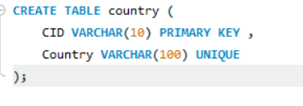
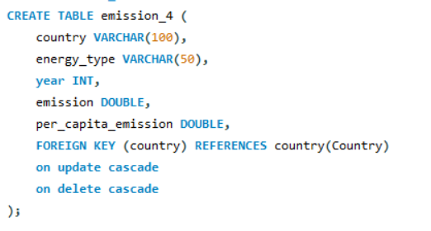
Data Description
Tables
Country Table Emission Table

Slide 9
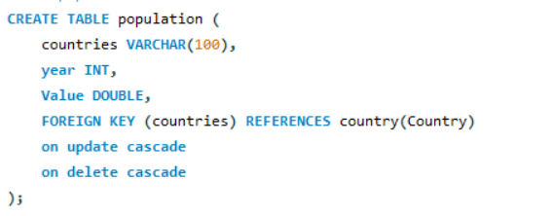
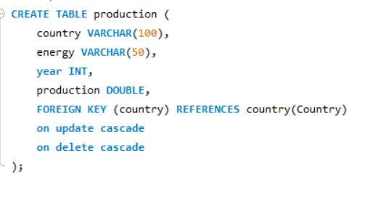
Data Description
Tables
Population Table Production Table

Slide 10
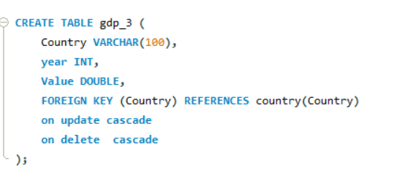
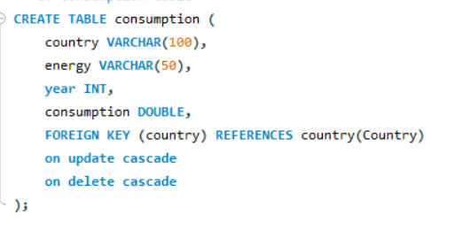
Data Description
Tables
GDP Table Consumption Table

Slide 11
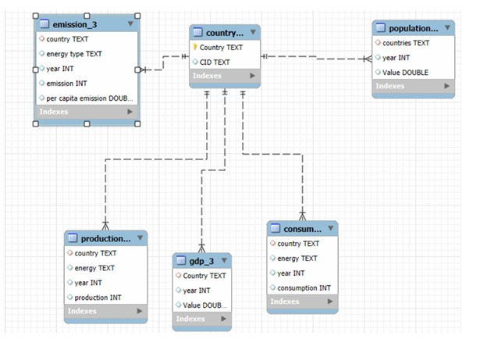
ER Diagram and Schema Explanation

Slide 12
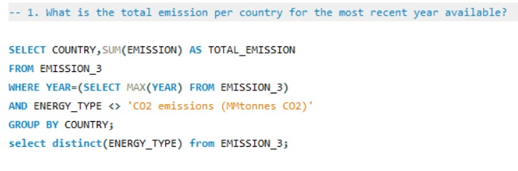
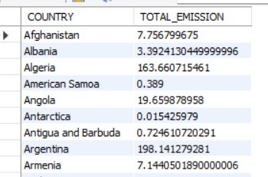
Queries
1.What is the total emission per country for the most recent year available?
Insights:
This analysis identifies the total emissions generated by each country in the latest available year.It helps compare countries based on their overall emission levels, excluding the already calculated total CO₂ row to avoid double-counting.

Slide 13
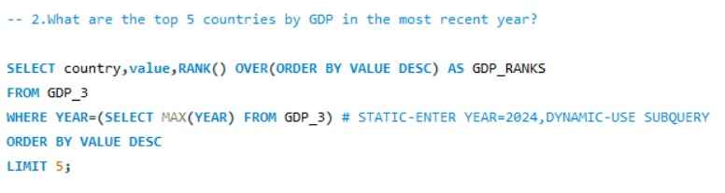
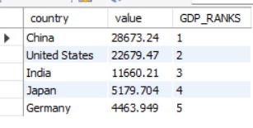
Queries
2. What are the top 5 countries by GDP in the most recent year?
Insights:
This identifies the five countries with the highest GDP in the latest available year. It gives an overview of the largest economies represented in the dataset.

Slide 14
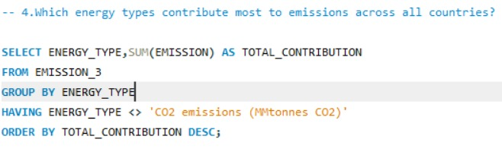

Queries
3. Which energy types contribute most to emissions across all countries?
Insights:
This measures what energy types contributed to the most of the emissions.

Slide 15
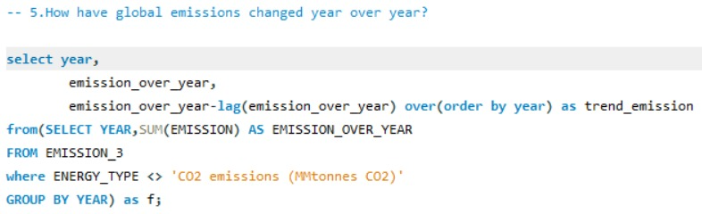
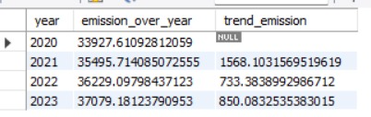
Queries
4.How have global emissions changed year over year?
Insights:
This analysis identifies the total emissions generated by each country in the latest available year.It helps compare countries based on their overall emission levels,excluding the already calculated total CO2 row to avoid double-counting

Slide 16
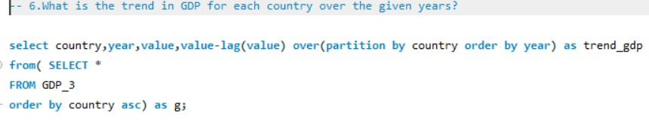
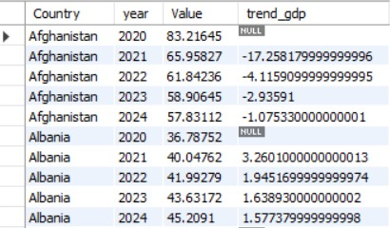
Queries
5. What is the trend in GDP for each country over the given years?
Insights:
It helps identify periods of economic growth or decline for individual countries,positive value means increased,negative value means decreased,for some countries,gdp increased meanwhile others it is decreased.

Slide 17
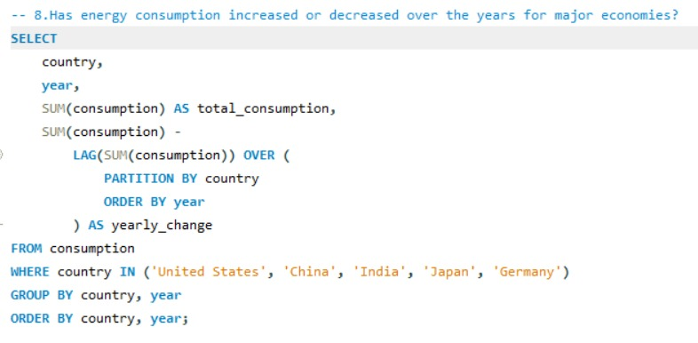
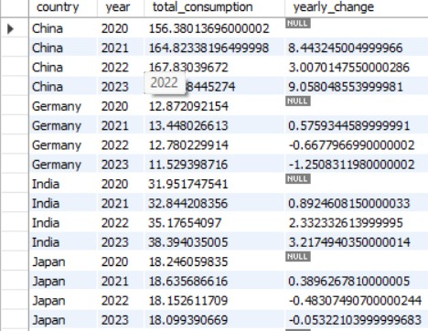
Queries
6.Has energy consumption increased or decreased over the years for major economies?
Insights:
Energy consumption increased consistently in China and India from 2020 to 2023, with India showing steady growth. Germany and Japan experienced decreases in the later years, indicating a declining trend in energy consumption.

Slide 18
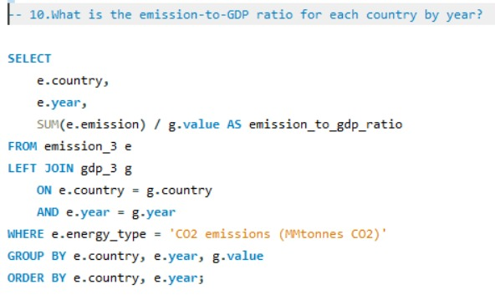
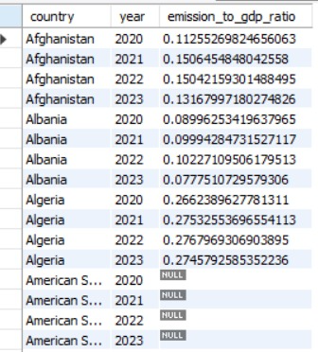
Queries
7. What is the emission-to-GDP ratio for each country by year?
Insights:
The emission-to-GDP ratio generally increased in Algeria and Afghanistan during 2020–2023, indicating higher emissions relative to GDP. Albania showed a slight decline by 2023, while some countries have NULL values due to missing or unmatched GDP data.

Slide 19
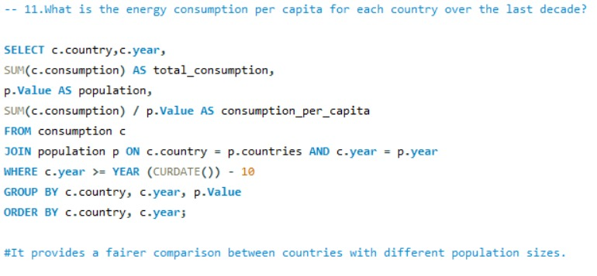
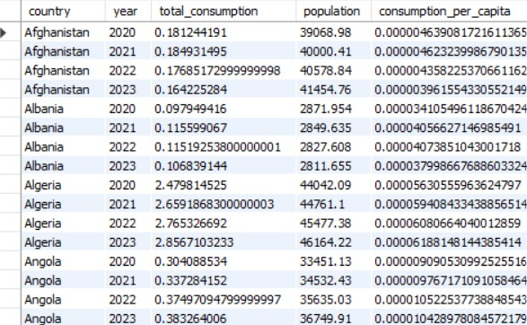
Queries
8. What is the energy consumption per capita for each country over the last decade?
Insights:
It provides a fairer comparision between countries with different population sizes.

Slide 20
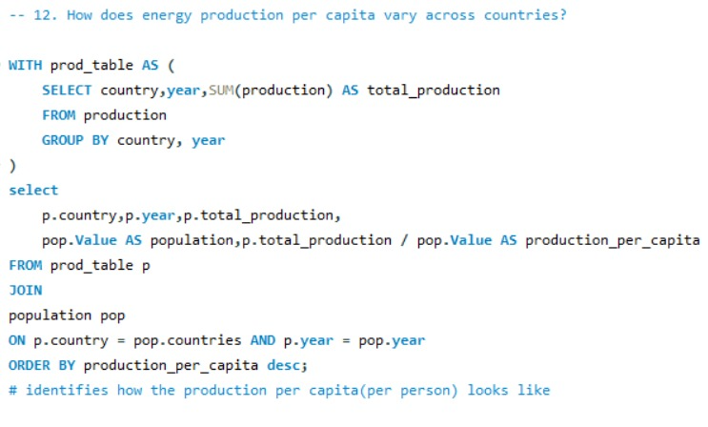
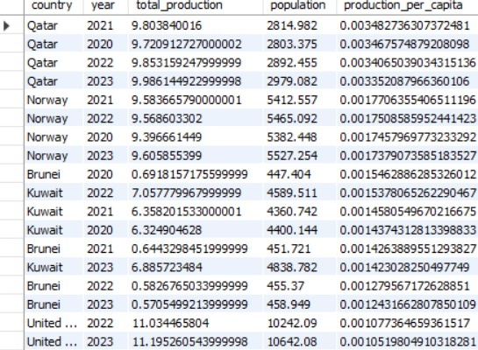
Queries
9. How does energy production per capita vary across countries?
Insights:
It identifies how the production per capita(per person) looks like

Slide 21
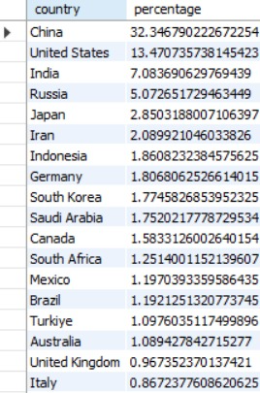
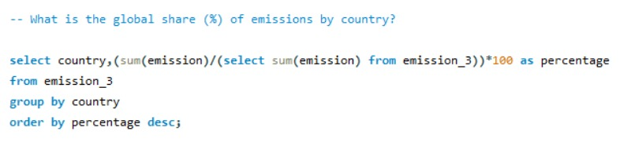
Queries
10. What is the global share (%) of emissions by country?
Insights:
China has highest share of emissions,followed by United States and India.It shows how much each country contributes to the overall emissions represented in the dataset.

Slide 22
Recommendations
Promote Renewable Energy
Countries should increase the use of renewable energy sources such as solar, wind, and hydropower to reduce dependence on fossil fuels and lower emissions.
Improve Energy Efficiency
Energy-efficient technologies and practices should be encouraged in industries, transportation, and households to reduce unnecessary energy consumption.
Reduce Fossil Fuel Dependency
Since coal and oil are major contributors to emissions, countries should gradually reduce their dependence on fossil-fuel-based energy and promote cleaner alternatives.
Balance Energy Production and Consumption
Countries with a large gap between energy production and consumption should improve energy planning to reduce excessive dependence on imports or unused production capacity.

Slide 23
Conclusion
The project analyzed global energy consumption, production, GDP, population, and emissions using SQL. The analysis shows that increasing energy demand is linked to economic and population growth, while fossil fuels remain major contributors to emissions.
The study highlights the importance of renewable energy and efficient energy use. Overall, sustainable development requires balancing energy needs, economic growth, and environmental responsibility.

Slide 24


Slide 25

THANK YOU

