Slide 1
Web Application For Product Return Management
PIP104 University Project-II
Review-1
Batch Number: CAI-G38
Roll Number | Student Name
20201CAI0022 | Arikeri Praveen
20201CAI0051 | B Mohan Reddy
20201CAI0076 | Katta Uday
20201CAI0218 | Addagalla Koushikeswar
Under the Supervision of,
Dr.Mohammadi Akheela Khanum Professor
School of Computer Science & Engineering
Presidency University

Slide 2
Introduction
Problem Statement :
In case of excess supply, wrong/damaged deliveries to end customers, SKF customer service team returns the product back to the regional warehouse irrespective of the condition of material. Hence, sometimes we (India Distribution Centre) end up receiving damaged stocks even after an ok Proof of Delivery which results in blocked stocks and we end up scrapping them leading to loss. A solution can be developed that a proper justification for return is mentioned and the right decision on return of goods is taken.

Slide 3
Abstract
SKF customer service team returns all products to the regional warehouse irrespective of their condition, even in case of excess supply or wrong/damaged deliveries to end customers. This can lead to the India Distribution Centre receiving damaged stocks, which are then blocked and scrapped, resulting in a loss. A solution can be developed to require a proper justification for returns and to ensure that the right decision is taken on whether or not to return goods.
This could involve:
* Developing a set of criteria for determining whether a product is eligible for return.

Slide 4
Abstract
Implementing this solution would help to reduce the number of damaged products returned to the warehouse and would save money on scrapping costs.

Slide 5
Literature Review
From [1] the author has discussed the problem faced by the service team while returning the product. He came with some set of criteria such as proper justifications for returns, return policies, etc.
From [2] a study of Impact of Damaged Goods Returns on the Supply Chain, the authors identify a number of ways that companies can minimize the impact of damaged goods returns, such as:
implementing a strict quality control process, improving packaging and shipping procedures.
From [3] The Impact of Customer Satisfaction on Damaged Goods Returns by Brown and Green (2021). This study found that customer satisfaction is a significant predictor of damaged goods returns. The study also found that businesses can reduce damaged goods returns by improving customer satisfaction. The study identified a number of strategies for improving customer satisfaction, such as providing high-quality products, offering excellent customer service, and making it easy for customers to return products.

Slide 6
Literature Review
A number of studies have shown that requiring a proper justification for returns can be effective in reducing the number of unnecessary returns.

Slide 7
Objective
The objective of the proposed method is to reduce the number of damaged products that are returned to the warehouse and to ensure that customers receive high-quality products. This will help to reduce the cost of scrapping damaged products, improve customer service, and protect the company's reputation.

Slide 8
Proposed Method
The proposed method to overcome the situation of damaged products being returned to the warehouse is to develop a web application. From the web application we will gather the data related to the cause of the return, etc. From the collected data we can conclude the condition of the product. Accordingly the SKF service team will decide the regional warehouse for shipping the product.

Slide 9
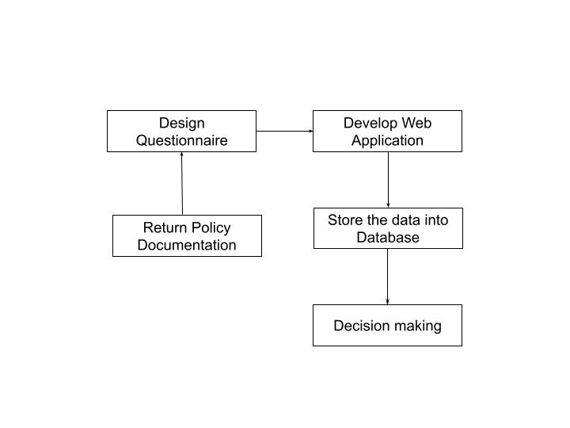
Architecture Diagram

Slide 10
Modules
1. Design Questionnaire
2. Develop Web Application
3. Database
4. Decision Making

Slide 11
Software Details
Programming Languages :
HTML and CSS for creating web page.
Java Servlet for connecting database and web page.
MYSQL for storing and retrieving user data.
Developer Tools :
Eclipse IDE
Visual Studio Code

Slide 12
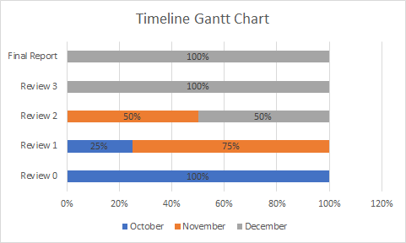
Timeline Gantt Chart

Slide 13
Conclusion
The proposed web application is a feasible and effective way to overcome the situation of damaged products being returned to the warehouse. By using a web application to implement the proposed method, SKF can improve its customer service, reduce costs, and protect its reputation.

Slide 14
References
[1] Product Returns Management: A Comprehensive Review and Future Research Agenda: https://www.tandfonline.com/doi/abs/10.1080/00207543.2021.1933645
Date of Publication : 31st May 2021
[2] The Impact of Damaged Goods Returns on the Supply Chain :
https://www.supplychainbrain.com/blogs/1-think-tank/post/34878-how-the-returns-industry-can-reduce-the-impact-of-supply-chain-disruptions
Date of Publication: 15th May 2022
[3] The Impact of Customer Satisfaction on Damaged Goods Returns https://www.mdpi.com/2071-1050/14/1/410
Date of Publication : 31st December 2021

Slide 15
Thank You

