Slide 1

AI-Driven Stock Price Prediction: Harnessing Machine Learning for Smarter Investments
Koushik Goud Dindu – 001046374
Nikitha Bandakindi - 001053196

Slide 2
Brief Overview of our project
In this project, we aim to predict stock prices by leveraging the power of deep learning techniques, specifically focusing on Long Short-Term Memory (LSTM) and Gated Recurrent Unit (GRU) models.
Our primary objective is to develop advanced LSTM and GRU models, as well as a base model for comparison, and analyze their performance in predicting the stock prices of three companies: RELIANCE, TATA MOTORS, and ADANI GREEN.
By doing so, we hope to gain insights into the effectiveness of these models for stock price prediction and their potential applications in the finance industry.
Ultimately, we aim to provide a comprehensive understanding of these advanced models and their implications for investors and traders seeking data-driven decision-making tools in the stock market.

Slide 3
DEMO Disclaimer
Note: We will not be able to present a live demo of our models due to the long computation time (1.8-2.5 hours) for each version.

Slide 4
Motivation
Importance of accurate stock price prediction for investors and traders
Accurate stock price prediction is crucial for investors and traders, as it can significantly impact their returns and risk management strategies.
Limitations of traditional techniques
Traditional techniques, such as fundamental and technical analysis, have limitations in predicting stock prices due to their inability to capture complex patterns and consider a multitude of factors influencing stock prices.
The potential of deep learning models like LSTM and GRU in capturing complex patterns in financial data
Deep learning models, such as LSTMs and GRUs, have the potential to overcome these limitations by effectively capturing intricate patterns and non-linear relationships in financial data, leading to improved accuracy in predicting future stock prices.

Slide 5
Problem definition
The problem definition of our project includes:
Predicting the stock prices of three companies: RELIANCE, TATA MOTORS, and ADANI GREEN.
Developing advanced LSTM and GRU models that can accurately predict the stock prices.
Comparing the performance of different LSTM and GRU models to identify the best-performing model.
Our aim is to create models that can predict the stock prices with a high degree of accuracy, which can be useful for investors and traders in making informed decisions.

Slide 6
Challenges
High volatility and non-stationarity of stock prices
Noisy and complex data
Large computation time for training deep learning models
To develop accurate stock price prediction models, we faced several challenges. The highly volatile and non-stationary nature of stock prices, along with noisy and complex data, made it difficult to identify meaningful patterns. Additionally, training deep learning models such as LSTM and GRU required a significant amount of computation time, which added to the complexity of the project.

Slide 7
Data collection and preprocessing
Data sources:
Historical stock prices of RELIANCE, TATA MOTORS, and ADANI GREEN obtained from Kaggle dataset containing historical daily prices for Nifty 100 stocks and indices currently trading on the Indian Stock Market.
Each stock data contains many technical indicators such as OHLCV (Open, High, Low, Close, and Volume) data. Overall, 55 Technical indicator values are also present.
Preprocessing steps:
After collecting the data, we performed various preprocessing steps to prepare the data for training the LSTM and GRU models. The preprocessing steps included data cleaning, feature extraction, and normalization.
Data cleaning involved removing any missing or invalid data points and removing any outliers in the data. For feature extraction, we extracted relevant features such as open price, high price, low price, and closing price for each day.
Normalization was an important step to ensure that the features were on a similar scale. We normalized the data using the MinMaxScaler method from the Scikit-learn library, which scales the data to a range of 0 to 1.
These preprocessing steps were necessary to ensure that the models were trained on clean and relevant data, and that the features were appropriately scaled to improve the model's performance.

Slide 8
Model Architecture - Baseline LSTM Model
Type: Long Short-Term Memory (LSTM) RNN
Purpose: Capture long-term dependencies in sequential data
Architecture:
2 LSTM layers (50 hidden units each)
2 Dense layers for prediction
Advantages: Addresses vanishing gradient problem
Limitations: Lower capacity for complex patterns

Slide 9
Model Architecture - ADVanced LSTM Model
Type: Long Short-Term Memory (LSTM) RNN
Purpose: Improved version of the baseline LSTM model
Architecture:
3 LSTM layers (100 hidden units each)
Dropout layers (dropout rate: 0.4/0.5) between LSTM layers
2 Dense layers for prediction
Advantages: Higher capacity to capture complex patterns
Limitations: Increased computational cost

Slide 10
Model Architecture – ADVanced GRU Model
Type: Gated Recurrent Units (GRU) RNN
Purpose: Efficient alternative to LSTM for handling sequential data
Architecture:
3 GRU layers (150 hidden units each)
Dropout layers (dropout rate: 0.5/0.7/0.8) between GRU layers
2 Dense layers for prediction
Advantages: Reduced computational cost compared to LSTM
Limitations: May not capture long-term dependencies as effectively

Slide 11
Evaluation metrics
Mean Absolute Error (MAE): MAE measures the average absolute difference between the true values and predicted values. It is a simple and intuitive metric that is easy to interpret. However, it does not penalize large errors as heavily as other metrics, like MSE.
Formula: MAE = (1/n) * Σ|y_true - y_pred|
Mean Squared Error (MSE): MSE measures the average squared difference between the true values and predicted values. By squaring the errors, it heavily penalizes large deviations, making it more sensitive to outliers than MAE. It is widely used in regression problems, but its value can be hard to interpret due to the squaring operation.
Formula: MSE = (1/n) * Σ(y_true - y_pred)^2
Root Mean Squared Error (RMSE): RMSE is the square root of MSE. It has the same unit as the original values, making it easier to interpret than MSE. Like MSE, it is sensitive to outliers and heavily penalizes large errors.
Formula: RMSE = √(MSE)
Mean Absolute Percentage Error (MAPE): MAPE measures the average absolute percentage difference between the true values and predicted values. It is useful for comparing errors across different scales since it is expressed as a percentage. However, it can be problematic when the true value is zero or close to zero, as the percentage error becomes undefined or extremely large.
Formula: MAPE = (1/n) * Σ|(y_true - y_pred) / y_true| * 100

Slide 12

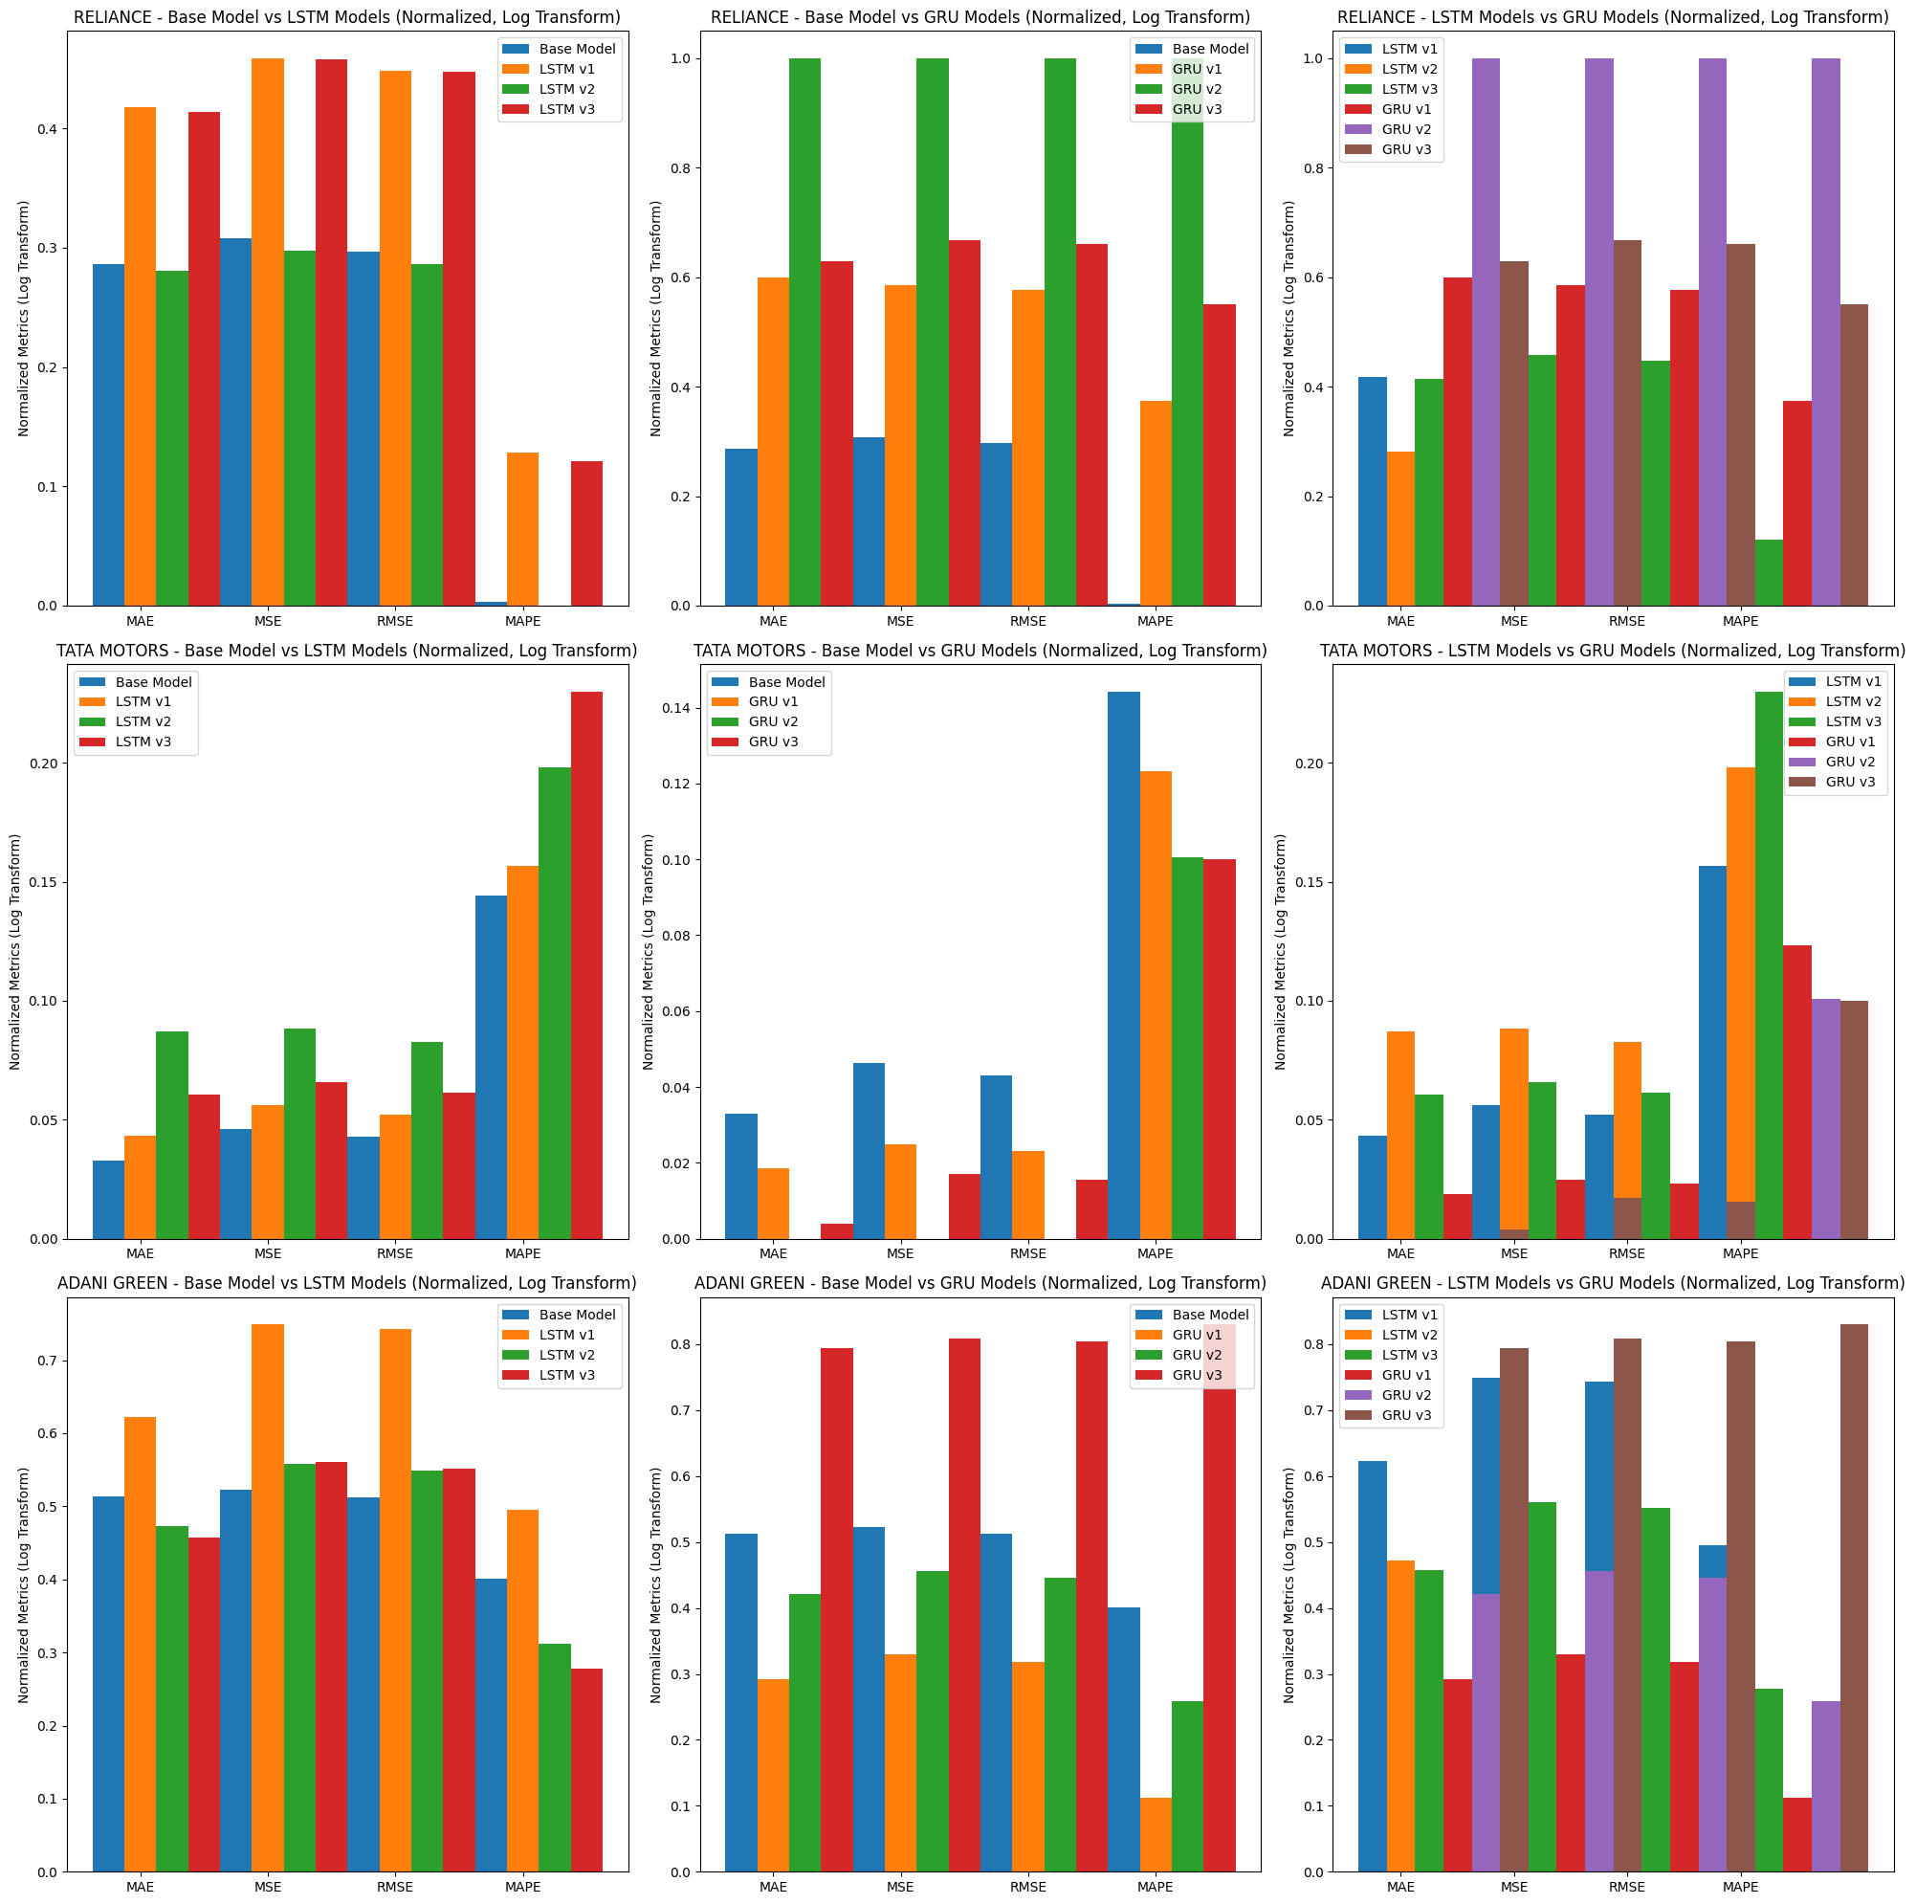
RESULTS AND ANALYSIS
The visualization suggests that there is no one-size-fits-all model for predicting stock prices.
Reliance: The advanced LSTM model, specifically Version 2 with a 0.4 dropout rate and 20 epochs, provides the best performance for Reliance, showing improvements in all error metrics compared to the baseline model.
Tata Motors: The advanced GRU model performs the best for Tata Motors across all versions. The optimal configuration for this stock is Version 2 with a 0.8 dropout rate and 20 epochs.
Adani Green: The advanced LSTM model, specifically Version 3 with a 0.4 dropout rate and 6 epochs, provides the best performance for Adani Green, showing improvements in all error metrics compared to the baseline model.

Slide 13
Conclusion
After visualizing the comparison charts, we can draw the following conclusions:
For all three stocks, the advanced LSTM and GRU models generally outperform the base model in most metrics, indicating the effectiveness of these models in capturing complex patterns in the stock price data.
When comparing the advanced LSTM models with the advanced GRU models, there is no consistent winner. For some stocks and metrics, the LSTM models perform better, while for others, the GRU models outperform. This suggests that the choice between LSTM and GRU models may depend on the specific stock and the metric of interest.
In terms of the metrics, the advanced models show a more significant improvement in the MSE and RMSE compared to the MAE and MAPE. This indicates that the advanced models are particularly effective in reducing large errors in the stock price predictions.
In conclusion, the advanced LSTM and GRU models have demonstrated their effectiveness in predicting stock prices for RELIANCE, TATA MOTORS, and ADANI GREEN.

Slide 14
Future work
While there is no one-size-fits-all answer to which model is the best, the results suggest that a combination of advanced LSTM and GRU models can be used to create a robust stock price prediction system.
Further analysis and experimentation with different model architectures, hyperparameters, and feature engineering techniques can help improve the models' performance and refine the choice of the best model for each stock.

Slide 15

Thank You!

