Slide 1

NVR SEARUP KUMAR J
COMPUTER NETWORKS
GO BACK N - ARQ

Slide 2
INTRODUCTION TO GO BACK N
Go-Back-N (GBN) is an Automatic Repeat reQuest (ARQ) protocol used in data communication.
It ensures reliable data transmission over unreliable networks.
Based on Sliding Window Protocol for flow control and error handling.

Slide 3
Sender: Can send multiple frames (up to a window size 'N').
WORKING PRINCIPLE OF
GO-BACK-N
Receiver: Only accepts frames in order. If an error occurs, all subsequent frames are discarded.
Retransmission: If an acknowledgment (ACK) is not received, the sender resends all unacknowledged frames.

Slide 4


Window size (N) determines how many frames the sender can transmit before waiting for an acknowledgment.
• If an error occurs, all unacknowledged frames are retransmitted.
WINDOW SIZE IN
GO-BACK-N
Example (N = 4)
• Sender transmits Frames 1, 2, 3, 4.
• If Frame 4 is lost, the receiver discards Frame 5 and beyond.
• Sender retransmits Frame 4 and all subsequent frames after timeout.

Slide 5
PROGRAM

Slide 6
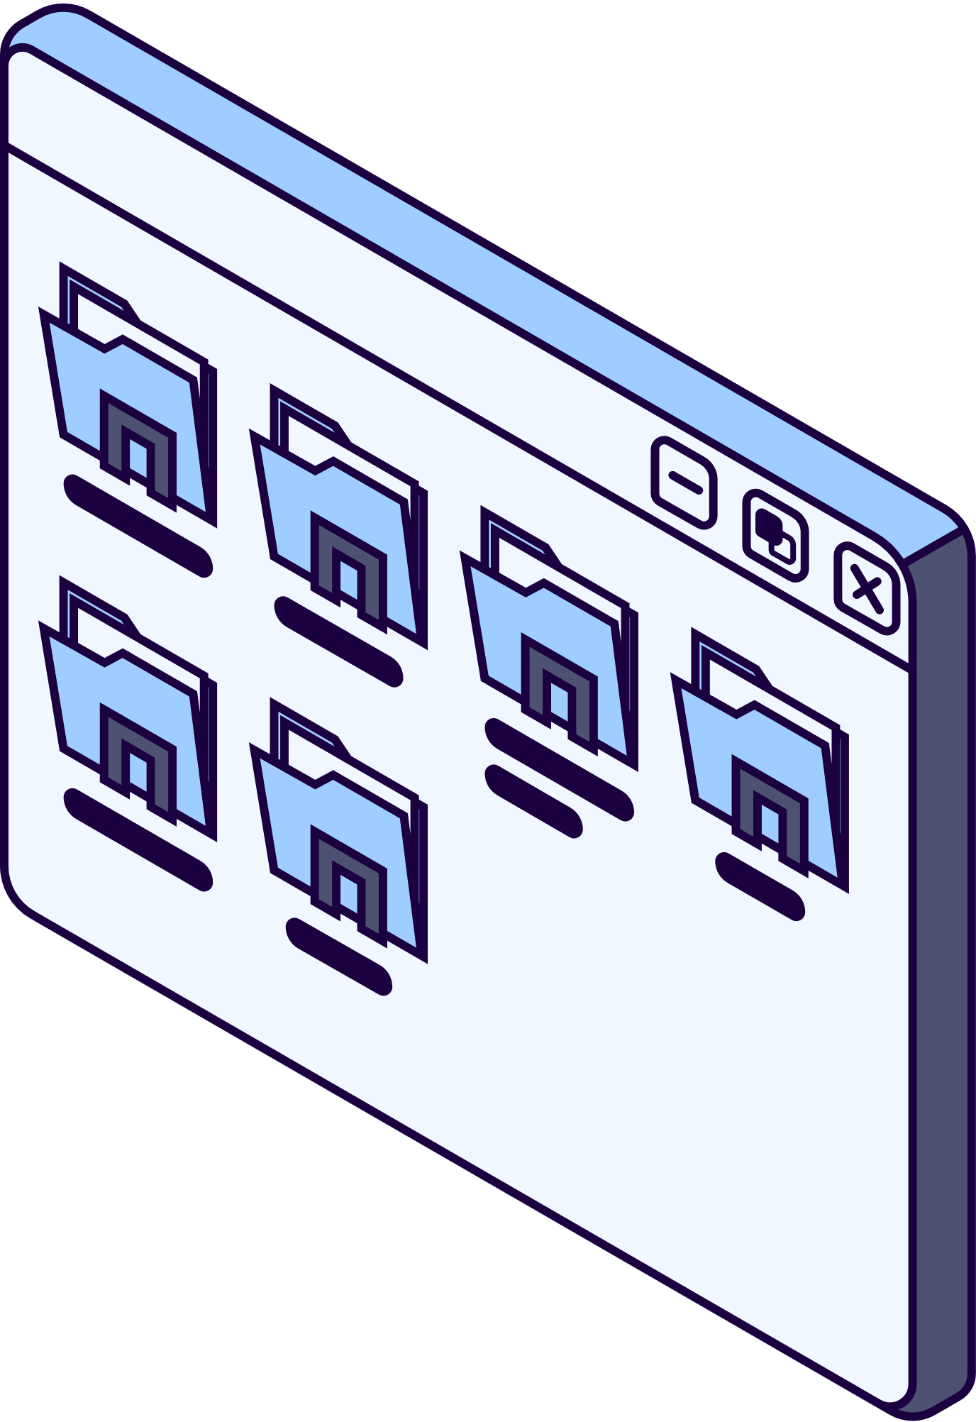
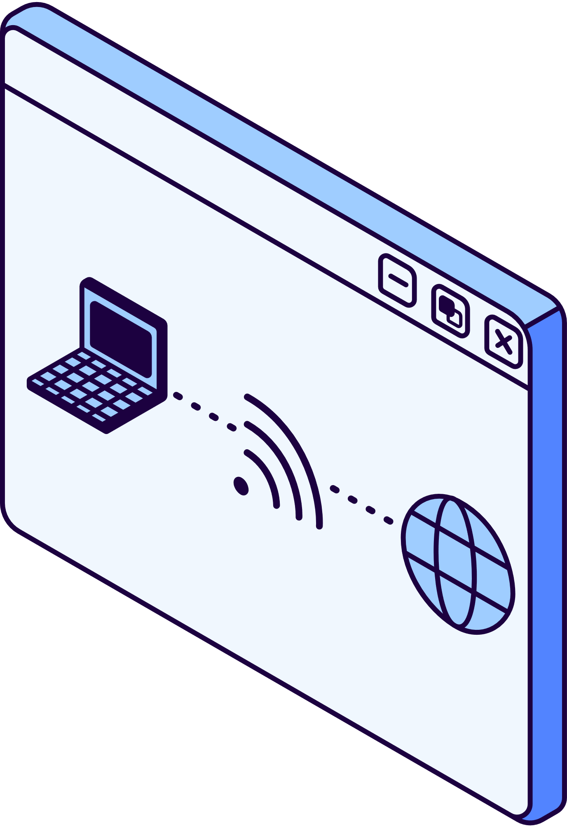
ADVANTAGES OF GO-BACK-N
✔ Efficient for networks with low error rates.
✔ Ensures ordered delivery of packets.
✔ Works well when network delay is minimal

Slide 7
CONCLUSION
Go-Back-N is widely used in reliable communication.
Effective in low-error networks but inefficient in high-loss scenarios.
Used in applications like video streaming, gaming, and satellite communication.

Slide 8
THANK YOU

