Slide 1


SRI SIDDHARTHA INSTITUTE OF TECHNOLOGY (Declared as Deemed to be University Under Section 3 of the UGC Act, 1956 Approved by AICTE, Accredited by NBA, NAAC ‘A ’Grade) AGALAKOTE, TUMAKURU – 572107, KARNATAKA
DEPARTMENT OF INFORMATION SCIENCE AND ENGINEERING
IS5MP1- MINI PROJECT - I
Child Health Care
Under the guidance of
Mrs. Champakamala S
Assistant Professor
Department of Information Science and
Engineering
PRESENTED BY
LIKITH GOWDA M J 20IS050
KOUSHIK U PAI 20IS044

Slide 2
CONTENTS
ABSTRACT
INTRODUCTION
OBJECTIVE
SYSTEM REQUIREMENT
WORKING
APPLICATION
REFERENCES

Slide 3
ABSTRACT
Our programs support children and their families during difficult healthcare experiences in a way that promotes hope, healing and happiness… something we believe every child deserves!
During unfavorable conditions like unhealthy situation of a child , our project supports the guardians to get their best facilities.
The aim of this study was to investigate child health-care coordinators' experiences of being a facilitator for the implementation of a new national child health-care program in the form of a web-based national guide.

Slide 4


INTRODUCTION
Basically for every parents there children are the most important part in there life , so maintaining a good health is the basic responsibility of every parent.
Protecting and improving the health of children is of fundamental importance. Over the past several decades, we have seen dramatic progress in improving the health and reducing the mortality rate of young children.
Now a days ,due to the lack of best health facility the child death rate is increasing, that could be easily prevented by given access to health care and improvements to their quality of life.
Your child deserves to be safe and well cared for at all times.

Slide 5

OBEJECTIVES
Decreasing the childhood death and infant mortality rate.
Promote and protect health of a children.
Monitoring child growth and development towards health level of childrens.
In most of the cases the child and his family do not know certain essentials of health.
Your child care provider should verify that this check shows that the
adult does not have a history of child abuse or violence.
Objectives of Child Health Foundation shall be to work for the promote
on and improvement of the health of the children in India.

Slide 6

System Requirements
HTML (HYPER TEXT MARKUP LANGUAGE ) : HTML IS THE STANDARD MARKUP LANGUAGE FOR DOCUMENTS DESIGNED TO BE DISPLAYED IN A WEB BROWSERS.
CSS (CASCADING STYLE SHEETS) : CSS HANDLES THE LOOK AND FEEL PART OF A WEB PAGE.
JAVASCRIPT : JAVASCRIPT IS A DYNAMIC COMPUTER PROGRAMMING LANGUAGE.
BOOTSTRAP : BOOTSTRAP IS A FREE FRONT-END FRAMEWORK FOR FASTER AND EASIER WEB DEVELOPMENT.

Slide 7
WORKING
The “Child Health Care” project is basically a web site interface , which is user-friendly and easily accessible.
The facilities are being stored on shared hosting services so it can be accessed from anywhere.
Basically there are 3 facilities available in this web interface :
Finding nearby Child Care Hospitals
Facilitating expert Child Specialist
Fast Ambulance Service

Slide 8
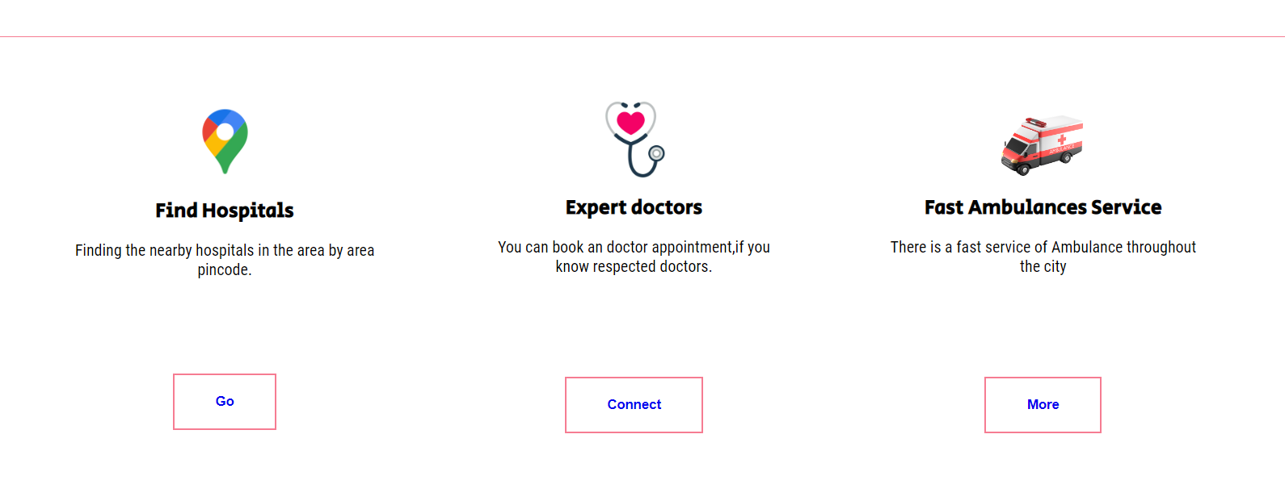
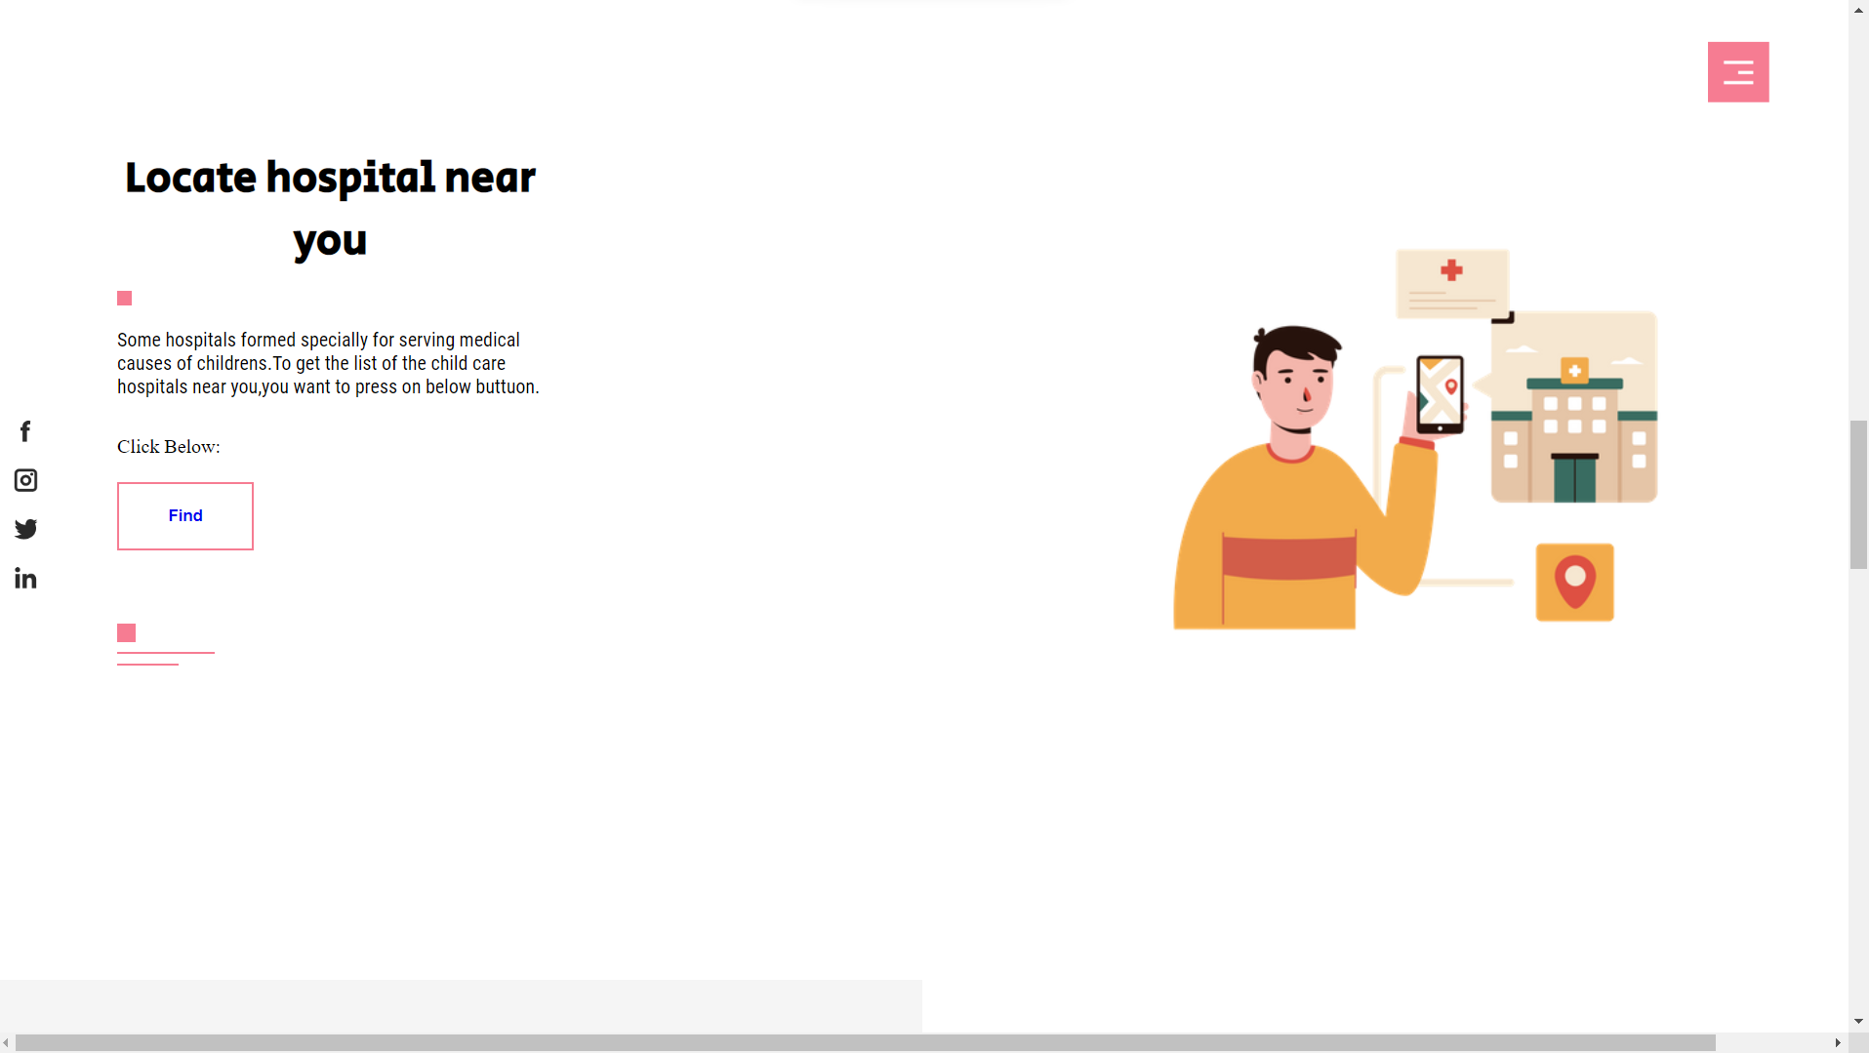
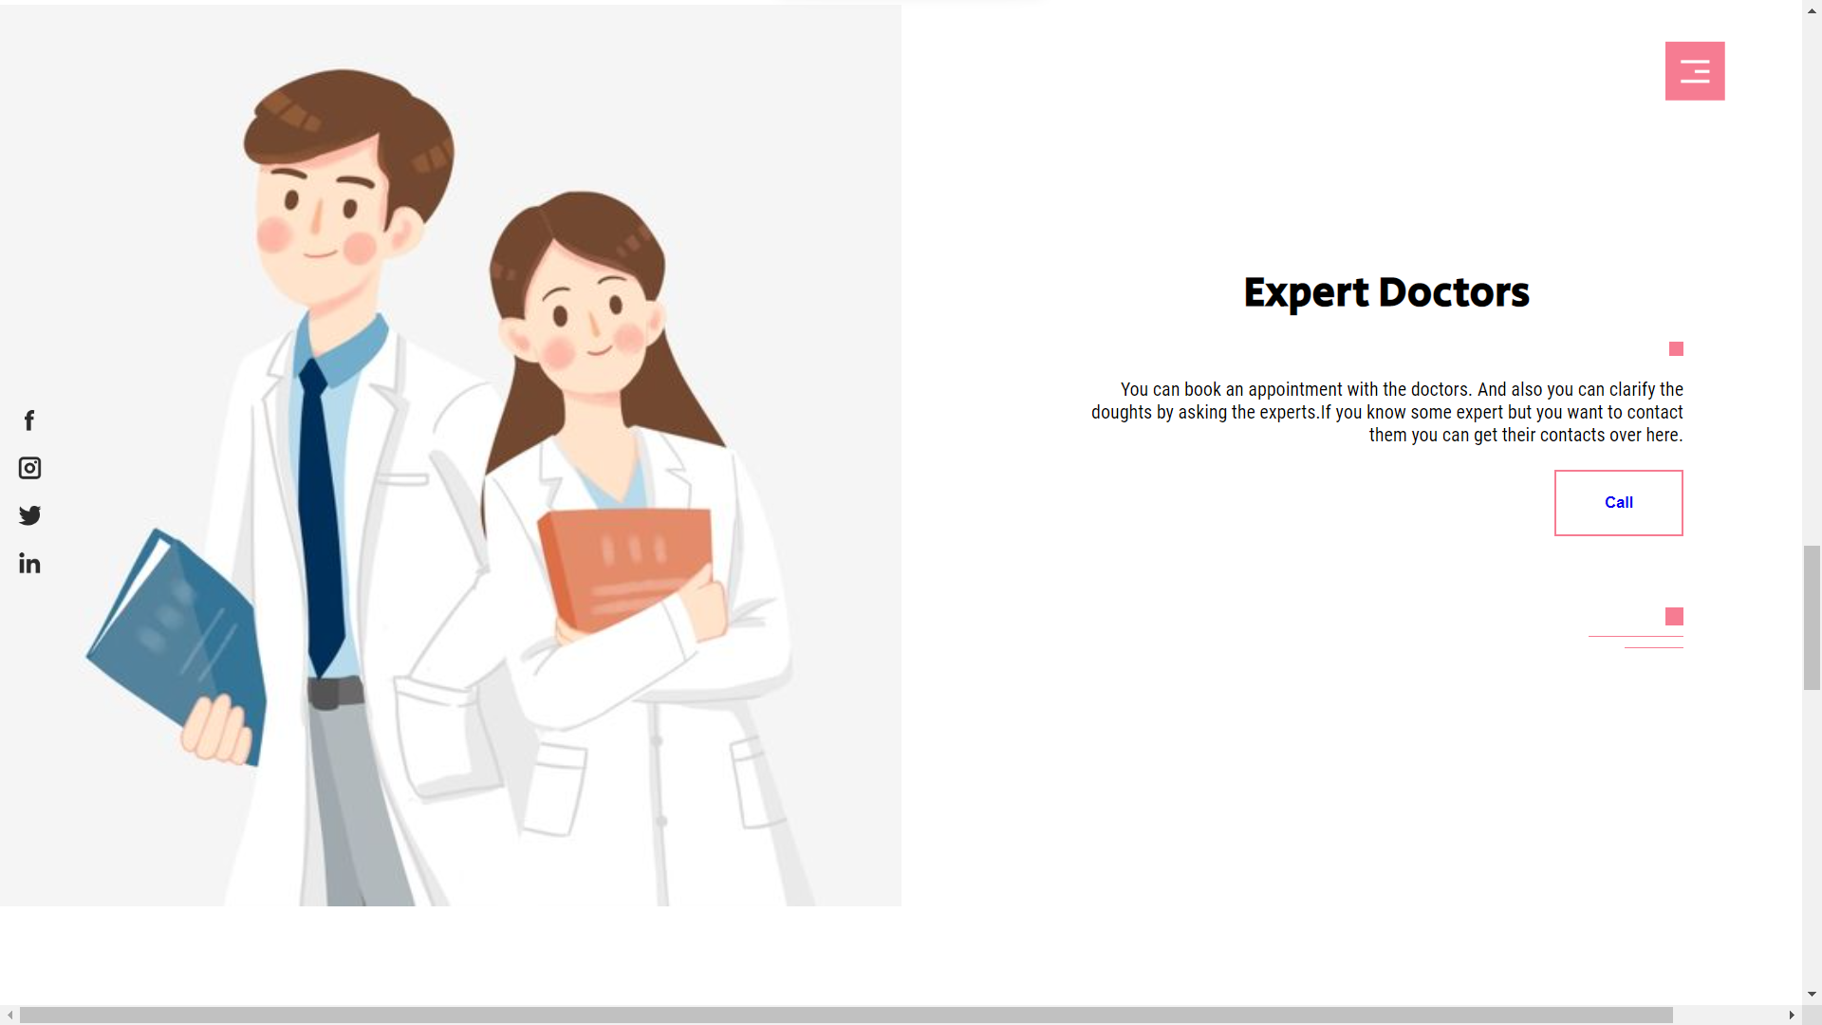
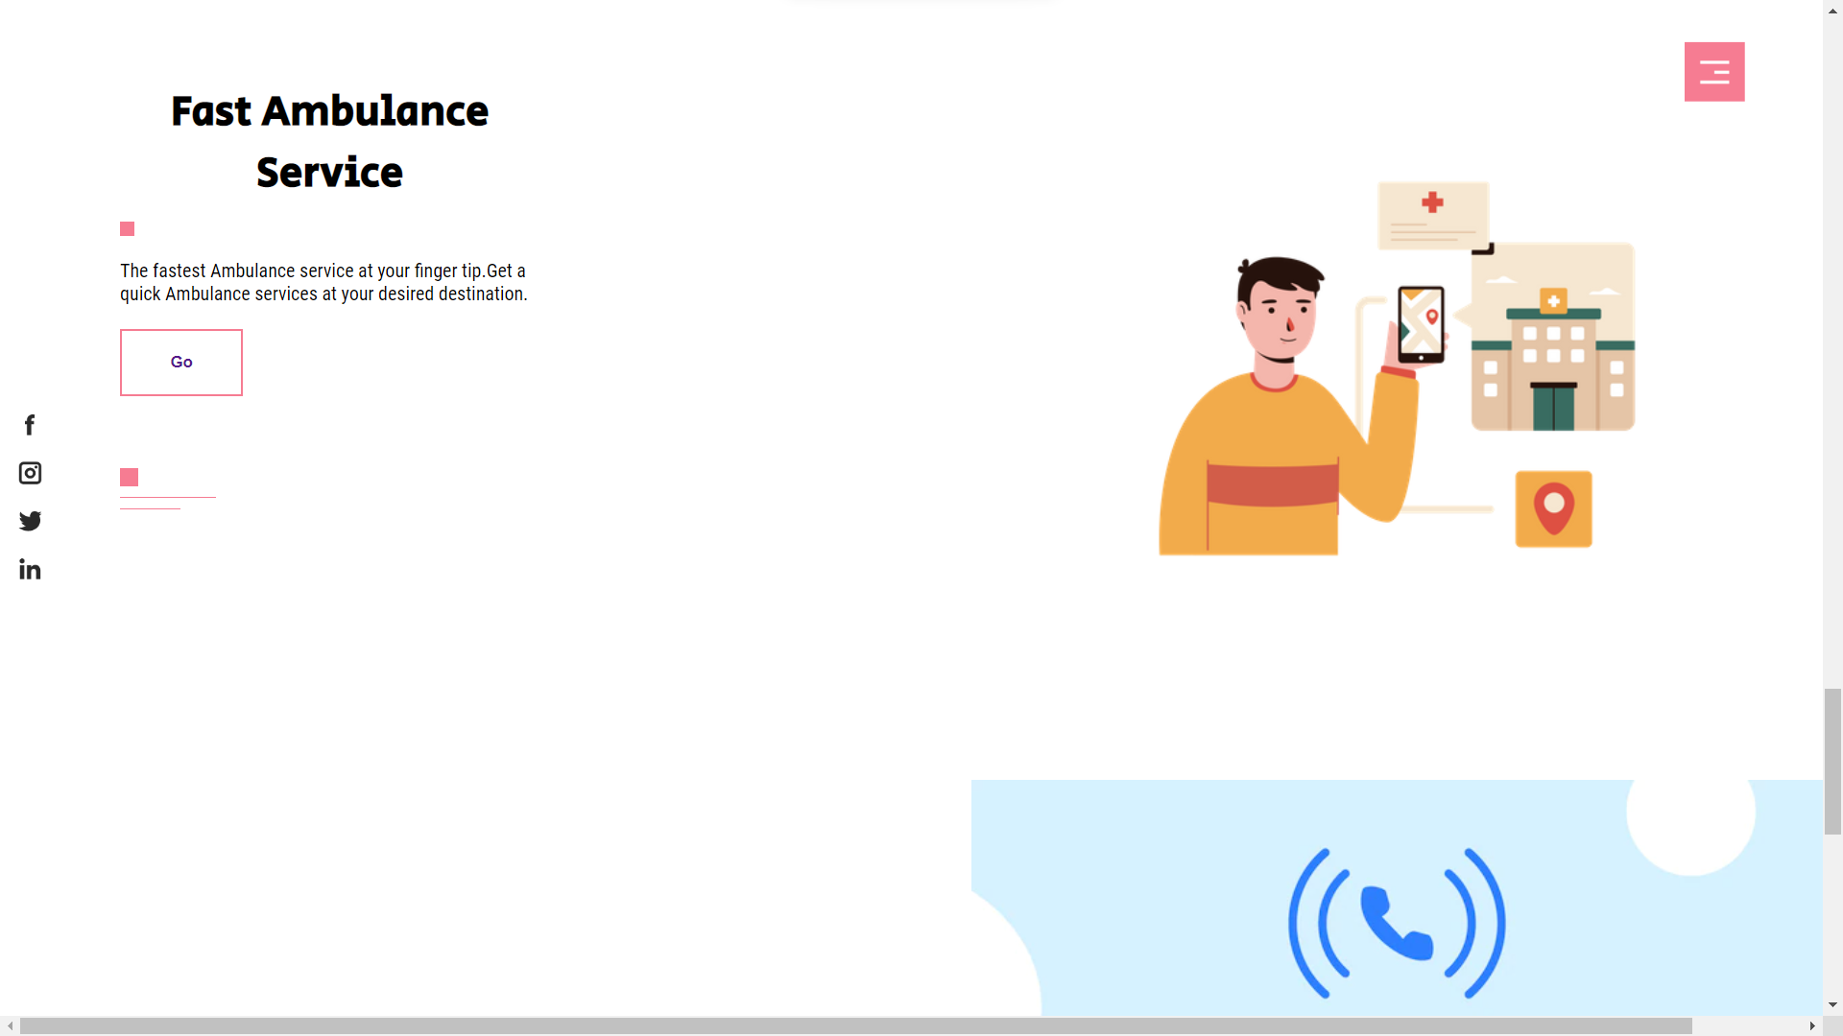
Facilities
Finding Child Health Care Hospital
Expert Child Specialist
Fast Ambulance Service

Slide 9
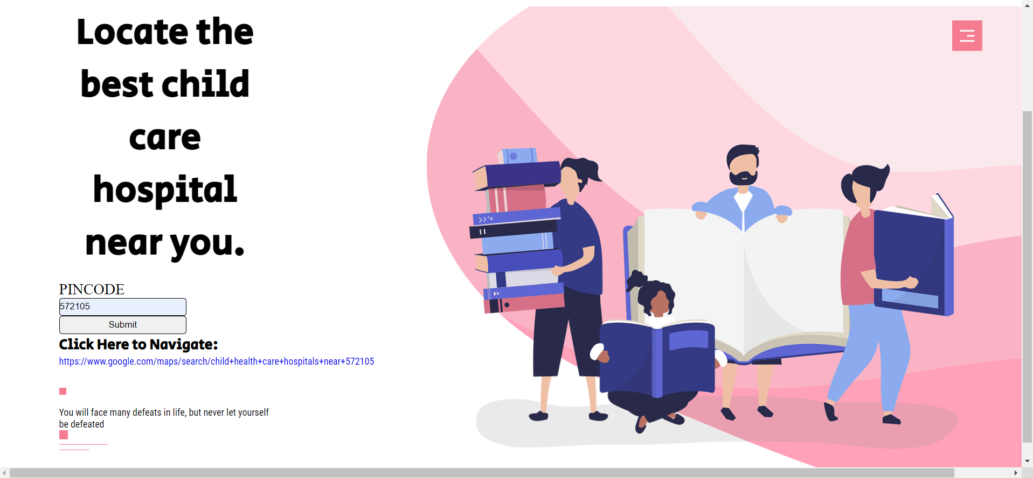
Locating the nearest Hospital
When the user navigate to the locating page, a box to enter a pin code will appear.
When the user enter the pin code , it generate a link which navigate to the list of hospitals in the map.

Slide 10
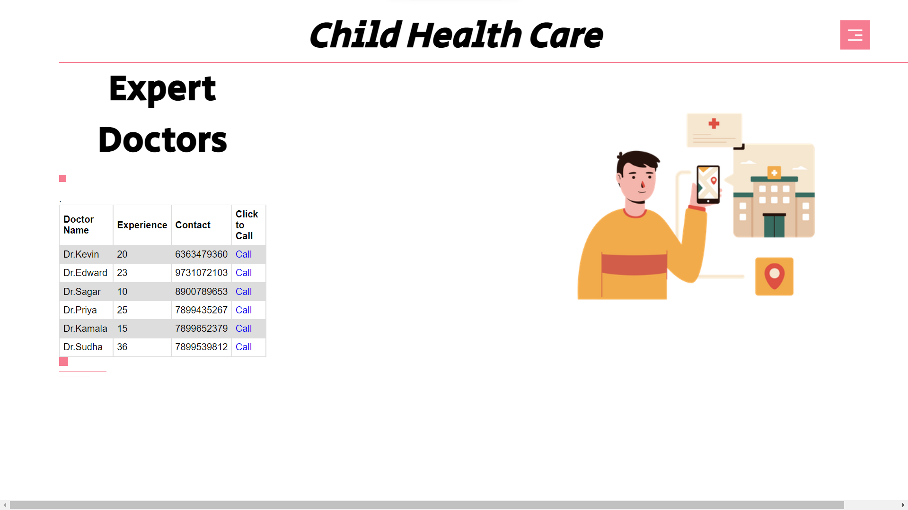
Fetching the Child Specialists
Similarly as above, when the user navigate to the “Expert Doctor” Page, which includes list of expert doctors.
The list include doctors details like Name , Experience and Contact details.
From which they can contact the specialists directly when they needed.
This reduces the burden of searching the well authorized doctors at emergency.

Slide 11
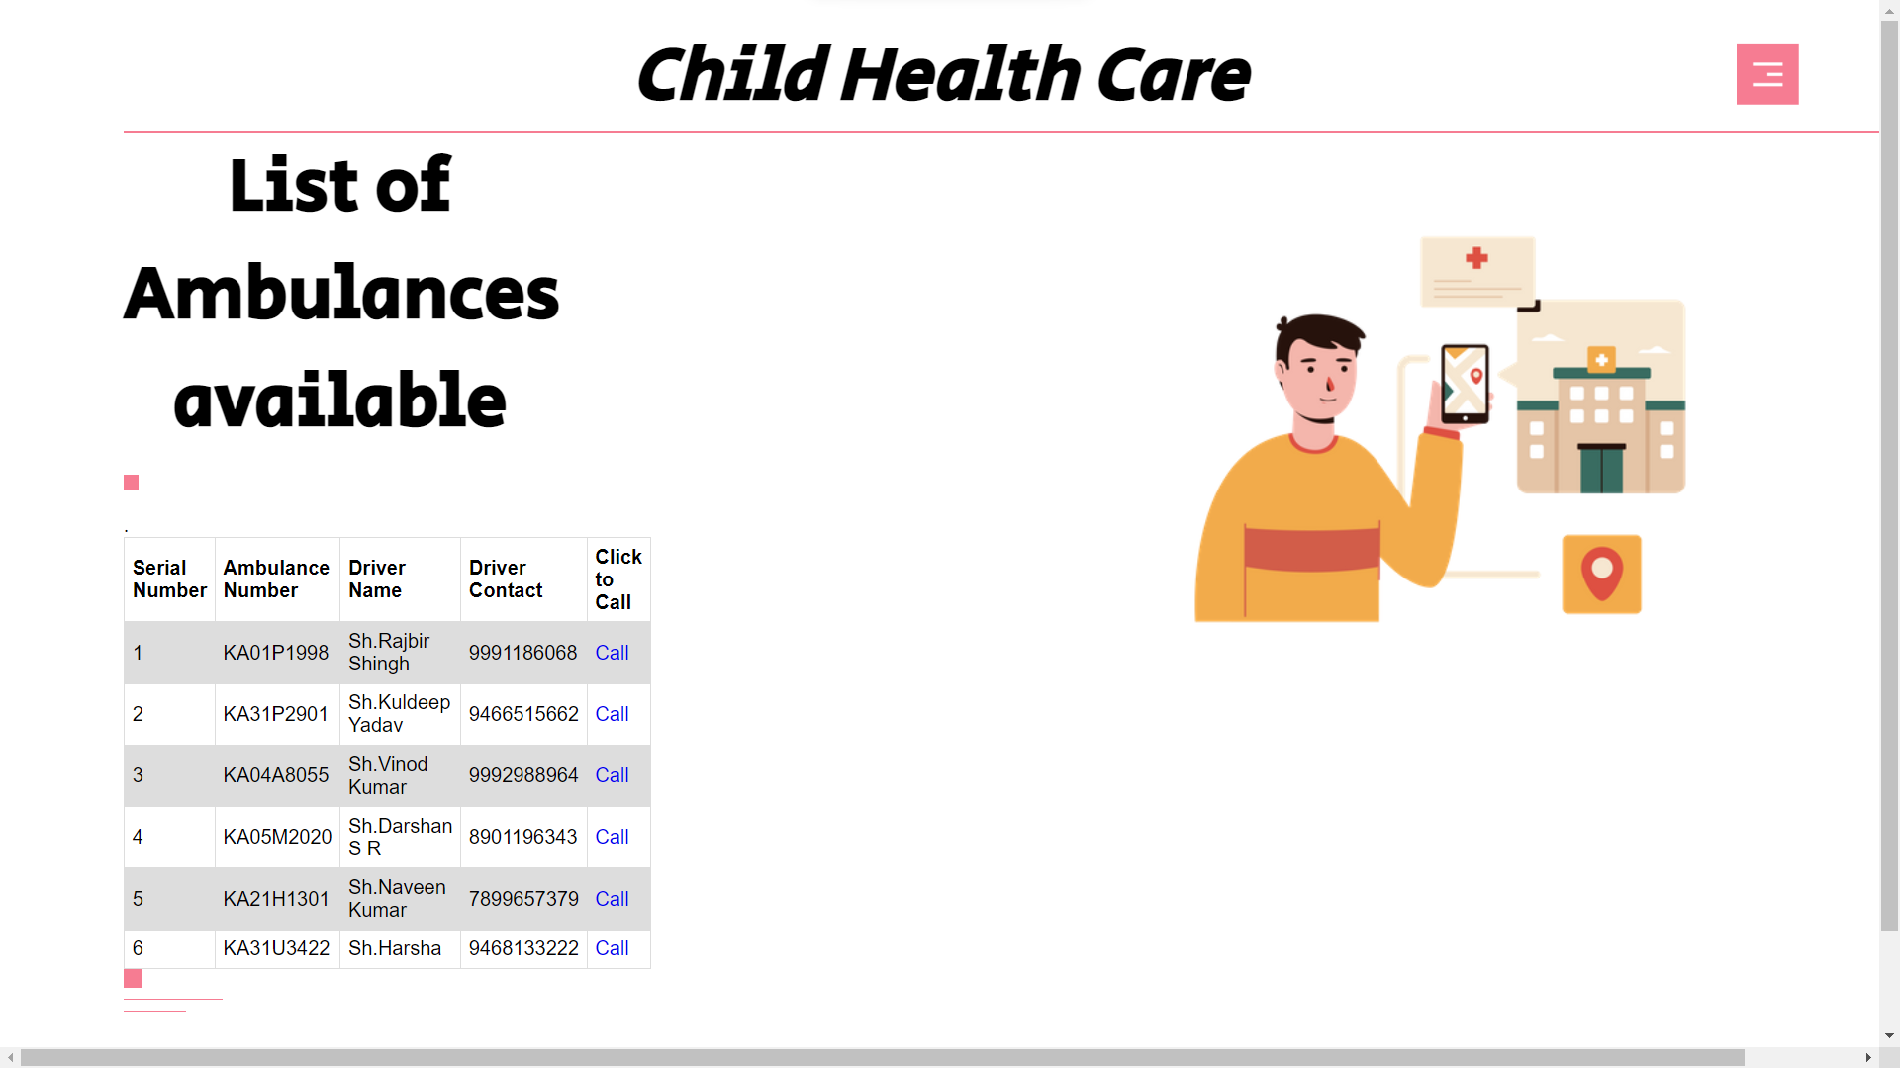
Fast Ambulance Service
When the user click on the button of Ambulance Service Facility, it will redirect to the page which include the list of Ambulance Services .
The list include Ambulance details like Driver Name, Ambulance Number and Driver Contact details.
From which they can contact the Ambulance directly when its emergency case.
This reduces the burden of searching nearby Ambulances and Contacting them.

Slide 12

APPLICATIONS
The Services offered by the web page, that can be accessed at any location.
It is User-friendly interface that mean it is simple/easy to use.
It helps for resulting best quality health services of child.
Installation of application(apps) are avoided, as it promotes web pages.
It avoids paid membership access, easy to access by common peoples.

Slide 13

REFERENCES
W3School.
Stack Overflow
Geeks-for-geeks
Wikipedia
Net Solutions.

Slide 14
Thank you
“Time and health are two precious assets that we don’t recognize and appreciate until they have been depleted”
-Denis Waitley

