Slide 1
MINI PROJECT 2 ON CLASSIFICATION BY ANALYSING HOUSE DATA
NAME-KOUSTAV BANERJEE​

Slide 2
BUSINESS OBJECTIVE
Build a predictive model to determine the Grade(A,B,C,D,E) of house
1
Grade represents conditions of the house ranging from A(best)-E(worst)
2
Grade can be useful for buyers before buying houses
3

Slide 3
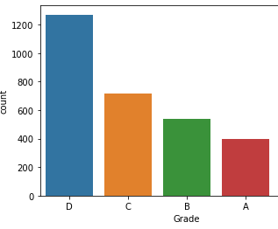
D grade houses are most available in number and E grade houses are least in number
​

Slide 4
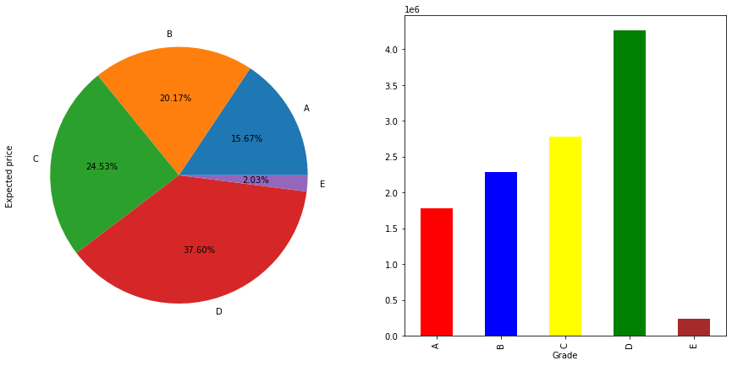
A grade houses have highest average sales,followed by B,C,D,E in descending order Thus it shows A-grade houses AND B-GRADE are MOST POPULAR AND MOST IN DEMAND

Slide 5
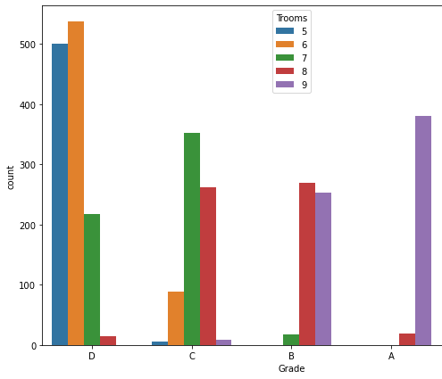
A and B which are good quality houses most are 9 rooms and 8 rooms, MOST BAD QUALITY HOUSES HAVE 5 ROOMS AND 6 ROOMS

Slide 6
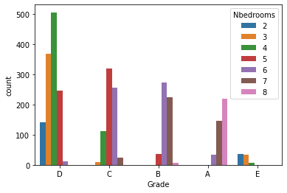
A and B which are good quality houses most have 8 bedrooms,7 bedrooms and 6 bed rooms, MOST BAD QUALITY HOUSES HAVE 2 bedrooms,3bedrooms,4bedrooms

Slide 7
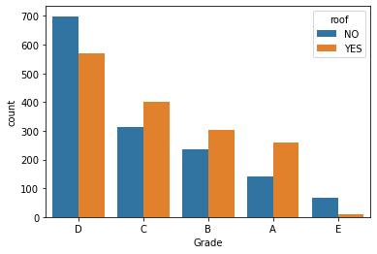
MOST OF THE BEST QUALITY AND MEDIUM QUALITY HOUSES HAVE ROOFS.MOST OF POOR QUALITY HOUSES DON’T HAVE ROOFS

Slide 8

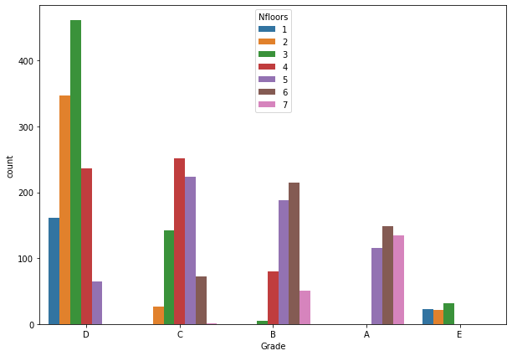
MOST OF THE BEST QUALITY HOUSES HAVE 5,6,7 FLOORS.AND MOST OF POOR QUALITY HOUSES HAVE 2,3,4 FLOORS

Slide 9
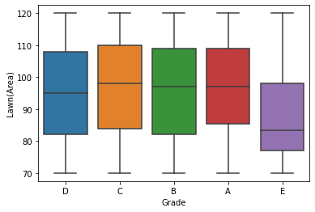
A,B,C which ARE BEST GRADE AND GOOD GRADED HOUSES HAVE HIGH LAWN AREA,THE POOR QUALITY HOUSES HAVE LOW LAWN AREA

Slide 10
DATA PRE-PROCESSING TECHNIQUES USED
Firstly importing the necessary libraries and checking for null values, here as there is no null values in the dataset so no missing value treatent needed
Converting categorical columns to numerical columns using label encoder and scaling the data using MinMaxScaler
After scaling the data checking which columns affect the target columns and how it affects the target column.

Slide 11
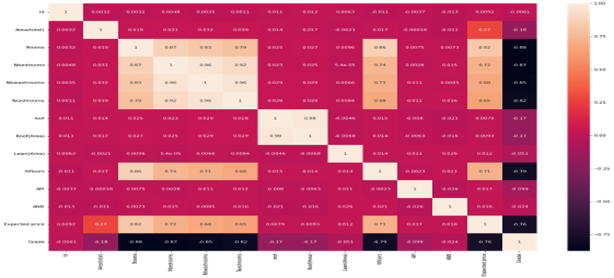
FACTORS AFFECTING HOUSE GRADES
Number of rooms
Number of bedrooms
Number of washrooms
Expected price
Area of Lawn
Area of Roof

Slide 12
WE HAVE TO FIT ANY TYPE OF A CLASSIFICATION MODEL AS THIS CASE STUDY FALLS UNDER CLASSIFICATION
HERE WE USE CLASSIFICATION MODEL BECAUSE IN THIS SCENARIO THE TARGET VARIABLE(GRADE) IS IN DISCRETE FORM

Slide 13
CLASSIFICATION
A SUPERVISED MACHINE LEARNING APPROACH
IT CLASSIFIES THE NEW OBSERVATIONS INTO A PRESENT NUMBER OF GROUPS OR CLASSES
IDENTIFY CATEGORY OF NEW OBSERVATIONS BASED ON LABELLED TRAINING DATA
IN CLASSIFICATION OUTPUT IS DISCRETE,IF OUTPUT HAS 2 DIFFERENT OUTCOMES IT IS CALLED BINARY CLASSIFICATION,IF OUTCOME HAS MORE THAN 2 OUTCOMES IT IS CALLED MULTICLASS CLASSIFICATION

Slide 14
CLASSIFICATION MODELS USED IN THE ANALYSIS
LOGISTIC REGRESSION
NAÏVE-BAYES CLASSIFICATION
DECISION TREE CLASSIFICATION
KNN CLASSIFICATION
RANDOM FOREST CLASSIFICATION

Slide 15
CROSS VALIDATION TECHNIQUES USED
CROSS VALIDATION IS USED TO MAKE SURE THAT OUR MODEL IS NOT OVERFITTING AND ALSO TO TEST THE PREDICTIVE POWER OF OUR MODEL
IN THIS ANALYSIS I HAVE USED THREE TYPES OF CROSS VALIDATIONS ,HOLDOUT METHOD,KFOLD METHOD,STRATIFIED KFOLD METHOD

Slide 16
EVALUATING CLASSIFICATION MODELS
THE EVALUATION METRICS FOR CLASSIFICATION MODELS ARE-
ACCURACY SCORE
PRECISION SCORE
RECALL SCORE
F1 SCORE
ROC –AUC-SCORE

Slide 17
ACCURACY SCORE – HOW OFTHN THE MODEL IS CORRECT
RECALL SCORE- HOW WELL DOES THE MODEL RECOGNIZE POSITIVE CASES
PRECISION-HOW EXACT IS THE MODEL(WHAT % OF POSITIVE CASES ARE ACTUALLY POSITIVE)
F1-SCORE- HOW EXACT IS TE MODEL AND HOW WELL DOES IT RECOGNIZE POSTIVE CASES
ROC-AUC-SCORE- IT GIVES AREA UNDER THE CURVE IN ROC-AUC –CURVE WHICH IS A CURVE OF TRUE POSITIV RATE VS FALSE POSITIVE RATE

Slide 18
GOOD CRITERIA FOR CLASSIFICATION MODEL
A GOOD CLASSIFICATION MODEL IS ONE WHICH HAS HIGH ACCURACY SCORE,HIGH RECALL SCORE,HIGH PRECISION SCORE,HIGH RECALL SCORE,HIGH ROC-AUC-SCORE,HIGH F1-SCORE
A PLOT OF TRUE POSITIVE RATE VS FALSE POSITIVE RATE ALSO KNOWN AS ROC-AUC-CURVE CAN ALSO BE USED TO EVALUATE A CLASSIFICATION MODEL.A GOOD CLASSIFICATION MODEL WILL HAVE ITS CURVE MUCH AWAY FROM THE THRESHOLD LINE

Slide 19
PERFORMANCES OF THE MODELS
MODEL NAME | ACCURACY SCORE | F1-SCORE | RECALL SCORE | PRECISION SCORE | KFOLD CROSS-VAL | Stratified K Fold | Repeated Stratified K Fold
Logistic Regression | 0.894 | 0.884 | 0.894 | 0.874 | 0.9003 | 0.902 | 0.87
Naïve-Bayes Classifier | 0.806 | 0.81 | 0.806 | 0.816 | 0.835 | 0.834 | 0.8
Decision-Tree Classifier | 0.86 | 0.858 | 0.860 | 0.858 | 0.861 | 0.86 | 0.82
KNN Classifier | 0.893 | 0.893 | 0.893 | 0.893 | 0.901 | 0.9 | 0.86
Random Forest Classifier | 0.881 | 0.876 | 0.881 | 0.876 | 0.901 | 0.9 | 0.87

Slide 20
Most of the models are showing their best performances in stratified K Fold cross validation which is performing a bit better than K Fold cross validation
KNN Classification and Random Forest Classification are the best performing models out of the 5 models used in the analysis
Both the models KNN Classification and Random Forest Classification are very much similar and equal in their performances but it is outweighing Random Forest in terms of F1score,recall score and precision score

Slide 21
ROC-AUC CURVE IS A PERORMANCE MEASUREMENT FOR A CLASSIFICATION MODEL AT VARIOUS THRESHOLDS.HIGHER THE ROC-AUC SCORE BETTER IS THE PERFORMANCE OF THE MODEL
MODEL NAME | ROC-AUC-SCORE
LOGISTIC REGRESSION | 0.981
NAÏVE-BAYES CLASSIFICATION | 0.96
DECISION TREE CLASSIFICATION | 0.904
KNN CLASSIFICATION | 0.985
RANDOM FOREST CLASSIFICATION | 0.983

Slide 22
REASONS FOR CHOOSING KNN CLASSIFICATION IN THIS CASE STUDY
BETTER ACCURACY,F1-SCORE,RECALL SCORE AAND ROC-AUC-SCORE THAN ALL OTHER MODELS
SIMPLE MODEL AND EASY TO INTRPRET
QUICK CALCULATION TIME
RANDOM FOREST CLASSIFIER HAS SLOW TRAINING TIME SO KNN CLASSIFIER IS PREFERABLE IN THIS SCENARIO

Slide 23
BUSINESS CONCLUSION
THROUGH DIFFERENT CLASSIFICATION MODELS WE CAN PREDICT THE GRADES OF HOUSES
WE CAN CHECK WHICH HOUSES HAVE GOOD GRADES AND WHICH HOUSES HAVE BAD GRADES
THIS CAN HELP BOTH THE CLIENT AND THE HOUSE OWNER

Slide 24


