Slide 1

NAME- KOUSTAV BANERJEE TOPIC- MINI PROJECT ON REGRESSION BY ANALYZING SUPERSTORE SALES DATA

Slide 2
BUSINESS OBJECTIVE
BUILDING A REGRESSION MODEL TO PREDICT SALES OF A STORE BY ANALYZING SUPERSTORE SALES DATA
1
GIVING IMPORTANT SUGGESTIONS TO INCREASE THE FUTURE SALES OF THE STORE AND TO ATTRACT MORE CUSTOMERS
2

Slide 3

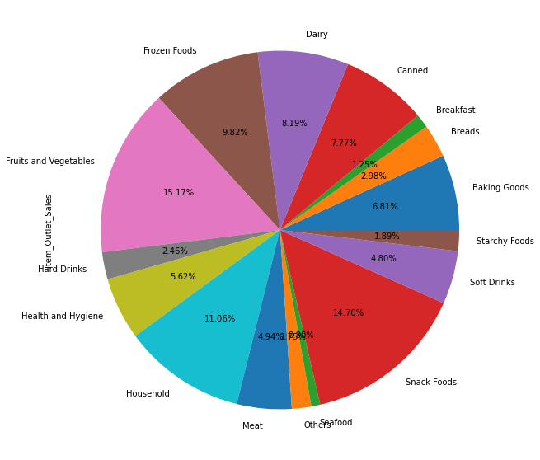
VEGETABLES AND SNACKS HAVE HIGHEST SALES
SO SHOPS HAVING VEGETABLES AND SNACKS WILL HAVE MORE SALES

Slide 4
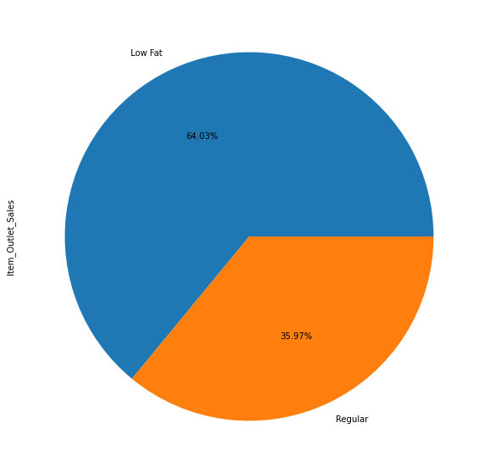
LOW FAT CONTENT FOOD MATERIALS HAVE MORE SALES THAN REGULAR AND HIGH FAT CONTENT FOOD MATERIALS
LOW FAT CONTENT FOODS ARE MORE PREFERED BY CUSTOMERS AS THEY ARE MORE HEALTHY
SHOPS HAVING LOW FAT CONENT FOODS WILL HAVE MORE SALES

Slide 5
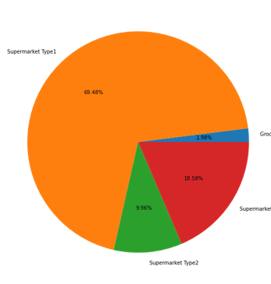
SHOPS IN SUPERMARKET TYPE1 HAVE MORE SALES THAN SHOPS LOCATED IN OTHER SUPERMARKETS SUPERMARKET TYPE1 SHOPS ARE MORE POPULAR AND ACCESIBLE TO THE CUSTOMERS

Slide 6
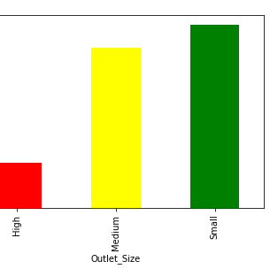
Shops with small outlet size and medium size outlets have more Sales compared to other shops.These shops are more popular amongst customer

Slide 7
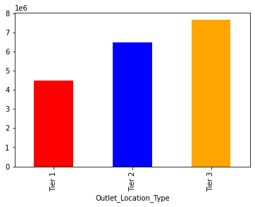
Shops located in tier 3 and tier 2 have way more sales than shops in tier 1
Shops located in tier 3 have best sales amongst all the shops
Shops in tier 1 have low sales as they are not accessible and easily reachable for the customers

Slide 8
Shops which have highest sales have the following properties
Located in tier3 and tier2 more preferably in tier3
Have Low-Fat content items
Have small sized and medium sized outlets more preferably in small sized outlets
Shops having vegetables and snacks
Located in Supermarket type 1 category
Hence if anyone wants to open a new shop and they make sure if they have fulfilled the following properties or criteria then they will have high sales and profits

Slide 9

DATA PREPROCESSING TECHNIQUES USED
First we import the necessary libraries and do the missing value treatment, the target variable had 30% null values so I decided to drop the rows having null values
Converting the categorical columns to numeric columns using Label Encoder
Using MIN Max Scaler (normalization) scaling the data and checking which columns affect the target column and how it affects the target column

Slide 10
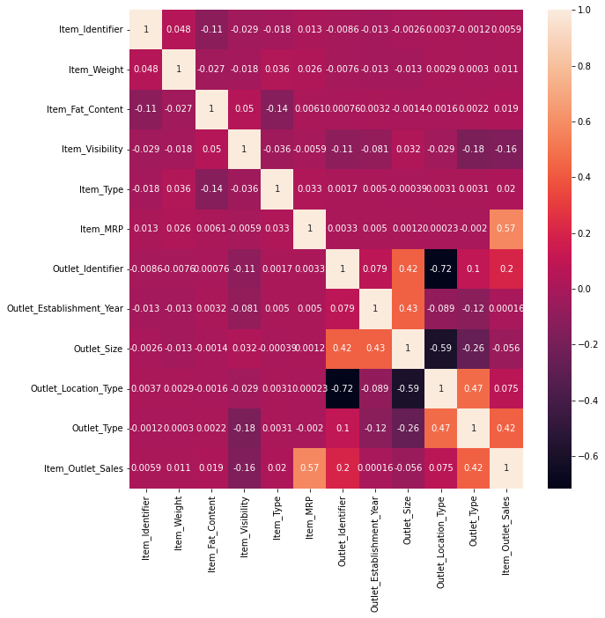
THE FACTORS AFFECTING SALES
ITEM_MRP
OUTLET-TYPE
OUTLET_IDENTIFIER
ITEM_VISIBILITY

Slide 11

FOR PREDICTING FUTURE SALES WE WILL HAVE TO FIT ANY TYPE OF REGRRESION MODEL AS THIS CASE STUDY FALLS UNDER REGRESSION
HERE WE USE REGRESSION MODELS BECAUSE IN THIS SCENARIO OUR TARGET VARIABLE (Item Outlet Sales) IS ONTINUOUS

Slide 12

WHAT IS REGRESSION?
REGRESSION IS A TECHNIQUE TO INVESTIGATE THE RELATIONSHIP BETWEEN INDEPENDENT VARIABLES OR FEATURS AND A DEPEMDENT VARIABLE OR OUTCOME
IT IS USED AS A METHOD FOR PREDICTIVE MODELIING IN MACHINE LEARNING IN WHICH AN ALGORITHM IS USED TO PREDICT CONTINUOUS OUTCOMES
TYPE OF SUPERVISED MACHINE LEARNING TECHNIIQUE
USED WHEN THE OUR TARGET COLUMN IS CONTINUOUS

Slide 13

REGRESSION MODELS USED IN THE ANALYSIS
LINEAR REGRESSION
BAYERS-RIDGE REGRESSION
KNN REGRESSION
DECISION TREE REGRESSION
RANDOM-FOREST REGRESSION

Slide 14
CROSS VALIDATION TECHNIQUES USED
CROSS-VALIDATION IS USSED MAINLY TO MAKE SURE THAT OUR MODEL IS NOT OVERFITTING AND TEST THE PREDICTIVE POWER OF A MODEL
IN THIS ANALYSIS I HAVE USED TWO TYPRES OF CROSS VALIDATION TECHNIQUE THAT IS HOLD OUT METHOD AND KFOLD METHOD

Slide 15
EVALUATING REGRESSOR MODELS
In regression models there are certain evaluation metrics we use to evaluate our model
R-square(Coefficient of determination),Root-Mean-Square (RMSE) value,Mean-Square-Value(MSE) and MEAN Absolute-Value(MAE)
Good Models are expected to have high R-square value and low MSE,RMSE and MAE values

Slide 16
R-square is coefficient of determination. It is a measure of model accuracy.Its value ranges from 0 to 1
RMSE-It is root mean squared error ,square root of the mean of squared differences between actual values and predicted values
MSE-It is Mean Squared Error,mean of squared difference between actual values and predicted values
MAE=It is Mean Absolute Error,mean of absolute difference between actual values and predicted values

Slide 17
PERFORMANCES OF THE MODELS
Model Name | R-square | Cross-Val-score | RMSE Value
Linear Regression | 0.54 | 0.54 | 0.176
Bayers-Ridge Regression | 0.55 | 0.53 | 0.17
KNN Regression | 0.67 | 0.65 | 0.15
Decision-Tree-Regressor | 0.65 | 0.65 | 0.16
Random-Forest-Regressor | 0.665 | 0.66 | 0.15

Slide 18

AFTER EVALUATING THE MODEL PERFORMANCES WE CAN SAY THAT HERE KNN-REGRESSOR AND RANDOM FOREST REGRESSOR HAS HIGHEST RSQUARE SCORE THAT IS MODEL ACCURACY AND LOWEST RMSE VALUES
SO THIS TWO MODELS PERFORMS THE BEST OUT OF THE 5 MODELS AND THE QUALITY PERFORMANCES OF BOTH THE MODELS ARE ALMOST EQUAL
WE CAN CHOOSE ANY ONE OF THE TWO MODELS FOR PREDICTING FUTURE SALES BUT PERSONALLY I PREFER AND PROPORSE THE KNN-REGRESSOR MODEL FOR PREDICTING FUTURE SUPRSTORE SALES

Slide 19

REASONS FOR PREFERING KNN-REGRESSOR
Quick Calculation Time
Simple Model and hence easy to interpret
Random Forest Regressor has slow training time hence for me its better to use KNN-Regressor in this scenario

Slide 20
BUSINESS SOLUTION
WE CAN FIND OUT SHICH FACTORS AFFECT THE SALES OF A PRODUCT OF THE STORE AND THE TOTAL SALES OF THE STORE ON A MONTHLY OR A YEARLY BASIS
AFTER FINDING OUT THOSE FACTORS AND HOW THEY ARE AFFECTING WE CAN MAKE A PREDICTION ON THE FUTURE SALES BASED ON A REGRESSION MODEL AND CHECK IF THE FUTURE SALES WILL MATCH OR BETTER OUR TARGET OBJECTIVE OR NOT
BASED ON THAT FINDING WE CAN PREPARE OURSELVES ON FINDING THE SOLUTIONS TO BETTER THE SALES IN CASE WE ARE NOT HAPPY WITH THE FUTURE SALES

Slide 21

THANK YOU

