Slide 1

MINI PROJECT 3 ON CLUSTERING
NAME-KOUSTAV BANERJEE

Slide 2
BUSINESS OBJECTIVE
TO CREATE CUSTOMER CLUSTER TO IDENTIFY DIFFERENT TYPE OF CUSTOMERS

Slide 3
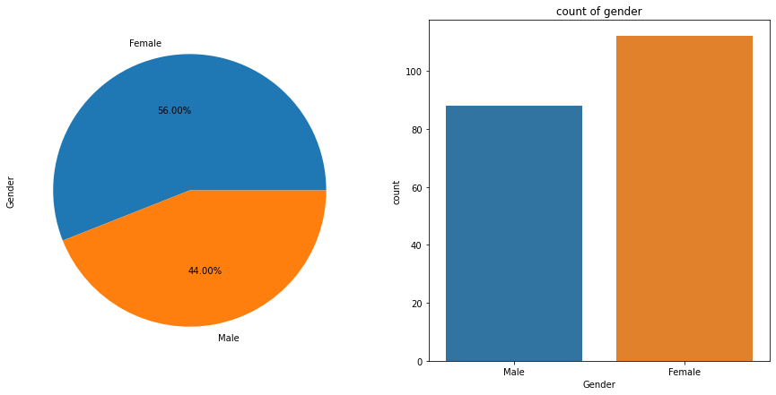
COUNT OF GENDER MONGST THE CUSTOMERS
THERE ARE 56% FEMALES AND 44% AMONGST THE CUSTOMERS
THUS FEMALES ARE MORE IN NUMBER COMPARED TO MALES

Slide 4
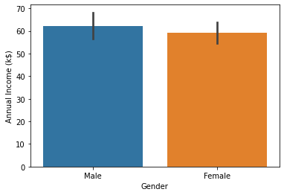
AVERAGE INCOME OF DIFFERENT GENDERS
AVERAGE INCOME OF MALES IS MORE THAN FEMALE CUSTOMERS,THUS THEY CAN BE MORE BENEFECIAL TO THE MALL

Slide 5
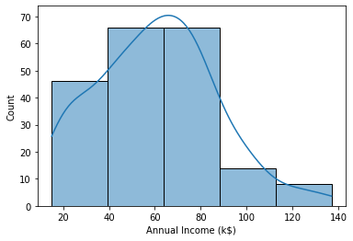
COUNT OF CUSTOMER WITH RESPECT TO ANNUAL INCOME
MOST CUSTOMERS HAVE ANNUAL INCOME BETWEEN 40$K-80$K WHICH IS MODERATE TO HIGHB INCOME
VERY FEW CUSTOMERS HAVE INCOME ABOUVE 100$K THAT IS VERY HIGH INCOME

Slide 6
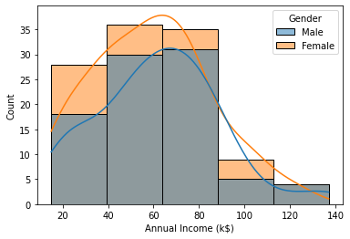
COUNT OF GENDER WITH RESPECT TO DIFFERENT ANNUAL INCOME RANGES
THERE ARE MORE FEMALES THAN MALES IN ANNUAL INCOME RANGE 20-130$K
IN INCOME RANGE 130$K-140$K MALES ARE MORE N NUMBR THAN FEMALES

Slide 7
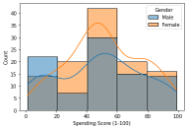
SPENDING SCORE WITH RESPECT TO GENDER
IN SPENDING SCORE RANGE OF 20-100 FEMALES ARE MUCH MORE IN NUMBER THAN MALES
MALES ARE MORE ONLY IN EXTREMELY LOW SPENDING RANGE
THUS FEMALES ARE MORE VALUABLE TO THE MALL AS CUSTOMERS THAN MALES

Slide 8
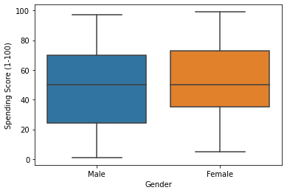
FEMALES HAVE MORE SPENDING SCORE THAN MALES

Slide 9
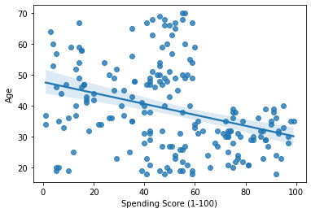
AGE HAS A STRONG NEGATIVE CORRELATION WITH RESPECT TO SPENDING POWER,THUS AS AGE INCREASES SPENDING POWER DECREASES

Slide 10
IMPORTANT FEATURES OF CUSTOMER ANALYSIS
FEMALES HAVE MORE SPENDING POWER COMPARED TO MALES
ANNUAL INCOME OF FEMALES ARE MORE THAN THAT OF MALES
AS AGE INCREASES SPENDING SCORE AND ANNUAL INCOME DECREASES
SO FEMALES CUSTOMERS AND CUSTOMERS IN LOWER AGE GROUPS (20-40)

Slide 11
WHAT IS CLUSTERING?
A CLUSTER IS A SETOF OBJECTS THAT ARE SIMILAR TO EACH OTHER AND DIFFERENT FROM OTHER CLUSTERS
CLUSTERING GROUPS DATA INTO CLUSTERS WITH RESPECT TO SIMILARITY IN DATA OBJECTS ANDSHARE SIMILAR CHARACTERISTICS IN THE SAME CLUSTER
THE GOAL OF CLUSTERING IS SIMILAR OBSERVATIONS ARE CLUBBED TOGETHER AND DISSIMILAR OBSERVATIONS ARE KEPT FAR AWAY

Slide 12
TYPES OF CLUSTERING
PARTIONING-Divides data into non-hierarchial groups.Centroid based method, Algorithm-K Means
01
DENSITY BASED-Connects hghly densed areas into clusters,Algorithm-DBSCAN
02
Hierarchia-Divides data into clusters on basis of hierarchy,creates Dendograms,Algorithm-Agglomerative Hierarchial Clustering
03

Slide 13
MODELS USED IN THE ANALYSIS
KMEANS CLUSTERING
AGGLOMERATIVE CLUSTERING
DBSCAN CLUSTERING

Slide 14
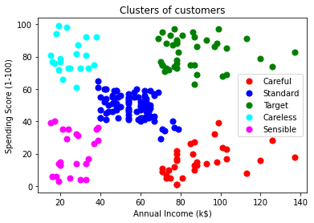
AGGLOMERATIVE(HIERARCHIAL) CLUSTERING WITH WARD LINKAGE
The blue coloured clusters are standard because they have moderate income and moderate spending score ,dependent customers
The green coloured clusters are our main target as they have high spending score and Annual income
Red coloured clusters have customers with high annual income and low spending score,thats why they are termed as careful
The pink coloured clusters have customers with low income and low spending score that is why they are termed as sensible and the cyan coloured cluster have customers with high spending score and low income thats why they are termed as careless

Slide 15
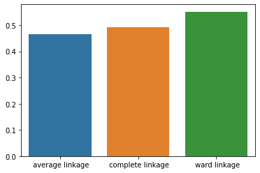
SILHOUEETE SCORE OF THE AGGLOMERATIVE CLUSTERING MODEL WITH RESPECT TO VARIOUS LINKAGES
WARD LINKAGE HAS HIGHEST SILHOUETTE SCORE HENCE IT IS BEST SUITED
AVERAGE LINKAGE HAS LOWEST HAS LOWEST SILHOUETTE SCORE
HIGHER THE SILHOUETTE SCORE,MORE DISTINGUISHED AND ,WELL DEFINED CLUSTERS ARE FORMED

Slide 16
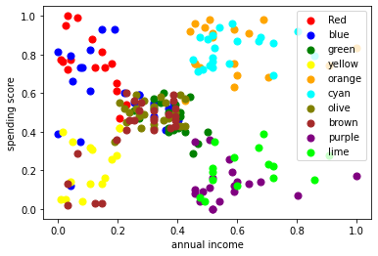
K-MEANS CLUSTERING
THE CLUSTERS FORMED ARE OVERLAPPING
THEY ARE NOT DISTINCT AND WELL APART FROM EACH OTHER,THUS IT IS VERY DIFFICULT TO PREDICT THE CLUSTER CHARECHTERISTICS

Slide 17
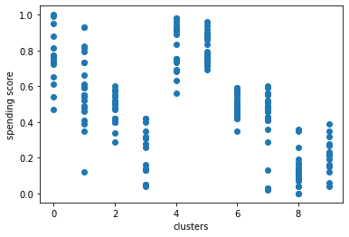
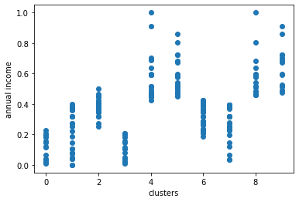
SPENDING SCORE AND ANNUAL INCOME WITH RESPECT TO EACH CLUSTER IN KMEANS CLUSTERING
cluster 4 and cluster 5 customers have high spending score and high annual income so they are our target
cluster 0 customers have low annual income but high spending score, so they are careless but can be useful for the company
cluster 8 has high income but low spending score so they will fall under careful category

Slide 18
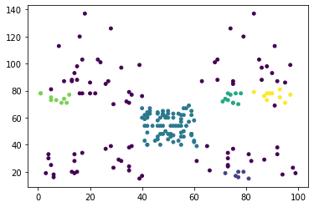
DBSCAN CLUSTERING
IN DBSCAN CLUSTERS ARE NOT WELL DEFINED AND CANT BE CLEARLY DISTINGUISHED
SO IT IS DIFFICULT TO GET ANY INTERPRETATION FROM THIS METHOD IN THIS SCENARIO

Slide 19
PERFORMANCE OF THE CLUSTERING MODELS
NAME | SILHOUETTE SCORE
K-MEANS CLUSTERING | 0.45
AGGLOMERATIVE HIERARCHIAL CLUSTERING | 0.556
DBSCAN (DENSITY BASED) | 0.113

Slide 20
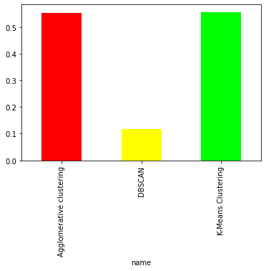
COMPARISION OF THE SILHOUETTE SCORES
AGGLOMERATIVE CLUSTERING AND K-MEANS CLUSTERING ARE THE TWO BEST MODELS FOR THIS CUSTOMER SEGMENTATION ANALYSIS

Slide 21
FINAL CONCLUSION
FROM THE SILHOUETTE SCORE K-MEANS AND AGGLOMERATIVE CLUSTERING ARE BEST SUITED FOR THIS SCENARIO,ALTHOUGH SILHOUETTE SCORE FOR AGGLOMERATIVE CLUSTERING IS SIGNIFICANTLY BETTER THAN KMEANS
IN AGGLOMERATIVE HIERARCHIAL CLUSTERING THE CLUSTERS FORMED WERE WELL DEFINED AND DISTINCT AS COMPARED TO K-MEANS WHERE CLUSTERS FORMED WERE OVERLAPPING
IN KMEANS CLUSTEING WE HAVE TO PREDEFINE THE NUMBE OF CLUSTERS,IN AGGLOMERATIVE CLUSTERING WE DON’T FACE THE PROBLEM OF HAVING TO PREDEFINE THE NUMBER OF CLUSTERS
THUS AGGLOMERATIVE CLUSTERING IS BEST SUITED FOR THE CUSTOMER SEGMENTATION

Slide 22
BUSINESS CONCLUSION
BY APPLYING CLUSTERING ALGORITHM WE CAN SEGREGATE CUSTOMERS IN VARIOUS CLUSTERS AND GET INTERPRETATION ABOUT THE DIFFERENT FEATURES OF DIFFERENT TYPE OF CUSTOMERS
FROM THE CLUSTERS WE CAN SEE WHICH CUSTOMERS HAVE HIGH INCOME,WHICH CUSTOMERS HAVE SPENDING POWER,WHICH AGE GROUP OF CUSTOMERS HAVE HIGH INCOME OR HIGH SPENDING POWER
THE MALL CAN IDENTIFY CUSTOMES WHOM THEY SHOULD BE FOCUS ON MORE BY CHECKING THE ANNUAL NCOME ,SPNDING POWER AND SPENDING HISTORY OF THECUSTOMERS

Slide 23


