Slide 1

MINI PROJECT 4 ON FURNITURE SALES BY APPLYING TIME-SERIES ANALYSIS
NAME-KOUSTAV BANERJEE

Slide 2
BUSINESS OBJECTIVE
Building A Forecast Model To Predict Furniture Sales

Slide 3
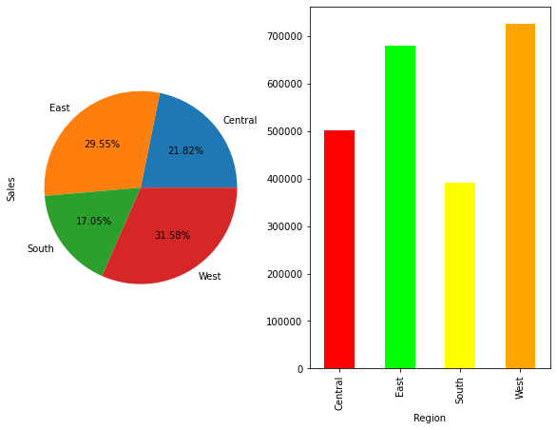
SALES WITH RESPECT TO REGION
WEST REGION HAS HIGHEST SALES,FOLLOWED CLOSELY BY EAST REGION
SOUTH REGION HAS LOWEST SALES

Slide 4

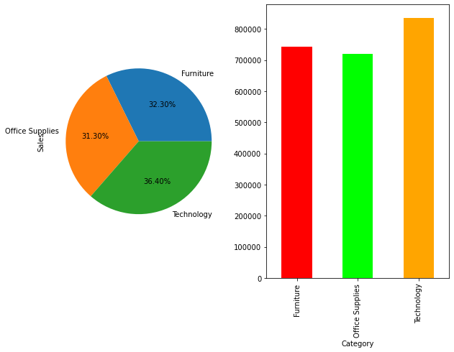
SALES WITH RESPECT TO CATEGORY
Technology has the highest sales
Office supplies has lowest sales

Slide 5
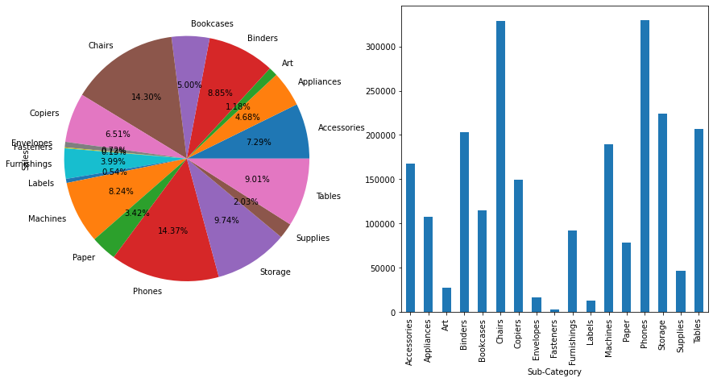
SALES WITH RESPECT TO SUB-CATEGORY
Phones and Chairs have highest Sales
Fasteners and Labels have lowest Sales

Slide 6
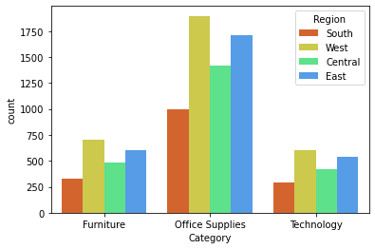
Every product category is most popular in the West Region and least popular in the South region

Slide 7
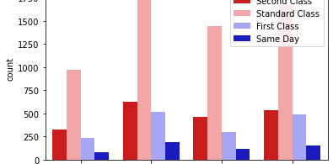
Ship-Mode with respect to Region
In every region Standard Class ship mode is most popular
Delivery on same day is least popular in every region

Slide 8
APPLYING TIME-SERIES MODELLING
To forecast furniture sales of a certain store we need to do time series analysis
Time series Analysis is a method of analyzing a collection of data points over a period of time
Time series analysis is used in Rainfall measurements, Temperature forecast, Sales forecasts.

Slide 9
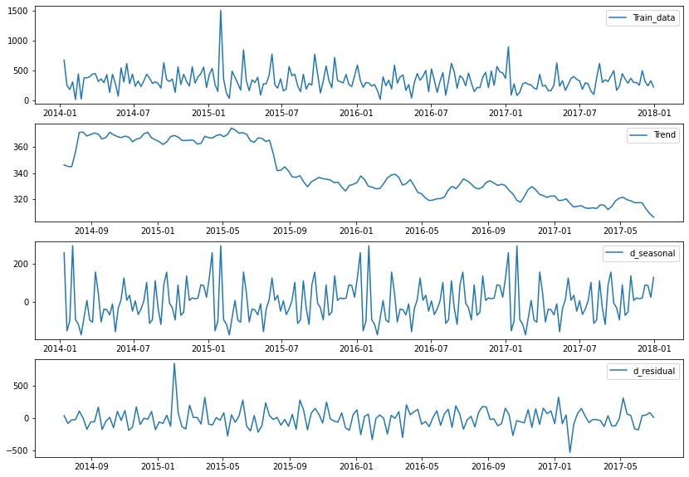
Checking Time-Series Components
the second graph shows there is a linear negative(downward) trend in the data
the third graph shows there is seasonality as a specific pattern is repeating at specific intervals fourth graph shows there is presence of irregularities(residuals) in the data

Slide 10
Checking Stationarity of The Data
Augmented-Dickey Fuller test is used to test whether the data is stationary or not
If the data is stationary we can proceed for model building

Slide 11
Checking Auto Correlation/Partial Auto Correlation
Auto-Correlation and partial autocorrelation are measures of association between current and past series values and indicate which past series values are most useful in predicting future values
From partial autocorrelation we get value of p and from auto correlation graph we get value of q.
p and q are parameters needed for defining the ARIMA model were p is number of autoregressive terms and q is number of lagged forest errors in the predictive equation

Slide 12
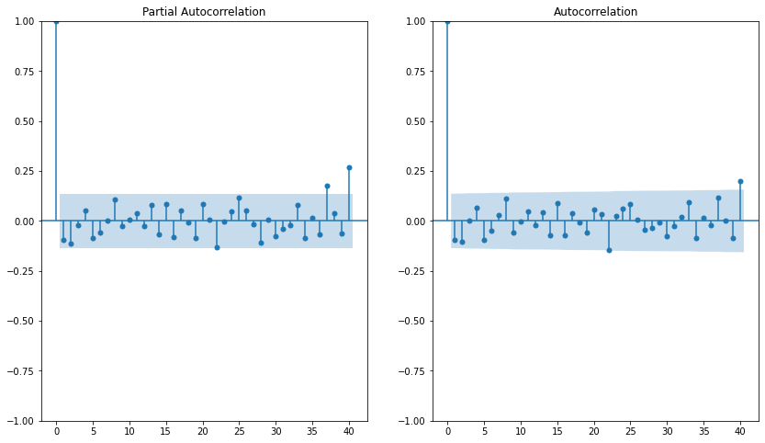
Finding p and q values from ACF/PACF plot
from pacf plot p=3,from acf plot q=2

Slide 13
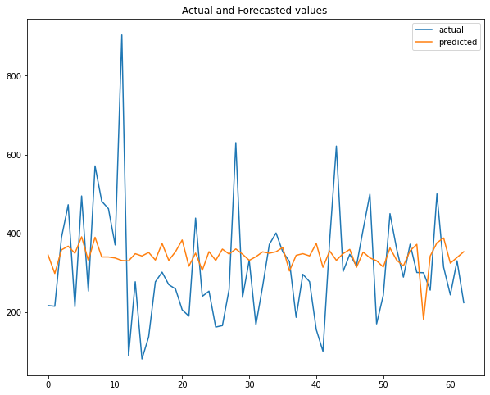
Actual and Forecasted values for ARMA model

Slide 14
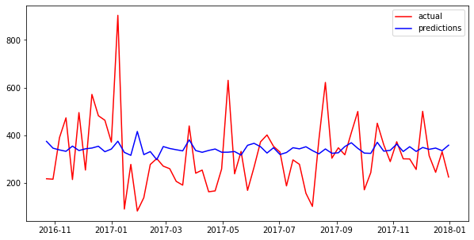
Actual And Forecasted Values for Sarima Model

Slide 15
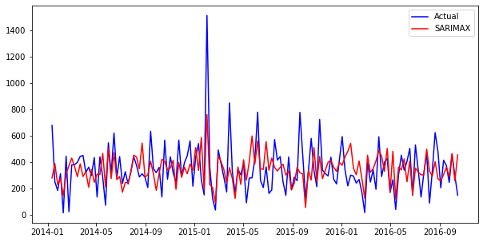
Actual and Forecasted values for SARIMAX model

Slide 16
PERFORMANCES OF THE MODELS
MODEL NAME | AIC | BIC | RMSE
ARMA | 1927 | 1936 | 145
SARIMA | 1941.5 | 1962 | 143
SARIMAX | 1902.08 | 1931 | 146

Slide 17
Choosing of the model
In terms of RMSE value SARIMA model is most appropiate
In terms AIC score SARIMAX model is most appropiate
From the actual value and predicted value plot we can see that sarimax is a better model than sarimax

Slide 18
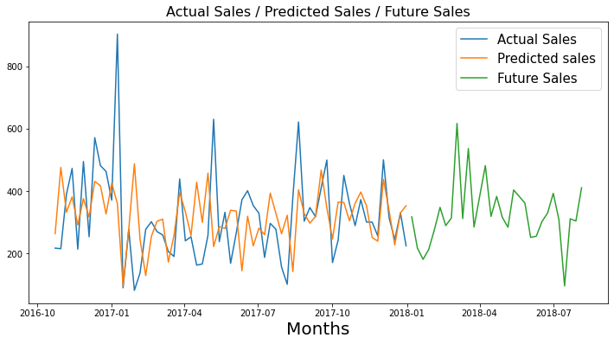
Actual and Forecasted values for SARIMAX model and future sales predictions using Sari-max model

Slide 19
BUSINESS CONCLUSIONS
TIME-SERIES MODELLING CAN BE USED TO PREDICT FUTURE SALES OF A PRODUCT/STORE
BASED ON THE PREDICTION THE SHOP/STORE CAN TAKE THE NECESSARY STEPS

Slide 20


