Slide 1
CREDIT REPAY HACKATHON
Name-Koustav Banerjee

Slide 2
COLUMNS CONSIDERED FOR THE ANALYSIS
AMT_INCOME_TOTAL
CAR
HOUSE
GENDER
OCCUPATION
NAME_CONTRACT_TYPE
WORK_PHONE
MOBILE_PHONE
DOCUMENTS SUBMITTED
AMT_CREDIT

Slide 3
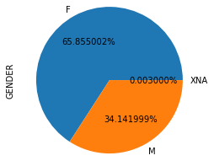
ANALYSIS OF GENDER COLUMN
65.85% OF THE CLIENTS ARE FEMALES AND 34.14% OF THE CLIENTS ARE
MALES

Slide 4
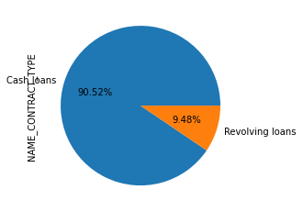
ANALYSIS OF CONTRACT TYPE
90.52% OF CLIENTS HAVE APPLIED FOR CASH LOANS AND 9.48% HAVE APPLIED FOR REVOLVING LOANS

Slide 5
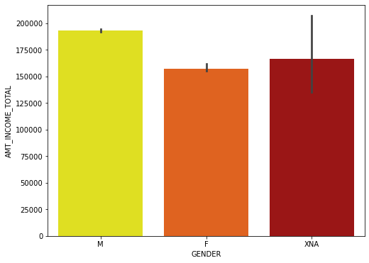
ANALYSIS OF AVERAGE TOTAL INCOME WITH RESPECT TO GENDER
MALES HAVE HIGHER AVERAGE INCOME COMPARED TO FEMALES

Slide 6
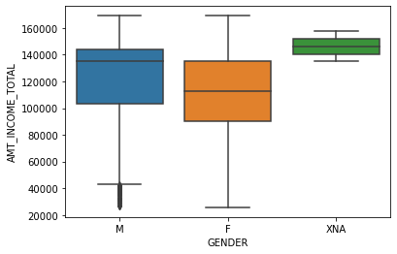
BOXPLOT OF TOTALINCOME WITH RESPECT TO GENDER
MALE CLINETS HAVE A BETTER SPREAD THAN FEMALE CLIENTS

Slide 7
From the box plot we can see that Male have a better spread of total income than females
Males have more income than females,those who have more income can have a chance to repay
So we can say male clients have a better chance to repay loan than female clients

Slide 8
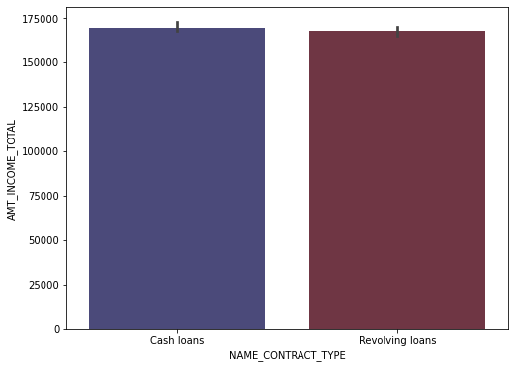
MEAN TOTAL INCOME WITH RESPECT TO TYPE OF CONTRACT
Cash Loans and Revolving Loans have almost same Mean Total Income
,Cash Loans have a bit higher Mean Total Income

Slide 9
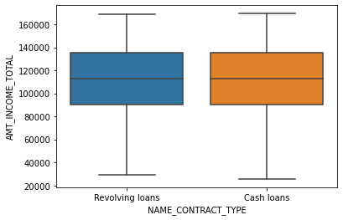
BOXPLOT OF TOTAL INCOME WITH RSPECT TO CONTRACT TYPE
CASH LOANS HAVE A BIT OF BETTER SPREAD OF TOTAL INCOME THAN REVOLVING LOANS

Slide 10
From the box plot and barplot we can say that Cash Loans have a better spread of total amount than revolving Loans
So we can say that those who have taken Cash Loans have better chances of repaying the Loan than those who have revolving loans

Slide 11
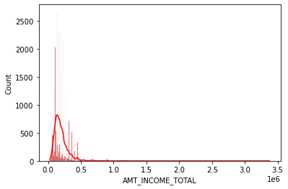
HISTOGRAM OF TOTAL INCOME OF CLIENTS WHO HAVE BOTH HOUSES AND CARS

Slide 12
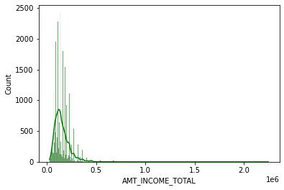
HISTOGRAM OF TOTAL INCOME OF CLIENTSWHO DON’T HAVE CAR AND HOUSE

Slide 13
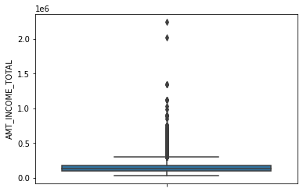
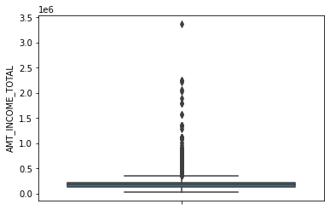
THE LEFT BOX PLOT IS FOR TOTAL INCOME OF THOSE CLIENTS WHO DONT HAVE CARS AND HOUSES AND THE RIGHT SIDE BOX PLOT IS FOR CLIENTS WHO HAVE CARS
AND HOUSES

Slide 14
From the two histogram and box plots of total income of clients with houses and cars and clients without houses and cars we can say that clients with houses and cars have better income than those who dont have houses and cars as total income of clients with houses and cars have better spread than total income of clients without cars and houses
So clients with houses and cars have more chances of repaying their loans than those who dont have houses and cars
Also those who have houses and cars the bank they can be better suited to give loans than those who dont have cars and housesbecause in that case bank can mortgadge their property temporarily if they dont keep onrepaying their loan

Slide 15
From the two histogram and box plots of total costs of clients with houses and cars and clients without houses and cars
#from this we can say that clients with houses and cars have better income than those who dont have houses and cars.
so clients with houses and cars have more chances of repaying their loans than those who dont have houses and cars
also those who have houses and cars the bank they can be better suited to give loans than those who dont have cars and houses
thats because in that case bank can mortgadge their property temporarily if they dont keep onrepaying their loan

Slide 16
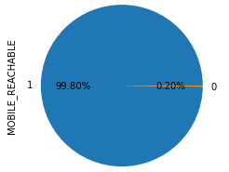
ANALYSIS OF REACHABLE MOBILE PHONES
99.8% of clients are reachable through their mobile,and 0.2% arent rechable through their mobile

Slide 17
Before approving the loan the bank must ensure that clients are reachable through their mobiles,as they can be contacted by the bank whenever required by the bank
Its very important for the bank to ensure that they have important contact details of th client and are able to contact the bank

Slide 18
MOBILE REACHABLE | MOBILE UNREACHABLE
99798 | 1

Slide 19
except 1 client every client have provided their mobile numbers and have reachable mobile numbers
bank should consider giving loan to those clients who have given mobile numbers and have a reachable mobile number

Slide 20
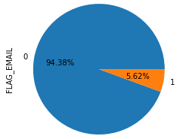
ANALYSIS OF CUSTOMERS WHO HAVE GIVEN THEIR EMAIL_ID
94.38% OF CLIENTS HAVENT GIVEN EMIAL AND 5.62% HAVE GIVEN EMAIL

Slide 21
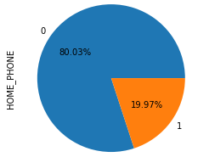
ANALYSIS OF CLIENTS WHO HAVE GIVEN THEIR HOME PHONE NUMBER
80% of clients havent given home phone number and 20% have given home phone number

Slide 22
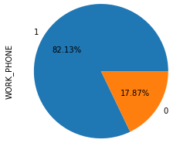
ANALYSIS OF WORKPLACE PHONE NUMBER OF CLIENTS
82.13% of Clients have given workplace phone number and 17.87% havent given their workplace number to the bank

Slide 23
While approving Loans the bank should make sure they have proper contact details of the client to contact them when they feel necessary,so lets check how many clients have given their mobile number, workplace number,email
Since many customers havent given email as lot of people may not use that and home phone number so we should make sure we have their other contact details like workplace number,mobile number

Slide 24
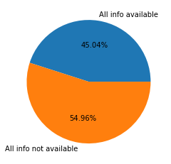
Clients WHO HAVE GIVEN WORKPLACENUMBER MOBILE NUMBER AND HAVE REACHABLE MOBILE NUMBER
45.04% CLIENTS HAVE GIVEN ALL THE IMPORTANT CONTACT DETAILS AND 54.96% CLIENTS HAVENT GIVEN IMPORTANT CONTACT DETAILS

Slide 25
45% of the clients have all required and important contact details that should be consiered by the bank before approving loan
The conditions are clients who have given mobile number,reachable mobile number and workplace number
These three should definately be considered before approving loans.These clients will have higher probability of getting their loan approval accepted compared to other clients

Slide 26
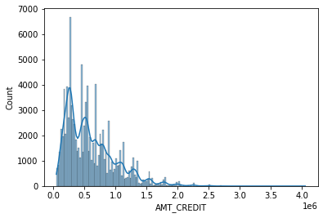
HISTOGRAM OF CREDIT AMOUNT OF CUSTOMERS HAVING CREDIT LIMIT GREATER THAN AVERAGE CREDIT LIMIT

Slide 27
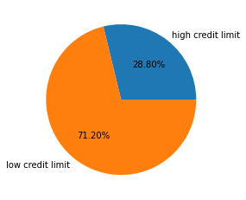
28.8% CLIENT HAVE CREDIT LIMIT > AVERGE CREDIT LIMIT

Slide 28
credit limit means total amount of credit available to a borrower,so those who have high credit limit should get higher chances of their loan being approved by the bank,28.8% of clients have credit limit higher than mean credit limit
bank should focus on giving loans to these clients

Slide 29
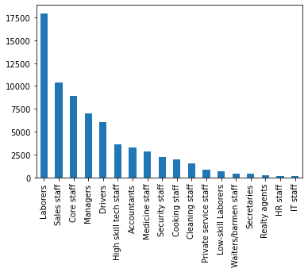
ANALYSIS OF CLIENTS WITH RESPEC TO THEIR OCCUPATION
From this bar graph we can see number of clients from which occupation
Has applied for Loan

Slide 30
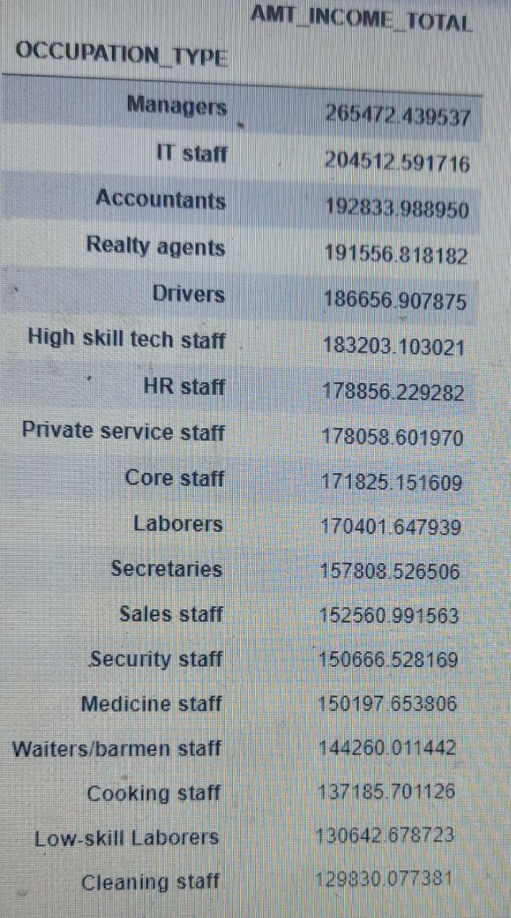
AVERAGE TOTAL INCOME OF CLIENTS BASED ON OCCUPATIONS

Slide 31
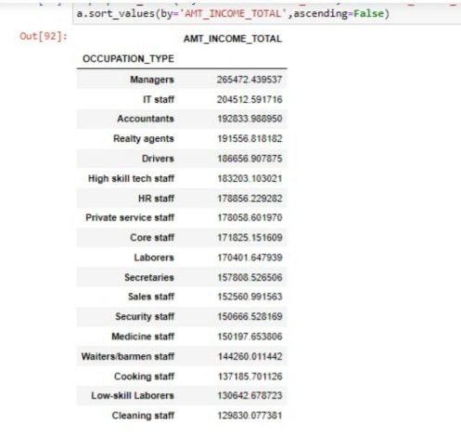

Slide 32
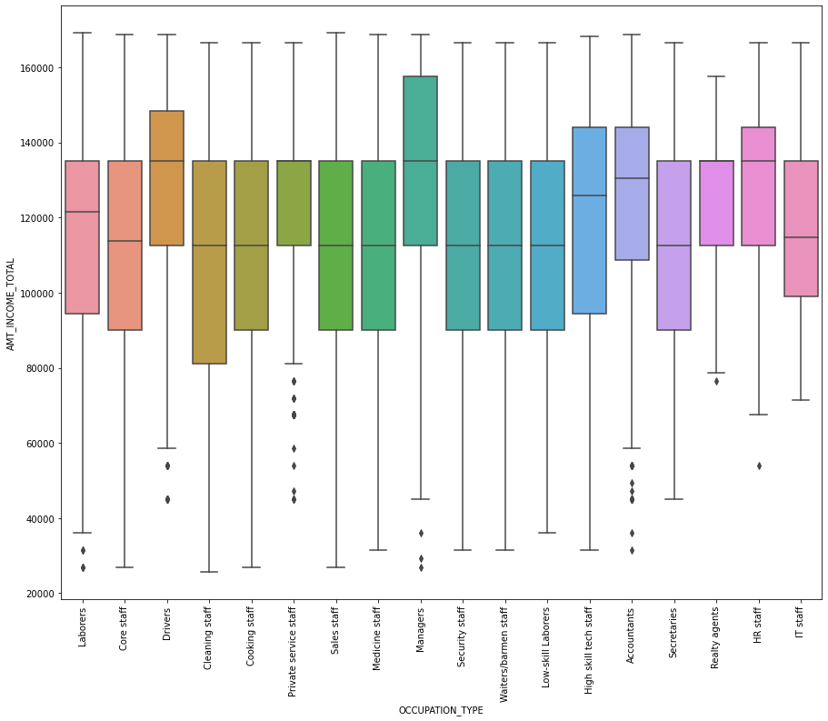
BOX PLOT OF TOTAL INCOME FOR VARIOUS OCCUPATION OF THE CLIENTS

Slide 33
From the boxplot we can see the spread of total amount is best for it staff,HRstaff,Manager ,accountants
From this we can say that people from these occupations should be have more chances of loans getting approved than those coming from other occupations

Slide 34
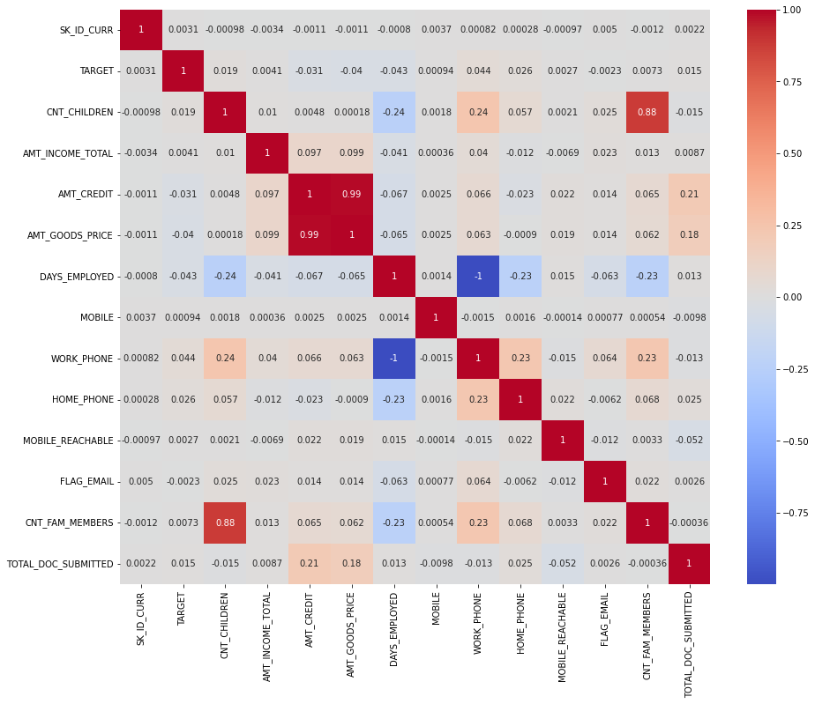

Slide 35
From the above heat map we can check and infer the correlation between all the columns,it helps us to visualize how each column is related with each other

Slide 36
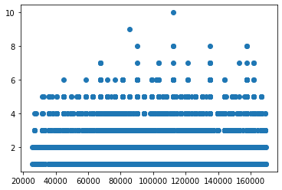

Slide 37
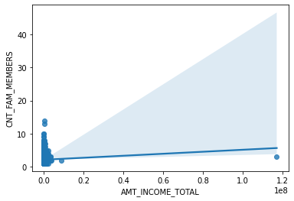
Corelation Coeffiecient=0.01257
From this regression plot we can say that clients with higher number of children can have more income so they
may have a chance of getting loan approved by the bank

Slide 38
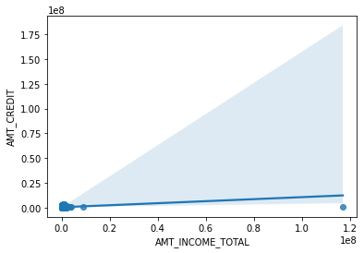
Correlation Coefficient=0.097
From the regression plot we can see that total income has small positive correlation wrt credit amount
more credit amount and more income means banks will give them higher chances of loan approval

Slide 39
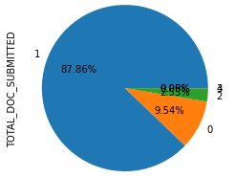
ANALYSIS OF THE NUMBER OF DOCUMENTS SUBMITTED
87.86% OF CLIENT HAVE SUBMITTED 1 DOCUMENT ,9.54% OF CLIENTS HAVE SUBMITTED 0 DOCUMENTS 2.5% CLIENTS HAVE SUBMITTED 2 DOCUMENTS

Slide 40
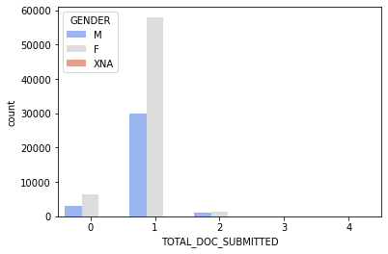
TOTAL DOCUMENTS SUBMITTED BY CLIENTS WITH RESPECT TO GENDER

Slide 41
While accepting loan applications bank should check that clients have given atlaeast 1 document
9.5% Clients havent submitted any documents so bank should considr before approving their loan application

Slide 42
CONCLUSION
For approving Loan Applications it is very important for the bank to check all the details of the client very carefully.
Monthly Income of the client,personal contact details(like phone-number,email),workplace contact details and documents(like salary slip,property details,aadhar card,pan card) should be checked thoroughly and carefully before approving Loans

Slide 43

THANK YOU

