Slide 1
A Project on ANALYSIS OF H1B VISA APPLICANTS
By
Kousthubha JK

Slide 2
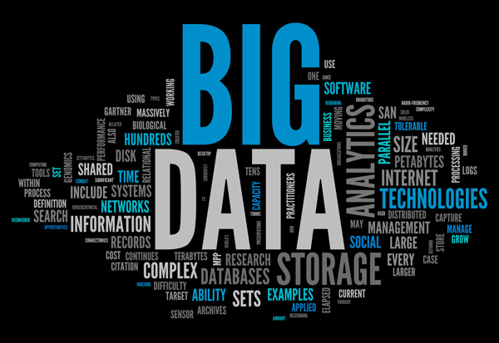

Slide 3
What is BigDATA
Big data is a term for data sets that are so large or complex that traditional data processing application software is inadequate to deal with them. Challenges include capture, storage, analysis, data curation, search, sharing, transfer, visualization, querying, updating and information privacy.

Slide 4
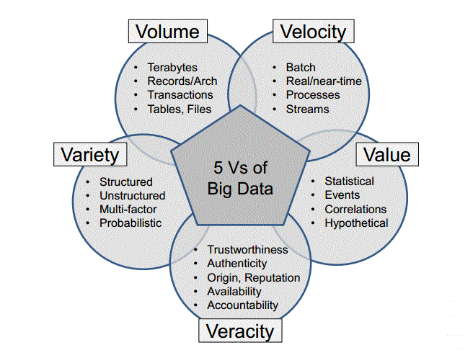

Slide 5
How big is ‘Big Data’?
Every day, we create 2.5 quintillion bytes of data – so much, that 90% of data in the world today has been created in the last two years alone.
When data sets get so big that they cannot be analysed by traditional data processing application tools, it becomes known as ‘Big Data’.
As different companies have varied ceilings on how much data they can handle, depending on their database management tools, there is no set level where data becomes ‘big’.
This means that Big Data and analytics tend to go hand-in-hand, as without being able to analyse the data it becomes meaningless.

Slide 6
Benefits of BigData
Identifying the root causes of failures and issues in real time
Fully understanding the potential of data-driven marketing
Generating customer offers based on their buying habits
Improving customer engagement and increasing customer loyalty
Reevaluating risk portfolios quickly
Personalizing the customer experience
Adding value to online and offline customer interactions

Slide 7
What is Hadoop?
Hadoop is an open-source software framework for storing data and running applications on clusters of commodity hardware. It provides massive storage for any kind of data, enormous processing power and the ability to handle virtually limitless concurrent tasks or jobs.

Slide 8
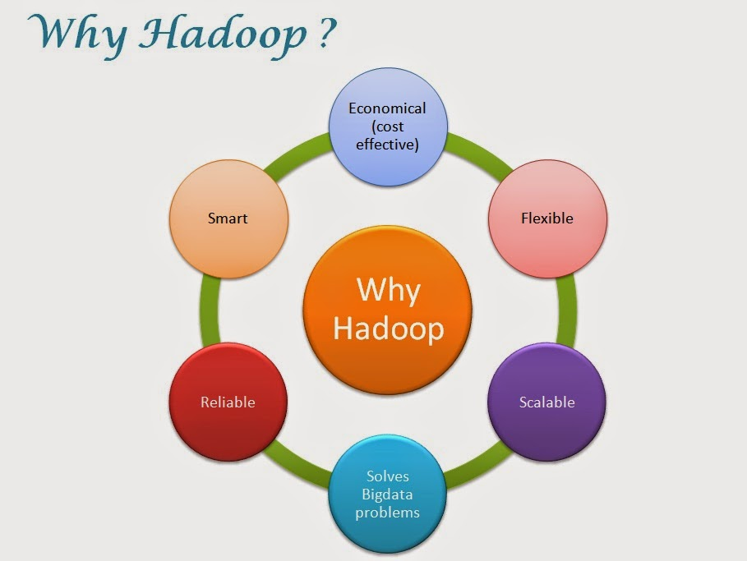

Slide 9
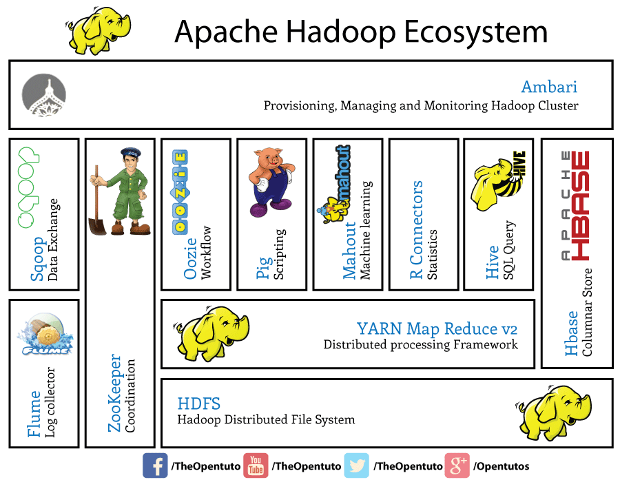

Slide 10
HDFS
Hadoop comes with a distributed filesystem called HDFS, which stands for Hadoop Distributed Filesystem.
Filesystems that manage the storage across a network of machines are called distributed filesystems.
HDFS, the Hadoop Distributed File System, is a distributed file system designed to hold very large amounts of data (terabytes or even petabytes), and provide high-throughput access to this information.

Slide 11
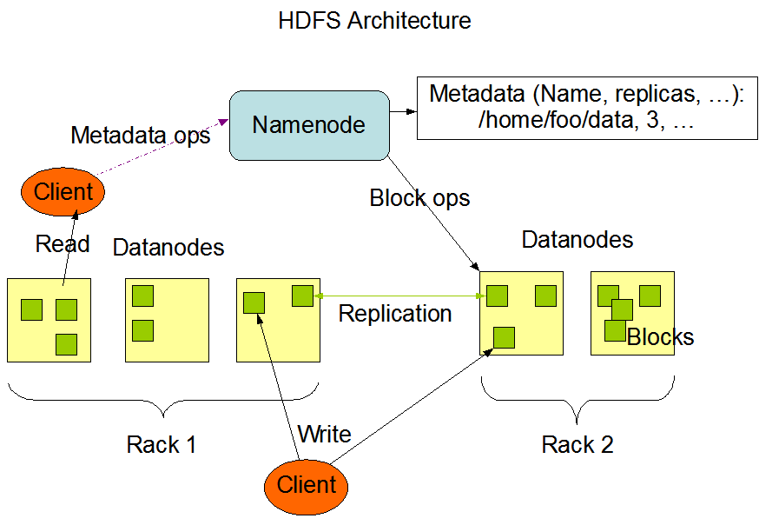

Slide 12
What is MapReduce?
MapReduce is a programming model
Programs written in this functional style are automatically parallelized and executed on a large cluster of commodity machines.
MapReduce is an associated implementation for processing and generating large data sets.

Slide 13

What is Hive?
Hive is a data warehouse infrastructure tool to process structured data in Hadoop.
It resides on top of Hadoop to summarize Big Data, and makes querying and analyzing easy.
Initially Hive was developed by Facebook, later the Apache Software Foundation took it up and developed it further as an open source under the name Apache Hive.

Slide 14

What is Apache Pig?
Pig is a platform for analyzing large data sets that consists of a high-level language for expressing data analysis programs
Pig generates and compiles a Map/Reduce program(s) on the fly.

Slide 15
Project Synopsis
1 a) Is the number of petitions with Data Engineer job title increasing over time?
b) Find top 5 job titles who are having highest growth in applications.
2 a) Which part of the US has the most Data Engineer jobs for each year?
b) Find top 5 locations in the US who have got certified visa for each year.
3)Which industry has the most number of Data Scientist positions?
4)Which top 5 employers file the most petitions each year?
5) Find the most popular top 10 job positions for H1B visa applications for each
year?

Slide 16
6) Find the percentage and the count of each case status on total applications for each year. Create a graph depicting the pattern of All the cases over the period of time.
7) Create a bar graph to depict the number of applications for each year
8) Find the average Prevailing Wage for each Job for each Year (take part time and full time separate)
9) Which are top ten employers who have the highest success rate in petitions?
10) Which are the top 10 job positions which have the highest success rate in petitions?

Slide 17
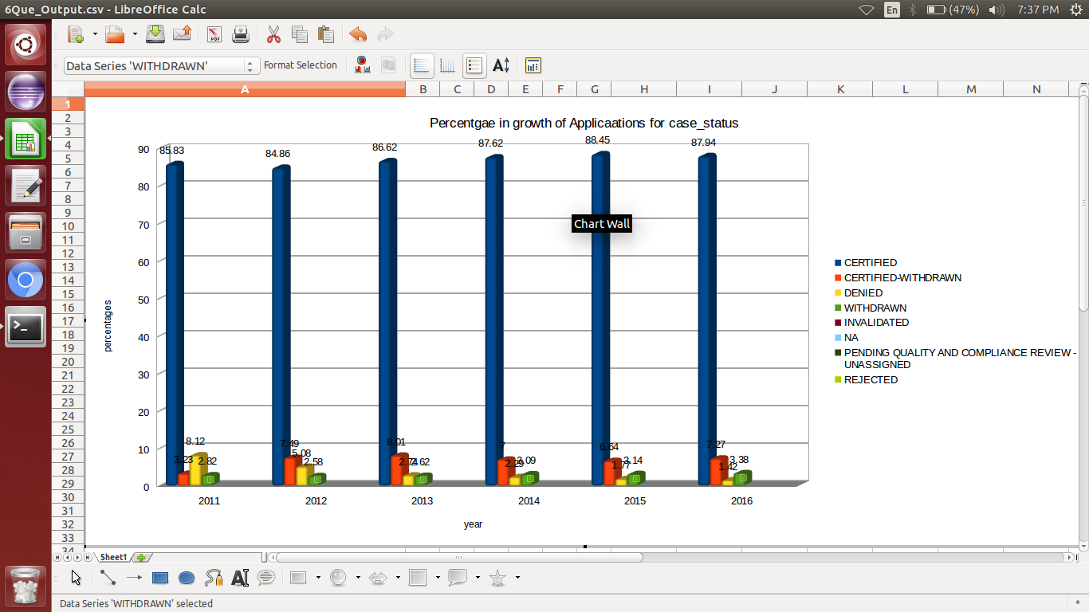

Slide 18
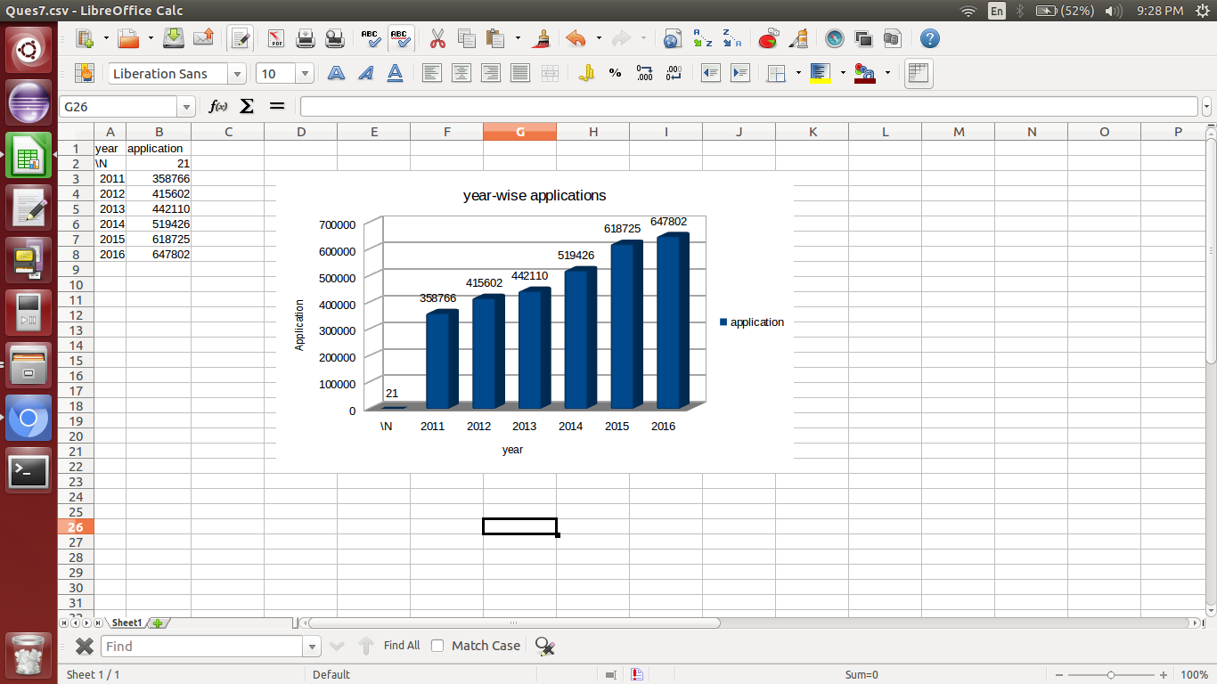

Slide 19


