Slide 1

Comprehensive IPL Match Analysis Using Historical Data
Under the guidance of
Mr Santosh K Sahu
By
Kedar Mahajan BT23CSA033
Koustubh Gadekar BT23CSA039
Prakhar Kothari BT23CSA052

Slide 2
Project Problem Statement
In-depth IPL Analysis
Pattern Recognition
Utilize detailed historical IPL match data, The project involves analyzing various match-level and ball-by-ball statistics of IPL datasets to uncover trends and insights. This analysis helps understand player performance, team strategies, and overall match dynamics.
Through pattern recognition, the project identifies recurring trends or strategies in IPL matches, such as which players perform best under certain conditions or how teams adjust tactics based on opponent strengths and weaknesses.
Visualization
The project leverages data visualization techniques to present the
analysis results in an easily digestible format, utilizing charts, graphs, and
interactive dashboards to showcase insights into player performances,
match outcomes, and season trends

Slide 3

Applications of the IPL Analysis Project
1.
Team Strategy
Inform tactical decisions from historical data
2.
Fantasy League
Predict player performance for enthusiasts
3.
Broadcast Insights
Data-driven commentary enhancements
4.
Sports Research
Support analytics-driven cricket research

Slide 4
Data Description: IPL Match & Delivery Datasets
Matches Dataset
Deliveries Dataset
ID, City, Date, Season
Innings, overs, ball number
Teams, Venue, Toss Info
Batsman, bowler, non-striker
SuperOver, Winners, Margin, Player of Match
Runs, extras, wickets, fielders involved
Umpires and Player lists
Batting team, dismissal details

Slide 5





Data Preprocessing and Feature Engineering
Cleaning
Handled NaNs, typos, consistent team & venue names
Exclusions
Dropped 'No Result' matches and deliveries
Standardization
Date formats and venue naming fixed
Feature Engineering
WonByWickets
WonByRuns

Slide 6
Exploratory Data Analysis Highlights
Seasons by match count
Highest runs by player
Top winning teams
Leading wicket-takers
Toss decisions & success rates
Super Over occurrence stats
Venue-wise match distribution

Slide 7
Key Conclusions from IPL Analysis
1.
Toss Influence
2.
Dominant Players
3.
Match Trends
Significant in specific venues,
depending on pitch and size of stadium
Consistent performers across seasons, strike rate of top batsman
Highest targets, most dot balls,
innings stats differences
4.
Excitement Factors
5.
Venue & Team Impact
6.
Distribution of runs
and wickets
throughout the overs
Super Overs add thrilling moments,
powerful knocks and
deadly best bowling figures
Critical in determining results
Helps understand powerplay and
death overs planning and strategies

Slide 8
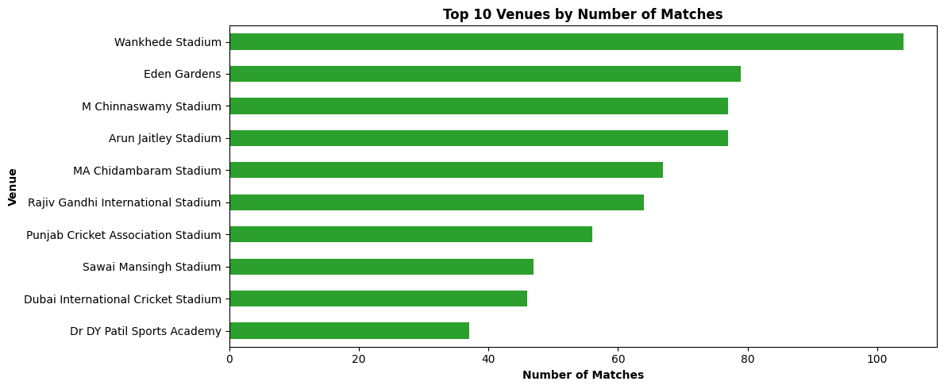
Q1. Which venue has hosted the most number of matches in IPL history?

Slide 9
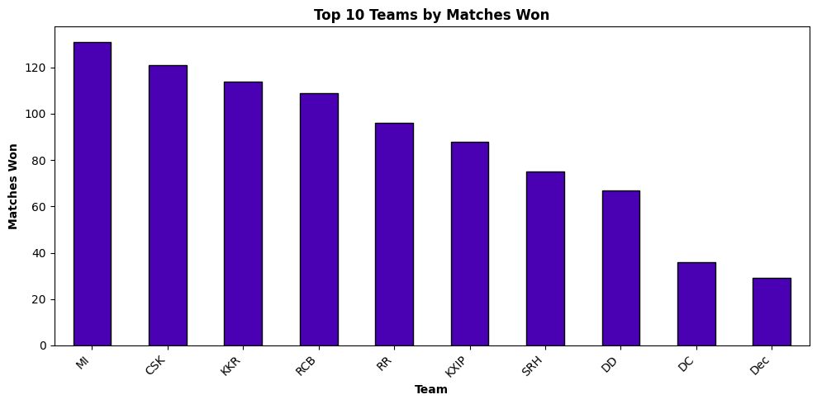
Q2. Which team has won the most number of matches in IPL history?

Slide 10
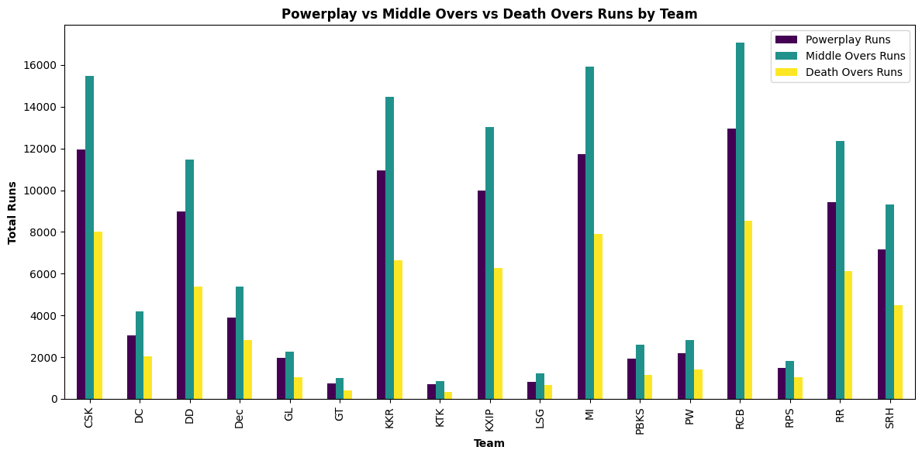
Q3. What is the distribution of runs scored by each team across the Powerplay, Middle Overs, and Death Overs in the IPL?

Slide 11
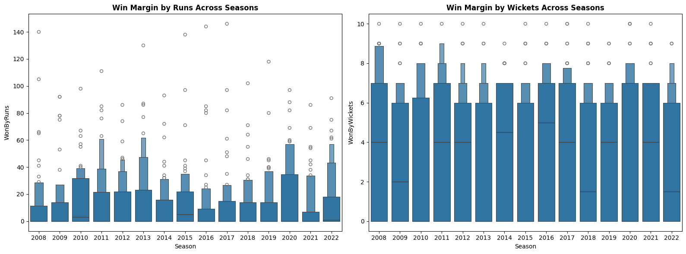
Q4. what is the winning margin of across the season?

Slide 12
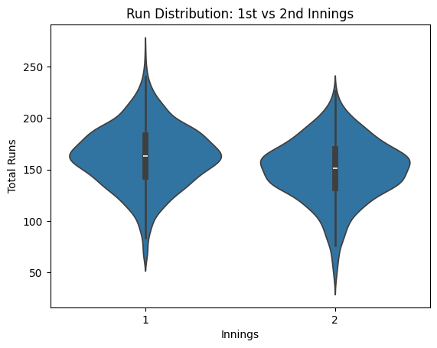
Q5. What is the difference in run scored in first and second graphs

Slide 13
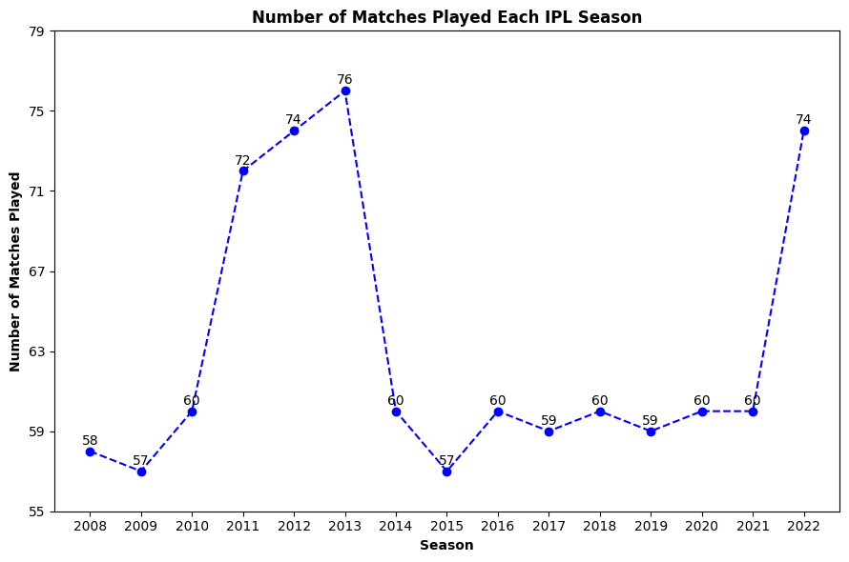
Q6. How many matches are played in each season of ipl?

Slide 14
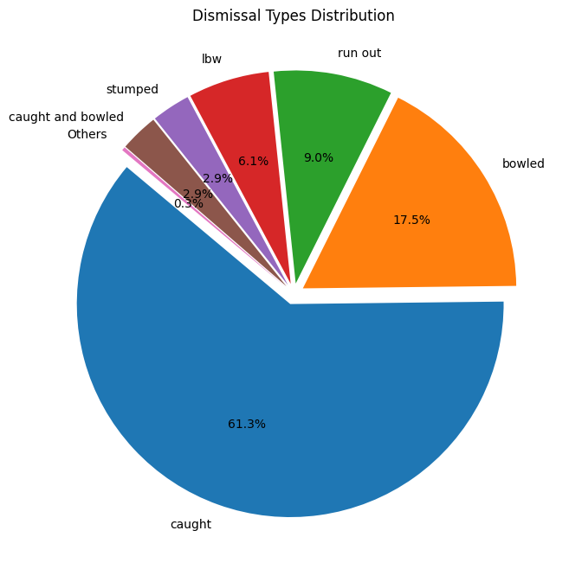
Q7. What is the distribution of different types of dismissals in the IPL?

Slide 15
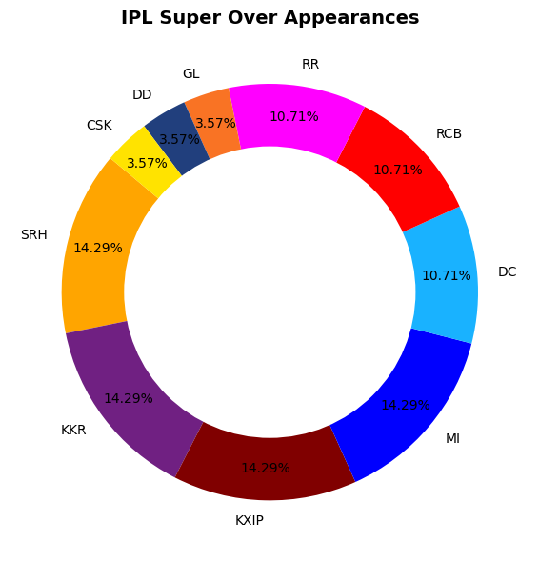
Q8. How many times each team have appeared in superover ?

Slide 16
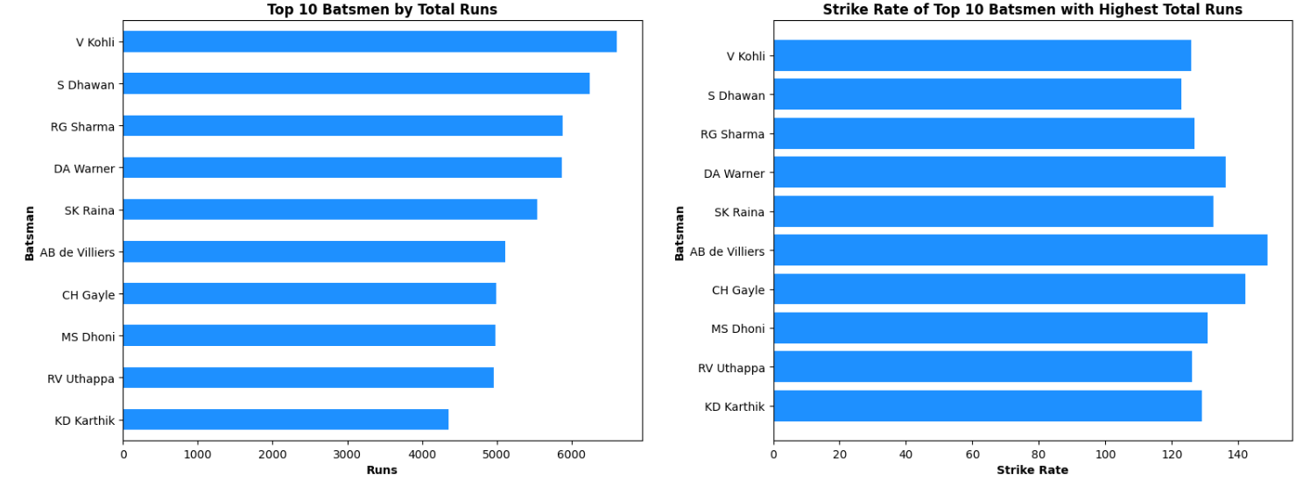
Q9. Who are the top 10 run scorers and their strike rates ?

Slide 17
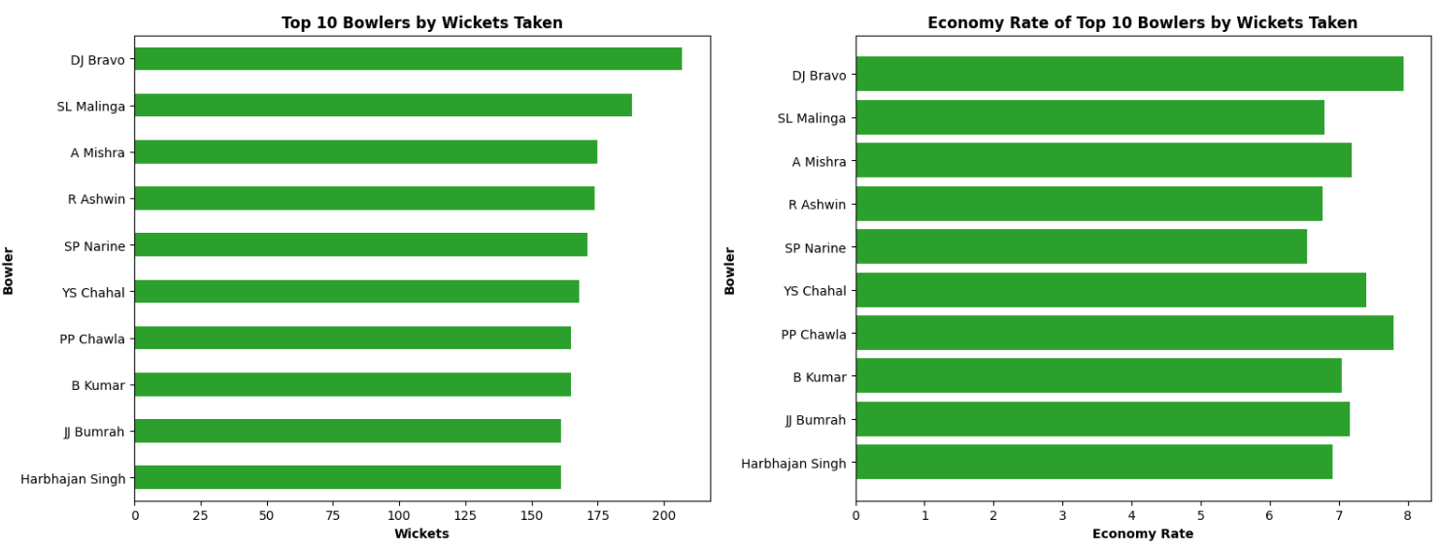
Q10. Who are the top 10 wicket takers and their economy rates?

Slide 18
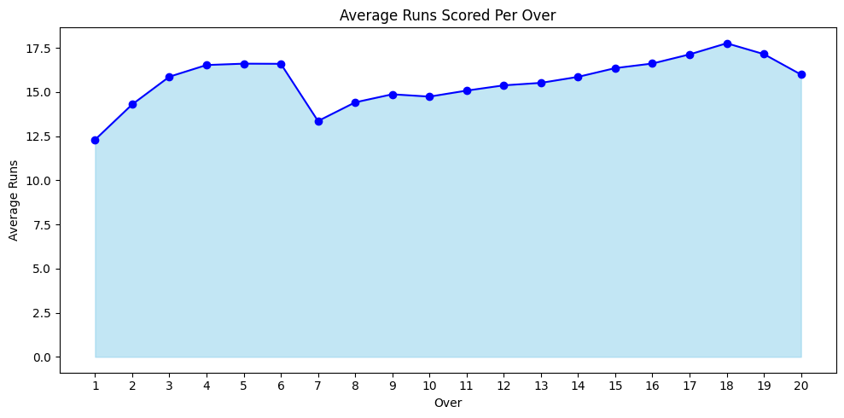
Q11. What is average runs scored in every over in IPL?

Slide 19
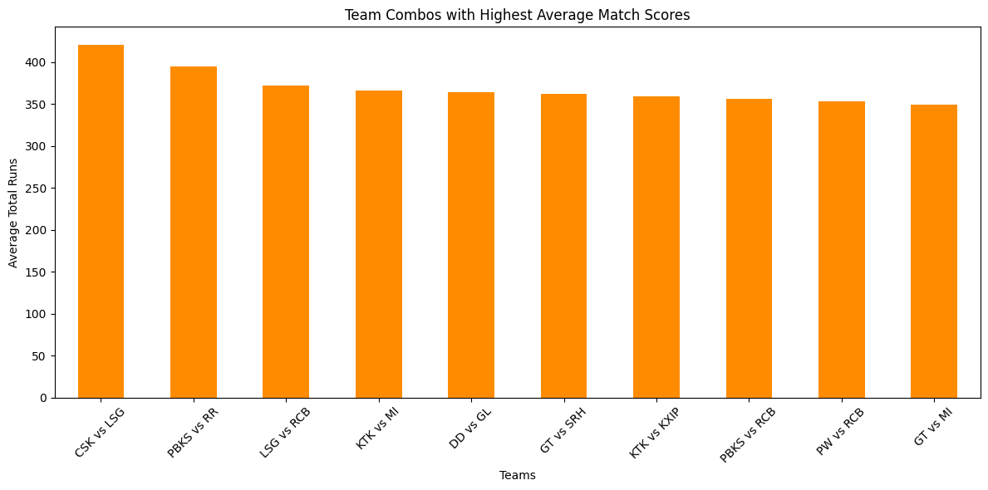
Q12. Which team combo gives highest scoring matches?

Slide 20
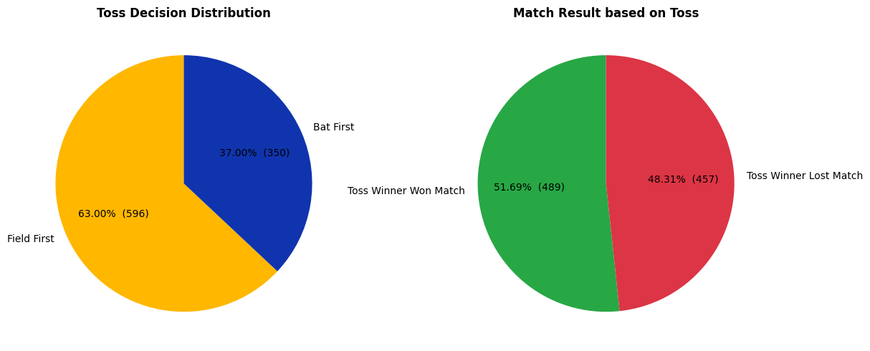
Q13 How much toss affected the result of the game?

Slide 21
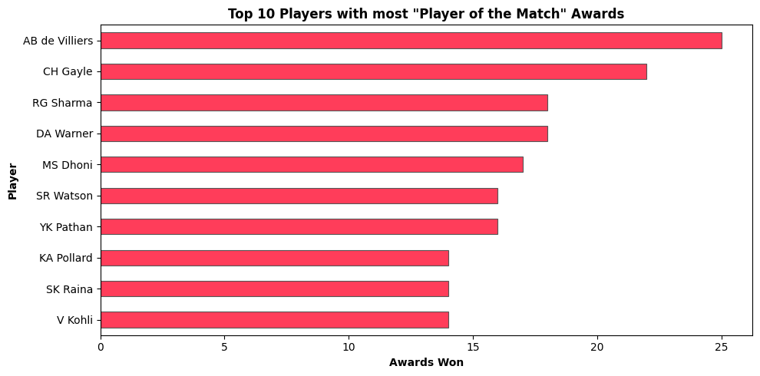
Q14. Who has won the most number of player of the match?

Slide 22
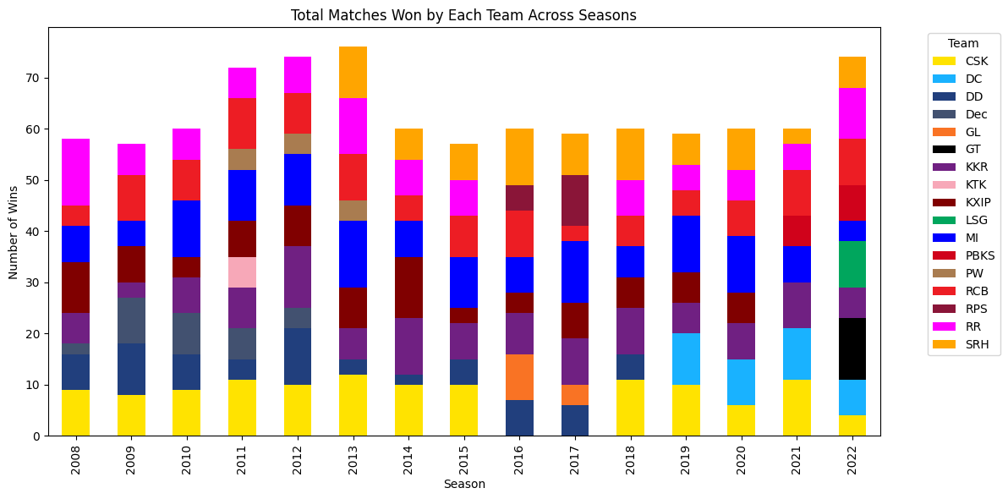
Q15. What is the win distribution of teams over the years?

Slide 23
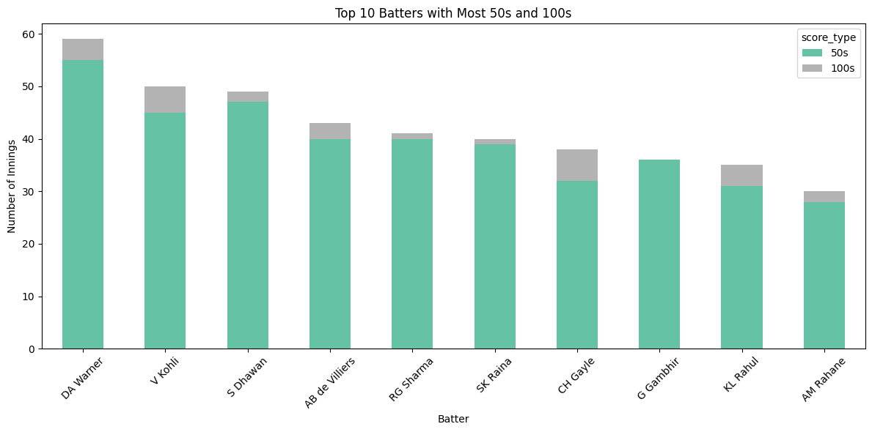
Q16. Who has scored most half centuries and centuries, show its distribution.

Slide 24
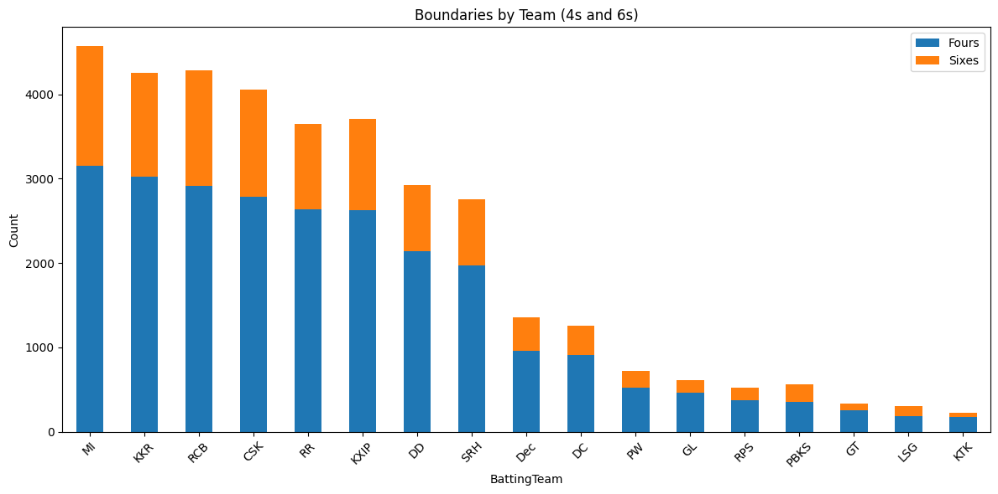
Q17. How many boundaries did each team scored?

Slide 25
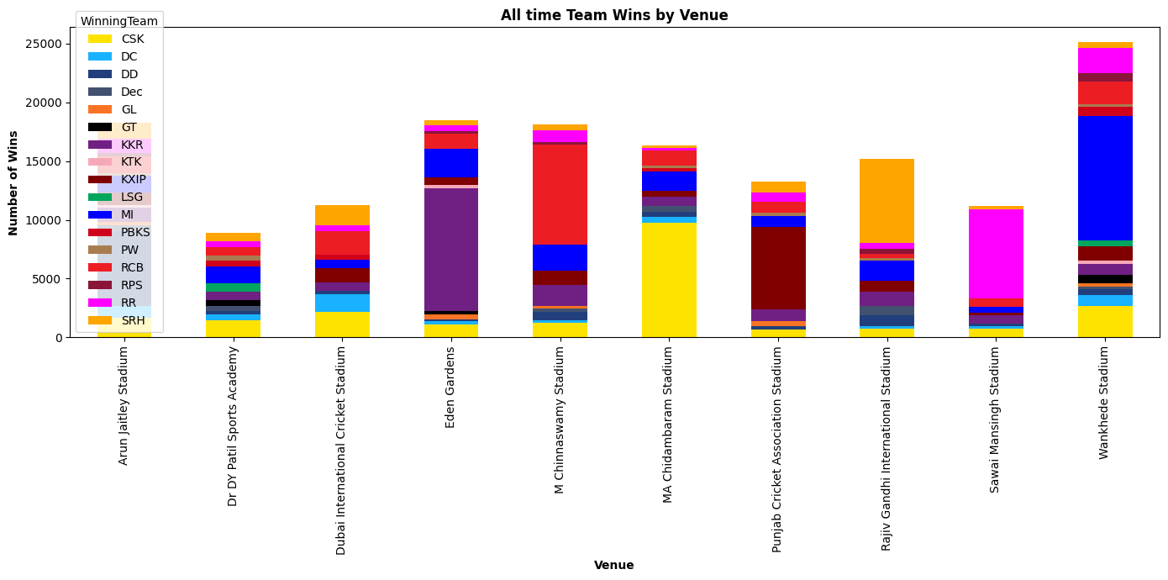
Q18. How many matches did each team win on most played stadiums?

Slide 26
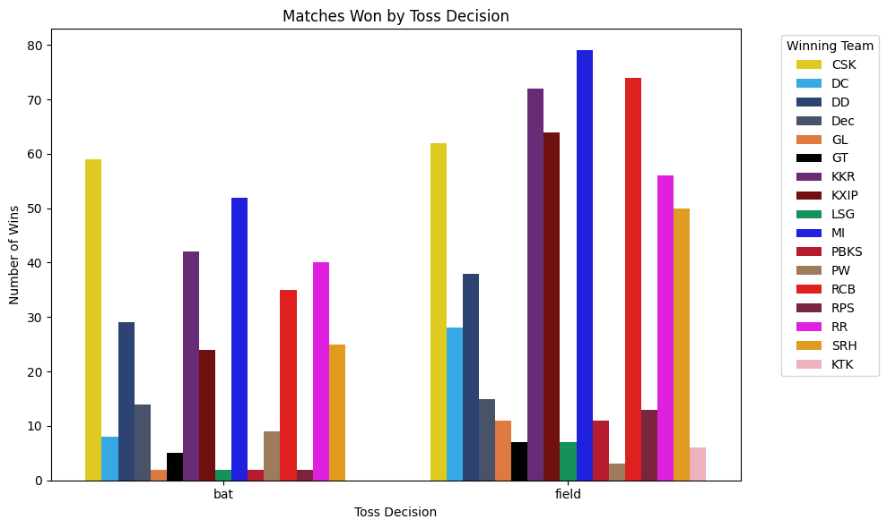
Q19. After winning the toss, how many matches did each team win?

Slide 27
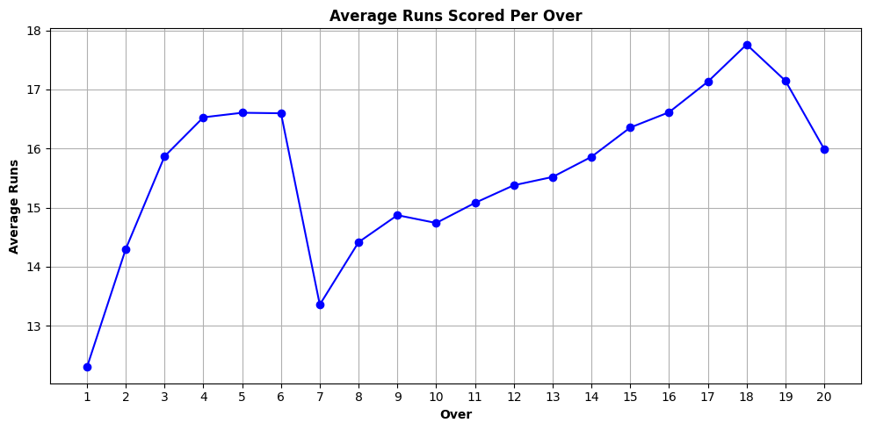
Q20. On an average how many runs are scored throughout the overs

Slide 28
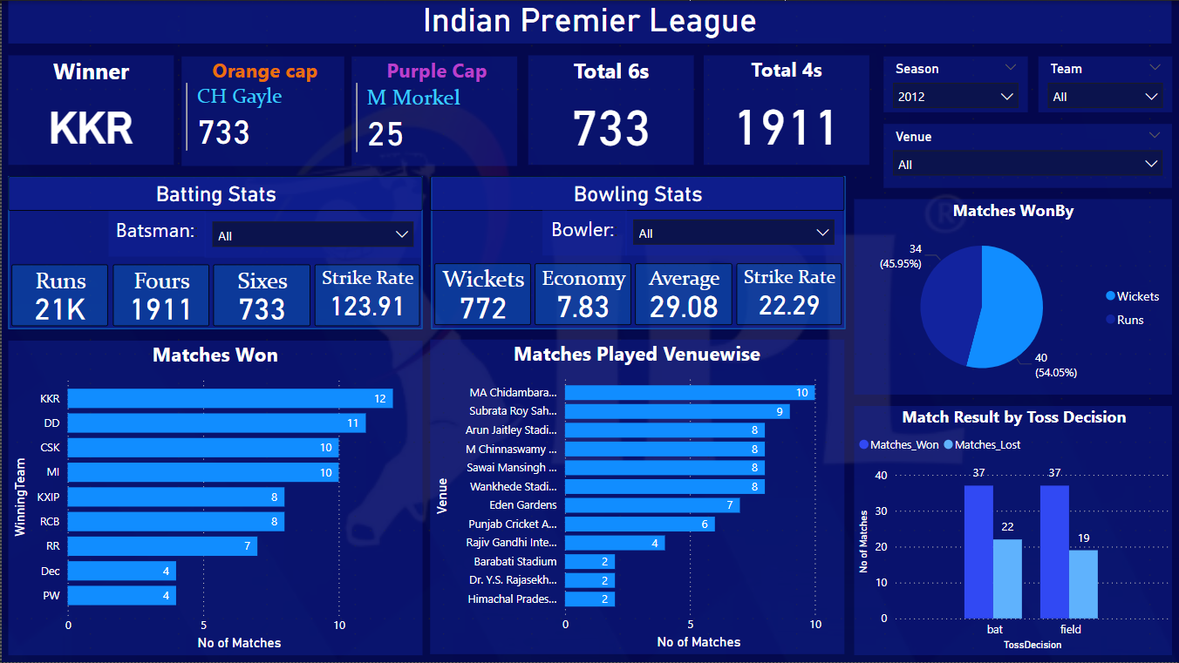
DASHBOARD 1

Slide 29
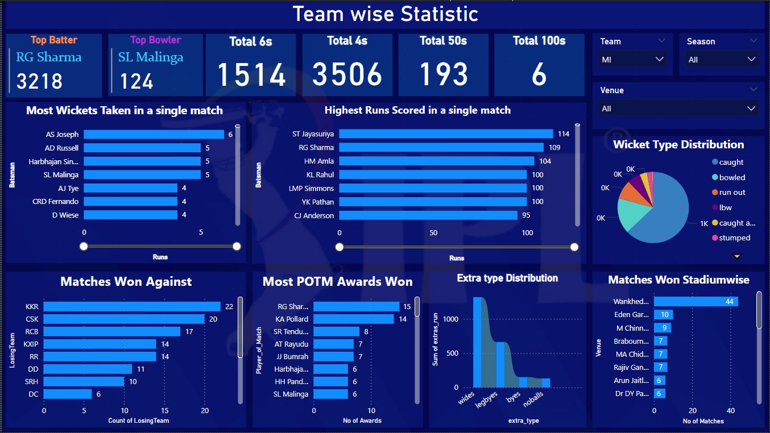
DASHBOARD 2
Q20. On an average how many runs are scored throughout the overs

Slide 30
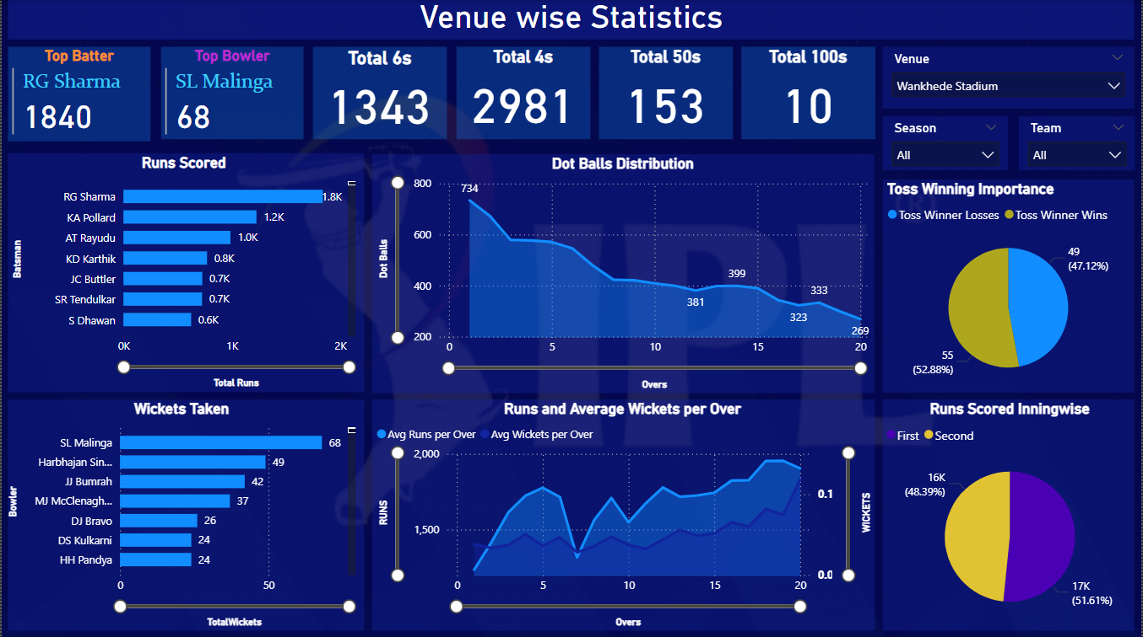
DASHBOARD 3

Slide 31
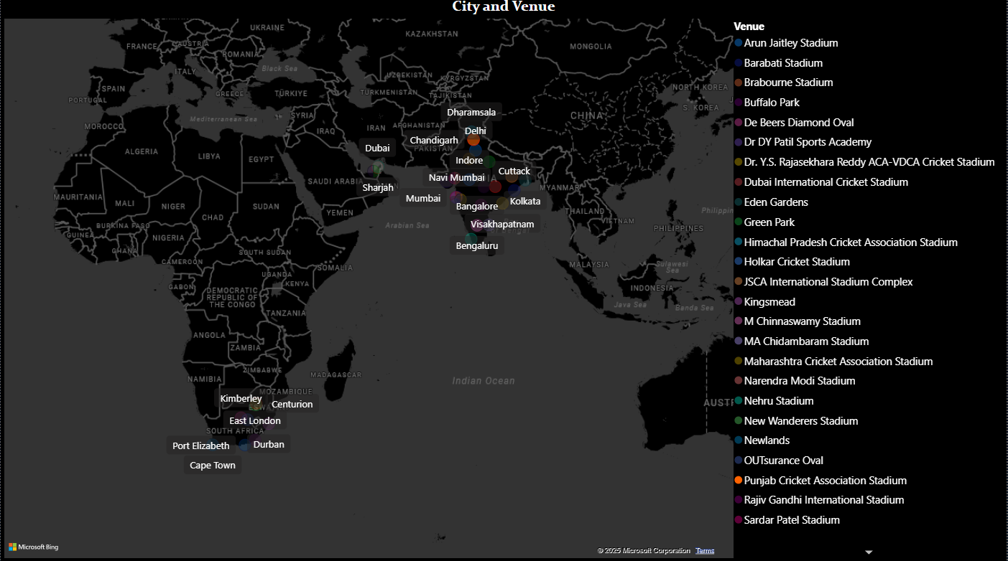
DASHBOARD 4 for Venue Filtering

