Slide 1

Housing Price Prediction Using Machine Learning
Guided by: Prof.S.A. Thorat

Slide 2
Presented BY:
Dnyanesh Ramesh Kulkarni (1801039)
Koustubh Rajendra Bhushinge(1803054)
Rajat Parmeshwar Halkude(1803056)
Prajwal Annasaheb Ghogare(1804064)
Pratik Pravin Gaikwad(1803062)

Slide 3
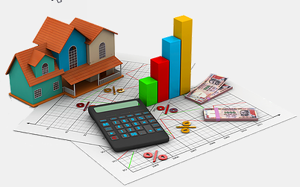
OUTLINE:
Introduction and Motivation
Data Source
Proposed Architecture
Model Demonstration
Testing the model
Results and Discussion
Conclusion and Future Scope
References

Slide 4
INTRODUCTION AND MOTIVATION:
Traditional models for processing and analysing housing data have helped us in all these years.
Bur modern techworthy race makes us liable to keep up with the competition in all sectors, traditional or not.
Because of these new circumstances, traditional data processing and analytical tools may not be able to capture, process and analyse highly complex information in the social and economic worlds.

Slide 5
Also, existing literature in this secors proved to be a prime motivator for this project.
Support Vector Machine (SVM) -Vapnik (1995)
- Foundation
-SVM can provide non linear transformation.
- Those separating planes should have a maximal margin to contain all the points with a very small error, and to provide spaces for new coming data
Rafiei and Adeli (2016) have used SVR to determine decisions regarding property developers.
-350 condos in Tehran
-26 models
- Prediction loss error=3.6%

Slide 6

PROBLEM STATEMENT:
Design and implement the digital tool model for prediction of the housing prices and sales cost using machine learning algorithms and existing data by as little as possible or no margin of error.

Slide 7


DATA SOURCE:
KAGGLE
Competition name:
House Prices - Advanced Regression Techniques
Predict sales prices and practice feature engineering, RFs, and gradient boosting

Slide 8
FILE DESCRIPTIONS:
train.csv - the training set
test.csv - the test set
data_description.txt - full description of each column, originally prepared by Dean De Cock but lightly edited to match the column names used here
sample_submission.csv - a benchmark submission from a linear regression on year and month of sale, lot square footage, and number of bedrooms

Slide 9
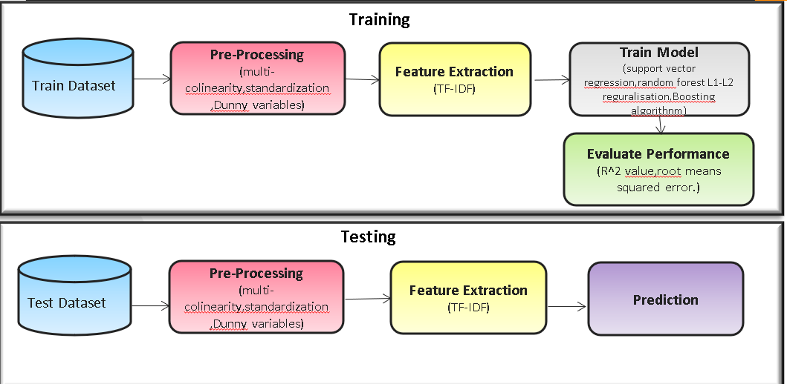
PROPOSED ARCHITECTURE:

Slide 10
VALIDATION : Model Evaluation and Accuracy - RESULTS
Model | RMSE(Logarithmic)
LightGBM | 0.117
XGBoost | 0.12
GradientBoost | 0.118
Random Forest | 0.147
Ridge | 0.113
Lasso | 0.114
Elasticnet | 0.114
Stacking | 0.111

Slide 11
Grapgh:

Slide 12
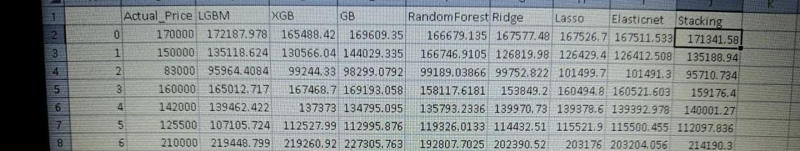
Validation:Prediction

Slide 13
GRAPH:

Slide 14
References:
https://www.kaggle.com/c/house-prices-advanced-regression-techniques/data
https://www.section.io/engineering-education/house-price-prediction/
https://escholarship.org/uc/item/3ft2m7z5
https://blog.hubspot.com/marketing/how-to-build-excel-graph

Slide 15
THANK YOU!!!

