Slide 1




Create Coffee lovers

Slide 2




AGENDA
1
Background
2
Methodology
3
Findings
4
Recommendations
5
Appendix

Slide 3
BACKGROUND

Slide 4
Background
New habit of ordering coffee via e food
GROW CUSTOMER
LOYALTY
Work from home, Socialising during lockdown
Breakfast cuisine generates the most orders within January ’21 (~38%)

Slide 5

Why do we have customer segmentation?
Customer Experience
Brand Loyalty
Competitive Advantage
Personalisation
Segmentation
Data Collection

Slide 6
METHODOLOGY

Slide 7





Methodology
Goal / Objective
Approach
Period
Geography / Location
Data
Create Coffee lovers
Behavioural customer segmentation
Method
K means clustering
January’ 21
All cities excluding Athens & Thessaloniki
Unique users who ordered from Breakfast cuisine
70K
Total number of orders for Breakfast cuisine
150K

Slide 8
Variables / Metrics
Order Value
Frequency
TotalSales (i.e. total basket value)
Avg Order Value (i.e. average basket per order)
Order Count (i.e. total number of orders)

Slide 9
FINDINGS

Slide 10
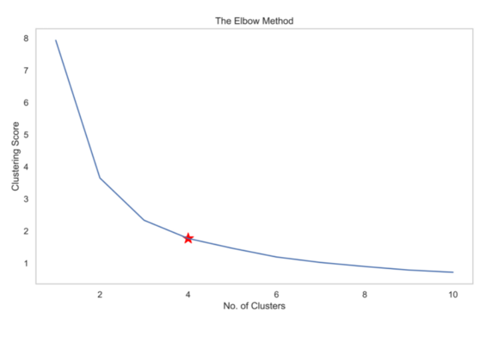
Number of clusters
4
Clusters were chosen
This was considered as the optimal number using the Elbow method

Slide 11
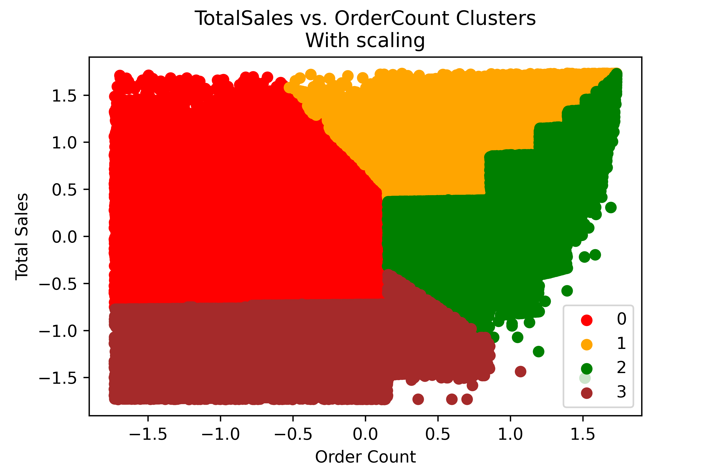
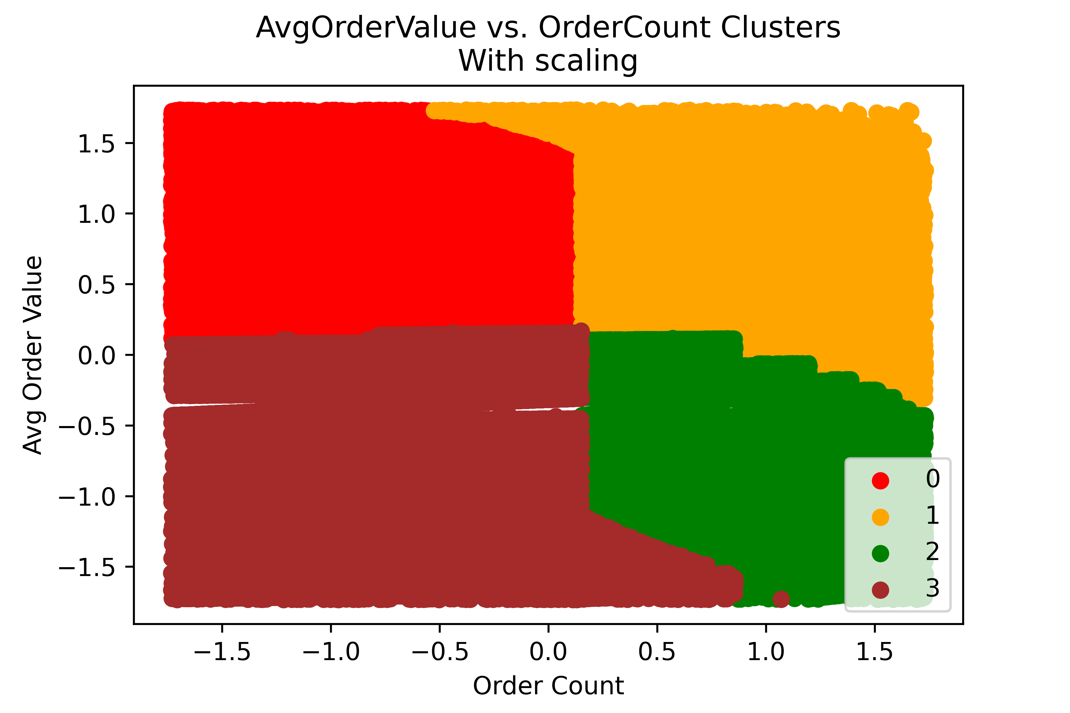
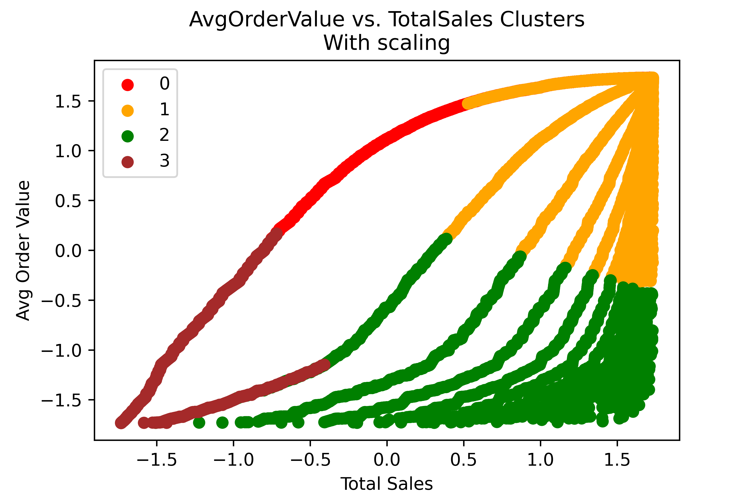
Green and red clusters with the highest opportunity
Opportunity 1
Opportunity 2
High-Low
Red cluster : High total sales value – Low frequency - High average order value
Medium-High
Green cluster: Medium total sales value – High frequency – Low average order value
Low Value
Brown cluster : Low total sales value –Low frequency - Low average order value
High Value
Orange cluster: High total sales value – High frequency - High average order value

Slide 12
RECOMMENDATIONS

Slide 13


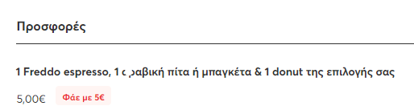
Recommendations
Red cluster
High-Low
Red cluster : High total sales value – Low frequency - High average order value
Green cluster
Medium-High
Green cluster: Medium total sales value – High frequency – Low average order value
Strategy to increase frequency via:
Email reminder
΄΄Μήπως ξέχασες τον καφέ σου σήμερα;¨
Discount code
Strategy to increase value via:
Cross-selling
Up-selling

