Slide 1
Spline tutorial
Suraj Balakrishna
22.05.2020

Slide 2
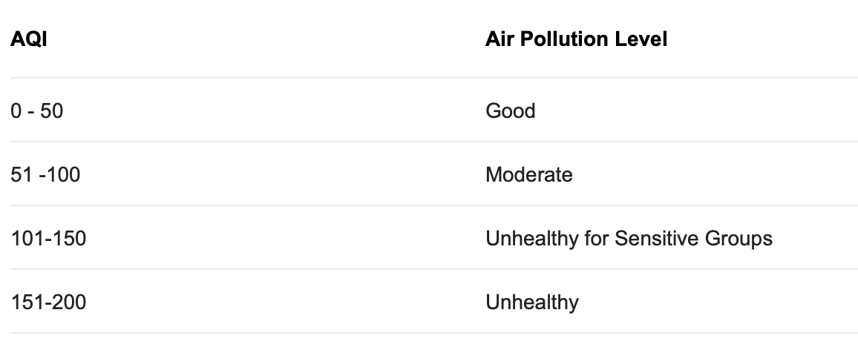
What would you do?
Outcome/Predicted variable: Air quality index as a continuous variable
Independent/predictor variable: Month as a continous variable
Aim: Predict the change in ‘Air quality index’ with respect to ‘Month’

Slide 3
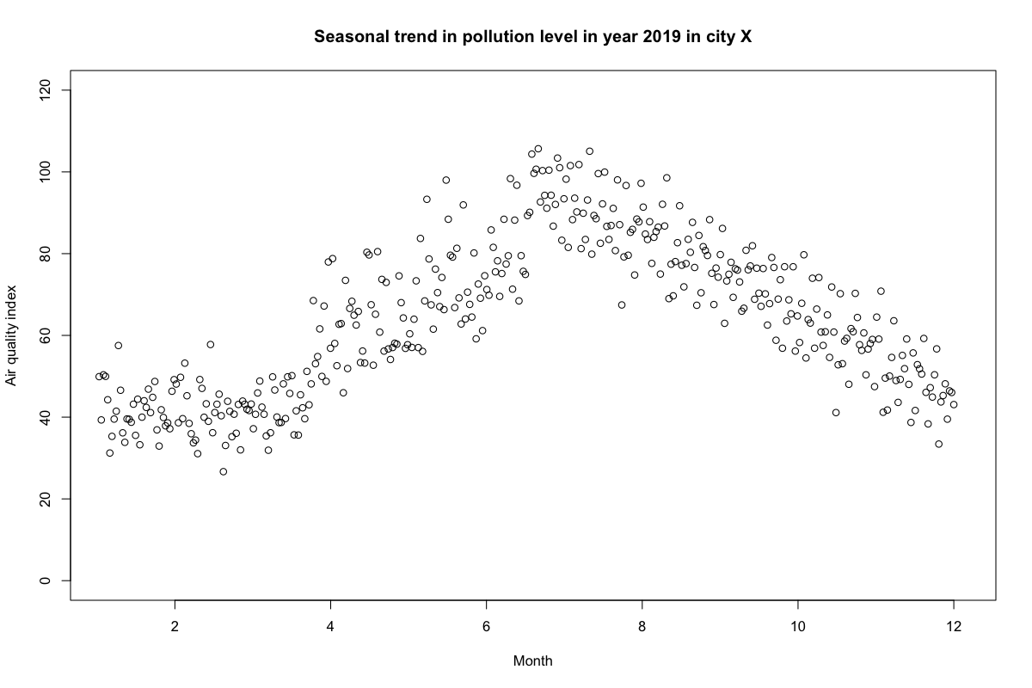
Plot of the data

Slide 4
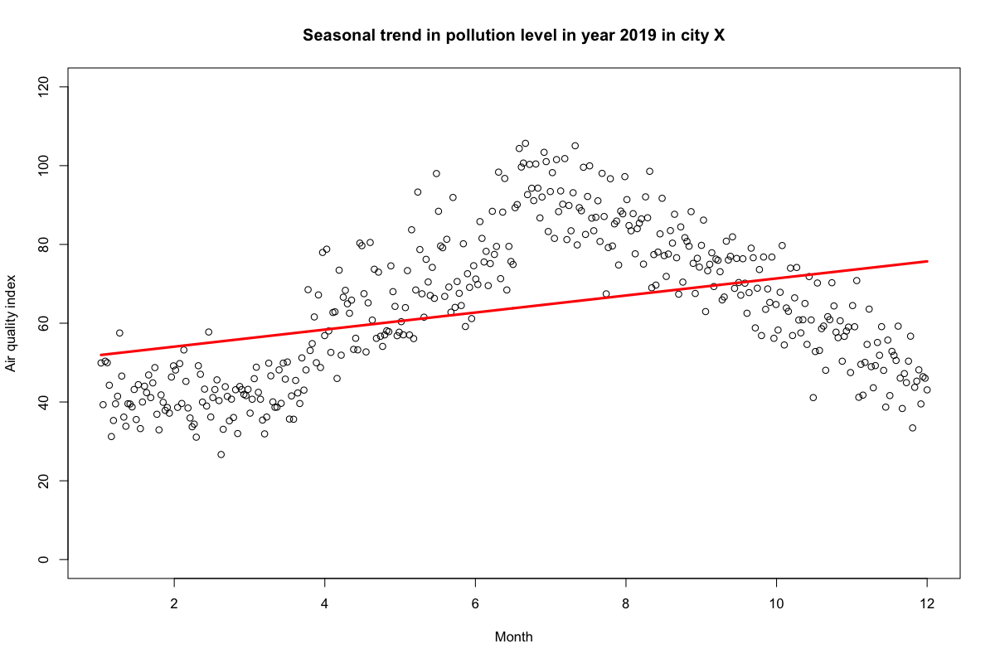
Linear regression
lm(aqi ~ month)

Slide 5
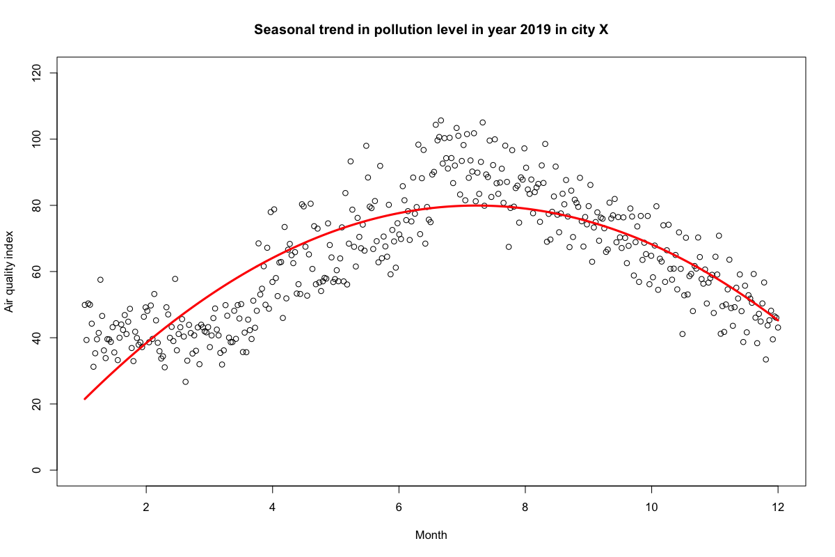
Polynomial regression of degree 2
lm(aqi ~ poly(month, 2))

Slide 6
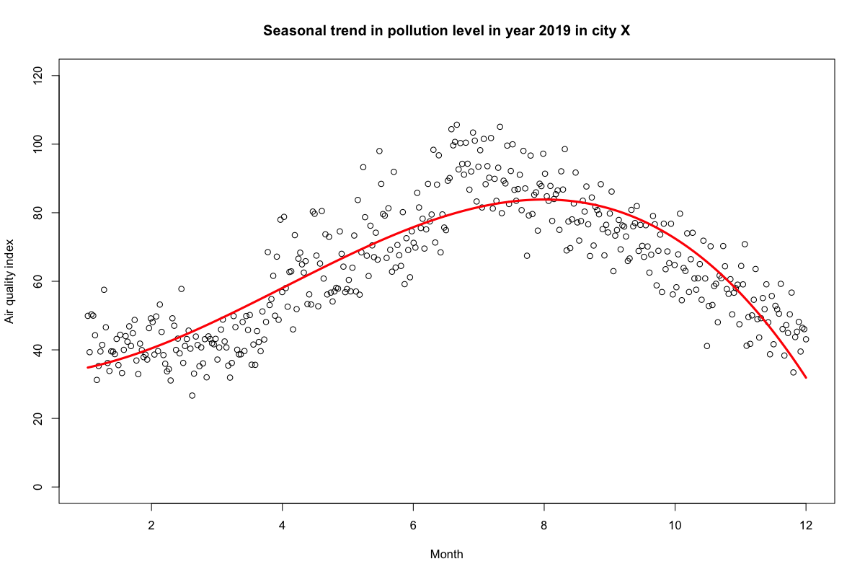
Polynomial regression with degree 3
lm(aqi ~ poly(month, 3))

Slide 7
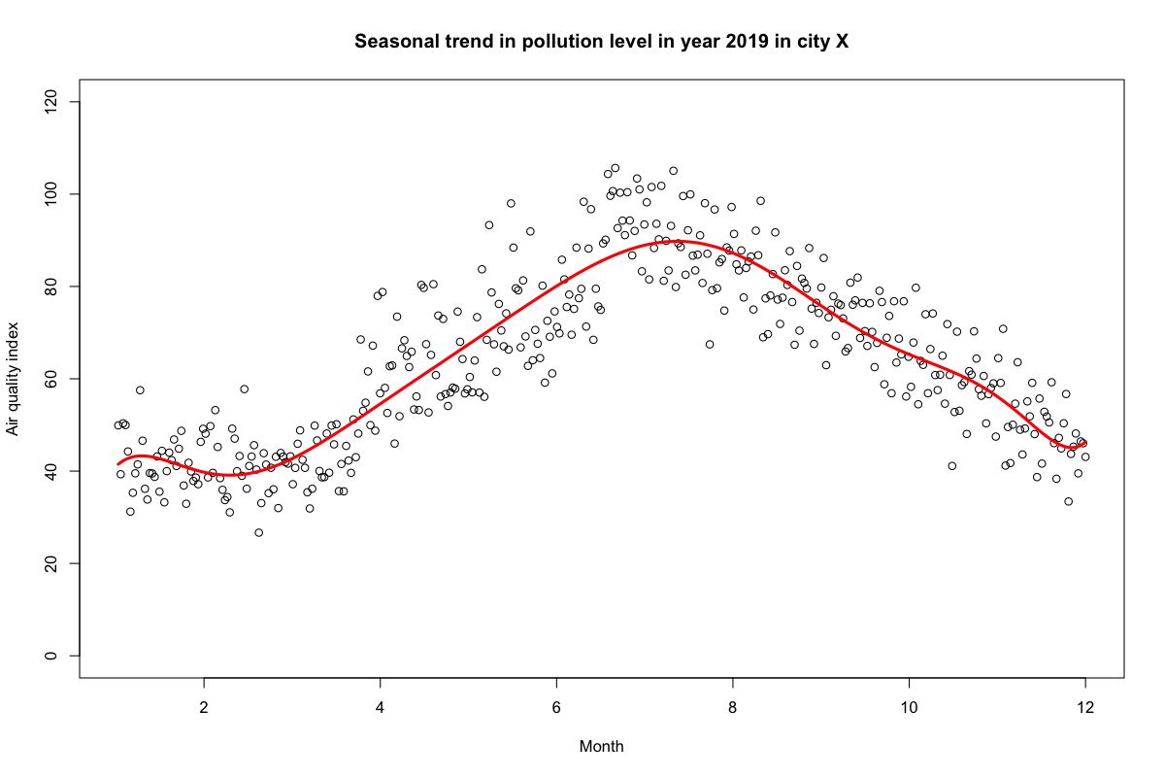
Polynomial regression with degree 10
lm(aqi ~ poly(month, 10))

Slide 8
Take home message so far:
Visualize the data before performing a regression
In general, degree of polynomial should not be higher than 3

Slide 9
Now what else could we do to make our model better?
How about we make our predictor variable into categorical variable?
Although the method seems convincing, not an optimal choice as you would lose information and sometimes be misleading.

Slide 10
Now what else could we do to make our model better?
How about we slice our predictor variable into pieces, fit piecewise regression model and join them together in a smart and efficient way!?
That’s exactly what Spline is ☺
Further read: https://cran.r-project.org/web/packages/crs/vignettes/spline_primer.pdf

Slide 11
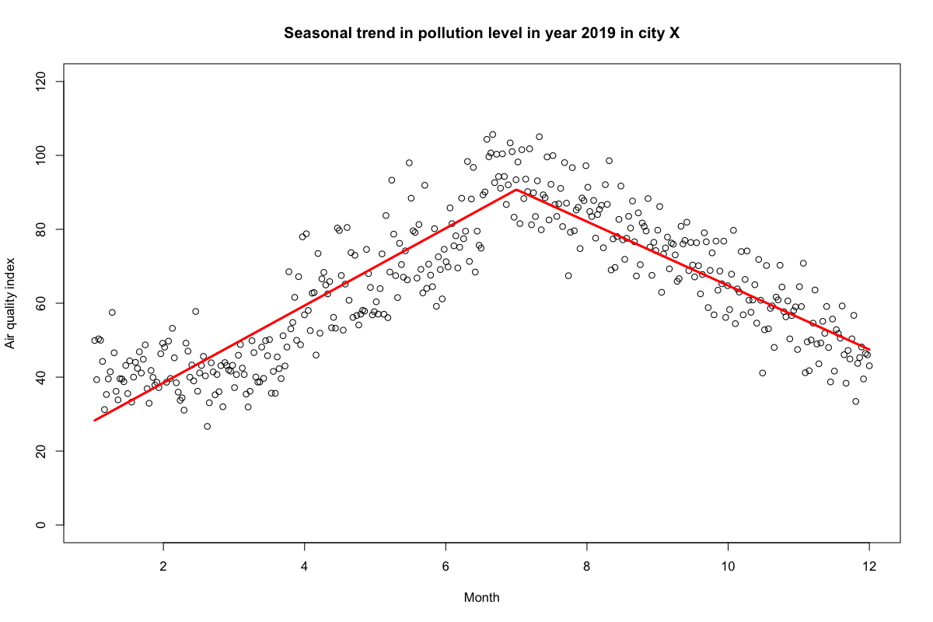
B-spline regression with a knot at month 7
lm(aqi ~ bs(month, degree = 1, knots = c(7)))
Important note: the coeffients of splines are not directly interpretable

Slide 12

B-spline regression with knots at months 3 and 7
lm(aqi ~ bs(month,
degree = 1, knots = c(3,7)))

Slide 13
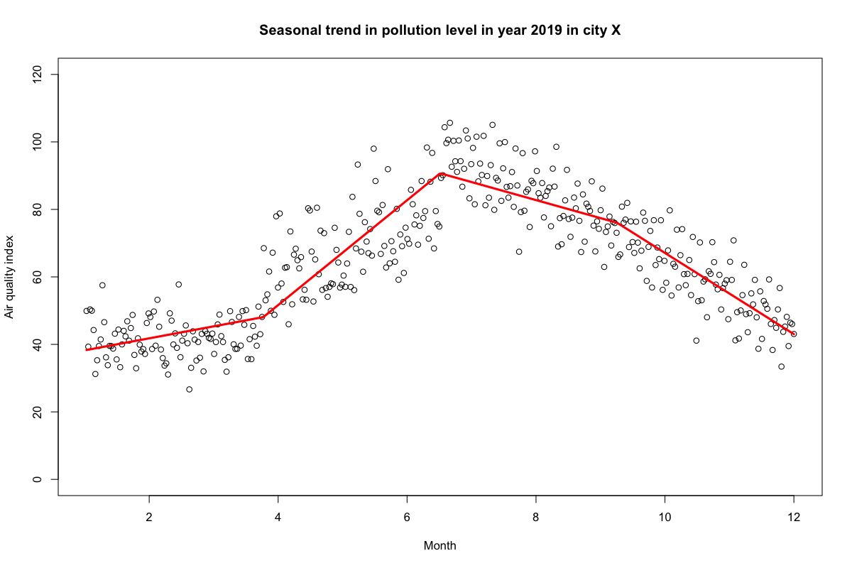
B-spline regression with 4 degrees of freedom
lm(aqi ~ bs(month, degree = 2, df = 4))
df – 1 knots are chosen based on quantiles:
`25%` = 3.770625
`50%` = 6.51375
`75%` = 9.256875

Slide 14

B-spline regression with 4 degrees of freedom and polynomial of degree 2
lm(aqi ~ bs(month, degree = 2, df = 4))
df – 1 knots are chosen based on quantiles:
`25%` = 3.770625
`50%` = 6.51375
`75%` = 9.256875

Slide 15

B-spline regression with 4 degrees of freedom and polynomial of degree 3
lm(aqi ~ bs(month, degree = 3, df = 4))
df – 1 knots are chosen based on quantiles:
`25%` = 3.770625
`50%` = 6.51375
`75%` = 9.256875

Slide 16
Take home message
Although, maths behind splines complicated, splines can easily implemented in our prediction models
Splines can improve the model prediction and is a better alternative to categorical variable
However, coefficients are not directly interpretable and requires additional degrees of freedom

Slide 17
Thank you

