Slide 1
nms-disaster-ccn
NMS:
Network Modeling and Simulation
nms-disaster-ccn.cc based on nms-p2p-nix.cc

Slide 2
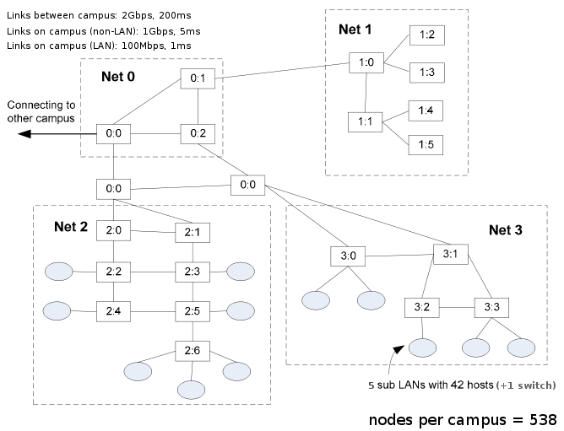
Topology
Server Farm
Backbone
Routers
4 Hosts
TCP Servers
Clients Network

Slide 3
Code
https://github.com/Waseda-Sato-lab/ccn-sim/blob/master/ndn-campus/scenarios/nms-disaster-ccn.cc

Slide 4
Expected Results
Latency
Throughput
Power Consumption
blablabla
Scale(the number of Nodes, Campus, Consumer, Producer….)

Slide 5
Scenario
Custom Interests ( Retrieving Disaster Information)
Custom Contents( Publishing Disaster Information)
Install Consumer / Producer to Subnet 2 / 3
How many Consumers / Producers?
Which Nodes? ( random?)
Set the FIB Strategy
Broadcast?
Forward to Specific CCN Node?
Q: How to Publish Contents to CCN Node?

