Slide 1
Electrogravitics
Gravitron Experiments

Slide 2
Background
The Computational Theory of Gravity (CTG) predicts field coupling
Most notable between the electric and gravitational forces
Other forces (including Higgs) experience minimal gravitic mixing
  Interaction with the field Lagrangians is via a scalar potential
  Electric and gravitational forces have similar mathematical structures
  Other forces differ substantially
The relevant physics is omitted:
  Causal graph holonomies -> Quantum Field Theory -> Classical Eqs of motion

Slide 3
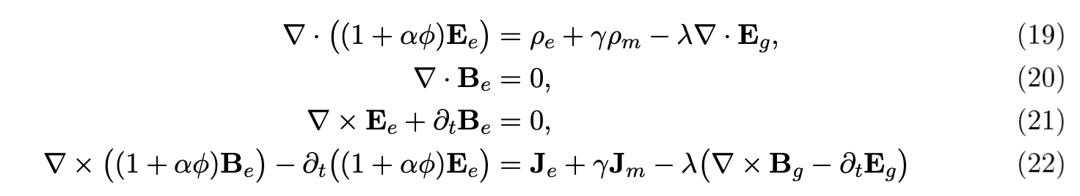
Experiments
Experiments should focus on the electrogravitic coupling
Evident in the Electrogravitic Maxwell Equations (EME)
Red terms are new additions of CTG to the original Maxwell Eqs (ME)
The structure of the equations gives us ideas for experiments

Slide 4
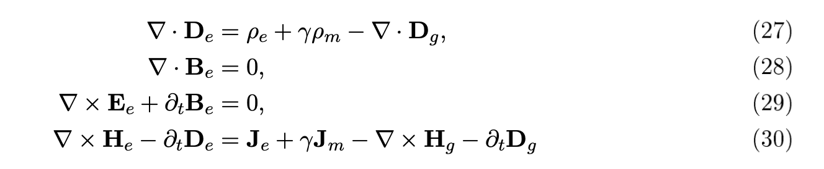

Side Note on Dielectrics
Note the similarity with the dielectric form of the ME
Specifically, compare $K=1+χ$ to the term: (1+$αφ$)
The EME can be rewritten in the familiar dielectric form:

Slide 5

Experiments: Weight Reduction
Weight reduction can occur via two channels:
  EME suggest opposing “Electric” components (thrust)
  Higgs potential directly modified (weight reduction)
Note: EME multiplicative constant $λ$ is small
Forces oppose

Slide 6
Experiment: Structure
Electrogravitics may weaken the lattice structure of a crystal
May also affect it at the atomic level via the strong force channel
Potential measurement options in specific crystals
  Opacity
  Modulating the frequency distribution of passing light
  Modulating the refractive index of the material

Slide 7

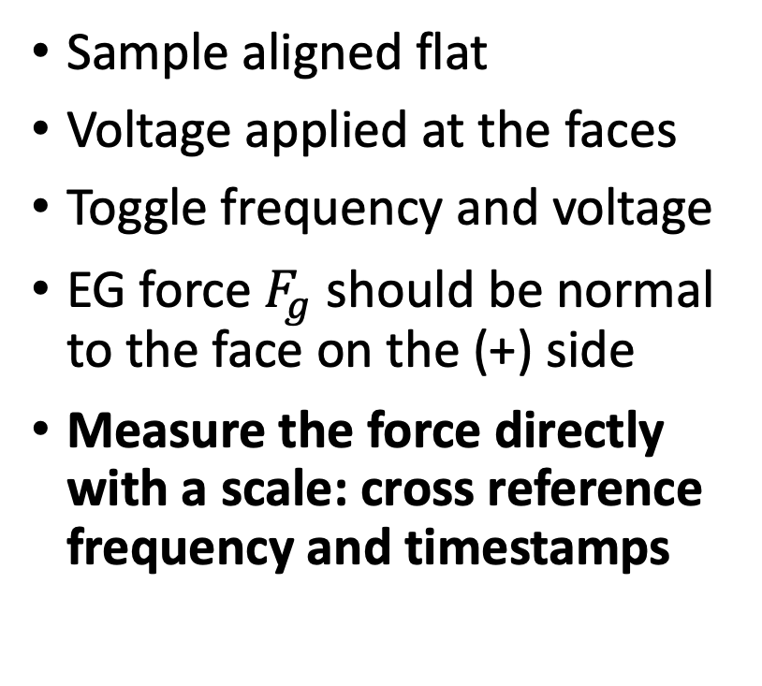
Exp. 1 – Weight Reduction – Direct Measurement
Sample aligned flat
Voltage applied at the faces
Toggle frequency and voltage
EG force $F_{g}$ should be normal to the face on the (+) side
Measure the force directly with a scale: cross reference frequency and timestamps
$$F_{g}$$
(+V)
(-V)

Slide 8


Exp. 2 – Weight Reduction – Reflection
(Same configuration as Exp. 1)
Apply impulse voltage
Measure the deviation $Δy$ in a reflected laser
$$Δy$$
(+V)
(-V)

Slide 9

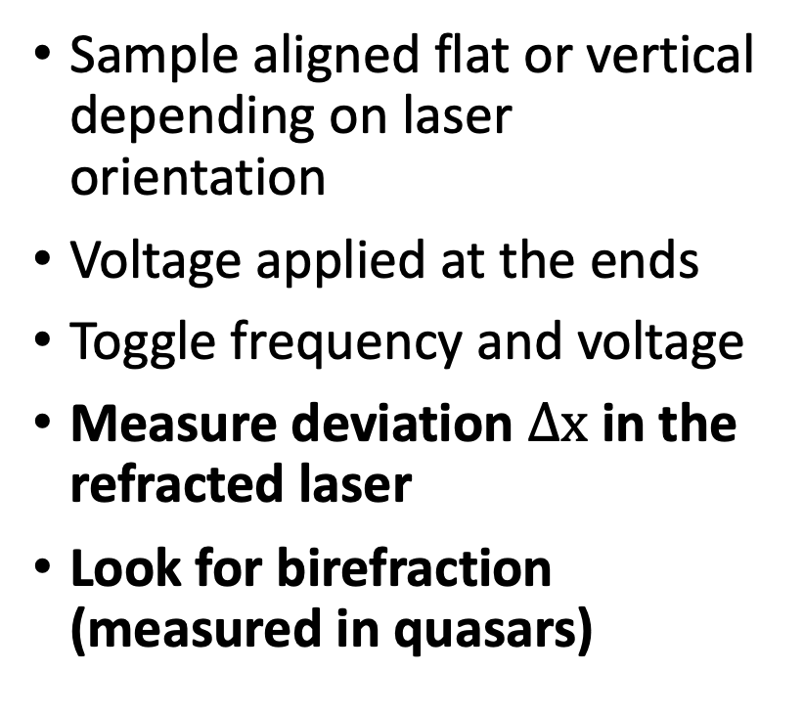
Exp. 3 – Structural Integrity – Refraction
Sample aligned flat or vertical depending on laser orientation
Voltage applied at the ends
Toggle frequency and voltage
Measure deviation $Δx$ in the refracted laser
Look for birefraction (measured in quasars)
(± V)
(∓V)
$$Δx$$

Slide 10
Exp. 4,5 – Structural Integrity – Spectra
(Same configuration as Exp. 3)
Measure deviation in the spectrum of white light
Measure deviation in the intensity of white light
(± V)
(∓V)

Slide 11
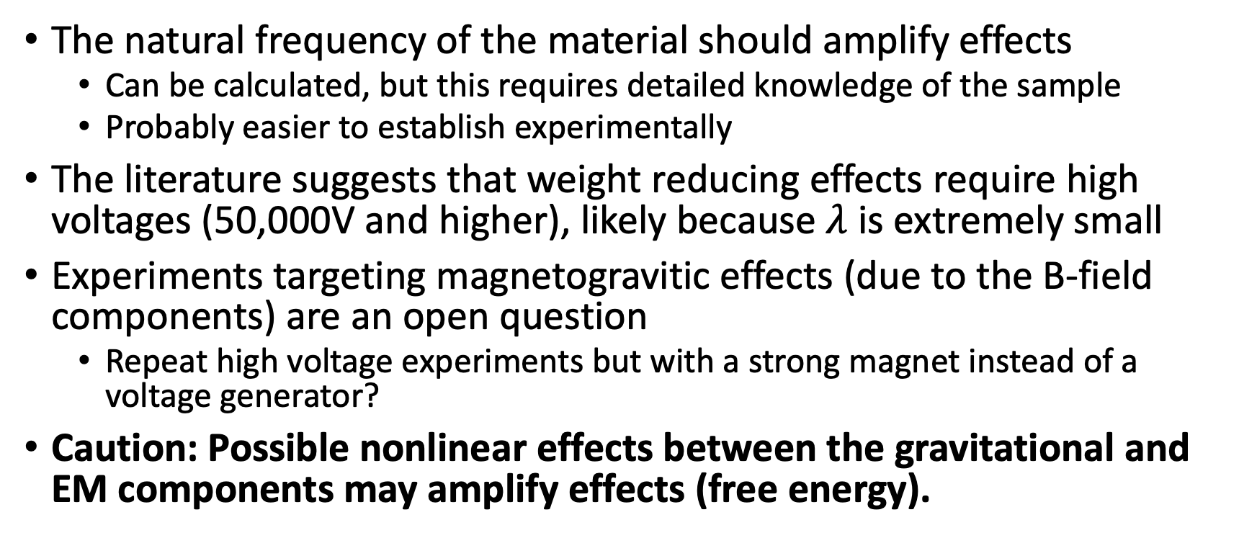
Notes
The natural frequency of the material should amplify effects
  Can be calculated, but this requires detailed knowledge of the sample
  Probably easier to establish experimentally
The literature suggests that weight reducing effects require high voltages (50,000V and higher), likely because $λ$ is extremely small
Experiments targeting magnetogravitic effects (due to the B-field components) are an open question
  Repeat high voltage experiments but with a strong magnet instead of a voltage generator?
Caution: Possible nonlinear effects between the gravitational and EM components may amplify effects (free energy).

