Slide 1
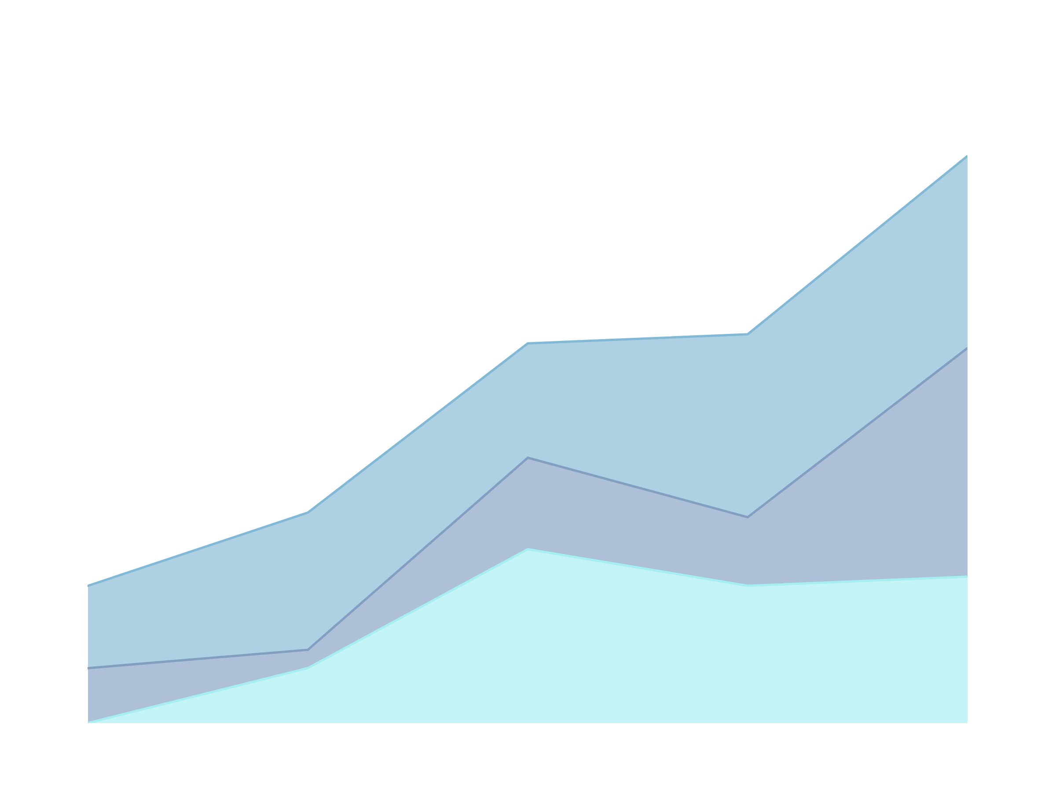
DISASTER TWEET CLASSIFICATION USING NLP
PROJECT PRESENTATION,
PREPARED BY SVITLANA KOVALIVSKA, PHD

Slide 2

PROJECT GOAL
The aim of this project was to develop a robust pipeline to classify whether tweets are about real disasters or not.

Slide 3
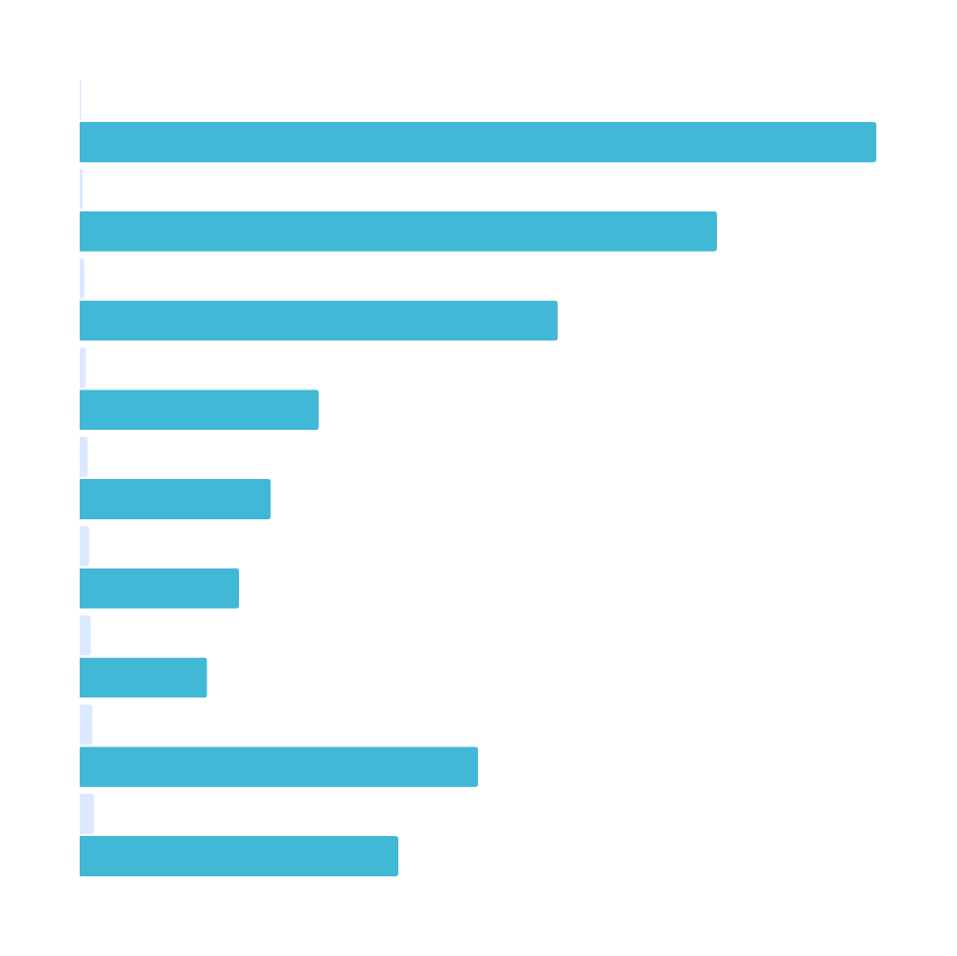
Key Takeaways
✅ Built full ML/NLP pipeline
✅ Compared 6 classical ML and 3 deep learning models
✅ Implemented advanced dual-input neural networks
✅ Achieved 80–82%+ accuracy across top models
✅ Demonstrated hybrid models outperform text-only in many cases

Slide 4
DATASET OVERVIEW
TEXT:
Tweet content
LOCATION:
Optional user-defined location
TARGET:
1 if the tweet refers to a disaster, 0 otherwise
KEYWORD:
Optional disaster keyword

Slide 5
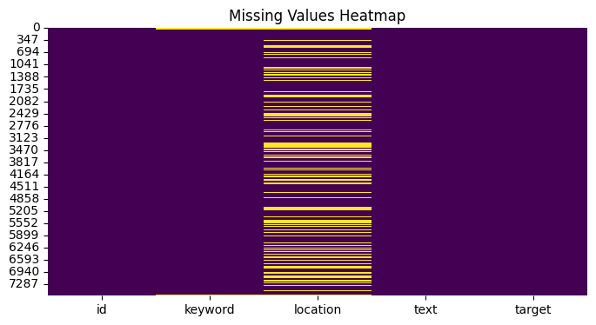
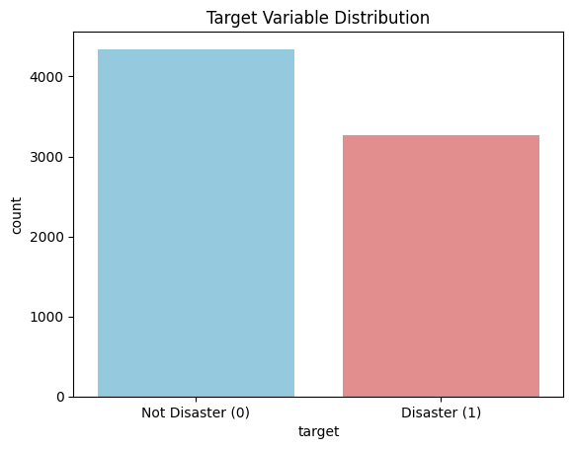
EDA
Missing Values:
text and target: No missing values
keyword: ~60 missing; filled or dropped as needed
location: ~33% missing; removed for text-only models, included in hybrid models
Distribution:
Class imbalance (~57% non-disaster, 43% disaster)
Adjusted using class weighting
Tweet Length:
Most tweets <140 characters — influenced padding and sequence length choices
Keyword Utility:
Keywords like “fire”, “earthquake”, and “accident” correlated well with disasters

Slide 6
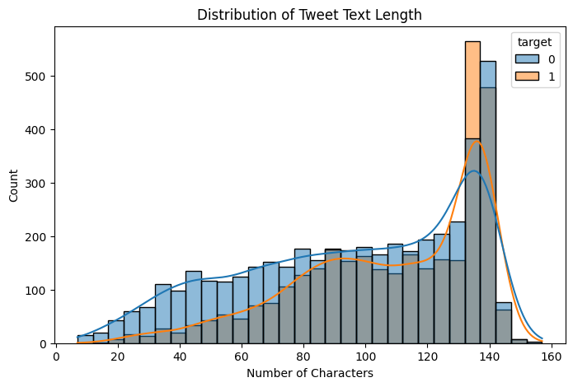
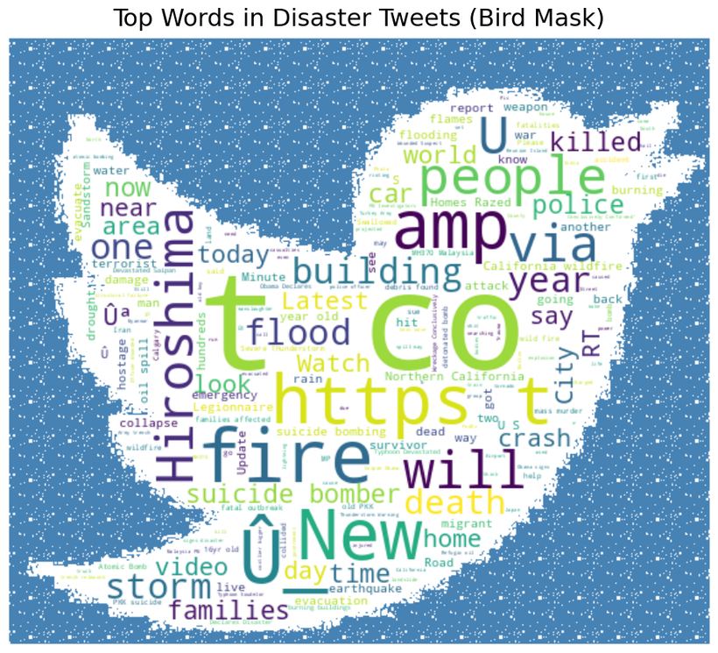
EXPLORATORY DATA ANALYSIS

Slide 7
DATA CLEANING & PREPARATION
Text Preprocessing:
Lowercased all tweets
Removed punctuation, URLs, mentions, hashtags, and stopwords
Applied tokenization, lemmatization, and stemming
Transformed using:
TF-IDF (for classical ML)
Tokenizer + padding (for deep learning)
BERT tokenizer (for transformer models)

Slide 8
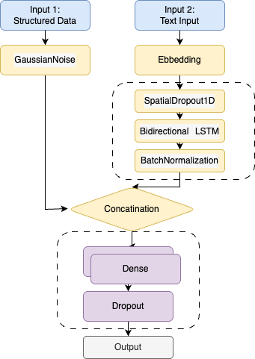
MODELING APPROACHES
1. Text-Only Pipeline
Input: text column
Used for: TF-IDF + ML models and BERT
Encoding: TF-IDF or BERT tokenizer
Pros: Simplicity, low preprocessing cost
2. Hybrid Pipeline
Inputs: text, keyword, location, text metadata
Used for: CNN, BiLSTM with auxiliary structured features
Architecture:
Branch 1: Embedding → Conv1D/BiLSTM → Pooling
Branch 2: Structured features → Dense
Combined: Concatenate → Dense → Output

Slide 9
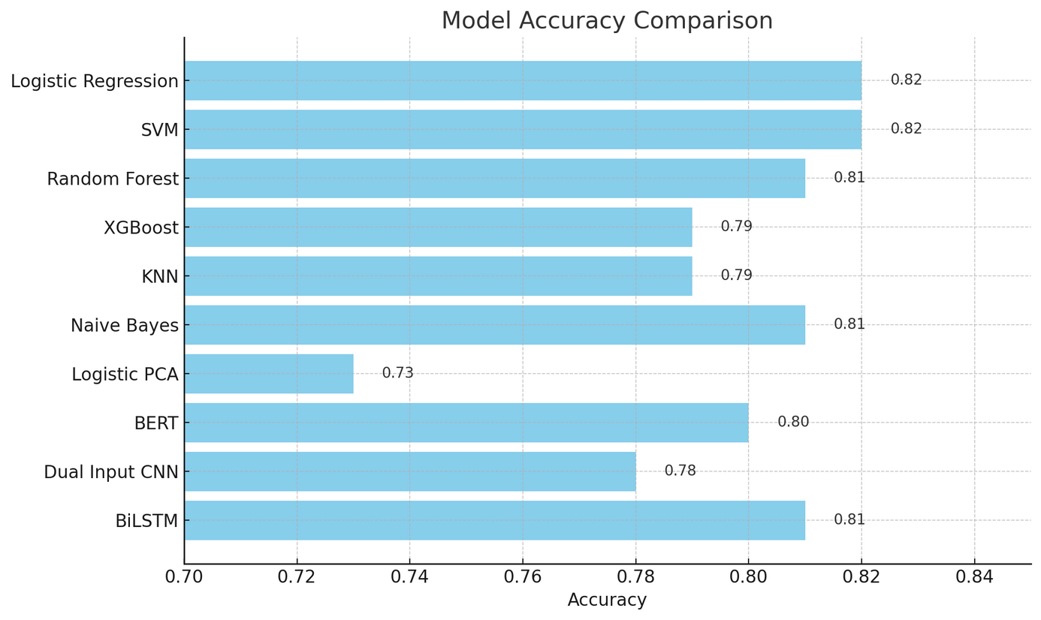
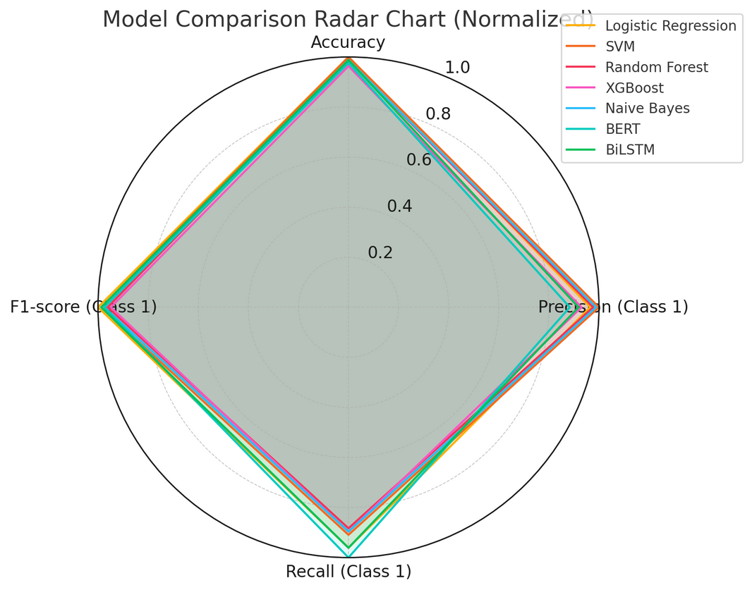
MODEL EVALUATION RESULTS

Slide 10
Model | Precision | Recall | F1-score
Logistic Reg. | 0.83 | 0.74 | 0.78
SVM | 0.86 | 0.70 | 0.77
Random Forest | 0.84 | 0.68 | 0.75
XGBoost | 0.80 | 0.69 | 0.74
KNN | 0.81 | 0.65 | 0.72
Naive Bayes | 0.85 | 0.69 | 0.76
LogReg PCA | 0.70 | 0.65 | 0.67
BERT | 0.76 | 0.77 | 0.76
Dual Input CNN | 0.88 | 0.75 | 0.76
BiLSTM | 0.79 | 0.74 | 0.77
OBSERVATION
Logistic Regression and SVM performed the best among classical models. Deep models like BiLSTM and BERT reached comparable performance, with BERT offering strong semantic understanding out of the box.
SVM and Dual Input CNN had the highest precision, meaning fewer false positives.
BERT achieved the best recall, detecting more true disaster tweets.
BiLSTM offered a balanced F1-score, showing it handled both precision and recall well.
KNN and LogReg PCA underperformed, showing weaknesses with high-dimensional sparse data or reduced feature sets.

Slide 11
INSIGHTS AND RECOMMENDATION
Best All-Rounder: Logistic Regression – simple, efficient, and highly accurate.
Best for Precision: SVM / CNN – low false positive rates.
Best for Recall: BERT / BiLSTM – suitable for critical cases where missing a disaster is costly.
Most Balanced Deep Model: BiLSTM – performs almost equally well across all metrics.
Best Lightweight Model: Naive Bayes – fast, robust, and generalizes well.
Underperformers: KNN (distance-based limitations in high-dimensional space), PCA (information loss).

Slide 12
Business-oriented guide to choosing the best model based on different objectives and priorities

Slide 13
WHEN MISSING A DISASTER IS TOO COSTLY (RECALL IS CRITICAL)
Recommended model:
BERT or BiLSTM
These models achieved high recall (BERT: 0.77, BiLSTM: 0.74)
They minimize the risk of missing critical disaster-related tweets
Business use cases:
Social media monitoring for emergency response
Real-time alert systems (e.g., natural disasters, accidents)

Slide 14
2. WHEN FALSE ALARMS MUST BE AVOIDED (PRECISION IS KEY)
Recommended model:
SVM (Precision: 0.86) or Dual Input CNN (Precision: 0.88)
Best suited to minimize false positives
Business use cases:
Moderation tools: false positives (non-disasters flagged as disasters) must be minimized
Search filters or recommendation engines where accuracy is crucial

Slide 15
3. WHEN BALANCE IS IMPORTANT (F1-SCORE IS THE FOCUS)
Recommended model:
BiLSTM or Logistic Regression
Both models deliver a balanced F1-score (~0.77–0.78)
Logistic Regression is also interpretable and fast to deploy
Business use cases:
Social media analytics
Generating reports or dashboards for strategic decisions

Slide 16
4. WHEN YOU NEED FAST DEPLOYMENT AND SIMPLICITY
Recommended model:
Logistic Regression or Naive Bayes
Lightweight, easy to maintain, and still ~80% accurate
Business use cases:
MVP development
Low-resource environments (cloud APIs, mobile apps)

Slide 17
5. WHEN YOU NEED SCALABILITY FOR HIGH-VOLUME DATA
Recommended model:
XGBoost
Combines strong performance with regularization and scalability
Widely used in industrial ML pipelines
Business use cases:
Processing large tweet streams in real-time
Enterprise-scale infrastructure

Slide 18
SUMMARY:
WHICH MODEL TO CHOOSE?
Scenario | Recommended Model | Why It Fits
Catch all possible disasters (recall) | BERT, BiLSTM | High detection rate of disaster tweets
Avoid false positives (precision) | SVM, CNN | Most precise predictions
Balanced classification (F1-score) | BiLSTM, Logistic Reg. | Reliable, interpretable, balanced
Fast, simple, lightweight deployment | Logistic Reg., Naive Bayes | Fast, minimal compute required
Enterprise-scale, high-volume data | XGBoost | High performance under heavy loads

