Slide 1
Venues Data Analysis
Valeria Kovergovich
Minsk is the largest city in Belarus with the population of over 2 million people a population density of 5 792 people per square kilometer. As a resident of this city, I decided to use Minsk in my project. The city is divided into 9 districts in total.
The district we're interested in is the Frunze district. It has 10 neighborhoods and there are a lot of venues located there. Therefore, we should to analyze this district we're interested in in order to figure out the best location for a new cafe. The preferred neighborhood will have a lower number of venues as compared to other neighborhood.
In order to find a solution, we'll need to create a map and cluster neighborhoods according to the venue density and analyze it.

Slide 2
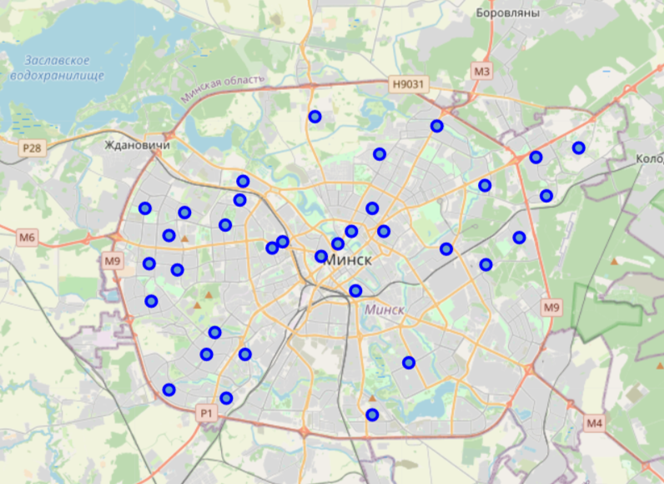
Map of Minsk

Slide 3
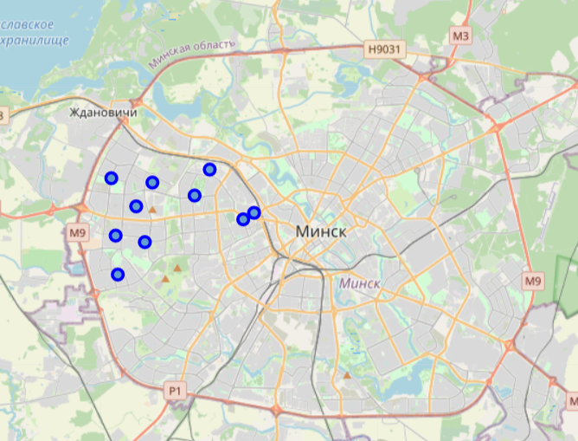
Map of the Frunze district

Slide 4
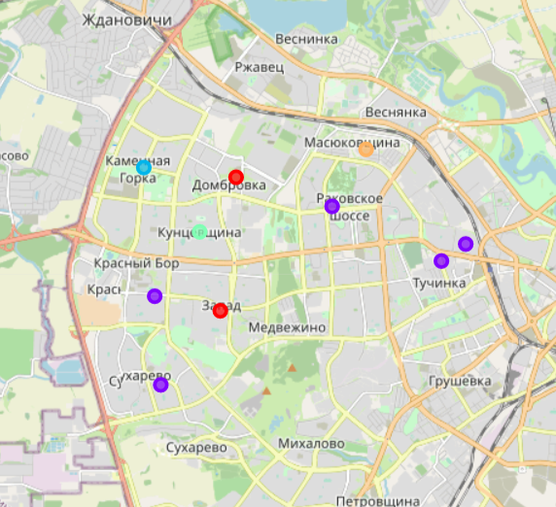
Clustered map of the Frunze district

