Slide 1

Unlocking Startup Success: A Deep Dive into Customer Insights
By Anusha Kovi
Notes:
Don’t spend more than 3 seconds presenting this slide.

Slide 2
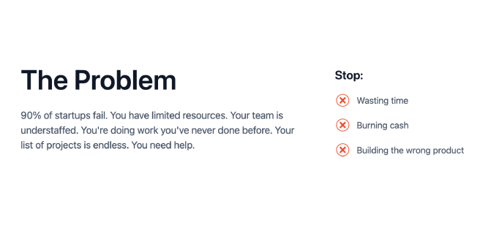
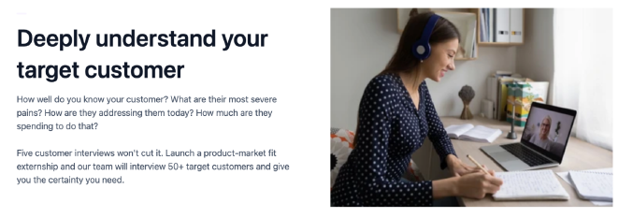
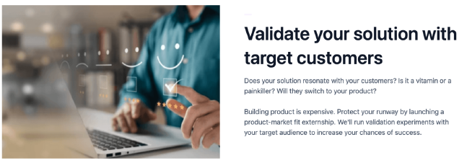
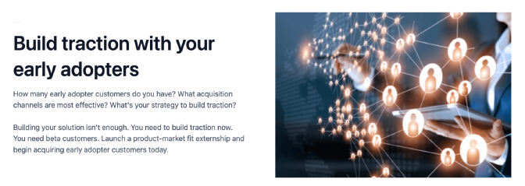
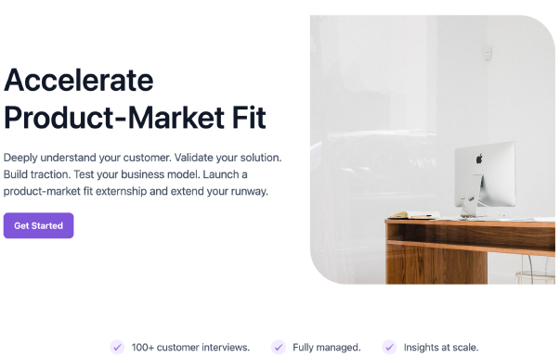
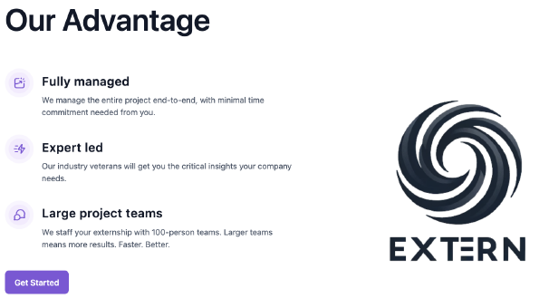

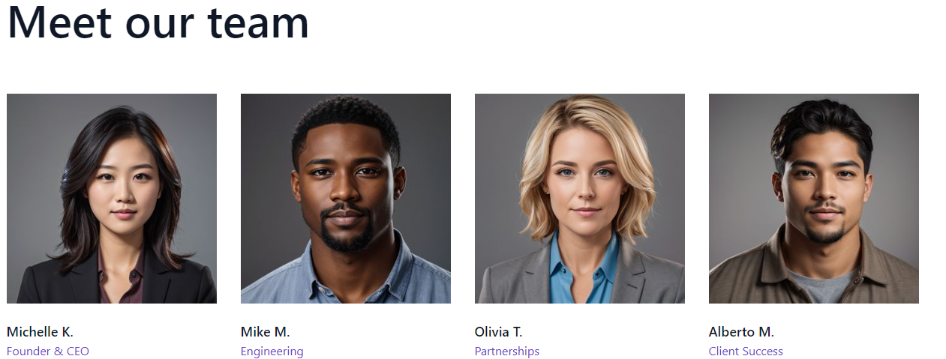
Resonance Ranking: Unveiling the Impactful Sections
Resonated the most
Resonated the least
The Problem
Social proof
Deeply understand your target customer
Validate your solution with target customers
Build traction with your early adopters
Hero/ Summary/
Overview
Advantage & Get Started
Meet our Team
Notes:
Don’t spend more than 15 seconds presenting this slide.
Provide a high-level overview of what resonated with the target customer the most and the least. This should set the premise for the insights you share for each section in the upcoming slides.

Slide 3
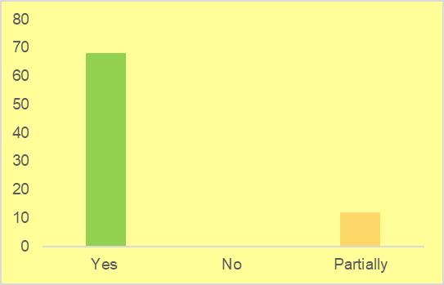
The Problem Section
“Currently, at my stage, it does resonate with me. We are at the stage of testing our products. So we have already lost some time.”
“If it's gonna save our startup time if it's gonna stop us from burning more cash and definitely building the right products, it's something that's interesting to me.”
Notes:
Don’t spend more than 15 seconds presenting this slide.
Unpack why the section resonated/did not resonate with the target customer using keywords/quotes from the interview transcript.
Create a new slide for each section.

Slide 4
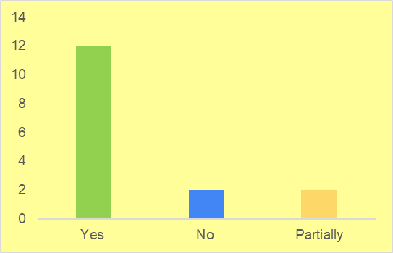
Social Proof Section
“Seeing big names like Snapchat and HP as testimonials gives me confidence. It signals that this solution is already trusted by established companies.”
“The fact that this solution is not just in the testing phase but is already being used by well-known companies makes me more inclined to trust and consider it for my startup.”
Notes:
Don’t spend more than 15 seconds presenting this slide.
Unpack why the section resonated/did not resonate with the target customer using keywords/quotes from the interview transcript.
Create a new slide for each section.

Slide 5
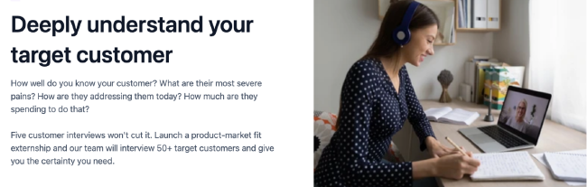
Deeply Understand Your Target Customer Section
“This sentence speaks directly to me because we tried to do many interviews, but we can't seem to do more than 5 or 10 interviews. So, I believe this paragraph speaks directly to me because we need more interviews at the moment to better understand our target customers.”
Notes:
Don’t spend more than 15 seconds presenting this slide.
Unpack why the section resonated/did not resonate with the target customer using keywords/quotes from the interview transcript.
Create a new slide for each section.

Slide 6
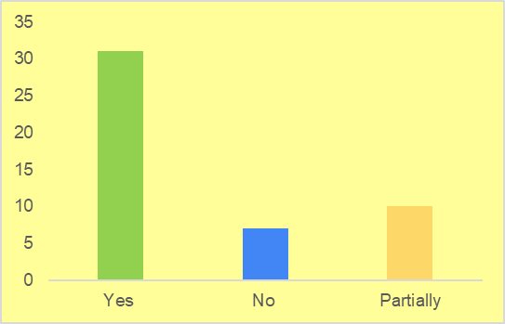
Validate Your Solution with Target Customers Section
“I was hoping to know more about, for example, validate your solution, how we can do that. Maybe instead of this picture, we can have a video explaining maybe the steps and more details.”
“I think the value proposition is a little bit vague. I'm speaking from the perspective of being the first time I stumbled upon this website. So if I read 'launch a product-market fit externship,' I would be a little bit confused but curious to understand what does externship or a product-market fit externship means.”
Notes:
Don’t spend more than 15 seconds presenting this slide.
Unpack why the section resonated/did not resonate with the target customer using keywords/quotes from the interview transcript.
Create a new slide for each section.

Slide 7
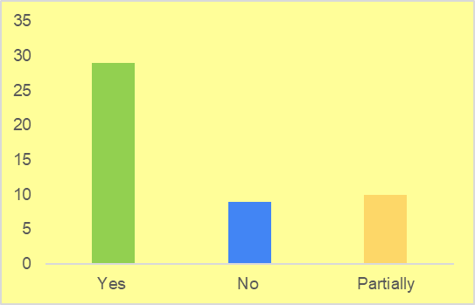
Build Traction with Your Early Adopters Section
“This part specifically speaks to me because, as a startup, you test more to see which channel is most effective for your offer. So, it's ideal if we can get a framework for how to choose the perfect channel before the testing.”
“I resonate with the statements about building traction and understanding your target customer, but I think the value proposition is a little bit vague. I was hoping to see more education about this part.”
Notes:
Don’t spend more than 15 seconds presenting this slide.
Unpack why the section resonated/did not resonate with the target customer using keywords/quotes from the interview transcript.
Create a new slide for each section.

Slide 8
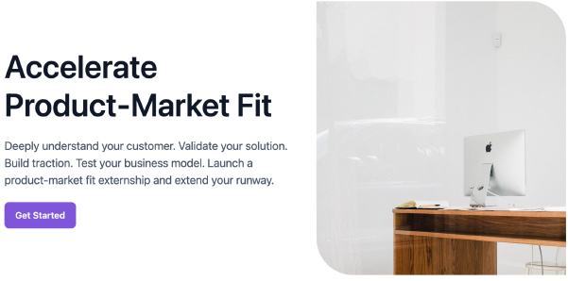
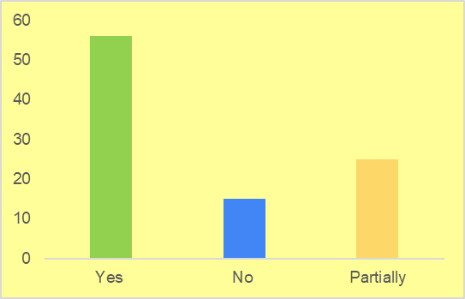
Hero/Summary/Overview Section
“So the term 'accelerate' does resonate. I think it's very relevant to my position at the moment. I'm interested to see how, as a startup, we can accelerate building a market-fit product.”
“I think if it was a paragraph, rather than bullets, I think it will have more value in it.”
“The value proposition is a little bit vague. I was maybe hoping to see more education about this part.”
Notes:
Don’t spend more than 15 seconds presenting this slide.
Unpack why the section resonated/did not resonate with the target customer using keywords/quotes from the interview transcript.
Create a new slide for each section.

Slide 9
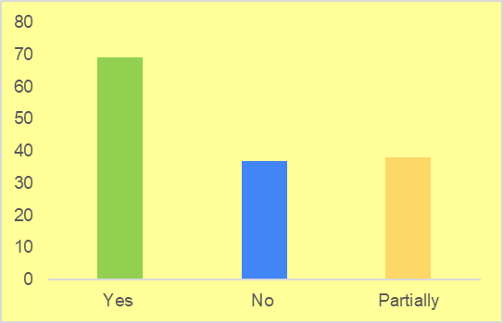
Advantage & Get Started Section
“I'm interested to know more about the solution. The previous sections did spark a lot of my interest. So, yes, I would fill the form.”
“I think the first two are great. Large project teams, we separate social puts in-person teams in order, teams men or results. I get the idea that the externship offers a lot of teams, but does it offer a number depending on the size of the startup, maybe?”
Notes:
Don’t spend more than 15 seconds presenting this slide.
Unpack why the section resonated/did not resonate with the target customer using keywords/quotes from the interview transcript.
Create a new slide for each section.

Slide 10
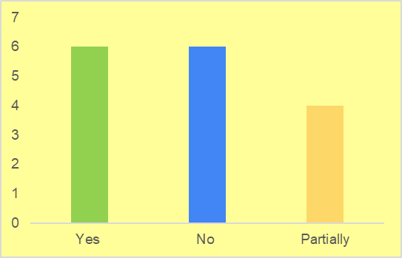
Meet Our Team Section
“I personally don't know them. So, I wouldn't know for sure if this is the right person or it's generated by AI. It would show me more credibility if I knew who the experts behind this service are.”
“The idea of having something fully outsourced by experts is going to hold a lot of value. I would like to see maybe industry veterans, who are the experts behind this service? Overall, it's great, but I was hoping for more clarity on who these industry experts are.”
Notes:
Don’t spend more than 15 seconds presenting this slide.
Unpack why the section resonated/did not resonate with the target customer using keywords/quotes from the interview transcript.
Create a new slide for each section.

Slide 11
Recommendation 1
Clarify Value Proposition
Provide more educational content, particularly related to the product-market fit externship concept and its value for startups
1
Builds Trust and Credibility
2
Enhances Customer Understanding
Notes:
Don’t spend more than 15 seconds presenting this slide.
Recap the insights from the data analysis setting the premise for what could be the next steps to improve the website.

Slide 12
Recommendation 2
Transparency on Team Faces
If using AI-generated faces, be transparent about it to maintain trust. Alternatively, consider using real images of the team
1
Builds Trust and Credibility
2
Personal Connection
3
Professionalism
Notes:
Don’t spend more than 15 seconds presenting this slide.
Recap the insights from the data analysis setting the premise for what could be the next steps to improve the website.

Slide 13
Recommendation 3
Address Team Size Concerns
Provide more information on how the number of project teams is determined and if it can be adjusted based on the size and needs of the startup
1
Enhance Transparency
2
Competitive Advantage
3
Customization for Startups
Notes:
Don’t spend more than 15 seconds presenting this slide.
Recap the insights from the data analysis setting the premise for what could be the next steps to improve the website.

Slide 14
Recommendation 4
Externship Terminology Explanation
Providing more education or clarification on such terms could be beneficial
1
Reduces Barriers to Entry
2
Enhances Customer Understanding
Notes:
Don’t spend more than 15 seconds presenting this slide.
Recap the insights from the data analysis setting the premise for what could be the next steps to improve the website.

Slide 15
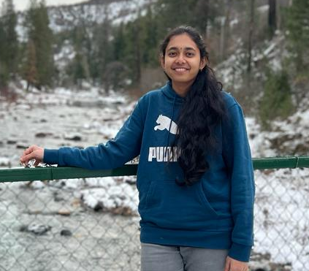



THANK YOU!
Connect with me on LinkedIn
akovi@mtu.edu
Michigan Technological University
Notes:
Don’t spend more than 15 seconds presenting this slide.
Recap the insights from the data analysis setting the premise for what could be the next steps to improve the website.

