Slide 1
Where is Linux Used?
75% of respondents were already using Linux and another 14% were evaluating it
43% of all web sites use Linux servers running the Apache Web server
11-‹#›

Slide 2
Basics
Shell
¬Shell is nothing but a Command prompt like in windows, When you enter the commands, you get your work done
¬The Shell is a command interpreter, it takes each command
and passes it to the OS kernel to be acted upon. It will displays the results of your operations on screen.
¬We have 'n' no.of shells available on any Unix Machine. each one has it's own strengths and weaknesses.
11-‹#›

Slide 3
Continued…
¬The most commonly available Shell(s) are:
Bourne Shell (sh)
Korn Shell (ksh)
C Shell (csh)
Bourne Again Shell (bash)
TC Shell (tcsh)
11-‹#›

Slide 4
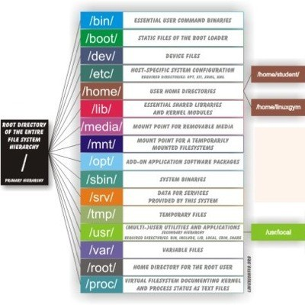
Unix Directory Structure/File System Architecture

Slide 5
Logging into the System
To login to your account type your user name and at the login prompt. Unix is Case Sensitive.
When the password prompt appears, type your password. Your password will never displayed on screen for security Measure. It is also case sensitive
Then You will get [username@hostname ]# or [username@hostname <pwd>]$.
#, means it is administrative User Login
$, means it is Normal user Login
And for Administrator always Username is ‘root’, and the User ID and Group Id is 0.

Slide 6
Basic Commands
Commands and their options
⎫Each and every command will have generally some options to get more information about the respective outputs.
⎫Options will be used by preceding “-”. Options will be given after entering the command by giving some space

Slide 7
Working with Basic Commands
Uname: Prints system information
-a print all information
-s print the kernel name
-r print the kernel release
-v print the kernel version
-m print the machine hardware name
-p print the processor type
-o print the operating system

Slide 8

Working with Basic Commands
ls – Listing of files and directories
Options:-
-l – long listing of files

Slide 9

– file type
- Normal file d Directory
l Link file
c character file b block file
2– File/Dir Permissions 3 – Owner
4 – Group membership 5 – File/Dir Size
6- File/Dir creation
/modification Date
7 – Time modified/created 8 – File name

Slide 10
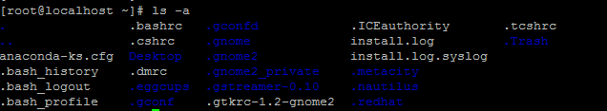
Working with Basic Commands
-a – Listing of normal files/dirs and as well as hidden files/dirs
-r – Print the output in reverse order
-t – Print the output in based on time
-h – Print the file/dir sizes in human-readable format
-1 – Print the file/dir output line by line

Slide 11
Working with Basic Commands
man – manual pages for commands or help for the commands
Example :- man ls
Output will be no. of pages…. To view the information line wise or page wise follow these…
To see the output line by line press “Enter “
To see the output page by page press “Spacebar”
To quit from the manual page press the “q” key
The above three options are useful in all other Unix commands, whenever this kind of scenario occurs.
clear – to clear the screen.

Slide 12
Working with Basic Commands
uptime-Tells how long the system has been running
date – To know present date and time
cal – To know the present month calendar.
if you want specific month calendar in specific year
cal 3 1999 – will display the March 1999 calendar.
pwd – To get the present/current working directory. mkdir – To create the directories
Ex:- mkdir dir1
To create multiple parent/child directories at a time mkdir –p dir1/sdir1

Slide 13
Working with Basic Commands
cd – To change the working directory
cd <dir_name> # Switches into specified directory.
cd .. cd ../../ cd /
cd - change)
#Moves one directory up
# Moves two directories up (and so on) #Move the / directory.
# Go back to you were previously (before the last directory
touch – To create the empty file, if file is not there, otherwise it updates file timestamp to current timestamp.
touch f1

Slide 14

Working with Basic Commands
cat – To create/view the files.
cat > file1 - will create a file, it prompts for entering the data, after entering the data, save the file by pressing Ctrl-D.
cat >> file1 – Will append the data to the file, it also prompts for entering the data, save the file by pressing Ctrl-D
Behavior of cat command
You can’t edit the files using the cat command… To view the multiple files
cat file1 file2

Slide 15
Working with Basic Commands
cp – to copy and paste the files/directories
- Syntax to copy the files
cp [options] <source> <destination>
To copy file1 as file2 in the same location. cp file1 file2
To copy file1 from your present working directory to some other directory
cp file1 /opt/dir1/
while copying you want to change the file name cp file1 /opt/dir1/file2

Slide 16
Working with Basic Commands
Contd..
To copy file1 from some other directory to your present working directory cp /opt/dir1/file1 . ( . Means present working directory)
while copying you want to change the file name cp /opt/dir1/file1 file2
To copy file1 from some directory to some where else in the system cp /opt/dir1/file1 /home/user1/
while copying you want to change the file name cp /opt/dir1/file1 /home/user1/file2

Slide 17
Working with Basic Commands
- Syntax to copy the directories
cp –r [options] <srcdir> <destdir>
Options:-
-f - to copy files/dir forcefully.. This option will be useful when we want to copy files/dirs, if already exists.
-i – Interactively copying the files by asking question want to copy or not?
-p – while copying files/dirs to preserve the file attributes like timestamp, permissions, ownership, groups.
cp –rf /opt/dir1 /home/user1/

Slide 18
Working with Basic Commands
rm – removing of files/dirs
- Syntax to remove the files rm [options] <filename>
-To remove a file rm file1
-To remove all files starts with “f” rm f*
To remove all files ends “f” rm *f
Syntax to remove the directories rm –r [options] <dirname>

Slide 19
Working with Basic Commands
mv – to move files/dirs from one location to another location…And also we can rename the files/dirs
-To rename a file/dir
mv file1 file2
mv dir1 dir2
-To move a file/dir
mv file1 /opt/dir1
mv dir1 /home/user1
-To move a file/dir and also rename
mv file1 /opt/dir1/file2
mv dir1 /home/user1/dir2

Slide 20
Working with Basic Commands
wc – To get the count of lines/words/characters
wc file1
To get the lines/words/characters output individually.
-l – no.of lines
wc –l file1
-w – no.of words
wc –w file1
-c – no.of characters
wc –c file1

Slide 21
Working with Basic Commands
To view the file content page by page
more
less
more <my_file> # views text, use space bar to browse, hit 'q' to exit
less <my_file> # a more versatile text viewer than 'more', 'q' exits,
'G' moves to end of text, 'g' to beginning, '/' find forward, '?' find backwards

Slide 22
Working with Basic Commands
- To view the file top lines based on numerical value
-head
head –n <filename>
by default you can see first 10 lines of the file head file1
to view first 20 lines from file1 head -20 file1
- To view the file end lines based on numerical value
-tail
tail –n <filename>
by default you can see end 10 lines of the file tail file1
to view last 20 lines from file1 tail -20 file1

