Slide 1
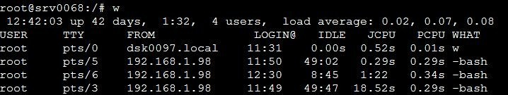
Working with Basic Commands
history- prints all the previously typed commands
who – prints the name of all users who have currently logged in who am i- prints the name and details of the current user whoami- prints the name of the current user
w- prints full information of all the users who have currently logged in

Slide 2
Working with Basic Commands
free-prints the size and usage of the ram and virtual memory
du- Summarize the disk usage of each file, recursively for directories Options:
-s –displays only the total sum for the each specified file/directory
-h –displays in human readable format
df- displays free disk space available for each mount we have Options:
-h –displays in human readable format
-i –list of inode information
-a –includes dummy file system

Slide 3
Working with Basic Commands
stat –displays file system/file status
tree — lists the contents of directories in a tree like format Options:
-a – all files including hidden files are printed.
-d – list of directories only
-f – prints the full path prefix for each file
-u – print the username along with the tree
-s – size of the file
exit – allows to exit from program, shell or come out of a linux network logout – just to come out of a linux network

Slide 4
Getting Help on Commands
help – it provides information about the command including options but not elaborately
syn: <command_name> --help
whatis – it provides the information about the command with out the sub commands(options)
syn: whatis <commad_name>
info –it provides the information of all the commands
man --manual, providing all information of the command syn: man <command_name>

Slide 5
Getting Help on Commands
Contd…
whereis –locates a binary,source,and manual page for a command
syn: whereis <comman_name>
which – locate a command
syn: which <command_name>

Slide 6
File Permissions
Permissions – In Linux, each and every file/directory will have permissions. we have three different kind of permissions for each
file/dir.
read
write
-execute
-r
-w
-x
- no permission - -
These permissions are having the numerical values assigned like:
read – 4 write – 2 execute – 1 no permission - 0
We have three different kinds of users for each file/dir and each user will have three different permissions
owner
group
-others
-u
-g
-o
owner –means who created the file.
group – means no. of users belongs to that group

Slide 7
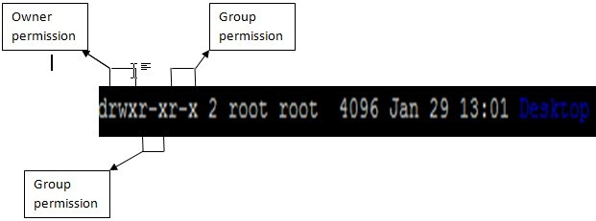
File Permissions
To change the file permissions or changing the ownership and groups of
file/dir.
We use the following commands:
chmod – To change the file/dir permissions chown – To change the file/dir ownership chgrp – To change the file/dir group.
- To know the permissions of a file/dir use the command : ls –l
In the o/p of ls –l command first column will have the permissions information.

Slide 8
File Permissions
chmod – To Change the file/dir permissions using the abbreviations..
syn: chmod [options] <perms> <file/dir>
To add write permissions to the group
chmod g+w file1 ( + is to add the permissions )
To add read and execute permissions to the others
chmod o+rx file1
To remove the write permissions for group and others
chmod go-w file1 ( - is to remove the permissions )
To add execute permissions to all the users and remove the write permissions to others
chmod ugo+x,o-w file1 Options –
-R - This option will be used to when you are changing permissions to directories to recursively apply permissions all the files/subdir in the dir.
chmod –R g+w dir1

Slide 9
File Permissions
To change the file/dir permissions based on the numerical values.
Each user will have all the three kinds of permissions read, write, execute order, like rwx. For example, if anybody don’t have specific permission it contains – in that place… like r-x, means no write permissions.
To calculate the numerical value of the each kind user’s take the some of their permissions numerical values….
⁻ For example, file1 contains the permissions like : rw-r-xr—
For owner – 4+2+0 – 6
For Group - 4+0+1 – 5
For Others – 4+0+0 - 4
So existing permissions for file 1 is 654
- To Change the file permissions to the like : rwxrw-r-x ; numerical value is 765
chmod 765 file1.
- Using –R options same thing can be applicable for even directories also.
11-‹#›

Slide 10
File Permissions
if you want to have the same file permissions what other file is having. chmod --reference file1 file2
- whatever the file1 permissions you will get same as the file2.
This chmod command can be executed to change the file/directory permissions only by administrator or owner of the file.. No other users will have the permissions to change even if they have the write permissions to do that.
Maximum permission what we can set is 777 and minimum permissions can set is 000
Permission | Value
--- | 0
--x | 1
-w- | 2
-wx | 3
r-- | 4
r-x | 5
rw- | 6
rwx | 7
11-‹#›

Slide 11
File Permissions
chown - To Change the ownership of file/dir permissions chown user2 file1
-To change ownership of file1 as user2 chown –R user2 dir1 ( For directories )
chgrp – To Change the group of file/dir permissions chgrp grp2 file1
-To change group of file1 as grp2 chown –R grp2 dir1 ( For directories )
-To Change the ownership and group of a file or directory at a time
chown <new username>:<new grpname> file/dir chown user2:grp2 file1
- Only admin can execute these two commands, no other user cannot execute these commands.
11-‹#›

Slide 12
Run Levels
Running the system in different states.
We have totally 7 run levels
- Shutdown
- Single User Mode ( no networking only root can login, if it is physical)
- Mutiluser mode + few networking services
- Mutiluser mode + all networking services
- Not Used ( But operating as 3)
- Runlevel 3 + GUI ( GUI will be available only on runlevel)
- Reboot
How to switch each run level
init <run level>
init 0
init 1
11-‹#›

Slide 13
Run Levels
-Each run level will have an associated directory with list of services
/etc/rc0.d
/etc/rc1.d
/etc/rc2.d
/etc/rc3.d
/etc/rc4.d
/etc/rc5.d
/etc/rc6.d
-If you go into the directories some of the files(services) will be starting with "S" and some will be starting with "K"
-if any file/service started with the S -- that service will run in that run level if any file/service started with the K -- that service will stop in that run level
11-‹#›

Slide 14
Run Levels
-All these run level files/services are linked files to the /etc/init.d files.
-/etc/init.d directory contains all the services which are available/provided by the redhat by default.
-Run level services will start/stop the respective services automatically.
-if you want to stop/start/status of any service there are two ways: service <servicename> start/stop/status/restart
-How to change default init level: syn: id:<init_level>:initdefault:
Ex: id:3:initdefault:
11-‹#›

Slide 15
How to shutdown and reboot the machine
--For Shut downing halt
shutdown poweroff
init 0
-- For restarting/rebooting reboot
shutdown -r
init 6
--shutdown -y now ( Shut down will start immediately)
--shutdown -y 1 ( Shut down will start in 1 min)
--shutdown -y 5 ( Shut down will start in 5 mins)
11-‹#›

