Slide 1
User Administration
•
•
User cannot be created with out the group
User will have generally two kinds of groups : Primary Group, Secondary Group
User will have only one Primary Group ( Mandatory )
User can have/belongs up to 15 secondary Groups. ( Optional )When a user is created in Linux :--
•
•
home directory ( /home/username)
mail account (/var/spool/mail/username)
unique UID & GID

Slide 2
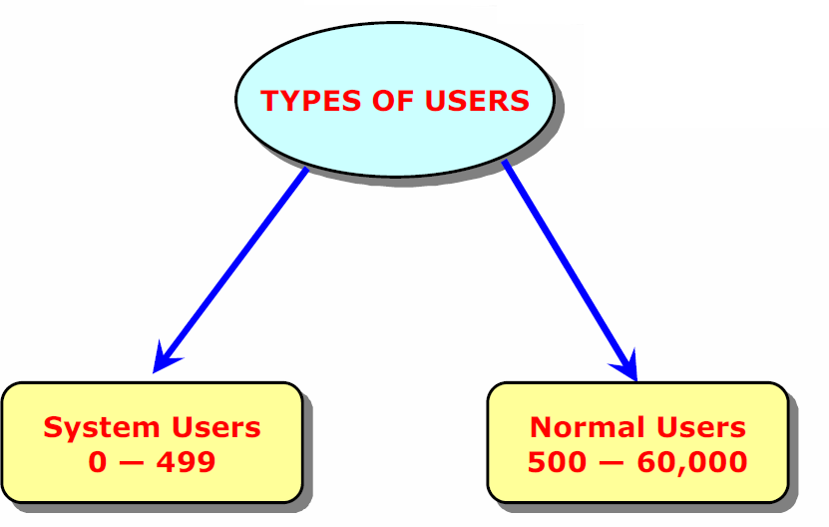
Types of Users
User and Group Administration Database Files
/etc/passwd
/etc/shadow
/etc/group

Slide 3
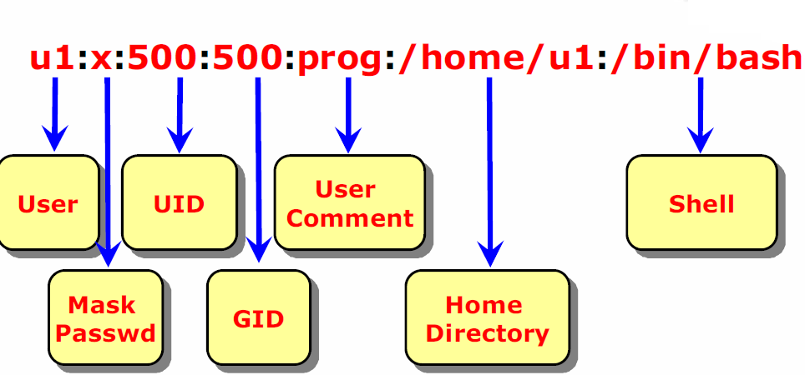
/etc/passwd - Database file of users

Slide 4
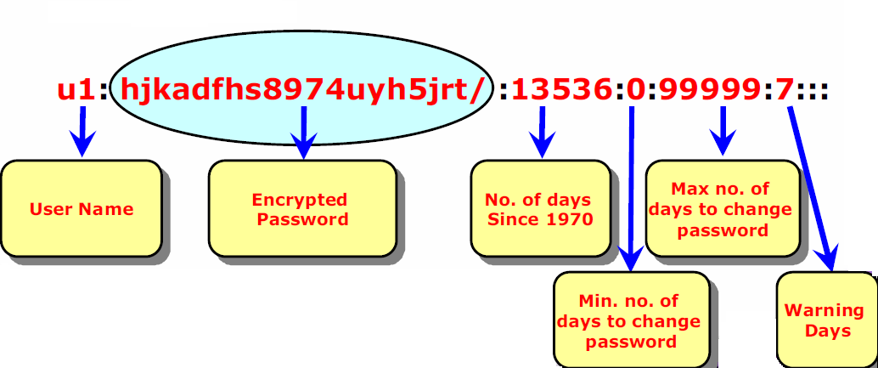
/etc/shadow
This file contains the encrypted user passwords assigned by the password binary file
Passwords are encrypted through DES (Data Encryption Standard ) or MD5 (Message Digest Ver. 5) Algorithm

Slide 5
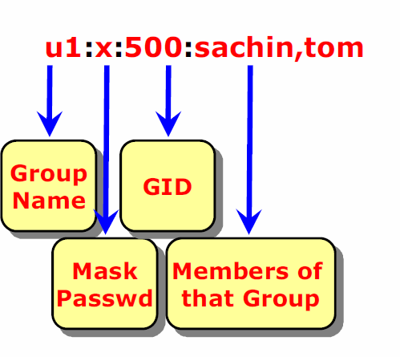
/etc/group
This file contains Group Name and GID of the groups

Slide 6
User Management
-- To create/modify/delete the user
•
•
•
useradd usermod userdel
syn for useradd:
useradd -u <uid> -g <GroupName> or <GID> -d <HomeDirectory> -m -s
<Shell> <Username>
ex: useradd -d /home/sravan -s /bin/bash –m sravan
-- Once you create the user, assigning the password passwd user1

Slide 7
User Management
•
If this is the first time, you creating the user, UID will be taken from the -
/etc/login.defs file.
•
GroupName or GID - It will create the new group with the username and assgins that group for the user.
•
If this is the first time, you creating the group, GID will be taken from the -
/etc/login.defs otherwise, UID will be taken from the /etc/passwd GID will be taken from the /etc/group

Slide 8
User Management
User Modification:
syn: usermod <options> <username> Options :
•
•
•
-L - Lock the account
-U - Unlock the account
-G –Add user to specific group
User Deletion
syn: userdel <options> <username>
Options :
-r - recursively

Slide 9
User Management
--To create/modify/delete the groups
groupadd
groupmod
groupdel
Group Creation
syn: groupadd <options> <groupname> Options :
-g - GID
-o - override
11-‹#›

Slide 10
Refer
https://www.howtogeek.com/50787/add-a-user-to-a-group-or-second-group-on-linux/
https://www.javatpoint.com/linux-user-management
https://www.tecmint.com/manage-users-and-groups-in-linux/

Slide 11
Find the Difference
•
Add a new user called vivek to a group called vsftp, enter:
# useradd -G vsftp -d /data/home/vivek -m vivek
# passwd vivek
•
Add Existing User To A Secondary Group
# usermod -G sales vivek
•
Add user tom to sales but also keep his existing membership of ftpusers, enter:
# usermod -G ftpusers,sales tom
Add Existing User To A Primary Group # usermod -g sales jerry
11-‹#›

Slide 12
CronJobs
•
When ever you perform any action repetitively we use the Cron Jobs, it is also called Automation of Jobs/Tasks or Scheduling of Jobs/tasks.
How to work with the Cron Jobs
•
–
–
–
crontab -e - to create the new cron Job
crontab -l - to list the cron job for that particular user
crontab -r - to remove the cron jobs completely for that user.
•
How to schedule a job?
crontab -e - It will open a vi editor kind of editor, if you have any existing cron jobs, it will open the editor with those jobs. otherwise, it will be empty
syn: minutes hours day month week task/job/action
•
•
•
•
•
Minutes - 00-59
Hours - 00-23
Days - 1-31
Month - 1-12
Week - 0-6( 0 sun)
11-‹#›

Slide 13
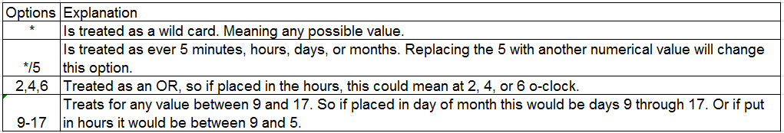
CronJobs
Ex: 0 12 14 2 * mkdir /root/crontest
11-‹#›

Slide 14
CronJobs
•
Where it will store the cron jobs?
/var/spool/cron - where all cron jobs stored. each and every user will have an file in this location with their user names, If they have the cron jobs scheduled.
Ex:
–
–
root user cron file user1 cron file
/var/spool/cron/root
/var/spool/cron/user1
•
All of your cron activities will be logged at one log file.
/var/log/cron
•
How do display the cronjobs?
–
–
crontab -l
crontab -l -u praveen
11-‹#›

