Slide 1
Data Science Course Overview

Slide 2
Serhiy Protsenko Doctor of Science, Professor from Sumy state university, ua. Primary Expertise: Physics of solid state, applied physics, material science, experimental technics Secondary Expertise: Labview, data science, python
Who Am I?

Slide 3
Content Philosophy
Application-based approach
Understand key principles
Balance depth with breadth
Course project

Slide 4

Communication
Communicate early and often
We will communicate via Telegram Messenger
https://telegram.org/
Public channel: @DataScienceLublin t.me/DataScienceLublin
Chat group: link is in channel @DataScienceLublin
We will use GitHub
https://github.com/SerhiyProtsenko/LublinDataScienceWorkshop

Slide 5
Set-up Your Environment
Prerequisites:
Hardware:
Laptop or PC :)
2+ Cores, 4+ Gb of RAM (ideally 8+ Gb)
Free disc space 3+ Gb
Software:
Recent build of Anaconda for Python https://www.anaconda.com/download/

Slide 6
Set-up Your Environment
Installations:
Download (detail is in channel telegram or GitHub) and install latest Anaconda build for Python 3.6+
Profit! You are ready to create/view Jupyter .ipynb notebooks

Slide 7
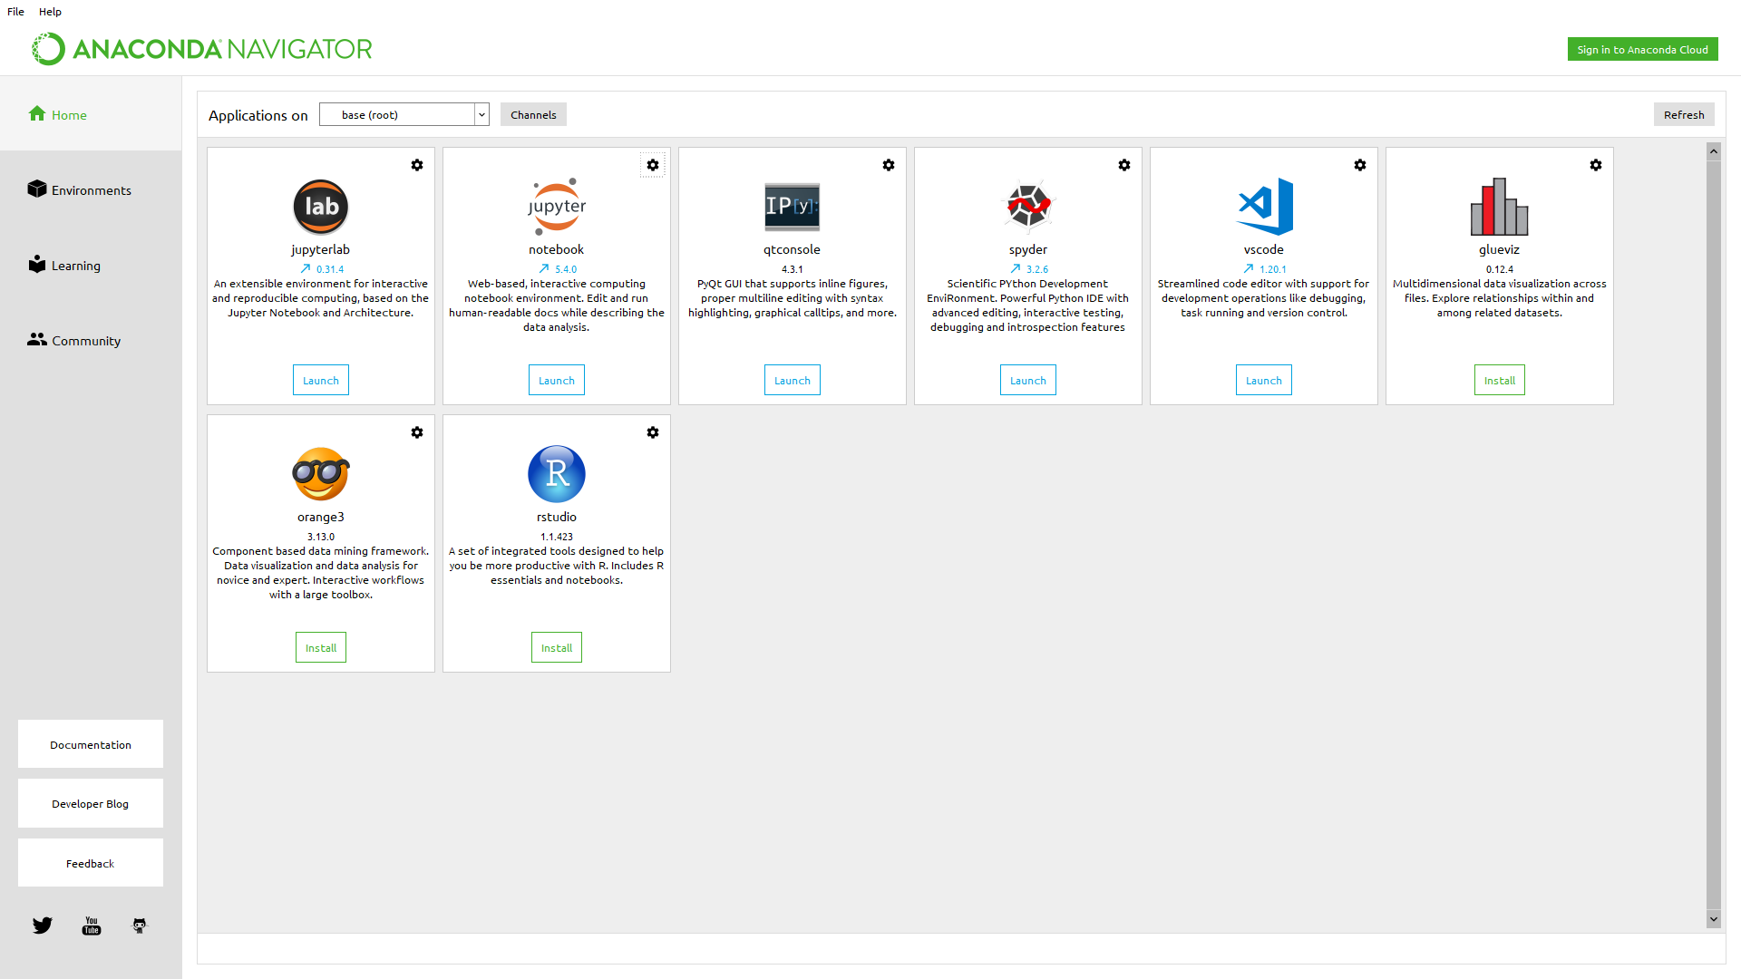
Anaconda navigator

Slide 8
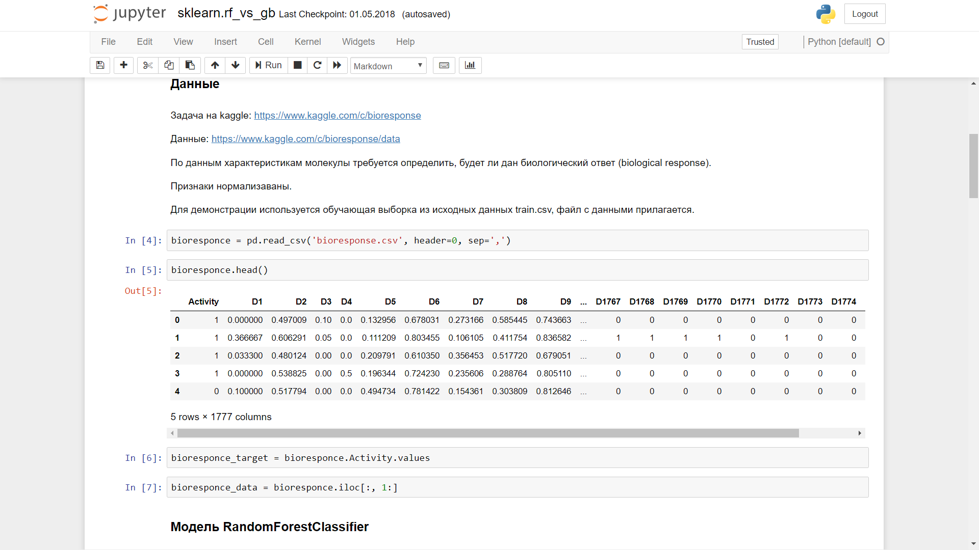
Jupiter notebook

Slide 9
How to Succeed
Effort not prior knowledge
Communicate what you’ve learned
Help your classmates
Be patient with yourself

Slide 10
Typical Class
Lecture
Code walk-throughs
Code exercises
Discussion of homework and readings
Exam

