Slide 1
Data Science Course Overview

Slide 2
Serhiy Protsenko Doctor of Science, Professor from Sumy state university, ua. Primary Expertise: Physics of solid state, applied physics, material science, experimental technics Secondary Expertise: Labview, data science, python
Who Am I?

Slide 3
Content Philosophy
Application-based approach
Understand key principles
Balance depth with breadth
Course project
Notes:
Application-based approach – I will be teaching you a combination of theory and practical implementation and having you practice things as much as possible – my goal is that you can effectively use these tools to do data science – data science means implementation, not just ideas
Understand key principles – I want you to understand the principles behind the methods and algorithms – “black box” data science will only get you so far – understanding what you’re doing and why will get you much further
Balance depth with breadth – I want you to know enough depth that you understand what you are doing, but not so much that we exclude crucial topics.
Course project – I am going to focus on the project from the start because that is where a lot of learning will occur

Slide 4

Communication
Communicate early and often
We will communicate via Telegram Messenger
https://telegram.org/
Public channel: @DataScienceLublin t.me/DataScienceLublin
Chat group: link is in channel @DataScienceLublin
We will use GitHub
https://github.com/SerhiyProtsenko/LublinDataScienceWorkshop
Notes:
Communicate early and often – I want to know how you are doing with the course, what confuses you, what learning style works for you and what doesn’t – keep us updated so I can help you to be successful – I am going to be checking in with you throughout the course and getting your feedback
Announcements and news will be published in this channel.
I invite to chat
We will use GitHub

Slide 5
Set-up Your Environment
Prerequisites:
Hardware:
Laptop or PC :)
2+ Cores, 4+ Gb of RAM (ideally 8+ Gb)
Free disc space 3+ Gb
Software:
Recent build of Anaconda for Python https://www.anaconda.com/download/

Slide 6
Set-up Your Environment
Installations:
Download (detail is in channel telegram or GitHub) and install latest Anaconda build for Python 3.6+
Profit! You are ready to create/view Jupyter .ipynb notebooks

Slide 7
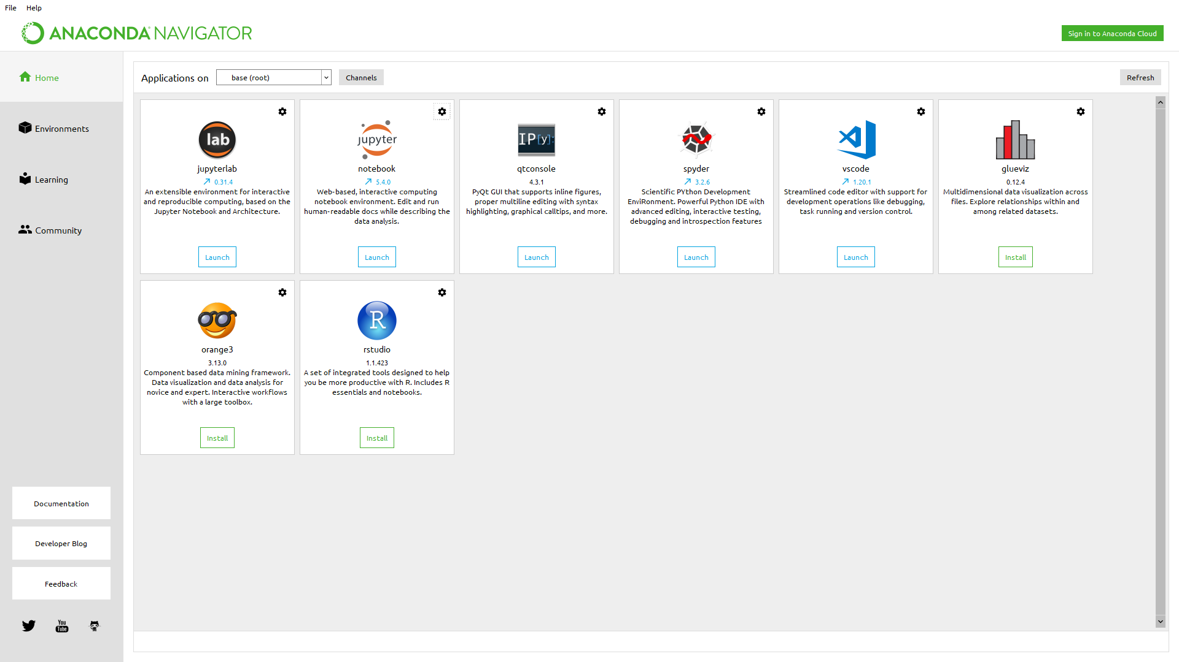
Anaconda navigator
Notes:
Anaconda is The Most Popular Python Data Science Platform.
Anaconda Distribution
With over 6 million users, the open source Anaconda Distribution is the easiest way to do Python data science and machine learning. It includes 250+ popular data science packages and the conda package and virtual environment manager for Windows, Linux, and MacOS. Conda makes it quick and easy to install, run, and upgrade complex data science and machine learning environments like Scikit-learn, TensorFlow, and SciPy. Anaconda Distribution is the foundation of millions of data science projects as well as Amazon Web Services' Machine Learning AMIs and Anaconda for Microsoft on Azure and Windows.
Reproducible Data Science and Machine Learning
The Python and R conda packages in the Anaconda Repository are curated and compiled in our secure environment so you get optimized binaries that "just work" on your system. Combined with conda's virtual environments and deep dependency management, you can easily reproduce exactly the same data science results across Windows, Linux, and MacOS systems. The 1,000+ packages in the Anaconda Repository are free for everyone, and we also host the Conda Forge community of conda package builders on anaconda.org.

Slide 8
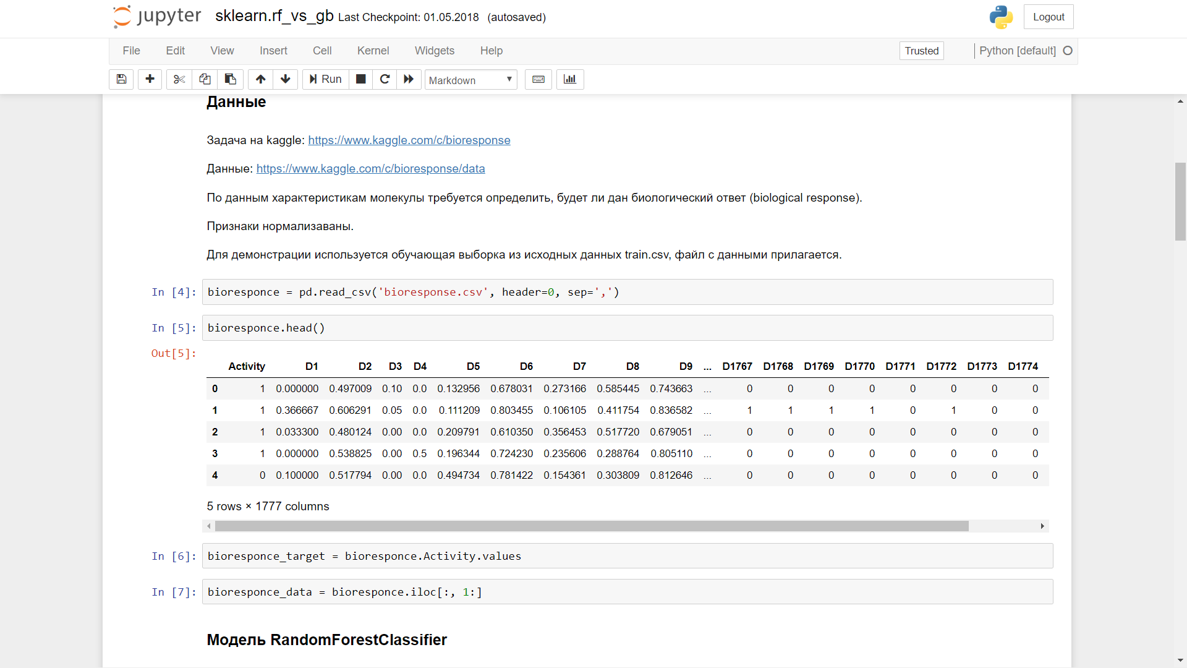
Jupiter notebook
Notes:
Project Jupyter is a non-profit, open-source project, born out of the IPython Project in 2014 as it evolved to support interactive data science and scientific computing across all programming languages. Jupyter will always be 100% open-source software, free for all to use and released under the liberal terms of themodified BSD license.
Jupyter is developed in the open on GitHub, through the consensus of the Jupyter community.

Slide 9
How to Succeed
Effort not prior knowledge
Communicate what you’ve learned
Help your classmates
Be patient with yourself
Notes:
Effort not prior knowledge – It’s not about what you know now, it’s about what you put into the course
Communicate what you’ve learned – Blog about class, share it with others – will definitely deepen your knowledge
Help your classmates – We are all teachers and we are all learners – don’t be shy
Be patient with yourself – It’s okay if you don’t understand some of the course material – there is a lot of material and the complexity can be quite high – focus on learning as much as you can – I want to equip you with enough knowledge that you can learn independently both during and after this course

Slide 10
Typical Class
Lecture
Code walk-throughs
Code exercises
Discussion of homework and readings
Exam

