Slide 1
DATA SCIENCE Intro to Data Science

Slide 2
0. who Is A Data Scientist? I. How Data Scientists Add Value II. the Data Mining Workflow
AGENDA
Notes:
All of our classes will involve some hands-on work (in the exercises section)

Slide 3
who Is A Data Scientist?
INTRO TO DATA SCIENCE
Notes:
Data science is the exploration and quantitative analysis of all available structured and unstructured data to develop understanding, extract knowledge, and formulate actionable results.

Slide 4
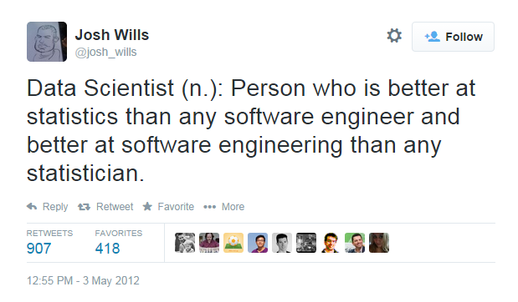
WHO IS A DATA SCIENTIST?
Notes:
~15-20 min for this section?

Slide 5
WHO IS A DATA SCIENTIST?
Data Scientists solve
complex problems
using data mining techniques
Problem
Domain
Computer Science
Statistics
Notes:
~15-20 min for this section?

Slide 6
WHO IS A DATA SCIENTIST?
Wide variance in terms of skillsets: many job descriptions are more appropriate for a team of data scientists
Data Scientists solve
complex problems
using data mining techniques
Problem
Domain
Computer Science
Statistics
Notes:
Data Scientists are Obsessed with Data
Finding data sources
Acquiring data
Cleaning and transforming data
Understanding relationships in data
Delivering value from data
Visualizing the result

Slide 7
How Data Scientists Add Value
INTRO TO DATA SCIENCE
Notes:
~15-20 min for this section?

Slide 8
HOW DATA SCIENTISTS ADD VALUE
Data mining techniques generally add value by doing one of four things:
Predicting the bad
Identifying the good
Automating existing processes
Identifying patterns in data
Data scientists can be found within many fields: let’s look at some additional examples to motivate this course.
Source: https://www.youtube.com/watch?v=fPzmnRj671Y

Slide 9
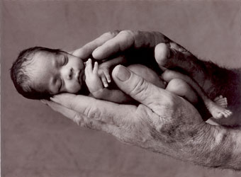
Example #1: Predicting Neonatal Infection
Problem: Children born prematurely are at high risk of developing infections, many of which are not detected until after the baby is sick
Goal: Detect subtle patterns in the data that predicts infection before it occurs
Data: 16 vital signs such as heart rate, respiration rate, blood pressure, etc…
Impact: Model is able to predict the onset of infection 24 hours before the traditional symptoms of infection appear
Image: http://www.babycaretips4u.com/wp-content/uploads/2014/03/premature-baby.jpg
Case Study: http://www.amazon.com/Big-Data-Revolution-Transform-Think/dp/0544002695

Slide 10

Example #2: Automating Government Paper-Pushing
Problem: Processing disability claims at the Social Security Administration is a time-intensive process, with many claims taking over 2 years to adjudicate
Goal: Automate the approval of a subset of the “simplest” disability claims
Data: Free text in the claims form
Impact: Able to fully automate 20% of the simplest claims. Rating accuracy of the algorithm is higher than the average claims examiner.
Case Study: http://datamininglab.com/images/case-studies/ERI_Text_Mining_SSA_Claims_for_Disability_Approval.pdf
Notes:
Other notable examples:
Google’s AI Predictions i.e., in Search and Maps
Voice Recognition for Virtual Assistants
Uber and Lyft price determination
Autopilot for Commercial Flights
Facebook Face recognition
Email Categorizations
Plagiarism Checkers
Optical Character recognition for Mobile Deposits etc
Fraud Prevention
Credit Decisions

Slide 11
the data Mining workflow
INTRO TO DATA SCIENCE
Notes:
~15-20 min for this section?
So what does data science look like?

Slide 12
The data MINING WORKFLOW
0. Define the problem / question
I. Identify and collect data
II. Explore and prepare data
III. Build and evaluate model
IV. Communicate results
Notes:
Lots of names you’d expect (also obama, nyt → politics = growth area)
Q: can you think of any others? → show some example in the browser
Soon the question will be: who doesn’t use data science?

Slide 13
0. Define the Problem / Question
THE DATA MINING WORKFLOW
Can I predict infection before it occurs?
Can I predict claim approval from the start of the process?
Notes:
~15-20 min for this section?

Slide 14
I. IDENTIFY AND COLLECT DATA
THE DATA MINING WORKFLOW
Vital Areas: Heart Rate, Blood Pressure, etc…
Want to collect all data on the claim form (mostly free text)
Notes:
~15-20 min for this section?

Slide 15
II. EXPLORE AND PREPARE DATA
THE DATA MINING WORKFLOW
Aggregate data at the minute level
Cluster like words
Notes:
~15-20 min for this section?

Slide 16
III. BUILD AND EVALUATE Models
THE DATA MINING WORKFLOW
Compare Decision Tree with Logistic Regression
Start with Naïve Bayes Classifier
Notes:
~15-20 min for this section?

Slide 17
IV. COMMUNICATE RESULTS
THE DATA MINING WORKFLOW
Create custom dashboard for doctors and nurses
Create report and dashboard proof of concept
Notes:
~15-20 min for this section?

