Slide 1


From DBA to
AI Agent Wrangler
Bringing Safe, Compliant AI Agents to SQL Server
A practical guide for DBAs in regulated, on-prem environments
1 / 27
Notes:
Welcome everyone. Today we're going to talk about what happens when AI agents—not just chatbots, but autonomous agents—start knocking on the door of your SQL Server instances. This is a practical talk. No hype. We'll cover what agents are, how they connect to SQL Server, what guardrails you need, and how your role as a DBA is evolving. Everything I show today assumes on-prem or regulated environments where compliance isn't optional.

Slide 2
Agenda — 50 Minutes
1
What Are AI Agents?
Chatbots vs agents, key differences
5 min
2
Agents + SQL Server
Architecture, MCP protocol, connection patterns
10 min
3
Demo
MCP agent querying SQL Server with guardrails
10 min
4
Compliance & Guardrails
Audit, security, regulatory requirements
10 min
5
The DBA Role, Evolved
New skills, new responsibilities
8 min
6
Tools & Takeaways
"Who Changed That?", Security Check, next steps
7 min
Overview
2 / 27
Notes:
Here's our roadmap for the next 50 minutes. We start with definitions—making sure everyone is on the same page about what AI agents actually are. Then we get into the architecture of how agents talk to SQL Server, followed by a live demo. The middle section is all compliance—10 full minutes because this is the part that matters most in regulated shops. Then we talk about how the DBA role is changing, and we close with some concrete tools you can start using.

Slide 3

Section 1
What Are AI Agents?
3 / 27
Notes:
Let's start with the basics. The term 'AI agent' gets thrown around a lot, and it's important to be precise about what we mean—especially when we're talking about giving something access to production databases.

Slide 4
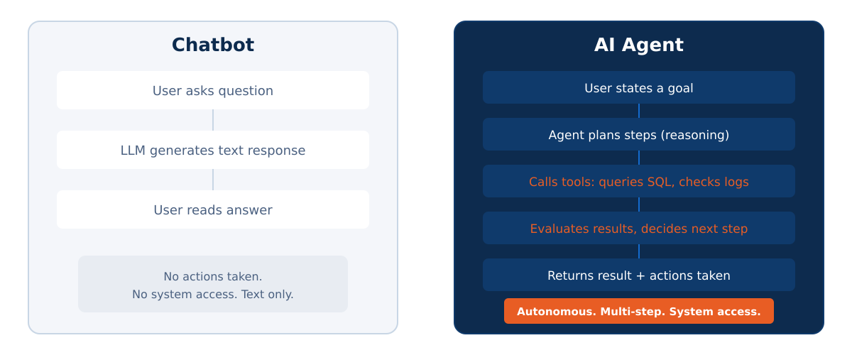
Chatbot vs. AI Agent
What Are AI Agents?
4 / 27
Notes:
Here's the key distinction. A chatbot is reactive: you ask a question, it generates text, done. An AI agent is goal-directed: you state an objective, and the agent plans steps, calls tools, evaluates results, and loops until the goal is met. Critically, agents take actions in the real world—they execute queries, modify data, call APIs. That's a fundamentally different risk profile than a chatbot that just generates text.

Slide 5




Key Properties of an AI Agent
Reasoning
Plans multi-step actions, not just one-shot answers
Tool Use
Calls external tools—APIs, queries, scripts—autonomously
Memory / State
Maintains context across steps; remembers what it's tried
Observation
Reads tool outputs, evaluates success, adapts plan
What Are AI Agents?
5 / 27
Notes:
Four properties define an agent. First, reasoning—it doesn't just pattern-match, it plans. Second, tool use—this is the big one for us. Third, memory—it keeps track of what it's done. Fourth, observation—it reads results and decides next steps.

Slide 6
Section 2
Agents + SQL Server
6 / 27
Notes:
Now let's get into the architecture. How does an AI agent actually talk to SQL Server? This is where the Model Context Protocol—MCP—comes in.

Slide 7
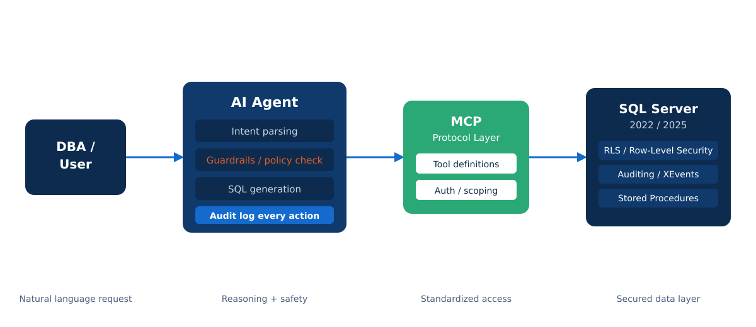
Agent-to-SQL Server Architecture
Agents + SQL Server
7 / 27
Notes:
The user makes a natural language request. The AI agent parses intent, checks guardrails, generates SQL, and logs every action. Between the agent and SQL Server sits the MCP protocol layer. On the SQL Server side, you use all your existing security: least-privilege logins, RLS, auditing, stored procedures.

Slide 8
What is MCP?
Model Context Protocol
Open standard for agent-tool communication
MCP Tool Definition
{
"name": "query_sql",
"description": "Run
read-only SQL query",
"parameters": {
"query": "string",
"database": "string"
},
"permissions": [
"db_datareader"
]
}
Defines tools an agent can call (like an API contract)
Handles authentication, parameter validation
Supports SQL Server via community MCP servers
Can be self-hosted on-prem—no cloud dependency
Agents + SQL Server
8 / 27
Notes:
MCP stands for Model Context Protocol. It's an open standard—not vendor-locked. MCP defines exactly which tools an agent can call, what parameters it can pass, and what permissions it needs.

Slide 9



Connection Patterns for Agents
Read-Only Explorer
Agent can SELECT from approved views and tables. No writes. Ideal starting point.
Stored Proc Executor
Agent calls pre-approved stored procedures only. No ad-hoc SQL. Strongest control.
Supervised Write
Agent proposes DML; DBA approves before execution. Human-in-the-loop pattern.
Agents + SQL Server
9 / 27
Notes:
Three patterns for agent access. Read-Only Explorer is your starting point. Stored Proc Executor is strongest control. Supervised Write requires DBA approval. Start read-only and earn your way up.

Slide 10



SQL Server 2025: AI-Relevant Features
Native Vector Search
Store and query embeddings directly in SQL Server. No external vector DB needed.
sp_invoke_external_rest_endpoint
Call REST APIs from T-SQL. Agents can be orchestrated partly from within the database.
Enhanced JSON / DynamicJSON
Better JSON handling for structured data exchange with agents and MCP servers.
Improved Security Auditing
Finer-grained audit events. Every agent action can be captured and correlated.
Agents + SQL Server
10 / 27
Notes:
SQL Server 2025 adds native vector search, REST endpoint invocation, better JSON, and improved auditing—all directly relevant to AI agent scenarios.

Slide 11
Section 3
Demo: MCP Agent + SQL Server
11 / 27
Notes:
Time for a demo. Before switching to VS Code, remind the audience what they're about to see. --- PRE-DEMO PREPARATION (do this before the talk) --- 1. CLONE THE REPO: git clone https://github.com/Azure-Samples/SQL-AI-samples.git cd SQL-AI-samples/MssqlMcp/Node npm install (this builds the TypeScript to dist/index.js automatically) 2. VERIFY SQL SERVER IS RUNNING: - SQL Server 2025 Developer Edition, local instance - AdventureWorks database restored - SQL Server Audit configured (see companion site for script) 3. CREATE TWO SQL LOGINS: a) AgentFullAccess — db_owner on AdventureWorks (for the 'scary' demo) b) AgentReadOnly — db_datareader on Sales and Production schemas only 4. CONFIGURE VS CODE: - GitHub Copilot Chat extension installed - Two MCP configs saved (switch between them during demo) - Settings > MCP Servers should show 'MSSQL MCP' 5. TEST EVERYTHING: - Start MCP server, type 'List tables in the database' - Verify it returns AdventureWorks tables - Kill and restart to clear state before going live

Slide 12
Demo Environment
Stack
What We'll Show
SQL Server 2025 (on-prem, Developer Edition)
Agent receives natural language request
MCP Server (Azure-Samples/SQL-AI-samples)
MCP server validates and scopes the request
Claude / GPT-4 as the LLM backbone
Agent generates & executes read-only SQL
AdventureWorks sample database
Guardrail blocks an unauthorized write attempt
Windows Authentication (service account)
Every action logged to SQL Server Audit
SQL Server Audit enabled
DBA reviews agent activity in real-time
Demo
12 / 27
Notes:
DEMO SETUP SLIDE — Walk through this verbally, then switch to VS Code. --- WHAT TO SAY --- We're using the MssqlMcp server from Microsoft's Azure-Samples/SQL-AI-samples repo. It's a .NET and Node.js MCP server that exposes 7 tools: ListTables, DescribeTable, CreateTable, DropTable, InsertData, ReadData, and UpdateData. Out of the box, it gives the agent full CRUD access — which is exactly the problem we're going to solve. --- VS CODE CONFIG (already saved, show it briefly) --- Open VS Code Settings (Ctrl+Shift+P > 'Open Settings JSON') and show: { "mcp": { "servers": { "MSSQL MCP": { "type": "stdio", "command": "node", "args": ["C:\\src\\SQL-AI-samples\\MssqlMcp\\Node\\dist\\index.js"], "env": { "SERVER_NAME": "localhost", "DATABASE_NAME": "AdventureWorks", "TRUST_SERVER_CERTIFICATE": "true" } } } } } Point out: the connection uses local auth, targets AdventureWorks, and the MCP server is self-hosted — no cloud calls. --- THEN --- Click 'Start' next to the MCP server entry. Show the 'Running' status. Open Agent Mode chat (Ctrl+Shift+I). Click the Tools icon and show the 7 MSSQL MCP tools listed. Say: 'Notice it has ListTables, ReadData, but also CreateTable and DropTable. That's what we'll lock down.'

Slide 13
Demo: Read-Only Query
● ● ● MCP Agent Terminal
> User: "Show me the top 5 products by revenue
this quarter from AdventureWorks"
[Agent] Planning: need Sales.SalesOrderDetail +
Production.Product for current quarter...
[MCP] Tool: query_sql | DB: AdventureWorks
| Perms: db_datareader ✓
[Agent] Executing SELECT query...
[Audit] Action logged: agent_read | 2025-06-15
10:23:41 | rows_returned: 5
[Agent] Result: Top 5 products returned ✓
Demo
13 / 27
Notes:
DEMO PART 1: THE HAPPY PATH — Read-only query succeeds. --- LIVE STEPS IN VS CODE --- 1. In Agent Mode chat, type exactly: 'Show me the top 5 products by total revenue this quarter from AdventureWorks' 2. WATCH THE AGENT WORK (narrate each step for the audience): - Agent calls ListTables to discover the schema - Agent calls DescribeTable on Sales.SalesOrderDetail - Agent calls DescribeTable on Production.Product - Agent calls ReadData with a SELECT query joining the tables - Point out: each tool call shows in the chat with parameters 3. SHOW THE RESULT: - Agent returns a formatted table of top 5 products - Say: 'The agent discovered the schema, planned the join, executed a SELECT, and returned results. All read-only. All through MCP tools.' 4. SHOW THE AUDIT (switch to SSMS or Azure Data Studio): - Run the audit query from the companion site: SELECT event_time, action_id, statement, server_principal_name FROM sys.fn_get_audit_file('C:\AuditLogs\Agent\*.sqlaudit', NULL, NULL) WHERE server_principal_name = 'AgentServiceAccount' ORDER BY event_time DESC; - Point out the SELECT statements logged with timestamps --- IF SOMETHING GOES WRONG --- - If agent times out: 'This is live — sometimes the LLM takes a moment to plan.' - If wrong result: 'Notice it gave us slightly different results — the LLM isn't deterministic, which is exactly why we need guardrails, not just good prompts.'

Slide 14
Demo: Guardrail Blocks a Write
● ● ● MCP Agent Terminal
> User: "Update the price of product 680
to $49.99"
[Agent] Planning: UPDATE Production.Product
SET ListPrice = 49.99 WHERE ProductID = 680
[MCP] ✖ BLOCKED: Write operation not permitted
[MCP] Policy: agent_readonly | No DML allowed
[Audit] Action logged: agent_write_blocked |
severity: WARNING | escalated: true
[Agent] "I can't modify data directly. This
request has been flagged for DBA review."
Demo
14 / 27
Notes:
DEMO PART 2: THE GUARDRAIL IN ACTION — Write attempt gets blocked. --- OPTION A: USING SQL SERVER PERMISSIONS (recommended, most reliable) --- 1. BEFORE THIS STEP: Switch the MCP server connection to use the AgentReadOnly login. - Stop the MCP server in VS Code - Change the connection string env var to use the read-only service account - Restart the MCP server - Say: 'I've now switched to our least-privilege service account that only has db_datareader.' 2. In Agent Mode chat, type: 'Update the list price of ProductID 680 to $49.99 in the Production.Product table' 3. WATCH IT FAIL (narrate for audience): - Agent calls DescribeTable on Production.Product (succeeds) - Agent attempts UpdateData or InsertData tool - SQL Server returns permission denied error - Agent reports: 'I don't have permission to modify this data' - Say: 'The MCP server passed the request through, but SQL Server denied it. Defense in depth — even if the MCP layer didn't catch it, the database did.' 4. SHOW THE AUDIT: - Run the same audit query — show the FAILED action logged - Point out the action_id shows it was an UPDATE attempt that was denied --- OPTION B: USING MCP READONLY FLAG (simpler but less dramatic) --- - Set READONLY=true in the MCP server env config - The MCP server itself will refuse to expose write tools - Show that the Tools list in VS Code now only shows ListTables, DescribeTable, ReadData - Say: 'With READONLY mode, the agent never even sees the write tools.' --- KEY TALKING POINT --- Say: 'Two layers stopped this. The MCP server can filter tools, and SQL Server enforced permissions. Neither alone is sufficient — together they're robust.'

Slide 15


Demo Takeaways
Agent access is constrained by MCP tool definitions—not by the LLM's judgment
SQL Server's existing security (RLS, audit, permissions) works as-is
Write operations require explicit policy approval, not just agent intent
Every action—success or failure—is logged and auditable
The LLM can still hallucinate queries. Guardrails catch them before execution.
Demo
15 / 27
Notes:
DEMO WRAPUP — Switch back from VS Code to slides. --- WHAT TO SAY --- Walk through each takeaway on the slide: 1. 'The agent's access was constrained by the MCP tool definitions and SQL Server permissions — not by the LLM's own judgment about what it should or shouldn't do. The LLM wanted to run that UPDATE. The infrastructure said no.' 2. 'We didn't install any new security product. RLS, audit, permissions — all standard SQL Server features that have been there for years. They work against agents the same way they work against any other client.' 3. 'Write operations required explicit policy — a service account with only db_datareader. The agent's intent to write was irrelevant; the permissions said read-only.' 4. 'Every single action — the successful SELECTs and the failed UPDATE — showed up in SQL Server Audit. Complete forensic trail.' 5. 'Important caveat: the LLM can still generate queries that are syntactically valid but semantically wrong. It might join on the wrong column or misunderstand a date range. Guardrails prevent unauthorized actions, but you still need to validate the results make business sense.' --- TRANSITION --- Say: 'Now let's formalize what we just saw into a compliance framework. If your auditor asks how you're securing agent access, this next section gives you the answer.'

Slide 16
Section 4
Compliance, Auditability
& Guardrails
16 / 27
Notes:
This is the section that matters most for anyone in a regulated environment.

Slide 17
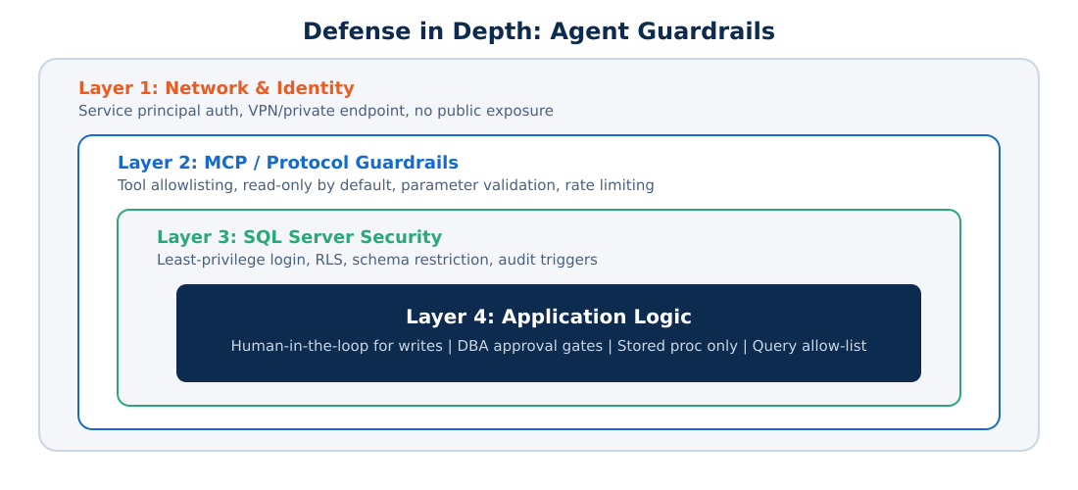
Defense in Depth for Agent Access
Compliance & Guardrails
17 / 27
Notes:
Four layers. Network & Identity → MCP Protocol → SQL Server Security → Application Logic. Each layer assumes the one above might fail.

Slide 18

Regulatory Compliance Checklist
HIPAA
Audit all PHI access, minimum necessary principle, BAA with AI vendor
SOX
Change management controls, segregation of duties, complete audit trail
GDPR
Data minimization, right to explanation, no automated decisions without consent
PCI-DSS
No cardholder data in agent context, network segmentation, access logging
Compliance & Guardrails
18 / 27
Notes:
HIPAA, SOX, GDPR, PCI-DSS—each has specific requirements for AI agent access. SQL Server already has tooling for all of this.

Slide 19
Building an Agent Audit Trail
What to Log | Where | Why
Agent identity & session ID | MCP server log | Correlate actions to specific agent instance
Natural language request (original) | Application log | Understand user intent for forensics
Generated SQL (exact text) | SQL Server Audit / XEvents | Verify what actually ran vs. intended
Rows accessed / modified (count) | SQL Server Audit | Detect over-broad queries
Blocked actions + reason | MCP server log + alert | Compliance evidence; threat detection
Execution duration & resource usage | SQL Server XEvents | Performance impact monitoring
Compliance & Guardrails
19 / 27
Notes:
Six things to log: agent identity, original request, exact SQL, row counts, blocked actions, and execution duration. Spans MCP logs, app logs, and SQL Server Audit.

Slide 20
Section 5
The DBA Role, Evolved
20 / 27
Notes:
AI agents don't replace DBAs—they change what DBAs do. And the new responsibilities are more interesting.

Slide 21
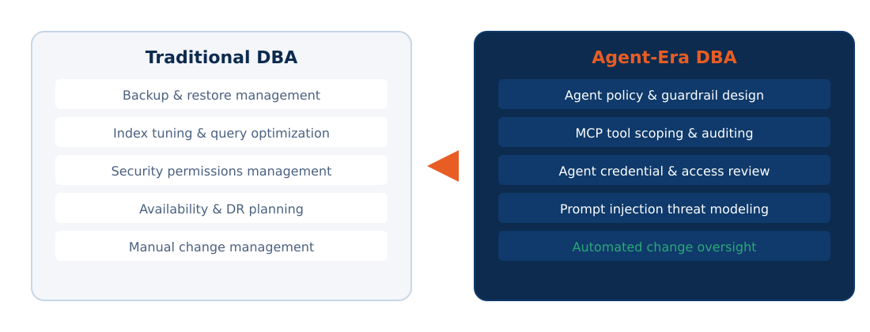
From Gatekeeper to Agent Architect
The DBA Role, Evolved
21 / 27
Notes:
Traditional DBA vs Agent-Era DBA side by side. You're not losing skills—you're adding agent policy design, MCP tool scoping, prompt injection awareness, and automated change oversight.

Slide 22
New Skills to Develop
MCP / Agent Protocol Fluency
Understand tool definitions, auth patterns, and scoping mechanisms
Prompt Injection Awareness
Know how malicious inputs can trick agents into running unintended queries
Agent Observability
Monitor agent behavior patterns, detect anomalies, correlate audit logs
Policy-as-Code
Define agent permissions declaratively—version-controlled, reviewable, testable
The DBA Role, Evolved
22 / 27
Notes:
Four skills: MCP fluency, prompt injection awareness, agent observability, and policy-as-code. All learnable, all build on existing security expertise.

Slide 23
Section 6
Tools & Takeaways
23 / 27
Notes:
Let's close with concrete tools and next steps.

Slide 24
"Who Changed That?"
Agent-aware change tracking for SQL Server
Schema Diff Tracking
Agent Attribution
Automatically detects and logs DDL changes made by agents vs. humans. Full before/after snapshots.
Correlates every change to the specific agent session, user request, and MCP tool call.
Alert & Escalation
Compliance Reports
Real-time alerts when agents make unexpected changes. Integrates with your existing monitoring.
Pre-built reports for SOX, HIPAA, and internal audit showing complete agent activity history.
Tools & Takeaways
24 / 27
Notes:
'Who Changed That?' provides schema diff tracking, agent attribution, real-time alerting, and compliance reports.

Slide 25

Security Check Tool
Automated security posture assessment for agent-connected SQL Server
Permission Audit
Configuration Check
Threat Simulation
Scans all agent service accounts. Flags over-privileged access. Recommends least-privilege fixes.
Validates MCP server config, audit settings, TDE status, network exposure. Scores your posture.
Simulates prompt injection and privilege escalation attempts against your agent setup.
Tools & Takeaways
25 / 27
Notes:
Security Check does permission audit, configuration check, and threat simulation. Run before going live and regularly after.

Slide 26
Key Takeaways
1
AI agents are not chatbots. They take actions. Treat them like any other service account with production access.
2
MCP gives you a control surface. Use it to define, scope, and audit every tool an agent can call.
3
Start read-only. Earn write access through proven guardrails, audit trails, and human-in-the-loop approval.
4
Your existing SQL Server security stack works. Layer agent-specific controls on top—don't replace what you have.
5
The DBA role gets more valuable, not less. You are the person who keeps agents safe and compliant.
Tools & Takeaways
26 / 27
Notes:
Five things to remember: agents take actions, MCP is your control surface, start read-only, existing security works, DBA role gets more valuable.

Slide 27
The agents are coming.
The DBA who understands them
becomes indispensable.
Thank you!
Questions?
27 / 27
Notes:
The bottom line: AI agents are coming to your SQL Server instances whether you're ready or not. The DBA who understands agent architecture, guardrails, and compliance becomes the most valuable person on the team.

