Slide 1

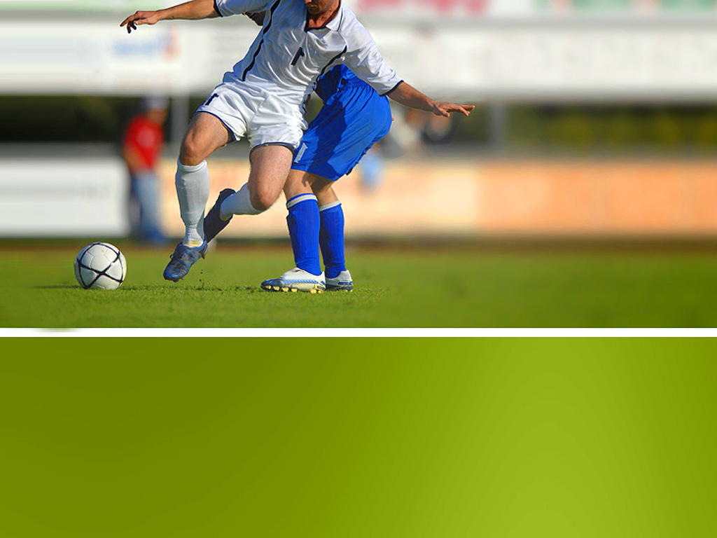
EN12024080186 Kowsalya R
FOOTBALL ANALYSIS

Slide 2
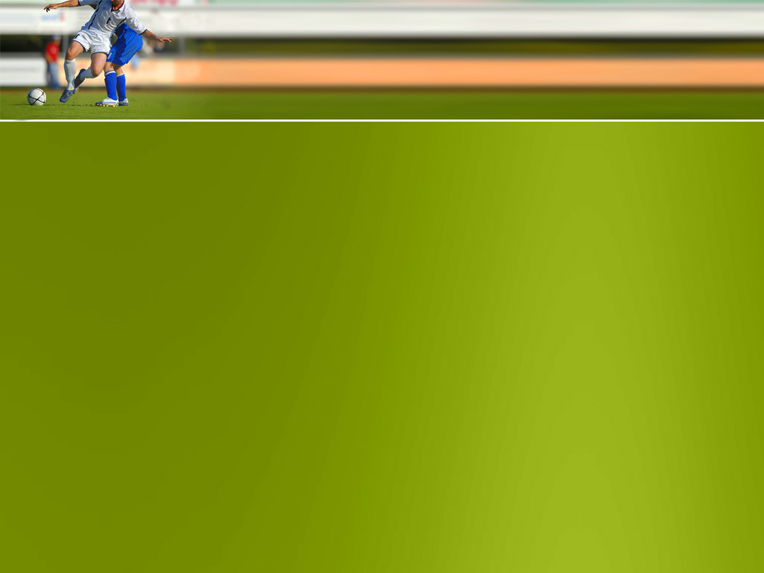
Objective
The objective of this presentation is to provide a comprehensive analysis of key factors influencing success in football, with a focus on player performance, team tactics, fan behavior.
Leveraging tools such as Excel, SQL, Python, and Tableau, we aim to dissect intricate game data to uncover insights crucial for optimizing team strategies and maximizing performance outcomes.

Slide 3




Tools Used
Widely used for data manipulation, analysis, and visualization.
Offers a user-friendly interface for basic statistical analysis and reporting, making it accessible to a broad range of users.
A popular relational database management system (RDBMS) used for storing and managing large datasets.
Provides powerful querying capabilities and supports advanced data analytics through SQL queries.
A web-based interactive computing environment used for data analysis, visualization, and sharing of code and results.
Supports multiple programming languages like Python, R, and Julia, making it versatile for various analytical tasks.
A leading data visualization tool that allows users to create interactive and insightful visualizations from various data sources.
Enables users to explore data, uncover patterns, and communicate insights effectively through dashboards and interactive reports.

Slide 4
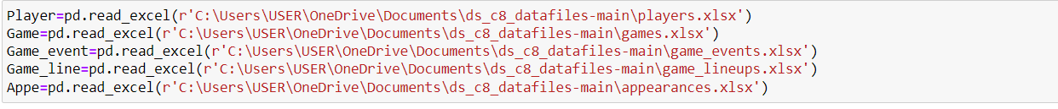
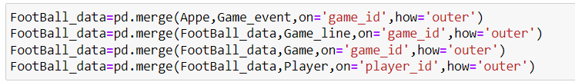
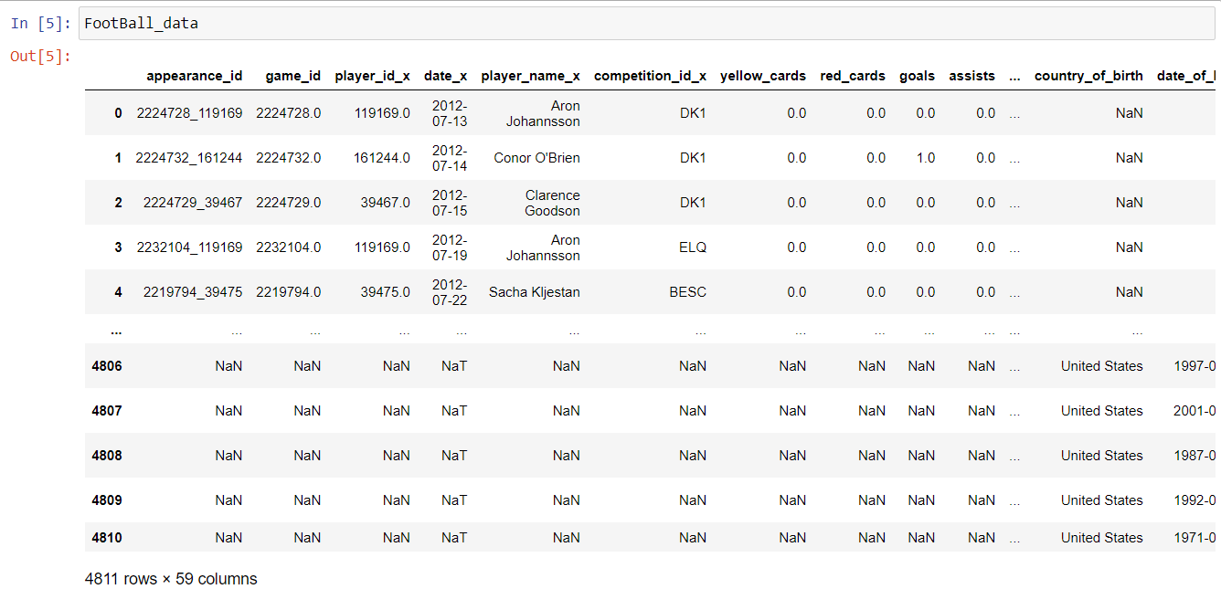
Data Preprocessing
Using Python,Read the different football dataset.
Using merge function, Join the datasets in single Data Frame.
Total rows and columns of the Data Frame of football is 4811 rows and 59 columns.

Slide 5
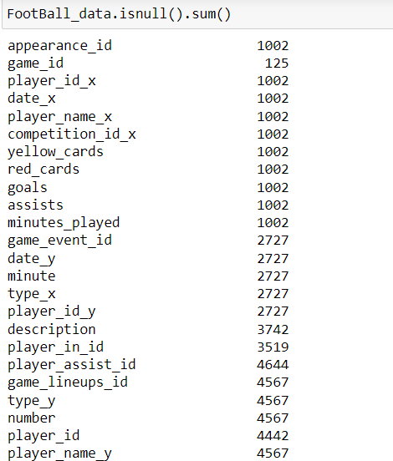
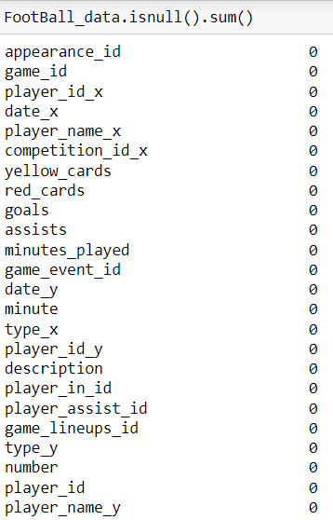
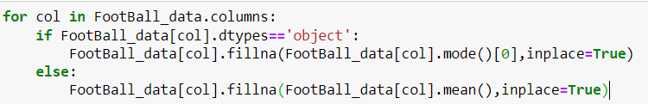
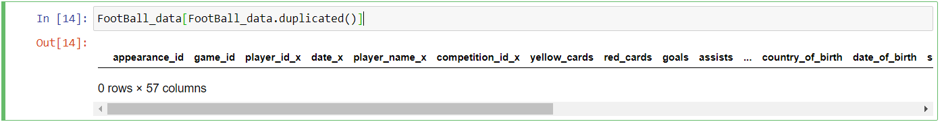
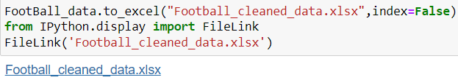
Data Preprocessing
Identifying there is any null values and duplicate rows. If there is any null value, Perform the null values replace with Categorical Columns in Mean and Numerical Columns in Mean.
Convert the cleaned data Frame to Excel for further analysis.

Slide 6
Focusing Area
Substitution Patterns
Event Analysis
Competition Analysis
Player Attributes and Demographics
Contract Management
Performance Analysis
Player Profile and Market Value
Team Comparison
Attendance and Stadium Analysis
Referee Analysis

Slide 7
Performance Analysis
Perform Analysis gives a insight of Player Performance such as Goals, Assists, Yellow and Red Card.
Identify key performance indicators (KPIs) such as goals scored, assists, yellow/red cards, and minutes played to evaluate player performance.
Chart from Excel with Interpretation of Chart

Slide 8
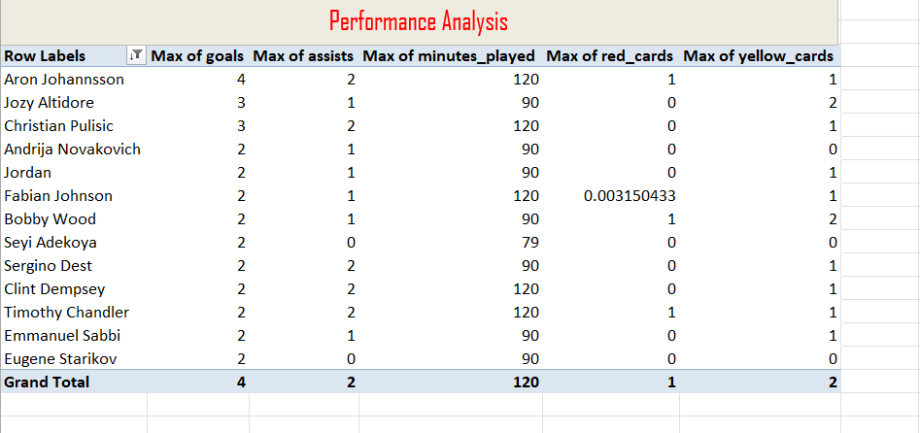
Performance Analysis
Interpretation:
Fabian Johnson Was score More goals in overall Seasons (1220).
Aron Johannsson Hits Maximum goals.

Slide 9
Player Profile And Market Value
Player Profile and Market Value gives insights for Which Player earn more Market value. For what they Earn More.
How do player attributes such as nationality influence their market value?
What is the correlation between a player’s Performance metrics goals, assists, red ,yellow Card and their Market Price?
Chart from Python matplotlib and Tableau with Interpretation of Chart

Slide 10
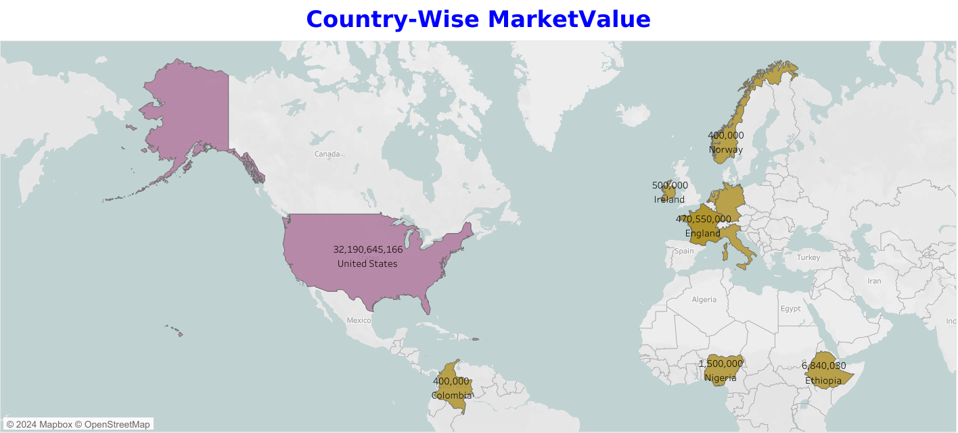
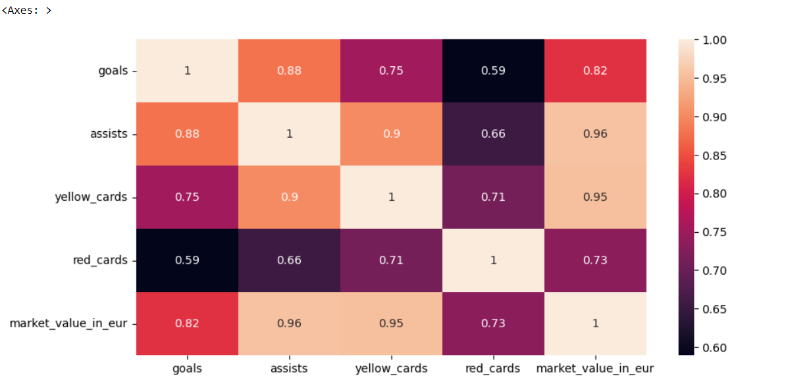
Player Profile And Market Value
Interpretation:
In US players Earn More Salary than Other Country.
Correlation Between Market Value and KPI’s are Positive Correlation. Assists have highly Correlated with Market value

Slide 11
Team Comparison
Team Comparison gives a insights for both Club Wise Key Performance of goals
Compare team performance metrics such as goals scored earned to benchmark against competitors.
Chart from Tableau with Interpretation of Chart

Slide 12
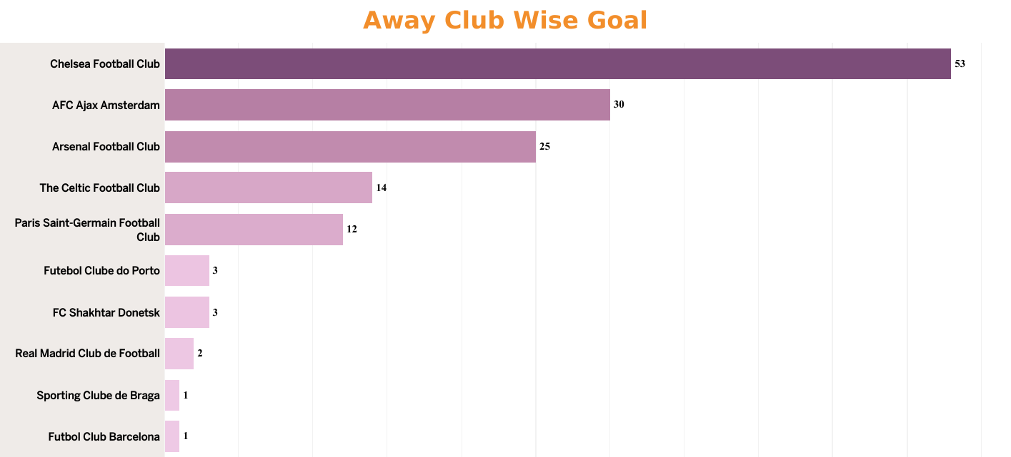
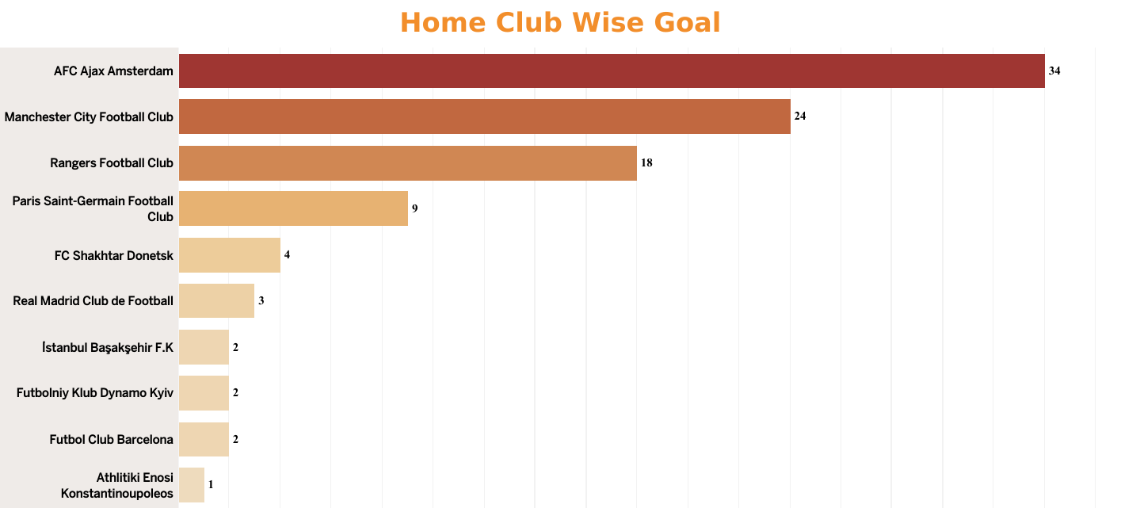
Team Comparison
Interpretation:
In Away Club(Chelsea Football Club) hits more Goals other than the other Clubs.
In both club Highest goal :
* Away Club- Chelsea Football Club
* Home Club- AFC Ajax Amsterdam

Slide 13
Attendance And Stadium Analysis
Attendance and Stadium analysis gives insights for which stadium have more attendance and which Competition have More Attendance
Which stadium have highest Attendance on past three season.
Which Competition have highest Attendance.
Chart from Excel and Tableau with Interpretation of Chart

Slide 14
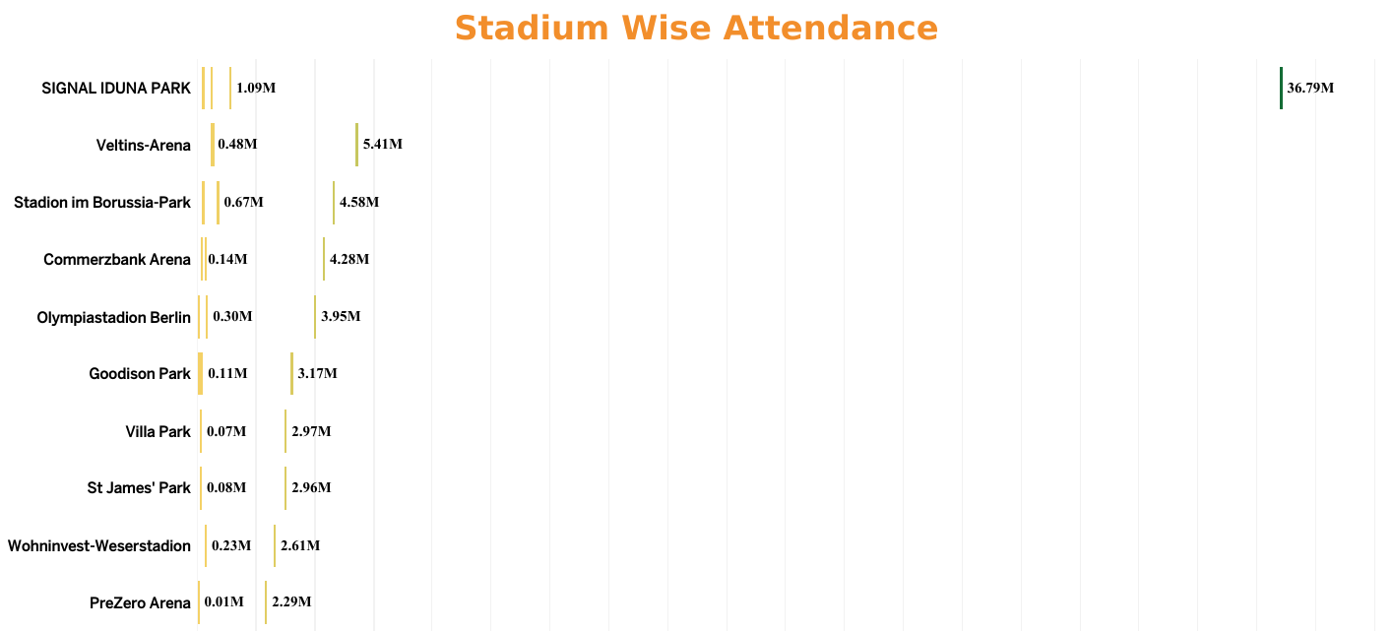
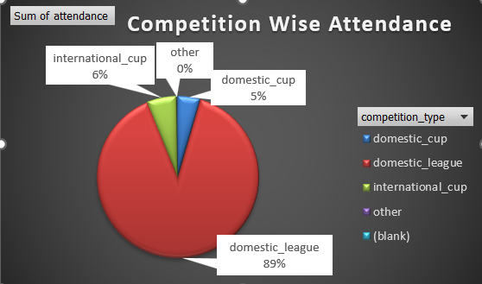
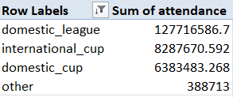
Attendance And Stadium Analysis
Interpretation:
In SIGNAL IDUNA PARK have highest Attendance on Domestic League.
In Domestic League Competitions have More Attendance than other Competitions.

Slide 15
Referee Analysis
Referee Analysis gives insights for the game who’s Give more Decision based on Player Performance
Display and identify the red cards issued by referee.
Chart from Tableau with Interpretation of Chart

Slide 16
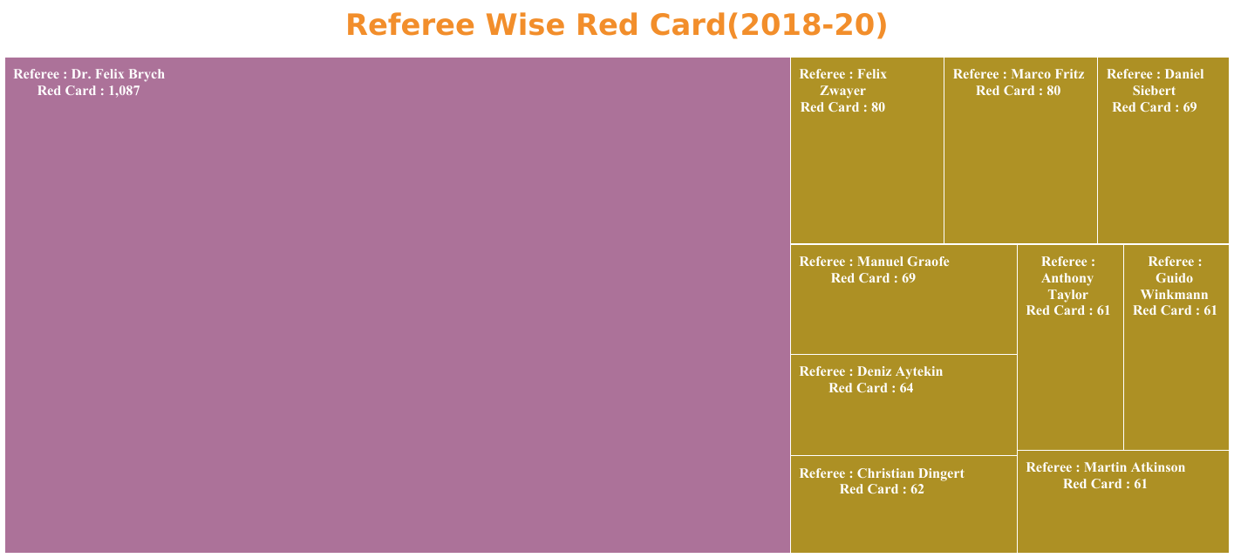
Referee Analysis
Interpretation:
Referee Dr. Felix Brych declare Mostly red-card in this Foot Ball data.

Slide 17
Substitution Pattern
Substitution Analysis gives insights for those Substitute hit Goals and Market Values for Substitute.
Display and Identify the substitute hits more goals in Final Round.
Which Substitute have earn more Market Values.
Chart from Tableau with Interpretation of Chart

Slide 18
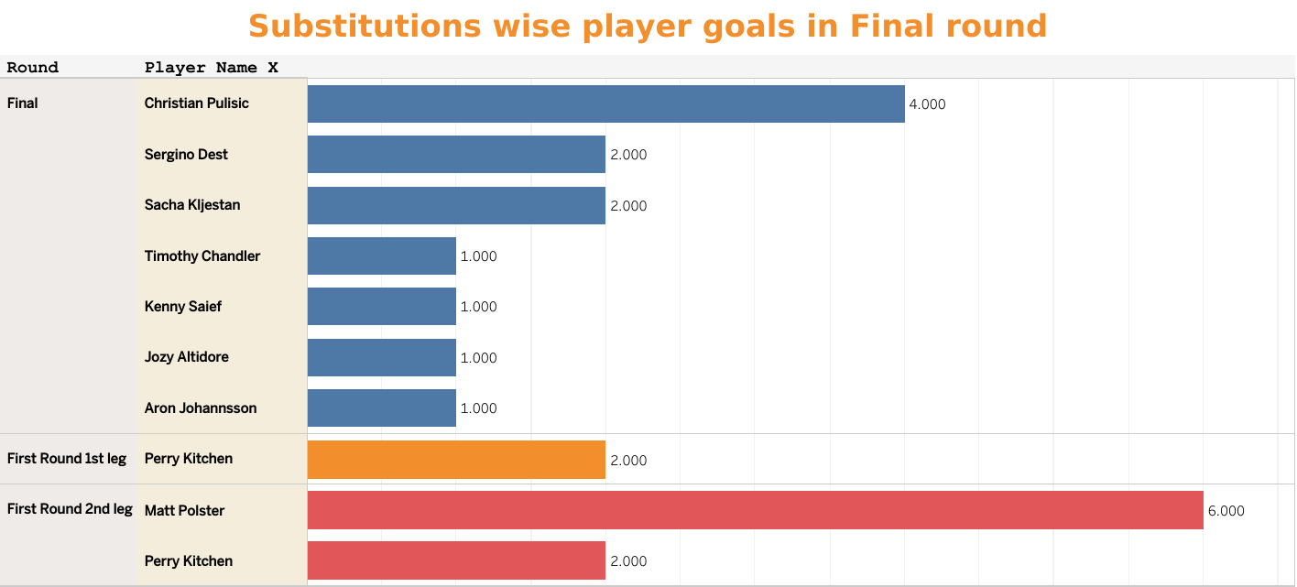
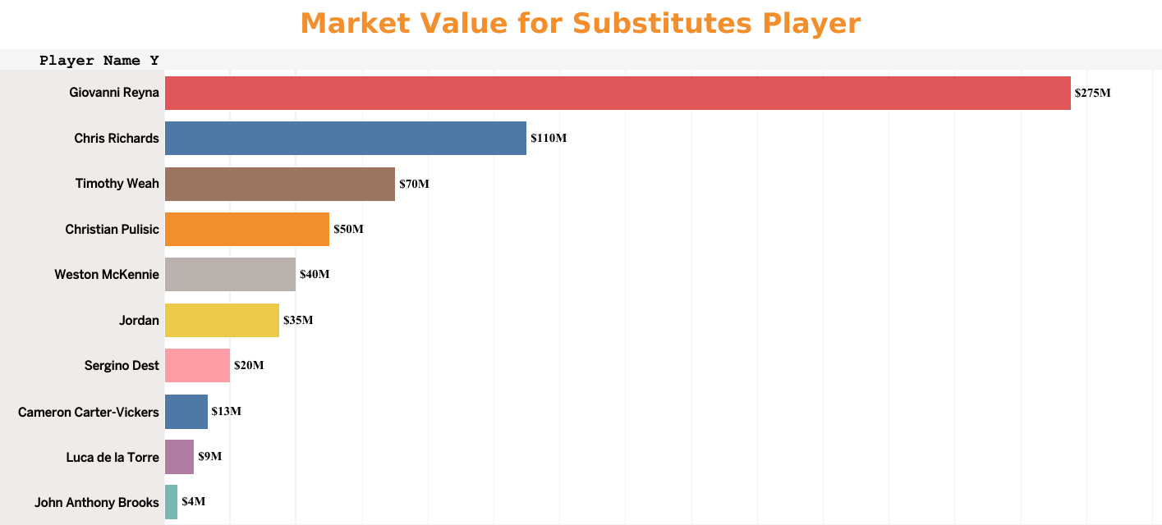
Substitution Pattern
Interpretation:
In Final-Round 2nd Leg, the Substitution player Matt Polster hits Highest Goals.
The Substitution Player Giovanni Reyna earned more Salary other than other Substitute.

Slide 19
Event Analysis
Event Analysis gives insights for those Event Organizer conduct the Most event in Both the Club.
Display and Identify the Club Wise Total Number of event Organized.
Chart from Tableau with Interpretation of Chart

Slide 20
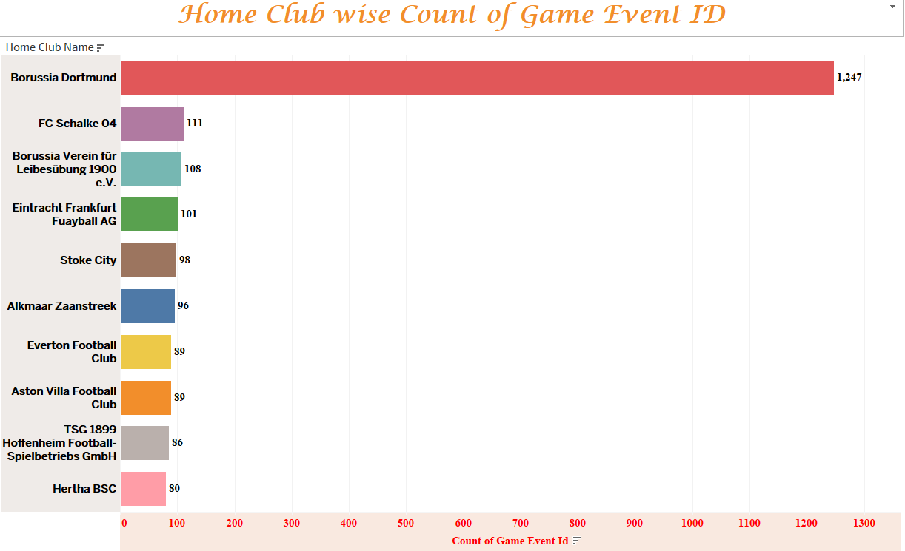
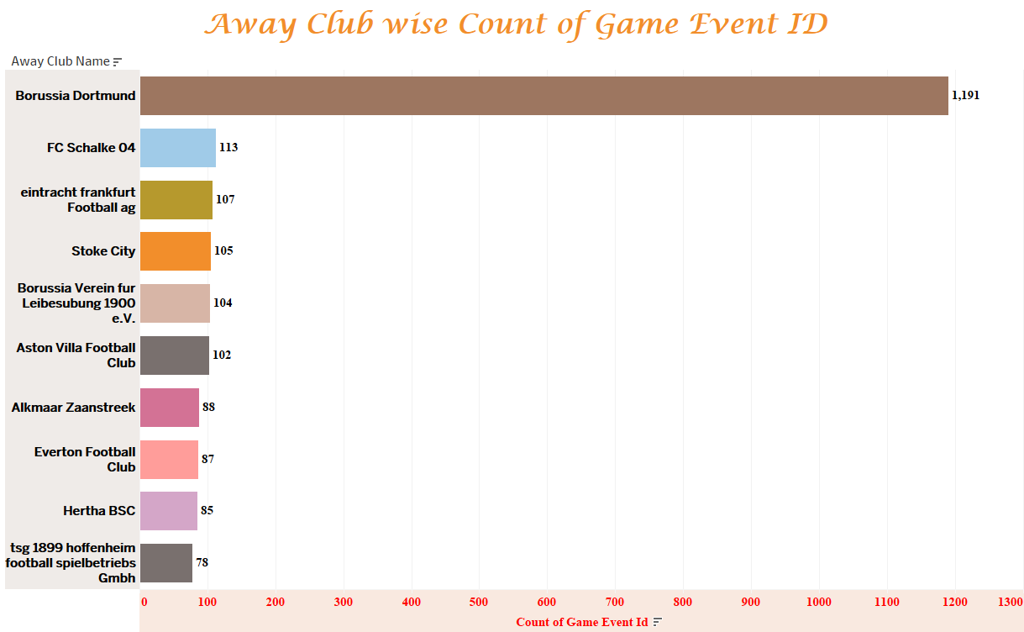
Event Analysis
Interpretation:
The Home Club are used event organizer Most in The Competition other then Away Club.
In Home Club- 1247
In Away Club- 1191

Slide 21
Competitions Analysis
Competition Analysis gives insights for the Goals of Competition and Red Card for Competition ID.
Visualize the total goal of each Competition.
Which Competition Id gets more red card.
Chart from Tableau with Interpretation of Chart

Slide 22
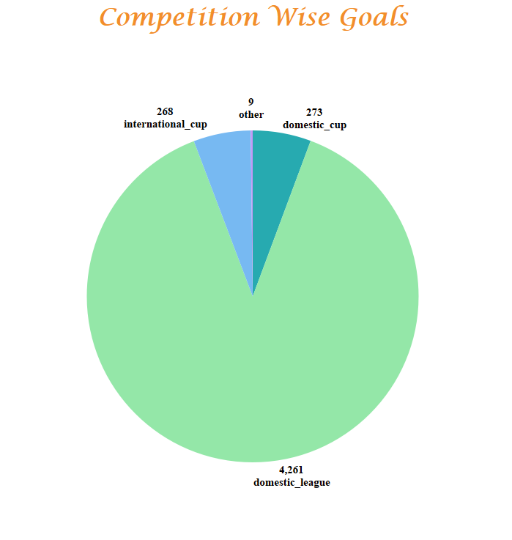
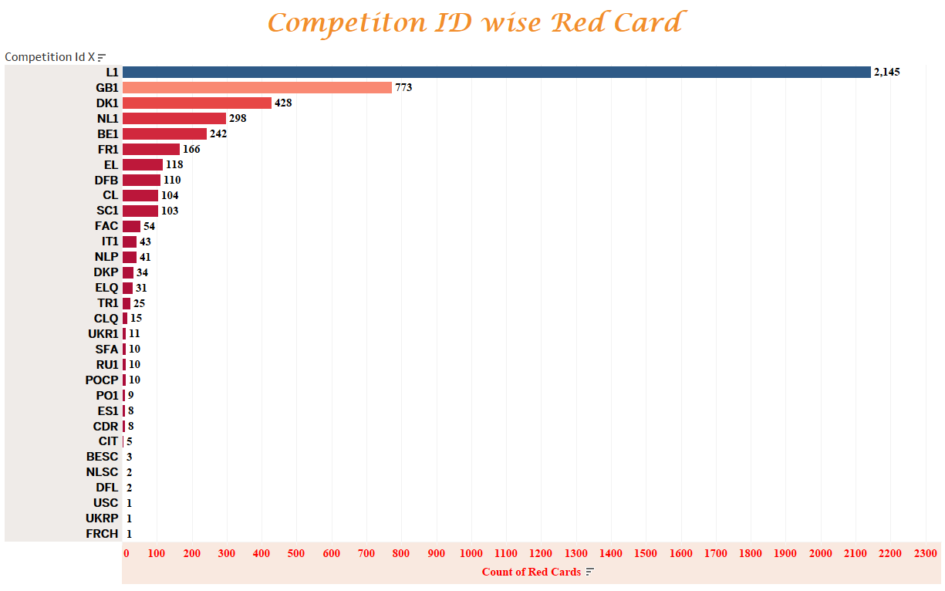
Competitions Analysis
Interpretation:
In Competition, Domestic League have more goals other than all. That means in that Competition Players are Really played well.
The Competition ID L1 Have More red card and FRCH have Less Red Card.

Slide 23
Player Attributes And Demographics
Player Attributes and Demographics gives insights for the Players Attributes like position, height.
Display and Identify which position of player hits more goals.
Is there any correlation between Heights and goals
Chart from Python matplotlib and Tableau with Interpretation of Chart

Slide 24
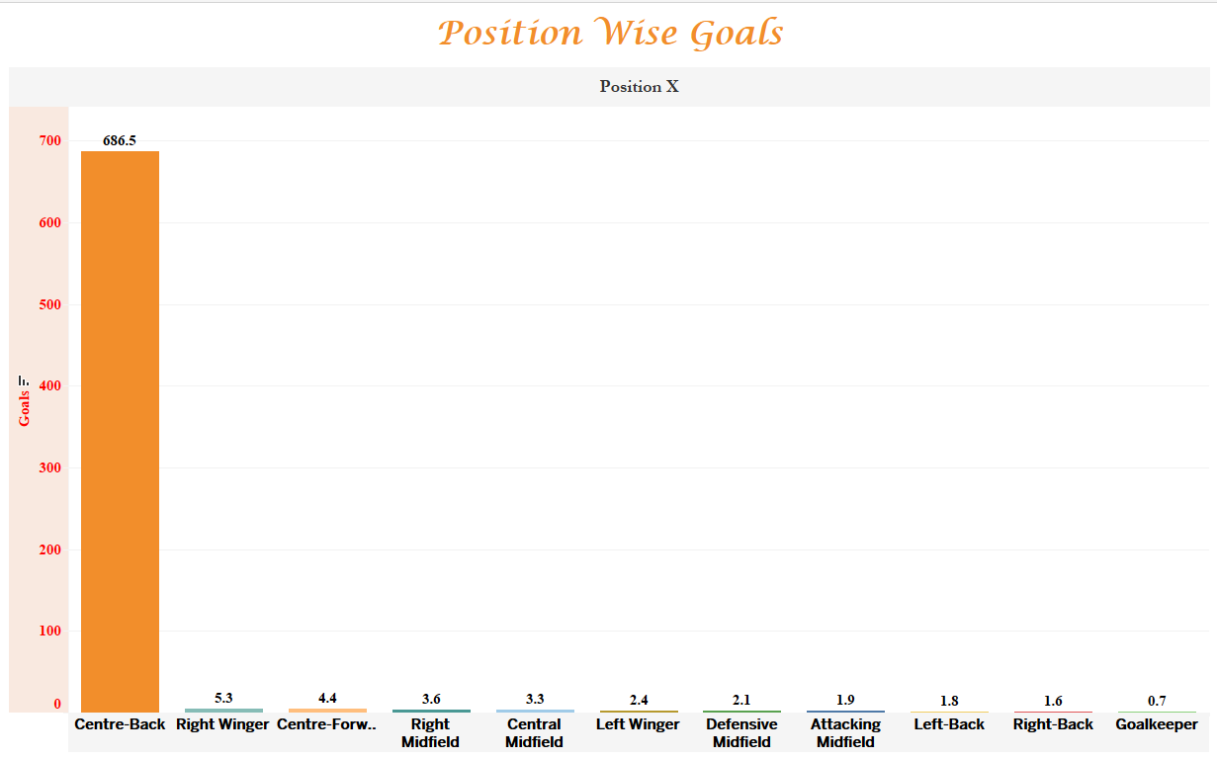
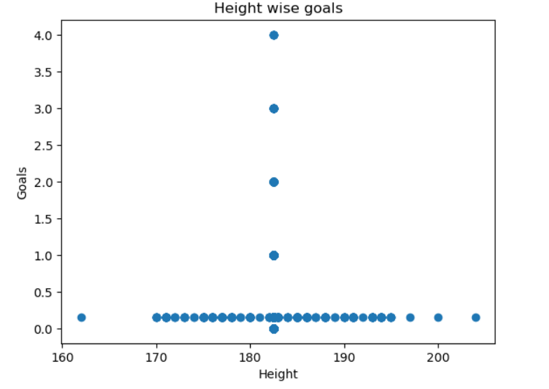
Player Attributes And Demographics
Interpretation:
In this data, The Centre-back position hits more goal in over all seasons. So that means Centre-back players are key player to hits the goal
The correlation between height and goal is positive correlation. For above 180 height players hits more goals.

Slide 25
Contract Management
Contract Management gives insights for the players Expire date due to the Contract Date.
Display and Identify the total Expiration Date on each Event.
Chart from Tableau with Interpretation of Chart

Slide 26
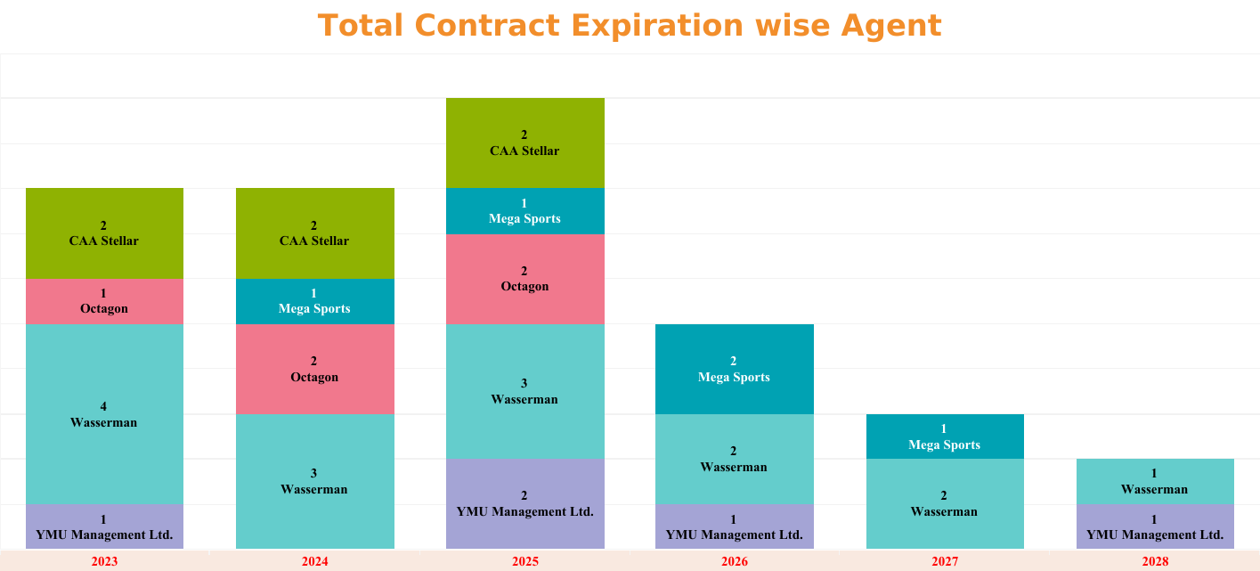
Contract Management
Interpretation:
The Contract Expiration year of the Each Agent count.
In year 2023, Wasserman Agent have highest Contract Expiration (4).

Slide 27
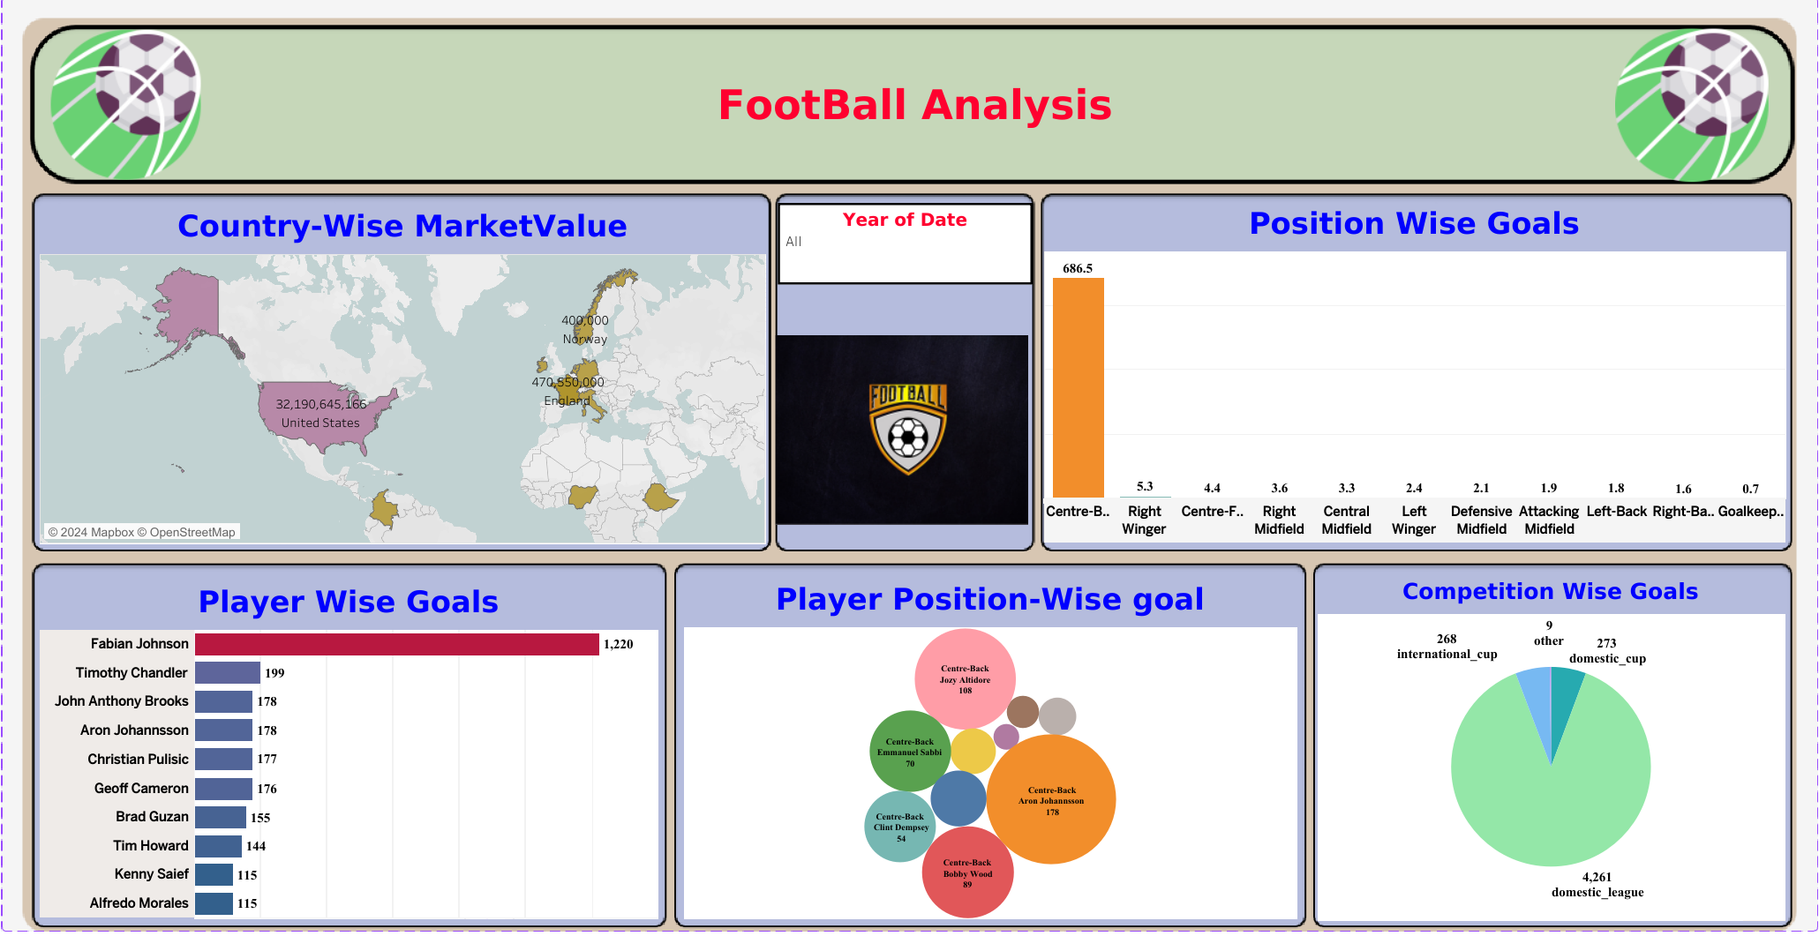
Dashboard
Dashboard-1 Dashboard-2

Slide 28
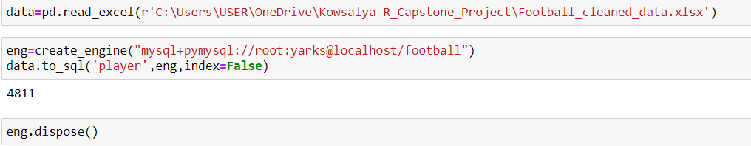
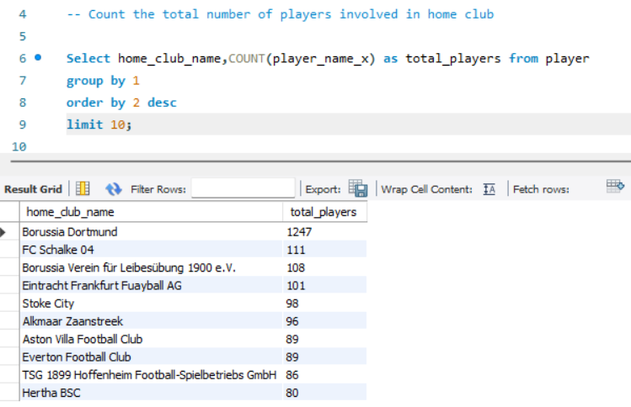
SQL
Using Python, Transfer the Excel file to SQL Data Base.
Using SQL Analysis the data .
Borussia Dortmund Home club have more players

Slide 29
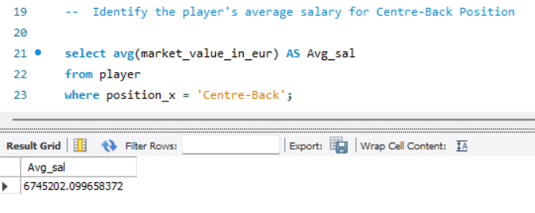
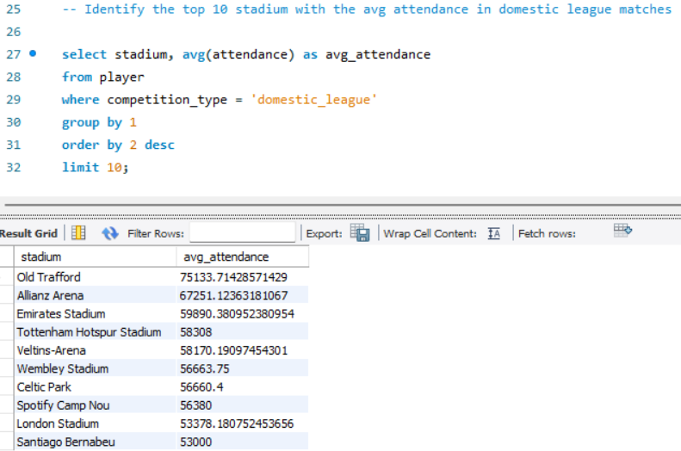
SQL
The Average Market value for Centre-back position is 6745202.099658372
The Old Trafford Stadium have highest average attendance (75133.71428571429)

Slide 30
Conclusion
The Centre back position Player have good potential. So, Give practice for other position player to improve the team.
Fabian Johnson player hits highest goal
United State players earn More Salary. So, United State player are Best player to choose for team Success.
The player height above 184cm are hits more goals. So, For choosing that player are best decision for Team.
The Domestic League Competition have highest Attendance.
Using this analysis, The Home Club are Practice more for hits more goal for Success.

