Slide 1
Employee salary Analysis using Excel
STUDENT NAME:V.Gowsalya Devi
REGISTER NO:2213331042095
DEPARTMENT:Department Of Commerce
COLLEGE: Bharathi Women's College

Slide 2
PROJECT TITLE
Employee Salary Analysis using Excel

Slide 3


AGENDA
Problem Statement
Project Overview
End Users
Our Solution and Proposition
Dataset Description
Modelling Approach
Results and Discussion
Conclusion
3/21/2024 Annual Review

Slide 4

PROBLEM STATEMENT
Our organization is concerned about potential salary disparities and the competitiveness of our compensation structure.We need to analyze employee salaries to identify benchmarks,and ensure fairness across roles and departments.

Slide 5

PROJECT OVERVIEW
The Employee Salary Analysis project aims to evaluate our current salary structure to identify any discrepancies and ensure competitiveness. The project involves collecting and analysing salary data across various departments and roles, benchmarking against industry standards, and assessing internal equity.

Slide 6

WHO ARE THE END USERS?
1.HR Managers: For refining compensation strategies and ensuring equitable pay practices.
2.Finance Teams: For budgeting and financial planning related to salary adjustments.
3.Executive Leadership: For making informed decisions on overall compensation policies.

Slide 7

OUR SOLUTION AND ITS VALUE PROPOSITION
We will conduct a comprehensive analysis of employee salaries, including benchmarking against industry standards and evaluating internal pay equity.
VALUE PROPOSITION :
This solution ensures fair and competitive compensation practices,help attract and retain talent,and aligns salary structures with Market trends and financial planning.

Slide 8
Dataset Description
The dataset includes employee salary information with fields such as employee ID,job title, department, salary, years of experience, education level,and performance rating.It provides comprehensive data for analyzing Salary distribution, identifying disparities,and benchmarking against industry standards.

Slide 9

THE "WOW" IN OUR SOLUTION
Employee Salary Analysis involves reviewing compensation data to ensure fair, competitive,and equitable pay,manage costs,and identify trends for better decision-making.Employee Salary Analysis involves examining and interpreting salary data to understand compensation trends and patterns.
3/21/2024 Annual Review
9

Slide 10
MODELLING
In modeling, employee Salary Analysis involves creating statistical model to predict salary trends,assess pay equity,and determine factors influencing compensation.This help in marking data-driven decisions about salary adjustments and budgeting.These models help organisation optimize salary structures and ensure fair compensation practices.
10

Slide 11
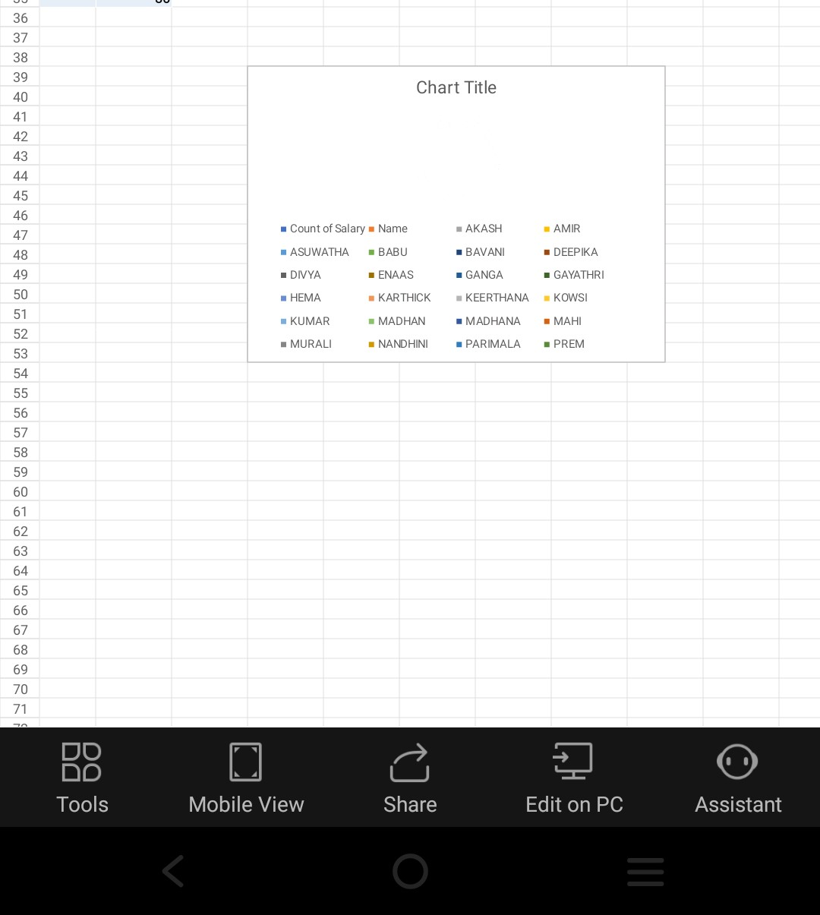
RESULTS
11

Slide 12
conclusion
In conclusion, Employee Salary Analysis models help organisations ensure fair compensation, predict salary trends,and manage budgets effectively by analysing salary data and identifying key influencing factors.

