Slide 1

ELECTRICITY BILL PREDICTION
- PRESENTED BY : C. KOWSALYA

Slide 2
TABLE OF CONTENTS
Dataset and features
Model Building
2
4
3
1
5
EDA
Problem Statement
Feature Work

Slide 3
PROBLEM
STATEMENT
The Problem Statement for Electricity Bill Prediction is to estimate the monthly electricity bill for a given company based on its power consumption details. The dataset contains 45,345 rows of records for different companies power consumption of various appliances such as fans, air conditioners, monitors, refrigerators, and televisions.
Given the power consumption details of these appliances, the goal is to develop a machine learning model that can predict the monthly electricity bill for a company. The model should be able to take into account the power consumption of each appliance and accurately estimate the electricity cost.
By utilizing this dataset and building an accurate prediction model, the aim is to provide companies with a tool to estimate their electricity bills in advance, allowing them to plan their energy usage and budget effectively.

Slide 4
Feature Work
If we deploy these models on a website, we can predict the electricity bill for companies
Dataset
Data is collected from Kaggle and stored in a dataframes.
Flow of Control of Project
Exploratory Data Analysis and Feature Selection
The dataset is being investigated to discover hidden Patterns. Important features are selected.
Model Building
The datasets are trained and Model is Created

Slide 5
DATA SET
AND
FEATURES
The dataset consists of 45,345 records, representing different companies, and includes information on their electricity bills. The dataset comprises 10 independent features and 1 dependent column named 'Electricity Bill'.
The goal of the analysis is to predict the values of the 'Electricity Bill' column, which is the target variable, using regression techniques. Since the predicted output will be a continuous value (the electricity bill amount), regression models are suitable for this task.

Slide 6
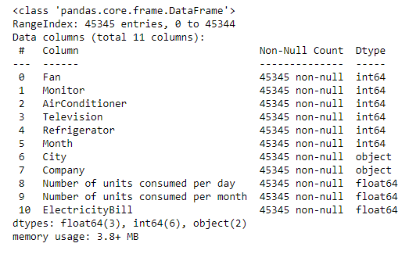
1) Fan : It represents the number of fans running in the company.
2) Monitor: It represents the number of monitors running in the company.
3) Air Conditioners: It represents the number of air conditioners running in the company.
4) Television: It represents the number of televisions running in the company.
5) Refrigerator: It represents the number of refrigerators running in the company.
6) Month: It indicates the month for which the power consumption data is recorded in the company.
7) City: It provides information about the geographical location of the company.
8) Company: It identifies the name of the company associated with the electricity bill.
9) Number of units consumed per day: It is the total power consumption in units for all appliances in the company on a daily basis.
10) Number of units consumed per month: It is the total power consumption in units for all appliances in the company for the entire month. It is calculated by multiplying the "Number of units consumed per day" by the number of days in a month.
11) Electricity Bill: It represents the monthly electricity bill amount in INR (Indian Rupees) for the company. It is the target variable that we want to predict using the given features.
Features

Slide 7
EXPLORATOY
DATA
ANALYSIS
Steps performed for Data Preprocessing
Missing Values Treatment
In this dataset, there are no null values present, so there is no need to treat or handle null values. If Null values present filtered the row with missing value and filled it up with appropriate values as determined.
Removed Duplicates
Selected and removed duplicate , kept the first occurrence of each row

Slide 8
Steps performed for Data Preprocessing
Feature Engineering
If feature extraction , by including the total number of appliances in the company, it calculates the total power consumed by all the appliances in the company.
If feature extraction , by including the electricity cost per unit, it calculates the cost per unit of electricity for both the city and the company. The electricity bill varies depending on the load supply.
In this dataset, there are two categorical variables, each with more than 10 categories. To encode these categorical variables, label encoding can be used.
Handling Categorical Data

Slide 9
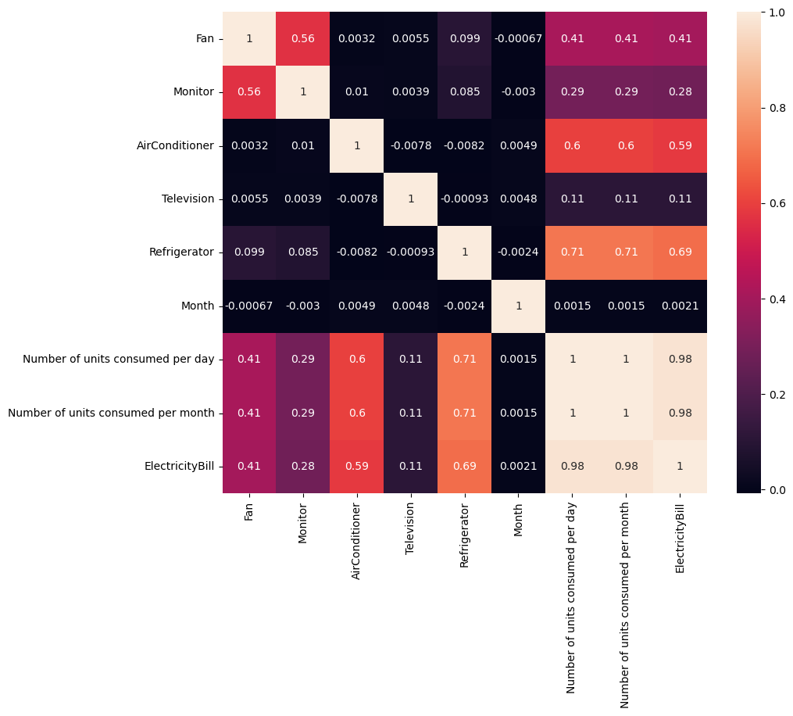
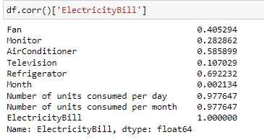
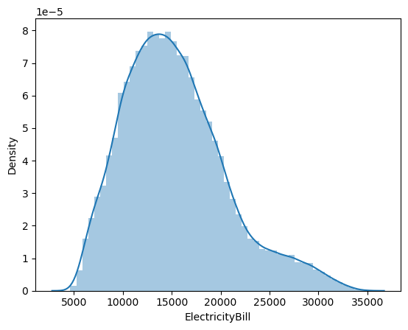
Correlation of Target variable with other
Dependent variables
Heat map for correlation of variables
Histogram of Target variable

Slide 10
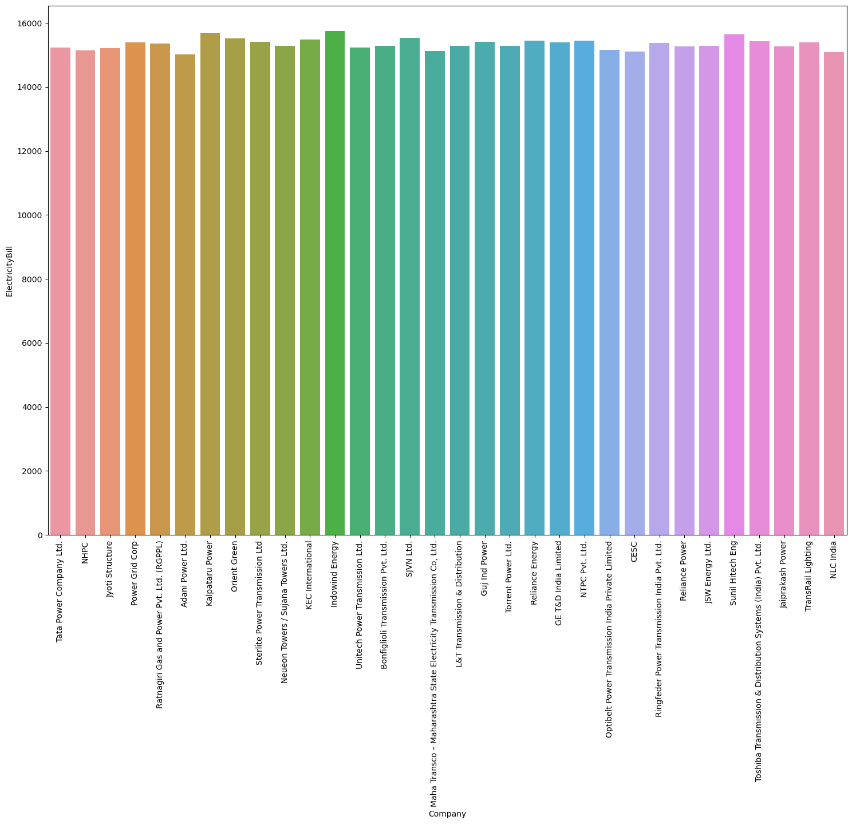
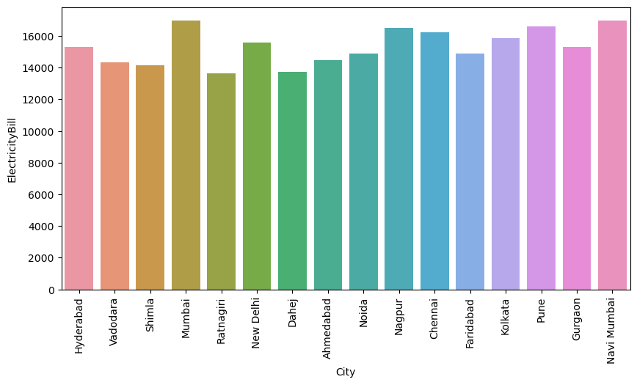
Visualizations Of Categorical Variables
Companies VS Electricity Bill
City VS Electricity Bill

Slide 11
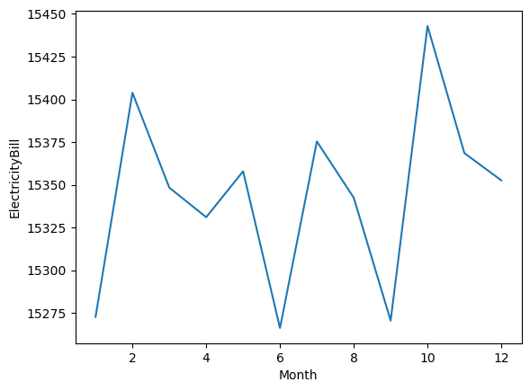
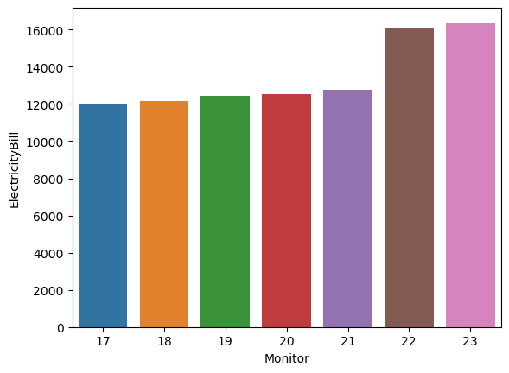
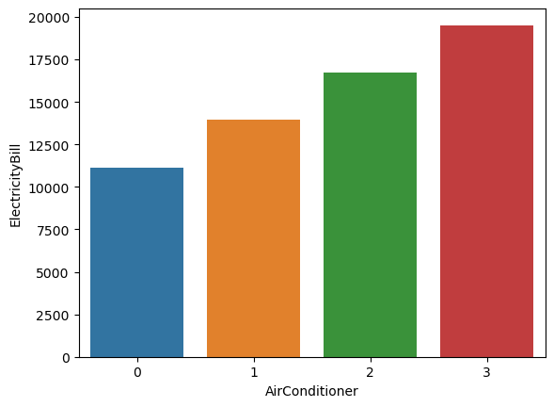
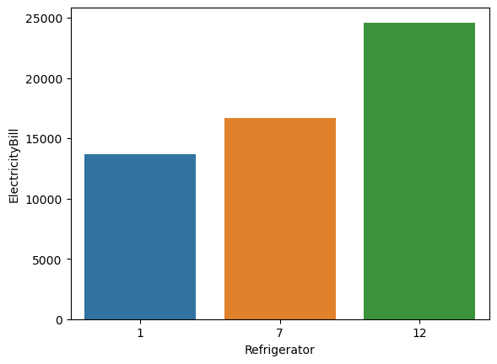
Month VS Electricity Bill
Monitor VS Electricity Bill
Air Conditioner VS Electricity Bill
Refrigerator VS Electricity Bill

Slide 12
MODEL
BUILDING
Split train and test to build machine learning models.
Then we will run different models on this data.
1) Linear Regression
2) Decision Tree
3) Random Forest

Slide 13
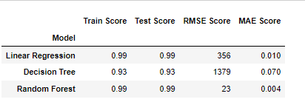
Accuracy Of Different Modules
By comparing, the Random Forest model performs the best among the three models, as it achieves the highest test score, the lowest RMSE score, and the lowest MAE score. It demonstrates strong predictive accuracy and generalization ability compared to Linear Regression and Decision Tree.

Slide 14
FEATURE
WORK
If we deploy these models on a website, we can predict the electricity bill for companies
By deploying electricity bill prediction models on a website, businesses can harness these advantages to improve financial planning, optimize costs, enhance operational performance, promote sustainability, engage customers, and make data-driven decisions to drive success in their energy management strategies.
In this dataset, we have important electrical appliances power consumption data. From a business perspective, we can conduct surveys or gather data on the power consumption of other electrical equipment within companies. By incorporating this additional data, we can improve the accuracy of predicting the exact electricity bill for companies.

Slide 15
Linear regression models can provide insights into customer behavior and its influence on electricity bills. By analyzing customer data and identifying patterns, businesses can develop targeted marketing or educational campaigns to encourage energy-saving behaviors among their customers.
Predicting electricity bills allows businesses to assess and manage the risk associated with energy costs. By understanding potential fluctuations in bills, businesses can implement risk mitigation strategies such as hedging contracts or exploring renewable energy options to stabilize and reduce long-term costs.
Equipment Upgrades and Maintenance: Regularly maintain and service equipment, machinery, and electrical systems to ensure they operate at peak efficiency. Consider upgrading to energy-efficient appliances, such as refrigerators and air conditioning units, to reduce energy consumption.
Continuous Improvement and Monitoring: Regularly review and reassess energy consumption patterns, track progress, and identify further opportunities for energy savings. Energy efficiency should be an ongoing process, and continuous monitoring and improvement are crucial for long-term cost reduction.

Slide 16
THANK YOU
PERSONAL INFO:
Name : C.KOWSALYA
Batch : PGDA 03

