Slide 1



TNWISE2026
TAMIL NADU HACKATHON FOR WOMEN IN SCIENCE & ENGINEERING
THEME: Inclusive Digital Transformation
SUB -THEME: Human-Centric & Inclusive Engineering Interface
TITLE: Multilingual ATM system
TEAM LEADER: S. Kowsalya Devi
COLLEGE: Adhiparasakthi Engineering College , Melmaruvathur.

Slide 2
PROBLEM STATEMENT
ATMs are widely used for banking, but many people in rural and semi-urban areas face difficulties due to language barriers and low literacy levels, Existing ATMs support limited languages and rely on text-based instructions, making them hard to use for many users. This leads to dependency and lack of access to essential financial services. Therefore, a multilingual, voice-enabled ATM system is needed to provide simple, user-friendly, and inclusive banking access.

Slide 3
PROJECT GOALS
Design a human-centric multilingual ATM system.
Enable voice-guided interaction for easy usage.
Support users from diverse linguistic and literacy backgrounds.
Provide a simple, intuitive, and inclusive interface.
Promote independent and accessible banking services.
Reduce dependency on others by enabling users to perform transactions independently.

Slide 4
METHODOLOGY
RESEARCH APPROACH
Analyse real-world challenges in rural ATM usage.
Design a multilingual, intuitive user interface.
Integrate voice-guided assistance for enhanced accessibility.
Study language barriers and literacy challenges.
Analyze existing ATM systems and their limitations.
Identify gaps in accessibility and user experience.

Slide 5
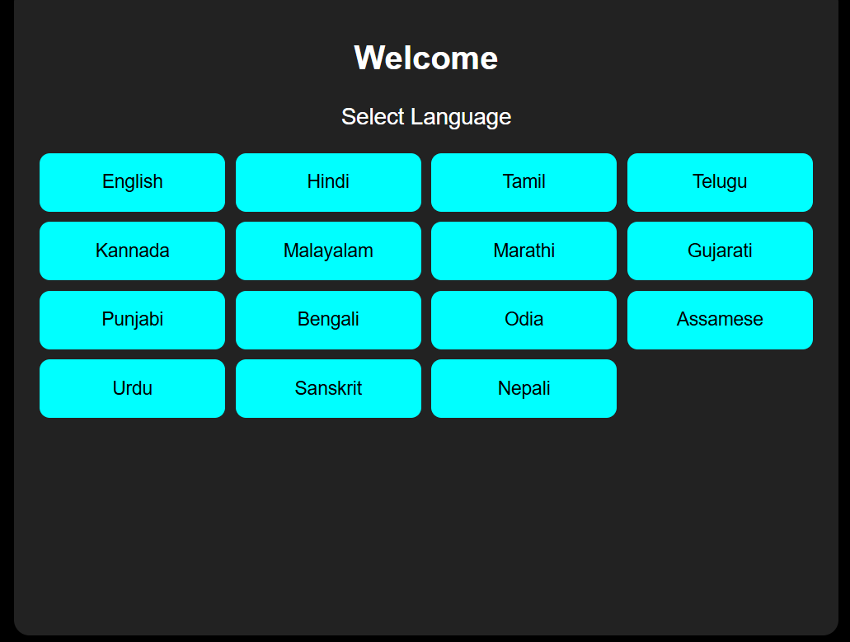
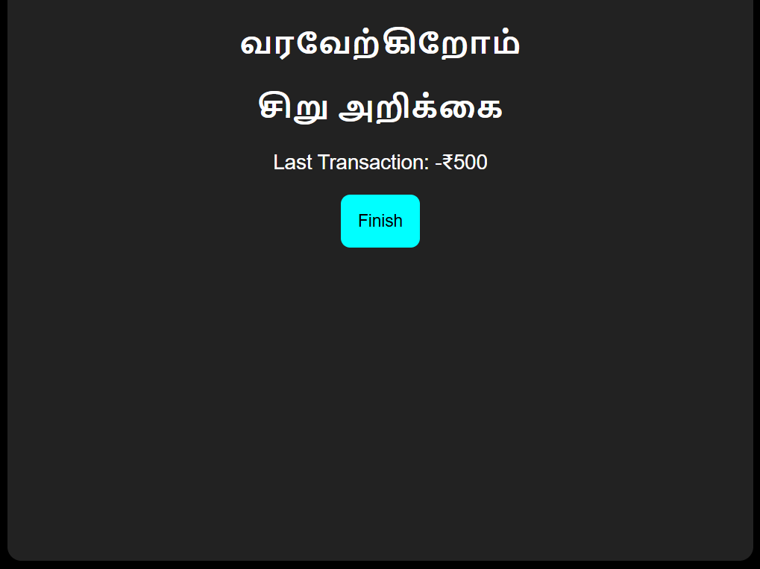
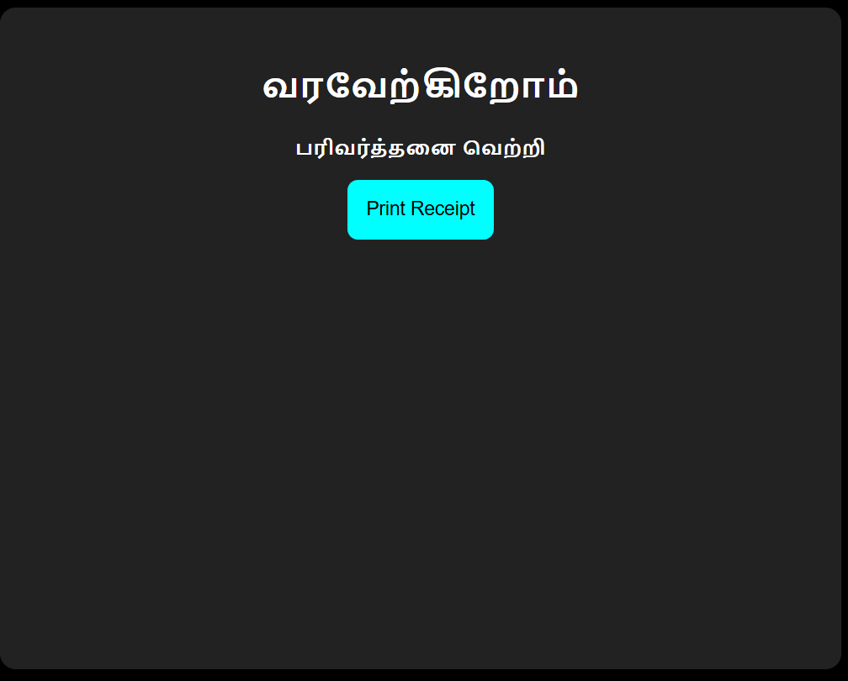
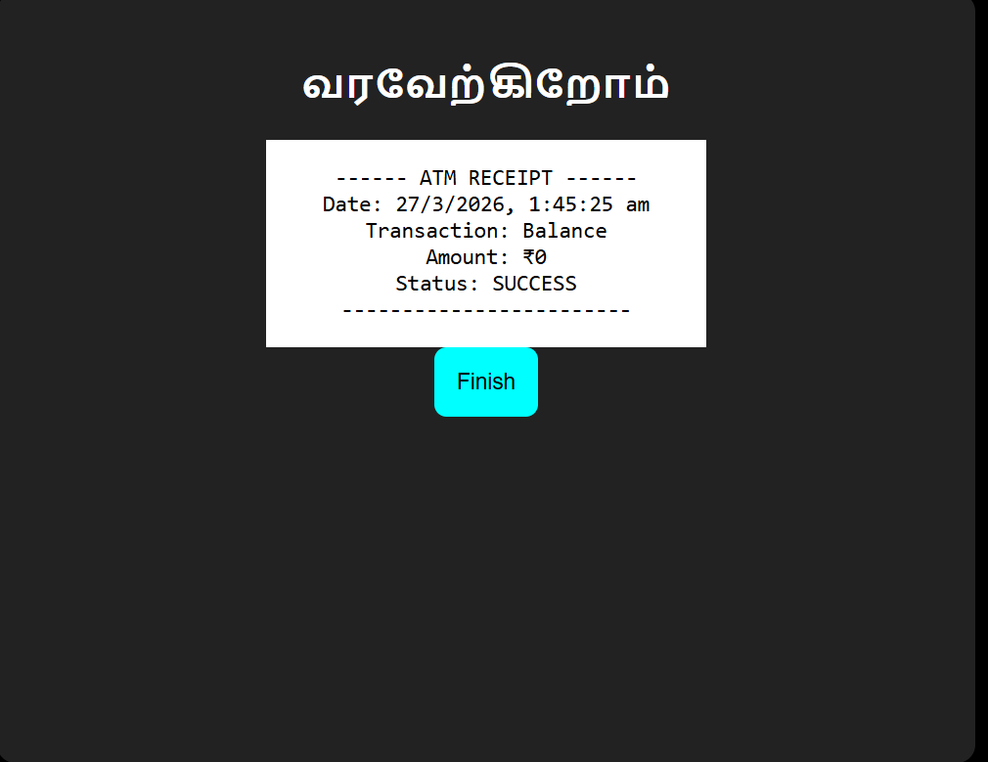

Slide 6
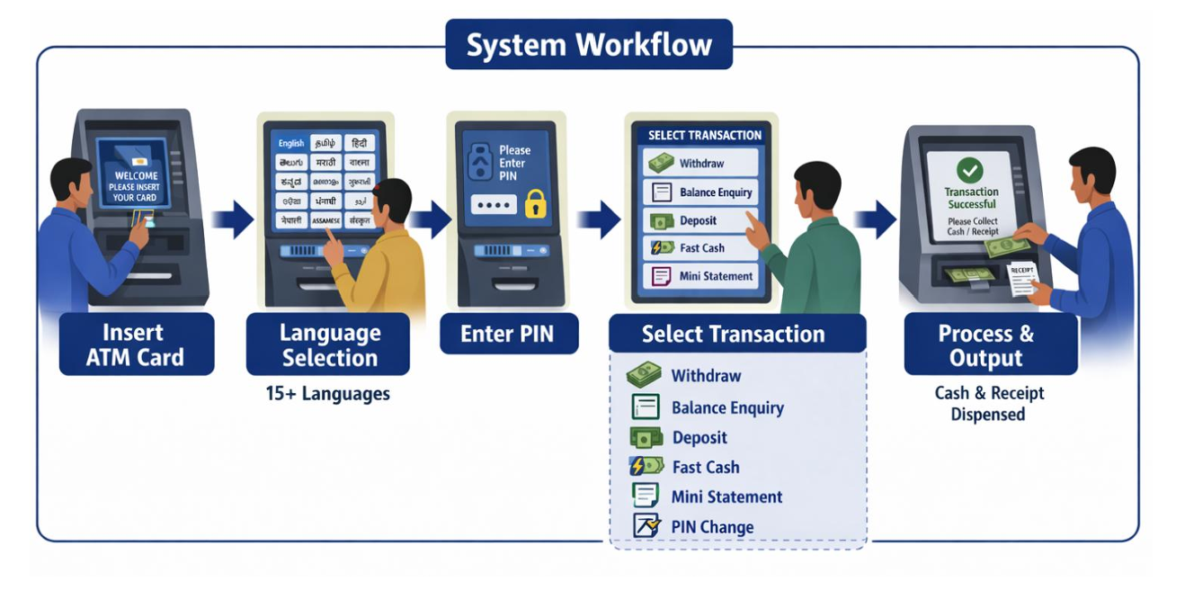
RESULT
Successfully developed a human-centric ATM prototype with multilingual support.
Integrated voice-guided interaction to enhance accessibility.
Improved usability for rural and low-literacy users.
Enabled independent and confident transaction experience.
Demonstrated a scalable solution for inclusive digital banking.

Slide 7
BUSINESS MODEL & COST
Value Proposition: User-friendly, multilingual ATM system enabling inclusive banking access
Target Customer: Banks, financial institutions, rural and semi-urban users
Revenue Model:
Software licensing to banks
Integration & maintenance service
Government collaboration for rural deployment
Development Cost: UI/UX design, software development
Technology Cost: Voice integration, language processing tools.
Scalability: Easily deployable across ATMs nationwide with
increasing adaption.

Slide 8
FUTURE SCOPE
* Transform ATMs into AI-powered, voice-driven smart systems.
* Enable real-time multilingual communication across diverse
users.
* Integrate advanced security features like biometrics and facial
recognition.
* Expand deployment to remote and underserved regions.
* Connect with digital banking ecosystems and smart devices.

Slide 9
CONCLUSION
This project reimagines ATMs as inclusive, human-centric systems that break language and literacy barriers.
With multilingual and voice enabled interaction, it enables independent and confident banking for every user.
It bridges the digital divide by making financial services accessible to rural and underserved communities.
Ultimately, it transforms ATMs into empowering gateways for inclusive digital marketing.

Slide 10
TEAM MEMBERS DETAILS
LEADER: S. Kowsalya Devi
SEM: 6th Semester
DEPARTMENT: BE(ECE)
YEAR:3rd Year
MEMBER 1: S. Roshini
SEM:6th Semester
DEPARTMENT: BE(ECE)
YEAR: 3rd Year
MEMBER 2: K. Gayathri
SEM:6th Semester
DEPARTMENT: BE(ECE)
YEAR: 3rd year
MENTOR: M. Malathi
DESIGNATION: Professor
DEPARTMENT: ECE
COLLEGE NAME: Adhiparasakthi Engineering College, Melmaruvathur.

Slide 11
THANK YOU

