Slide 1


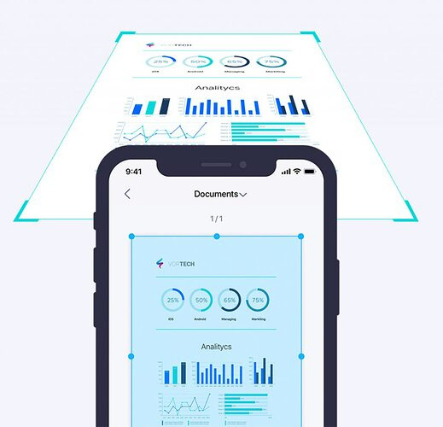

Doc
Scanner
Document
Scanner
Presented by
Md Kowsar Hossain
Id : 2110276152
CSE, University Of Rajshahi

Slide 2




Development Tools
Forntend
Flutter for building a responsive UI
Backend & Database
Node.js and scalable option for building APIs
SQLite for offline data storage
PDF Generator
Using the PDF Package

Slide 3
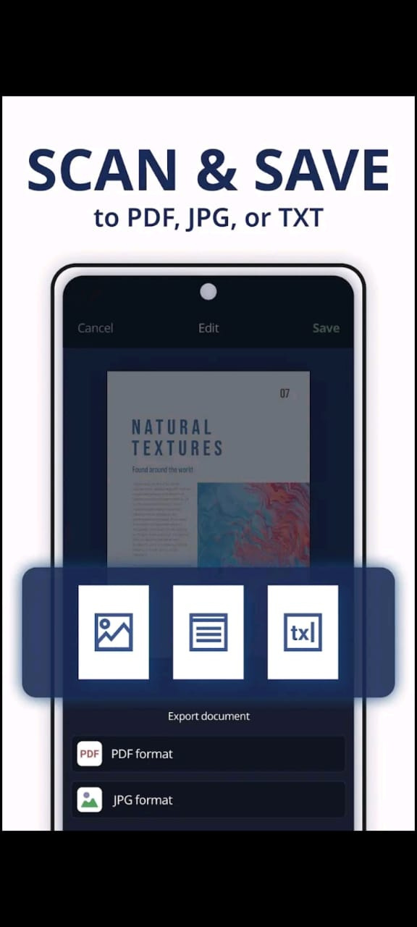
Features
Auto Document Detection
Multiple File Formats
Optical Character Recognition (OCR)
Batch Scanning
Filters and Enhancements

Slide 4
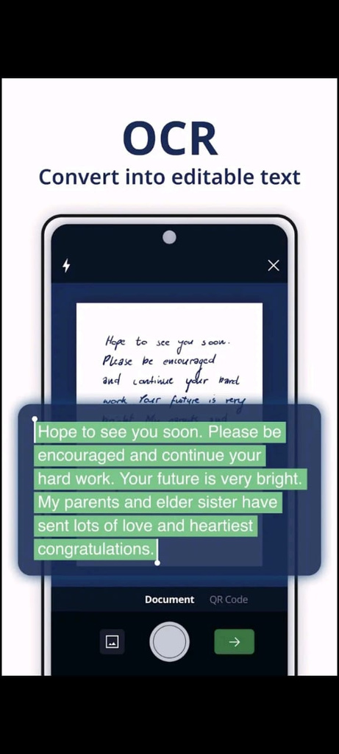
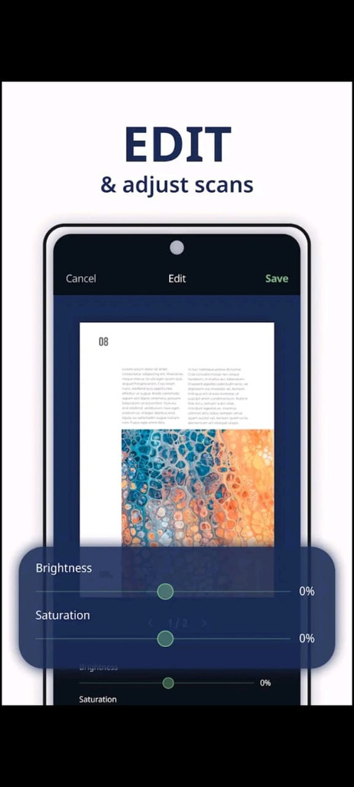
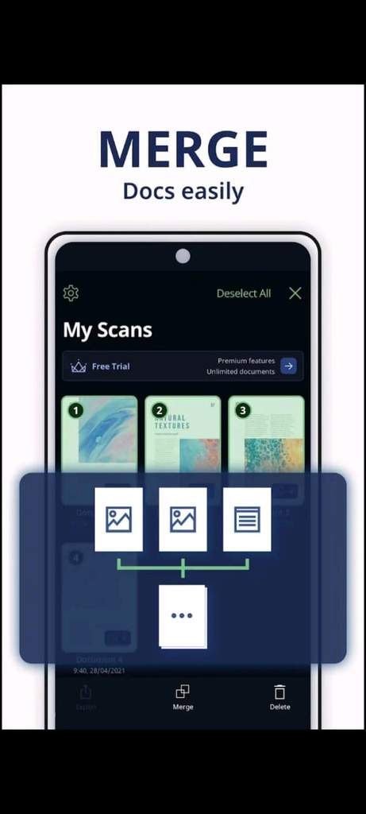
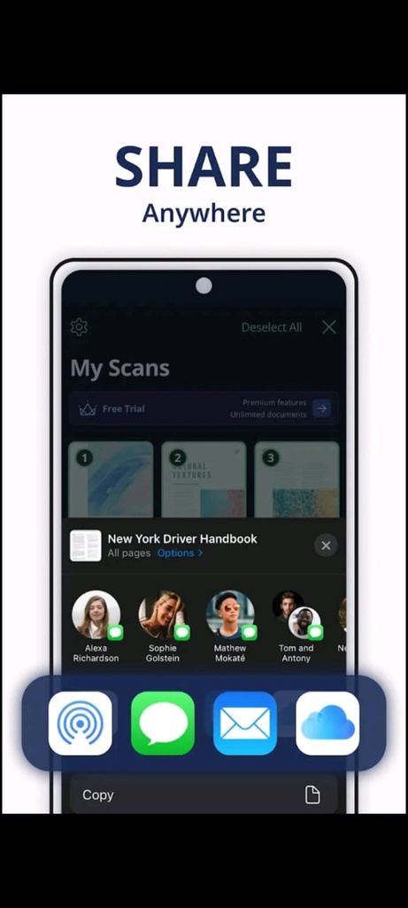

Use Cases

Slide 5


THANK YOU
For watching this presentation
Contact me
01757938463
mdkowsar143@gmail.com

