Slide 1
Error Coding Overview (§3.2)

Slide 2
Topic
Some bits will be received in error due to noise. What can we do?
Detect errors with codes »
Correct errors with codes »
Retransmit lost frames
Reliability is a concern that cuts across the layers – we’ll see it again
Later
Notes:
Icons from cisco icon library

Slide 3
Problem – Noise may flip received bits
1
1
1
Signal
0
0
0
0
0
Slightly
Noisy
1
1
1
0
0
0
0
0
Very
noisy
1
1
1
0
0
0
0
0

Slide 4
Approach – Add Redundancy
Error detection codes
Add check bits to the message bits to let some errors be detected
Error correction codes
Add more check bits to let some errors be corrected
Key issue is now to structure the code to detect many errors with few check bits and modest computation

Slide 5
Motivating Example
A simple code to handle errors:
Send two copies! Error if different.
How good is this code?
How many errors can it detect/correct?
How many errors will make it fail?
Notes:
Draw example of coded message. 2 errors can fool it

Slide 6
Motivating Example (2)
We want to handle more errors with less overhead
Will look at better codes; they are applied mathematics
But, they can’t handle all errors
And they focus on accidental errors (will look at secure hashes later)
Notes:
2 errors can fool it -- weak

Slide 7
Using Error Codes
Codeword consists of D data plus R check bits (=systematic block code)
Sender:
Compute R check bits based on the D data bits; send the codeword of D+R bits
Data bits
Check bits
D
R=fn(D)

Slide 8
Using Error Codes (2)
Receiver:
Receive D+R bits with unknown errors
Recompute R check bits based on the D data bits; error if R doesn’t match R’
Data bits
Check bits
D
R’
=?
R=fn(D)
Notes:
Note error may be in data or check bits

Slide 9
Intuition for Error Codes
For D data bits, R check bits:
Randomly chosen codeword is unlikely to be correct; overhead is low
All
codewords
Correct
codewords
Notes:
Add size of spaces

Slide 10

R.W. Hamming (1915-1998)
Much early work on codes:
“Error Detecting and Error Correcting Codes”, BSTJ, 1950
See also:
“You and Your Research”, 1986
Source: IEEE GHN, © 2009 IEEE
Notes:
Source: IEEE GHN, http://www.ieeeghn.org/wiki/index.php/File:Richard_Hamming_1598.jpg, Image policy: http://www.ieeeghn.org/wiki/index.php/IEEE_GHN_image_policy

Slide 11
Hamming Distance
Distance is the number of bit flips needed to change D₁ to D₂
Hamming distance of a code is the minimum distance between any pair of codewords
Notes:
Use 0 -> 000 and 1 -> 111 as an example

Slide 12
Hamming Distance (2)
Error detection:
For a code of distance d+1, up to d errors will always be detected
Notes:
Use 000, 111 code to show error detection

Slide 13
Hamming Distance (3)
Error correction:
For a code of distance 2d+1, up to d errors can always be corrected by mapping to the closest codeword
Notes:
Use 000, 111 code to show error correction

Slide 14
Topic
Some bits may be received in error due to noise. How do we detect this?
Parity »
Checksums »
CRCs »
Detection will let us fix the error, for example, by retransmission (later).
Notes:
Icons from cisco icon library

Slide 15
Simple Error Detection – Parity Bit
Take D data bits, add 1 check bit that is the sum of the D bits
Sum is modulo 2 or XOR
Notes:
Give example for 7 data bits

Slide 16
Parity Bit (2)
How well does parity work?
What is the distance of the code?
How many errors will it detect/correct?
What about larger errors?
Notes:
Give example for 7 data bits

Slide 17
Checksums
Idea: sum up data in N-bit words
Widely used in, e.g., TCP/IP/UDP
Stronger protection than parity
1500 bytes
16 bits

Slide 18
Internet Checksum
Sum is defined in 1s complement arithmetic (must add back carries)
And it’s the negative sum
“The checksum field is the 16 bit one's complement of the one's complement sum of all 16 bit words …” – RFC 791
Notes:
Give example of 5 and -5 in 1s and 2s complement

Slide 19
Internet Checksum (2)
Sending:
Arrange data in 16-bit words
Put zero in checksum position, add
Add any carryover back to get 16 bits
Negate (complement) to get sum
0001
f203
f4f5
f6f7
+(0000)
------
2ddf0
ddf0
+ 2
------
ddf2
220d
Notes:
Work through example

Slide 20
Internet Checksum (3)
Sending:
Arrange data in 16-bit words
Put zero in checksum position, add
Add any carryover back to get 16 bits
Negate (complement) to get sum
0001
f203
f4f5
f6f7
+(0000)
------
2ddf0
ddf0
+ 2
------
ddf2
220d

Slide 21
Internet Checksum (4)
Receiving:
Arrange data in 16-bit words
Checksum will be non-zero, add
Add any carryover back to get 16 bits
Negate the result and check it is 0
0001
f203
f4f5
f6f7
+ 220d
------
2fffd
fffd
+ 2
------
ffff
0000
Notes:
Work through example

Slide 22
Internet Checksum (5)
Receiving:
Arrange data in 16-bit words
Checksum will be non-zero, add
Add any carryover back to get 16 bits
Negate the result and check it is 0
0001
f203
f4f5
f6f7
+ 220d
------
2fffd
fffd
+ 2
------
ffff
0000

Slide 23
Internet Checksum (6)
How well does the checksum work?
What is the distance of the code?
How many errors will it detect/correct?
What about larger errors?
Notes:
Dist is 2, so fooled by 2 errors. But handles bursts up to 16 errors for a 16 bit checksum, and large errors ½^16

Slide 24
Cyclic Redundancy Check (CRC)
Even stronger protection
Given n data bits, generate k check bits such that the n+k bits are evenly divisible by a generator C
Example with numbers:
n = 302, k = one digit, C = 3
Notes:
Work though example: remainder is 2, need to add 1 to be divisible, so checksum is 1

Slide 25
CRCs (2)
The catch:
It’s based on mathematics of finite fields, in which “numbers” represent polynomials
e.g, 10011010 is x⁷ + x⁴ + x³ + x¹
What this means:
We work with binary values and operate using modulo 2 arithmetic

Slide 26
CRCs (3)
Send Procedure:
Extend the n data bits with k zeros
Divide by the generator value C
Keep remainder, ignore quotient
Adjust k check bits by remainder
Receive Procedure:
Divide and check for zero remainder

Slide 27
CRCs (4)
Data bits:
1101011111
Check bits:
C(x)=x⁴+x¹+1
C = 10011
k = 4
1 0 0 1 1 1 1 0 1 0 1 1 1 1 1
Notes:
Work it through …

Slide 28
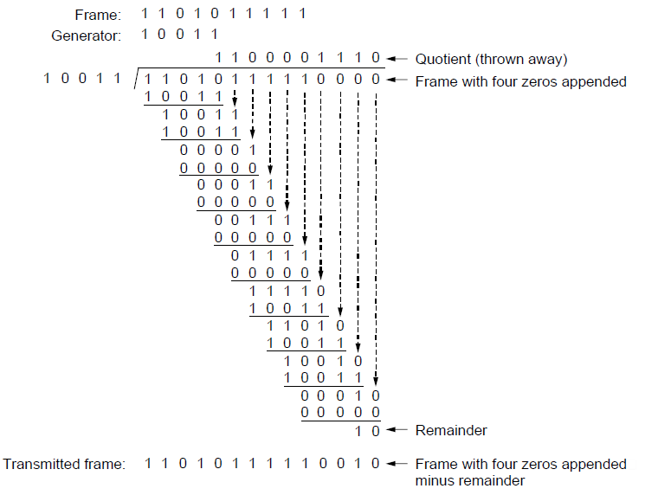
CRCs (5)
Notes:
CN5E slides #3-19

Slide 29
CRCs (6)
Protection depend on generator
Standard CRC-32 is 10000010 01100000 10001110 110110111
Properties:
HD=4, detects up to triple bit errors
Also odd number of errors
And bursts of up to k bits in error
Not vulnerable to systematic errors like checksums

Slide 30
Error Detection in Practice
CRCs are widely used on links
Ethernet, 802.11, ADSL, Cable …
Checksum used in Internet
IP, TCP, UDP … but it is weak
Parity
Is little used

