Slide 1
Smart School Network Design Using Cisco Packet Tracer
Kowser ahmed sajol
ID: 183002049

Slide 2
Content
1. INTRODUCTION
2. OBJECTIVES
3. DESCRIPTION AND SCREEN SHOTS
4. LIMITATIONS
5. CONCLUSION

Slide 3
INTRODUCTION
“Smart School Network Design Using Cisco Packet Tracer”
is a simulation project which demonstrate the smart way to manage a school.

Slide 4
OBJECTIVES
To design a network where PC, server, IOT devices can work together.
One campus can communicate to another internally and externally via internet.
Using IOT device’s data school will be managed in smart way.
Add service like mail.

Slide 5
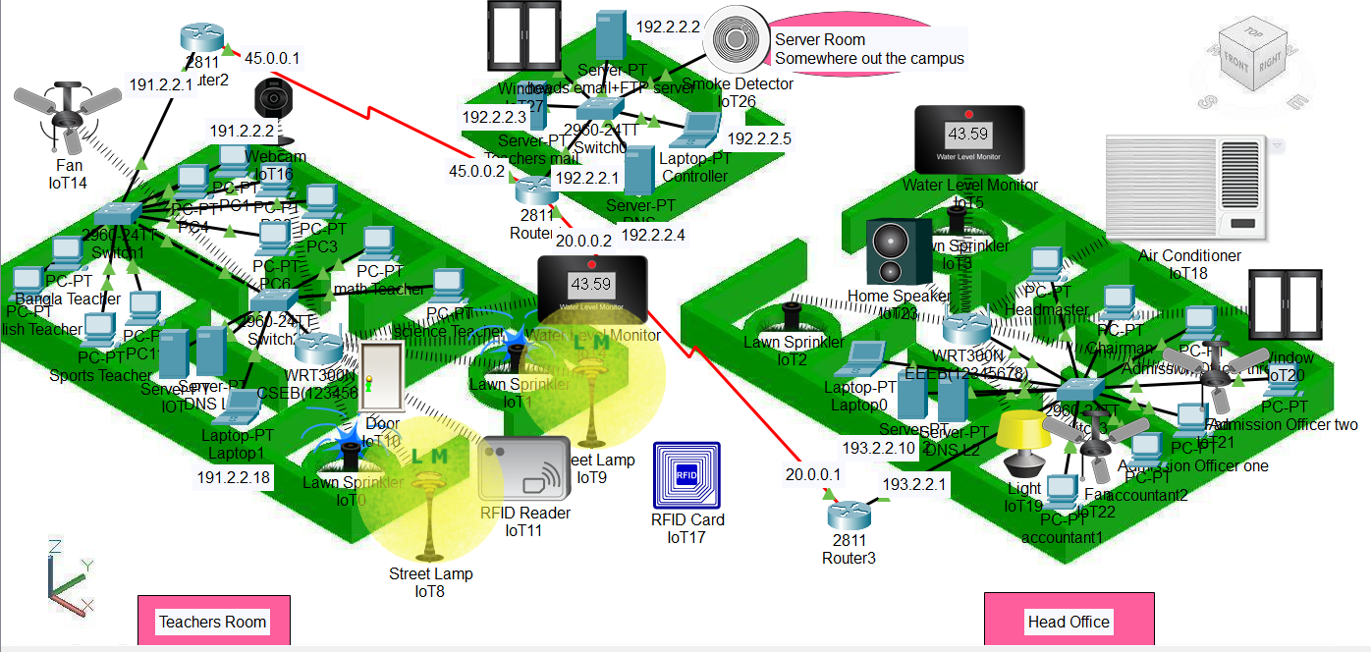
DESCRIPTION AND SCREEN SHOTS

Slide 6
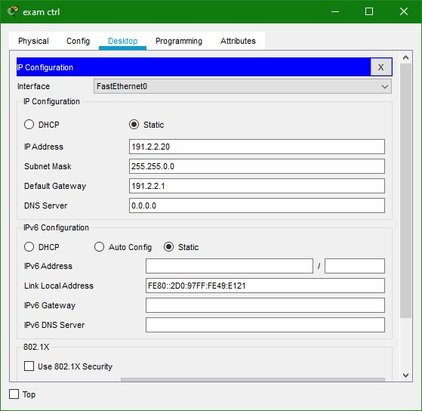
COMPUTER CONFIGURATION

Slide 7
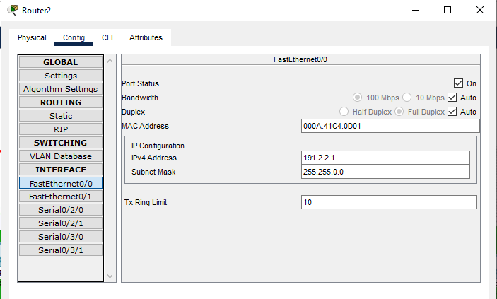
ROUTER CONFIGURATION

Slide 8
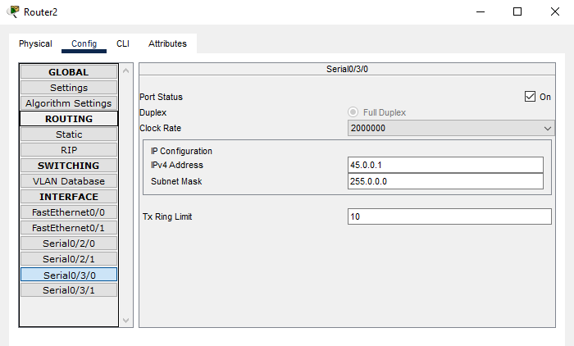
ROUTER CONFIGURATION

Slide 9
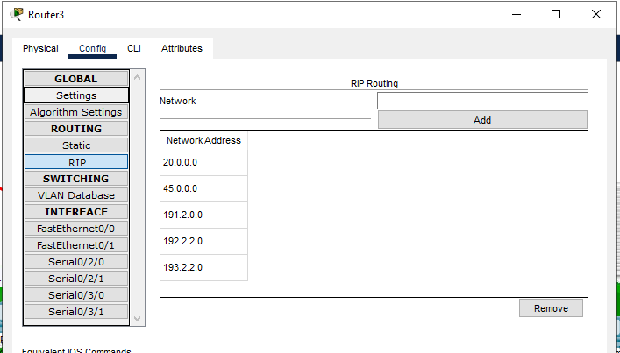
ROUTER CONFIGURATION

Slide 10
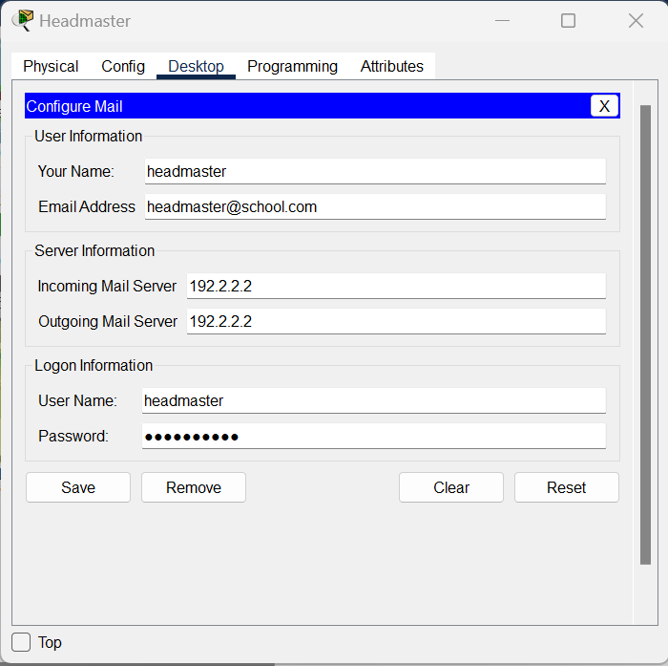
EMAILL CONFIGURATION

Slide 11
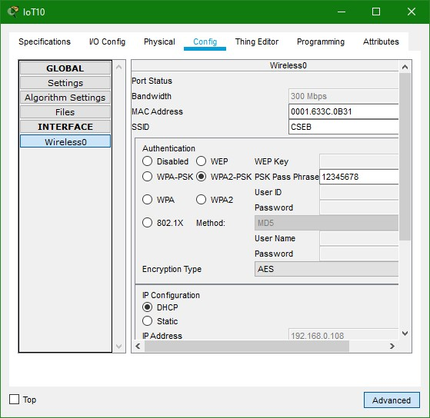
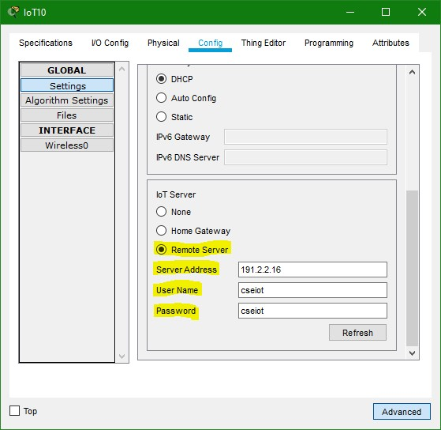
DESCRIPTION AND SCREEN SHOTS

Slide 12
LIMITATIONS
The project doesn’t demonstrate all possible smart services.
The security of IOT server and devices must be a serious concern.

Slide 13
CONCLUSION
The project shows only some basic IOT devices that is not enough to make a School smart.
The designed worked properly on cisco packet tracer simulator.

Slide 14
THANK YOU

