Slide 1

A presentation on
EXTRACTION AND ANALYSIS OF SARCOIDOSIS ILD PATTERN FROM LUNG HRCT IMAGE
SUPERVISOR
Dr. V. Vijaya Kishore, MTech., Ph.D.
Professor
Department of ECE
Submitted by
A. Kowshik Kumar (18121A0407) A. Venkatesh (18121A0404)
A. Tagore Siva Sai (18121A0402) E. Sumanth Kumar (18121A0449)
SREE VIDYANIKETHAN ENGINEERING COLLEGE (Autonomous)
Sree Sainath Nagar, A. Rangampet,
Tirupati-517102.

Slide 2
ABSTRACT
Most of the clinicians expressed cumbersome due to the enormous amounts of medical images and also poor quality of images during acquisition, limiting the correct diagnosis. A Large range of lung patterns of disease can be observed from CT scan images.
Medical image segmentation is an important step for successive image analysis tasks. The goal of segmentation is to separate region of interest (ROI) for extracting lung abnormalities of Interstitial Lung Disease (ILD) patterns like Sarcoidosis, Idiopathic pulmonary fibrosis, Malignant nodules, and Honey-comb.
In this project morphology-based segmentation is used to extract Sarcoidosis patterns that are used for diagnosis and prognosis of pulmonary disease.
Noise are added to original image for the evaluation of noise effect. Noise reduction capability of proposed method on a particular noise type is validated based on correlation coefficient, PSNR, BDE and GCE.

Slide 3
Objectives
To improve the diagnostics accuracy of the clinician.
To provide a reliable secondary opinion to aid in the decision-making process.
To reduce the computation complexity of algorithms to make them more suitable for real time applications.
To increase the efficiency in Identification, Interpretation and classification of ILD patterns.

Slide 4
Motivation
The amount of quantitative information available on medical images is enormous. Computerized quantification may hold more potential than computerized detection.
When radiologists are asked to name aspects of their work that are common, time consuming, and could be automated, they usually do not mention detection but rather documentation and quantification.
With the increase of image data along with the expanding volume of thoracic CT studies emphasizes the need for Computer Aided Diagnosis (CAD) schemes to assist the radiologists (clinicians) performing their daily diagnostic task to detect abnormalities which may represent lung cancers at an early and potentially more curable stage.
Current systems for computer-aided detection have been introduced as complementary tools that draw the radiologist's attention to certain image areas that need further evaluation.

Slide 5
Introduction
The examination of patient data is gained by image modalities such as CT, MRI, PET and US. Medical image analysis need image processing techniques.
Computed Tomography is more likely known as computed axial tomography or CAT scan is a principle that assists X – rays and computers to generate three-dimensional likeliness of the human body.
A pulmonary lung nodule is any space occupying lesion either solitary or multiple on the lung that is 3cm in diameter or less and if larger considered as Lung mass, are cancerous.

Slide 6
Existing Method
Sarcoidosis refers to the CT manifestation of diffuse pulmonary fibrosis. The clustered cystic air spaces are between 3-10mm in diameter but occasionally as large as 2.5cm.
Sarcoidosis is difficult to detect due to its textural and structural appearance, which changes with the progression of the diseases.
Existing methods are texture-based methods developed for detecting the honeycombing pattern.
Texture Based Methods For detecting ILD Patterns
Large range of lung texture patterns of disease can be observed in CT scan images.
These images are the intermixed of various patterns and hence it becomes very difficult for Radiologist to differentiate between them and diagnose the disease.
Limitations:
Prone to low interpretability.
Heavily influenced by CT dose.

Slide 7
Proposed Method
This project was modeled with morphological algorithm to segment the lung as ROI and ILD pattern sarcoidosis.
Salt & pepper noise, Speckle noise, Poisson noise, Gaussian noise are added to the original image for the evaluation of noise effect.
Noise reduction capabilities of proposed method on a particular noise type is validated based on correlation co-efficient and peak Signal-to-Noise ratio.
Graphical user interfaces (GUIs), also known as apps, provide point-and-click control of your software applications, eliminating the need for others to learn a language or type commands in order to run the application.
Open MATLAB Software.
Click on 'NEW' option and click on 'GRAPHICAL USER INTERFACE' and create a blank 'GUI', We are going to create an input image icons in GUI and create callback function and write the code for the displaying the input image.
Now we are going to add the noises to the image by creating an icon and writing a code for callback function.
After adding noises to the input image, we are going to perform segmentation for the input image and then going to extract the sarcoidosis pattern images and perform the operations of peak to signal noise ratio and correlation coefficient.

Slide 8
Overview of the Project
INPUT PROCESSING OUTPUT
SEGMENTATION
CT IMAGE
REGION GROWING
EXTRACTED SARCOIDOSIS PATTERN
EXTRACTION OF ROI PATTERNS EVALUATION IN NOISE

Slide 9
Methodology
Step1: Collecting the DICOM Lung CT images.
Step2: Convert the CT image into gray image.
Step3: Develop gradient images using appropriate edge detection function.
Step4: Mark the Foreground Objects using morphological operation.
Step5: Compute Background Markers.
Step6: Compute the Watershed Transform of the Segmentation Function.
Step7: Extraction of lung region.
Step8: Display of ILD patterns-ROI that includes lung region and Sarcoidosis pattern.
Step9: Add noise to the original image and repeat step 2 to 8.
Step10: Comparison of extracted ROIs from original and noise added original images and computing Peak-Signal to Noise ratio and Correlation Co-efficient between original ROI and Noise added ROIs.

Slide 10
Implementation Requirements
The program will be developed in MATLAB R2013b in Windows operating system.
The standard functions of MATLAB and MATLAB Image Processing Toolbox are used.
Because of large amount of data processed, a computer with at least 1GB of RAM is required.
Speed of the processor is not crucial.
HRCT lung images.

Slide 11
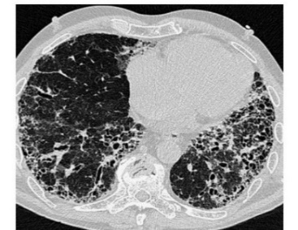
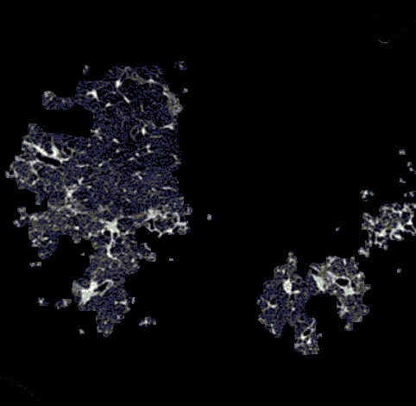
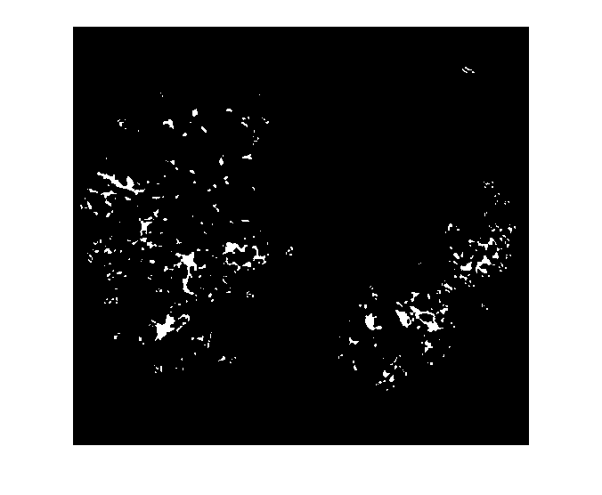
Resultant Output Images
ORIGINAL CT LUNG IMAGE
SEGMENTED ROI OF LUNG CT IMAGE
EXTRACTED SARCOIDOSIS PATTERNS

Slide 12
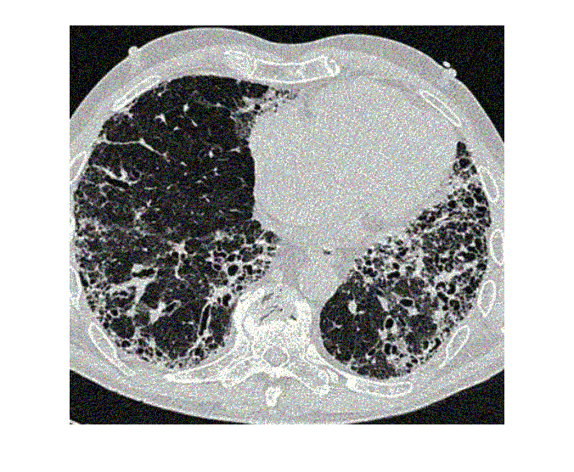
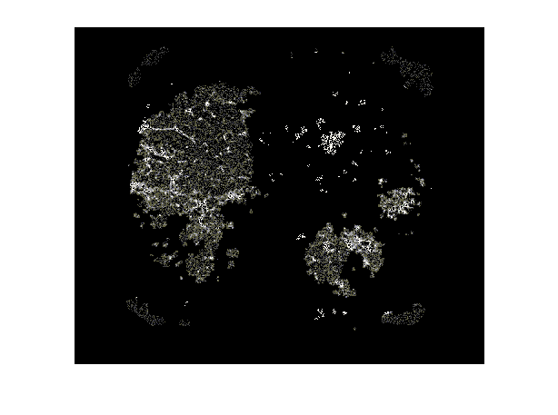
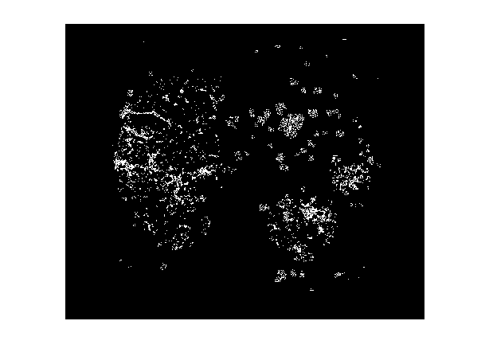
Extracted ROI Image Of Gaussian Noise
GAUSSIAN NOISE ADDED IMAGE
SEGMENTED ROI FROM GAUSSIAN NOISE ADDED IMAGE
EXTRACTED SARCOIDOSIS PATTERNS FROM GAUSSIAN NOISE ADDED IMAGE

Slide 13
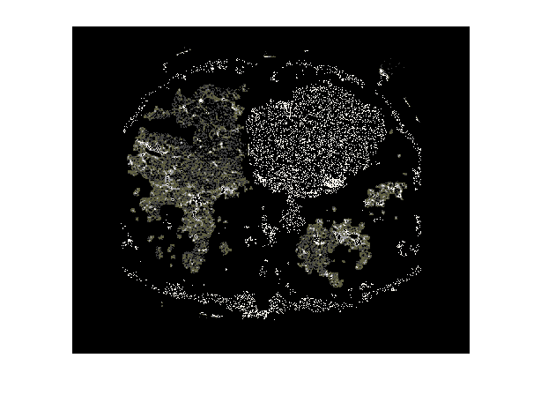
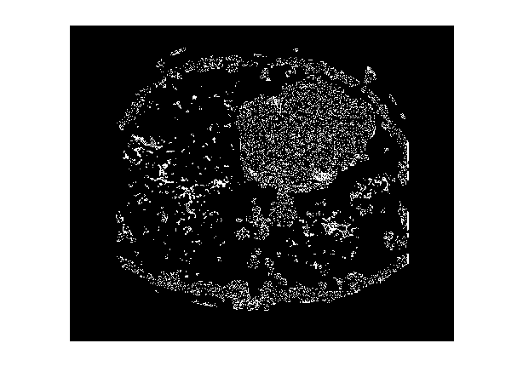
Extracted ROI Image Of Poisson Noise
POISSON NOISE ADDED IMAGE
SEGMENTED ROI FROM POISSON NOISE ADDED IMAGE
EXTRACTED SARCOIDOSIS PATTERNS FROM POISSON NOISE ADDED IMAGE

Slide 14
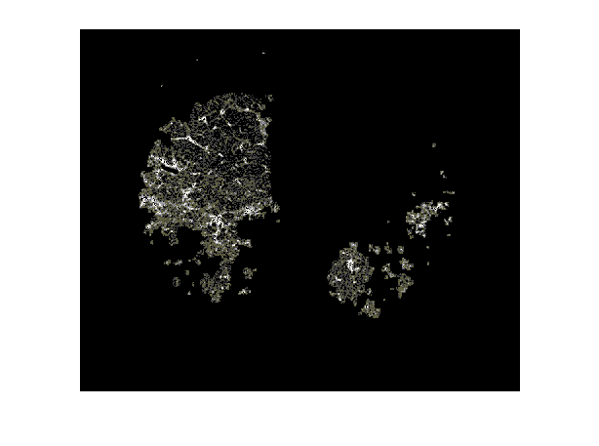
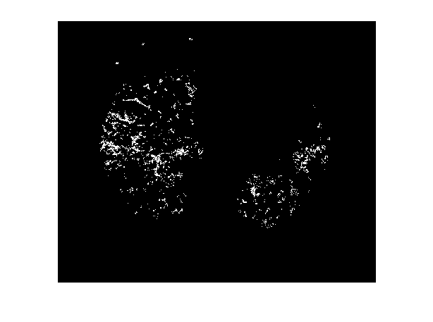
Extracted ROI Image Of Speckle Noise
SPECKLE NOISE ADDED IMAGE
SEGMENTED ROI FROM SPECKLE NOISE ADDED IMAGE
EXTRACTED SARCOIDOSIS PATTERNS FROM SPECKLE NOISE ADDED IMAGE

Slide 15
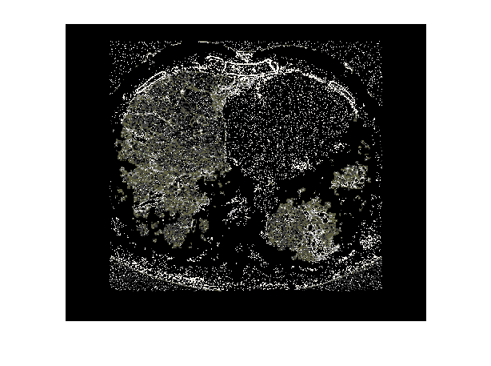
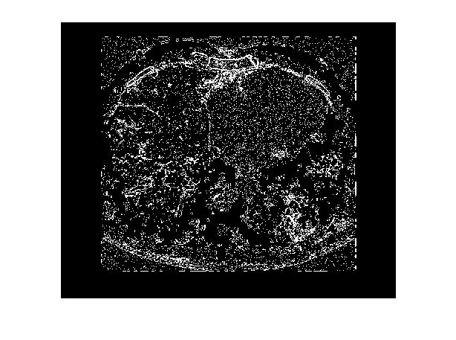
Extracted ROI Image Of Salt And Pepper Noise
SALT AND PEPPER NOISE ADDED IMAGE
SEGMENTED ROI FROM SALT AND PEPPER NOISE ADDED IMAGE
EXTRACTED SARCOIDOSIS PATTERNS FROM SALT AND PEPPER NOISE ADDED IMAGE

Slide 16
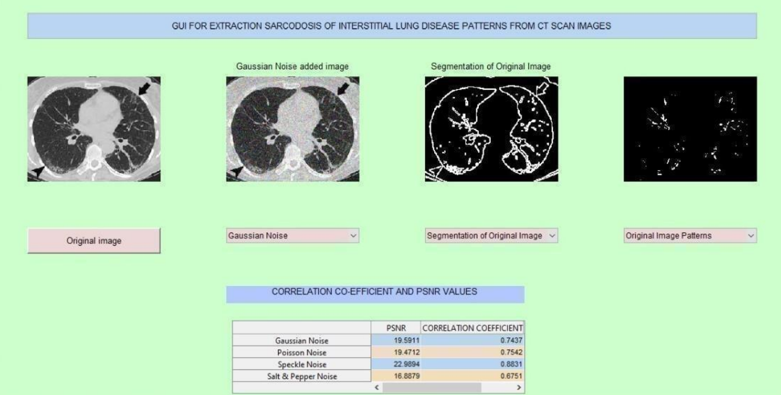
GUI Interface

Slide 17
CORRELATION CO-EFFICIENT AND PSNR VALUES OF DIFFERENT ROI IMAGES IN NOISY ENVIRONMENT
NOISE | PEAK SIGNAL TO NOISE RATIO | CORRELATION CO-EFFICIENT
GAUSSIAN
POISSON
SPECKLE
SALT AND PEPPER

Slide 18
Thank You

