Slide 1

A presentation on
EXTRACTION AND ANALYSIS OF SARCOIDOSIS ILD PATTERN FROM LUNG CT IMAGE
SUPERVISOR
Dr. V. Vijaya Kishore, M.Tech., Ph.D.
Professor
Department of ECE
Submitted by
A. Kowshik Kumar(18121A0407) A.Venkatesh(18121A0404)
A.Tagore Siva Sai(18121A0402) E.Sumanth Kumar(18121A0449)
SREE VIDYANIKETHAN ENGINEERING COLLEGE (Autonomous)
Sree Sainath Nagar, A. Rangampet,
Tirupati-517102.

Slide 2
Contents
Abstract
Objectives
Motivation
Introduction
Existing Method and it’s Limitations
Proposed Method
Overview of the Project
Literature Review
Sample input image
Resultant Output Images
Tools Used
Conclusion
References

Slide 3
Abstract
Medical image segmentation is an important step for successive image analysis tasks. The goal of segmentation is to separate region of interest (ROI) for extracting lung abnormalities of Interstitial Lung Disease (ILD) patterns like Sarcoidosis, Idiopathic pulmonary fibrosis, Malignant nodules, and Honey comb.
In this project morphology-based segmentation is used to extract sarcoidosis patterns that are used for diagnosis and prognosis of pulmonary disease. The performance of the proposed method is operated with watershed algorithm.
The image is filled with holes and performed the computation where the resultant value should be greater than threshold value and observed the possible and annotated abnormalities.

Slide 4
Objectives
To design and develop a computer assisted graphical user interface (GUI) tool for identification of lung sarcodoisis in CT images.
Graphical User Interface-user friendly allowing the users for easy computation of the sarcodoisis details in the DICOM images.
Reducing the computational complexity to a great extent and making the system suitable for real time applications.
To improve diagnosis accuracy of the clinician by providing secondary opinion.

Slide 5
Motivation
The amount of quantitative information available on medical images is enormous. Computerized quantification may hold more potential than computerized detection.
When radiologists are asked to name aspects of their work that are common, time consuming, and could be automated, they usually do not mention detection but rather documentation and quantification.
With the increase of image data along with the expanding volume of thoracic CT studies emphasizes the need for Computer Aided Diagnosis (CAD) schemes to assist the radiologists (clinicians) performing their daily diagnostic task to detect abnormalities which may represent lung cancers at an early and potentially more curable stage.
Current systems for computer-aided detection have been introduced as complementary tools that draw the radiologist's attention to certain image areas that need further evaluation.

Slide 6
Introduction
The examination of patient data is gained by image modalities such as CT, MRI, PET and US. Medical image analysis need image processing techniques.
A pulmonary lung sarcoidosis is any space occupying lesion either solitary or multiple on the lung that is 7mm in diameter or less and if larger considered as Lung mass, are cancerous.
The principal objectives of this course are to provide an introduction to basic concepts and techniques for medical image processing and to promote interests for further study and research in medical imaging processing.

Slide 7
Existing Method and it’s Limitations
Existing methods are Texture Based Methods For detecting ILD Patterns
Large range of lung texture patterns of disease can be observed in CT scan images.
These images are the intermixed of various patterns and hence it becomes very difficult for Radiologist to differentiate between them and diagnose the disease.
Drawbacks:
Prone to low interpretability.
Heavily influenced by CT dose.

Slide 8
Proposed Method
This project is modelled with morphology based reconstruction to segment the lung as ROI and ILD pattern sarcoidosis.
The Original Image is segmented using Watershed algorithm and processed further to evaluate the Original Region of Interest (ROI)
The Original ROI is further processed to the image filling and then the image is been identified with the sarcoidosis pattern for the Original ROI image.
The evaluation of both possible abnormalities and annotated abnormalities based on the threshold value.
The project is implemented by designing and developing a CAD-GUI tool which can help the clinicians in decision making of diagnosis and prognosis.

Slide 9
Overview of the Project
Step1: Collecting the DICOM Lung CT images.
Step2: Convert the CT image into gray image.
Step3: Develop gradient images using appropriate edge detection function.
Step4: Mark the Foreground Objects using morphological operation.
Step5: Compute Background Markers.
Step6: Compute the Watershed Transform of the Segmentation Function.

Slide 10
Overview of the Project
Step7: Extraction of lung region.
Step8: Display of ILD patterns-ROI that includes lung region and Sarcoidosis pattern.
Step 9: Any discontinuities present are filled, so that perfect region properties like boundaries and their respective centroids are maintained which helps to evaluate the area of the abnormality accurately
Step 10: Taking the area as a parameter to detect the abnormalities, all the possible abnormalities are annotated with areas. These quantification can be taken as secondary opinion to understand the progress of the Sarcoidosis ILD pattern. Based on this the diagnosis and prognosis of the disease can be performed.

Slide 11
Literature review
Morphological and anatomy based techniques classify insignificant three dimensional mass in the lung using size, brightness, region of interest (ROI).
Xiaolei and Gavrii “Biomedical Image Processing” consigned their theories to establish and accomplish to decoct significant features comprising of image dimensions, appearance, and irregularities in medical images.
Rastgarpour and Shanbehzadeh “Biological and Medical Physics, Biomedical Engineering” and “Digital Imaging and Communications in Medicine (DICOM)- A PracticalIntroductionandSurvivalGuide” ascertained peculiar methods for segmenting the truthful image features.
These techniques used to divide the image rely on many constraints like mass of the disease and distinguishing the structure of image.
These results provoke a difficult task for the researchers to project on literatures dealing with image segmentation.

Slide 12
Requirements
The program will be developed in MATLAB R2015a in Windows operating system.
The standard functions of MATLAB and MATLAB Image Processing Toolbox are used.
Because of large amount of data processed a computer with at least 1GB of RAM is required.
Speed of the processor is not crucial.
CT lung images.

Slide 13
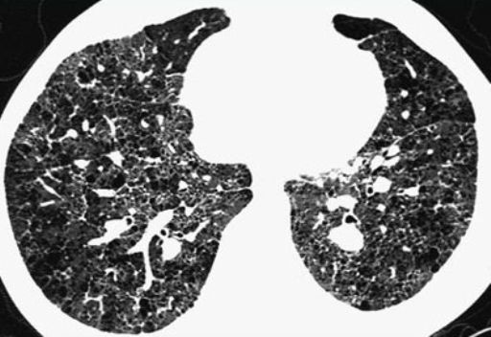
Sample input image

Slide 14
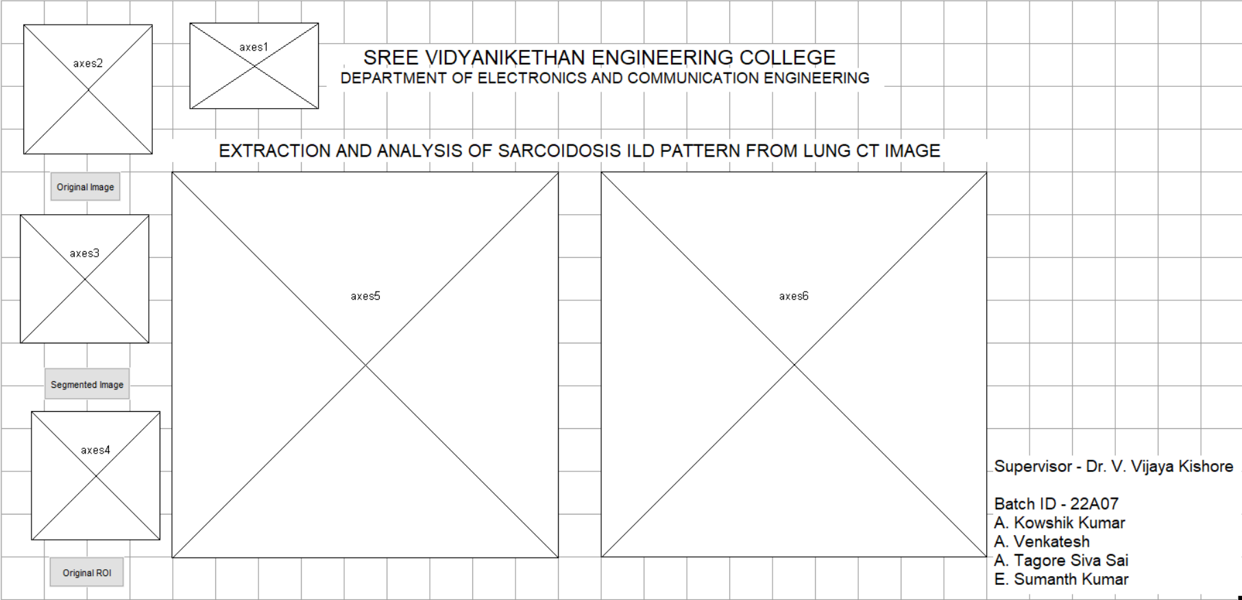
GUI Template

Slide 15
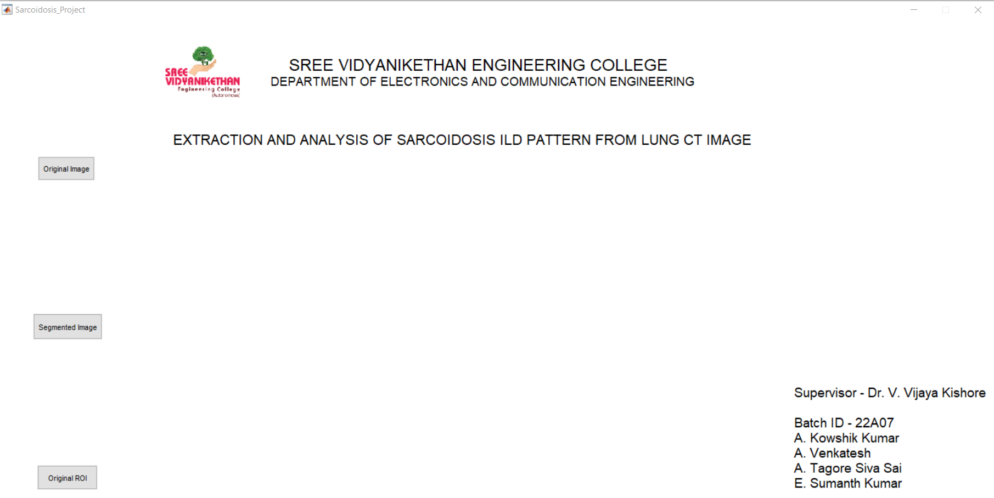
RESULTANT OUPUT WINDOW

Slide 16
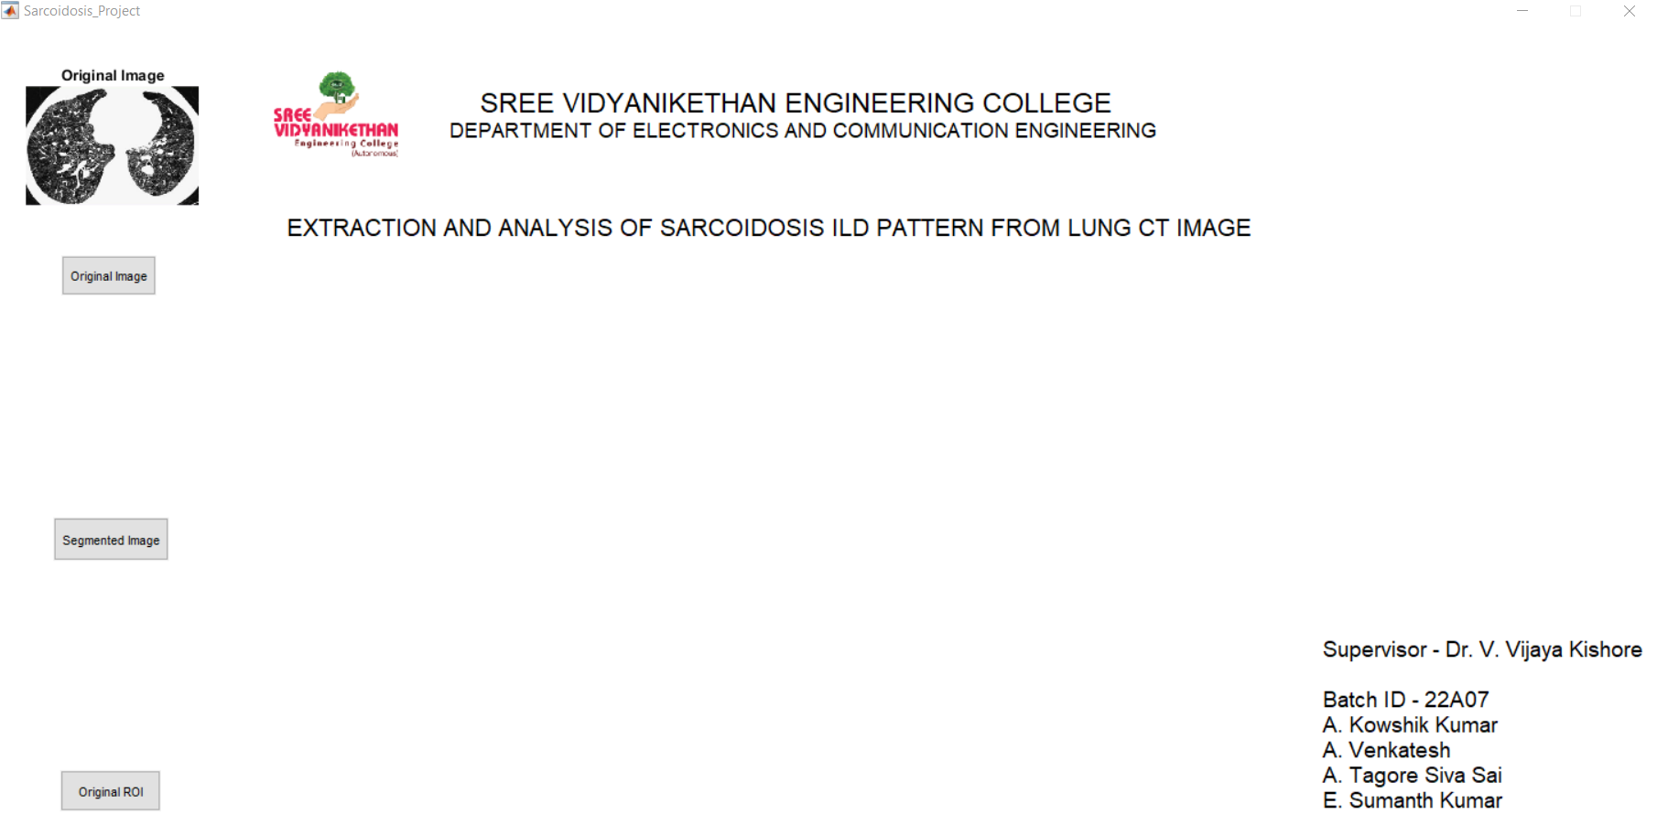
ORIGINAL IMAGE

Slide 17
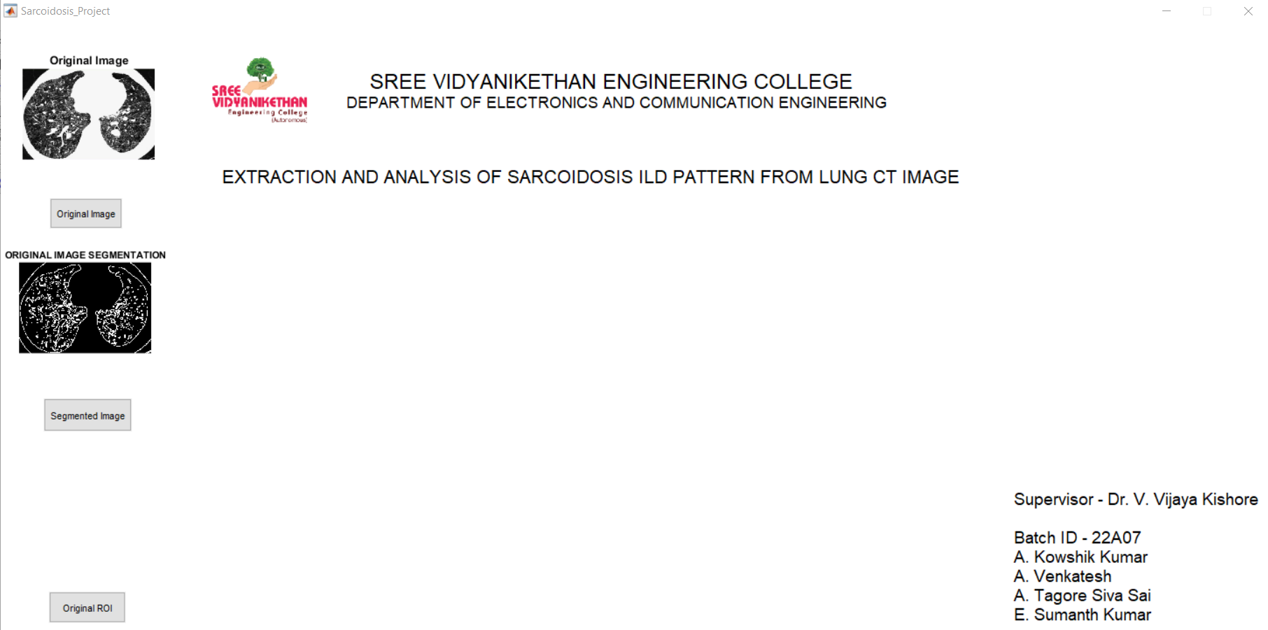
ORIGINAL SEGMENTED IMAGE

Slide 18
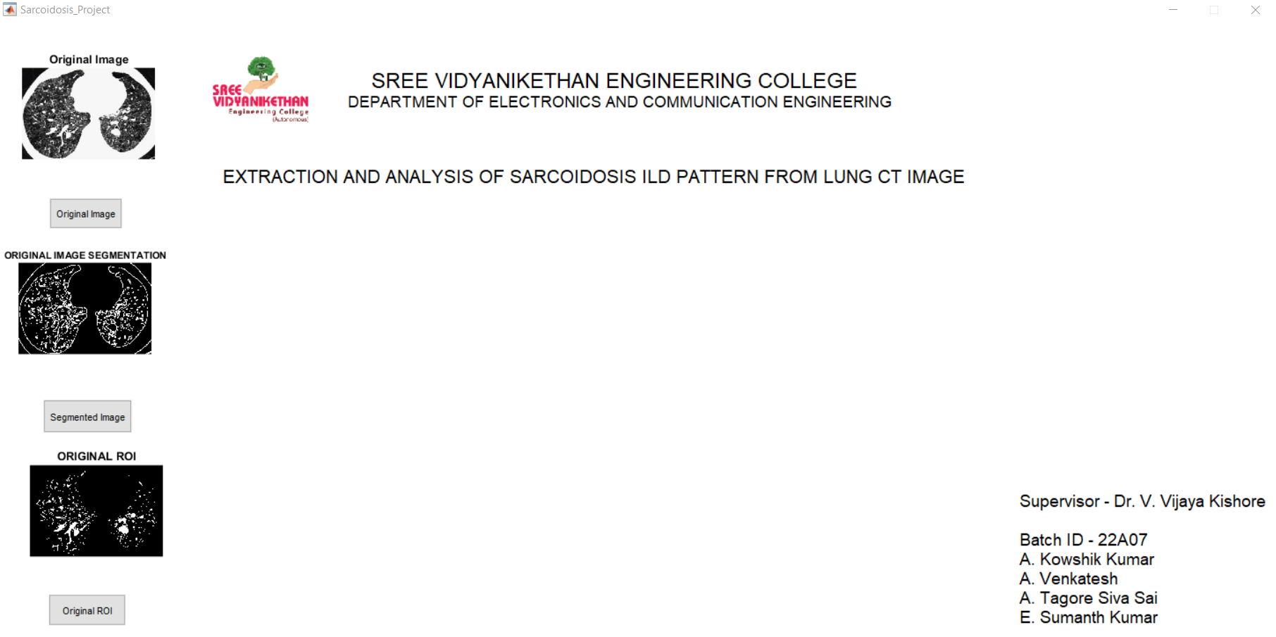
ORIGINAL ROI

Slide 19
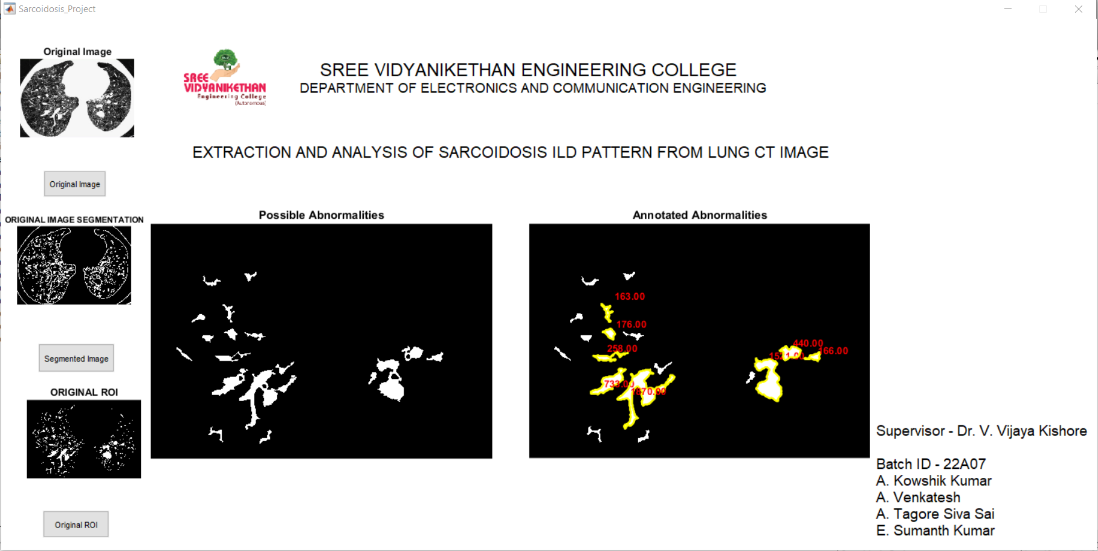
Abnormalities

Slide 20
Conclusion
Majority of the pulmonary diseases and their identification rely on geometric progression of lung spaces. Some of the physicians expressed the inadequacy in image parts which are known as (ROI)Region Of Interest.
Researchers convey seat focusing on ROI coding to guarantee the use of multiple and randomly shaped ROI’s in image, because depicting the importance of ROI is affected by the background regions that exhibit various levels of quality, brightness, and shapes. In this project, a GUI is designed to perform morphology-based segmentation is used to extract Sarcoidosis ILD pattern is developed and implemented.
Morphology based region of interest segmentation is implemented to extract various lung patterns by lung ROI segmentation that delineates the diseased part. The results provide a high-quality visual screening of extracted patterns of different ILD patterns such as malignant nodules, and sarcoidosis pattern.

Slide 21
References
[1] Felix Ritter, Tobias Boskamp, André Homeyer, Hendrik Laue, Michael Schwier, Florian Link, and Heinz-Otto Peitgen, “Medical Image Analysis”, Proceedings of CVPR’96 IEEE PULSE, pp 2154-2287 November/December2011.
[2] Kushal Kr. Roy, Amit Phadikar,”Automated Medical Image Segmentation: A Survey”, Proc. of Int. Conf. on Computing, Communication & Manufacturing2014.
[3] Ping-Lin Chang and Wei-Guang Teng, “Exploiting the Self-Organizing Map for Medical Image Segmentation”, IEEE International Symposium on Computer-Based Medical Systems (CBMS'07)0-7695-2905-4/07.
[4] V. Vijaya Kishore, R V S. Satyanarayana, “Computer-Aided Diagnosis Tool for Honeycomb Detection by Using Morphology And Wavelet Transform In Lung CT Images”, IFRSA’s International Journal Of Computing|Vol2|issue 2|April2012.

Slide 22
Thank you.

