Slide 1
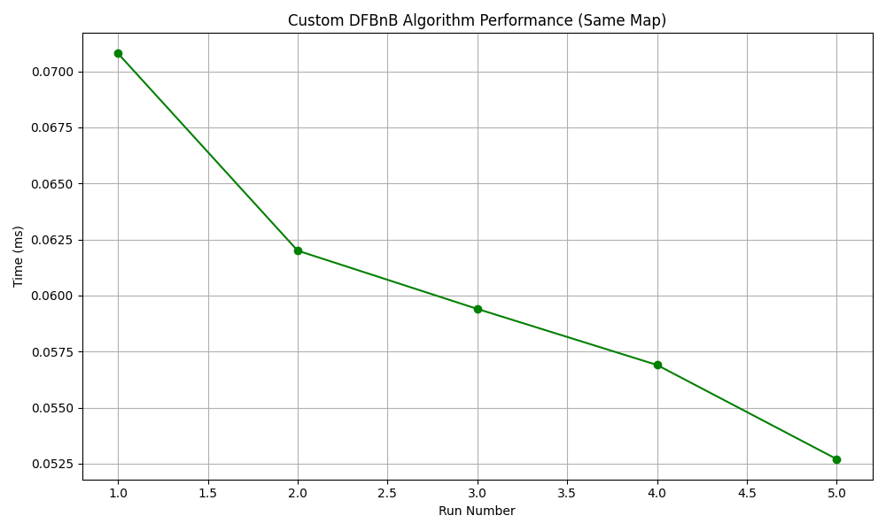
DFBnB
Heuristic function: Manhattan distance

Slide 2
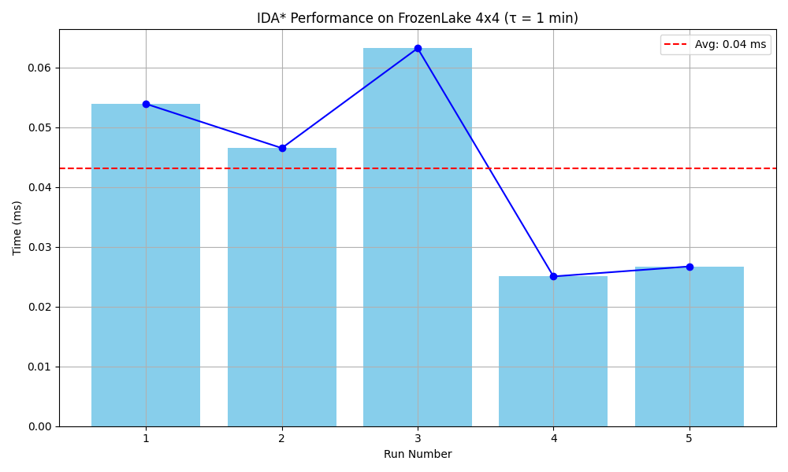
IDA*
Heuristic function: Manhattan distance

Slide 3
Reasons
DFBnB
Fast in small maps due to aggressive pruning
Stack-based → avoids revisiting
Performs well when goal is easily reachable
IDA*
More exhaustive due to repeated iterations
Safe from memory explosion (like DFS) but slower
Great for complex heuristics or large graphs
Timeout may occur if map has poor connectivity

Slide 4
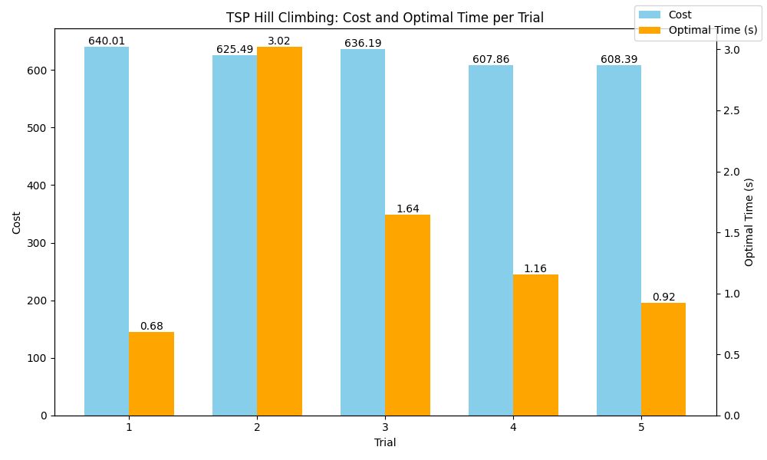
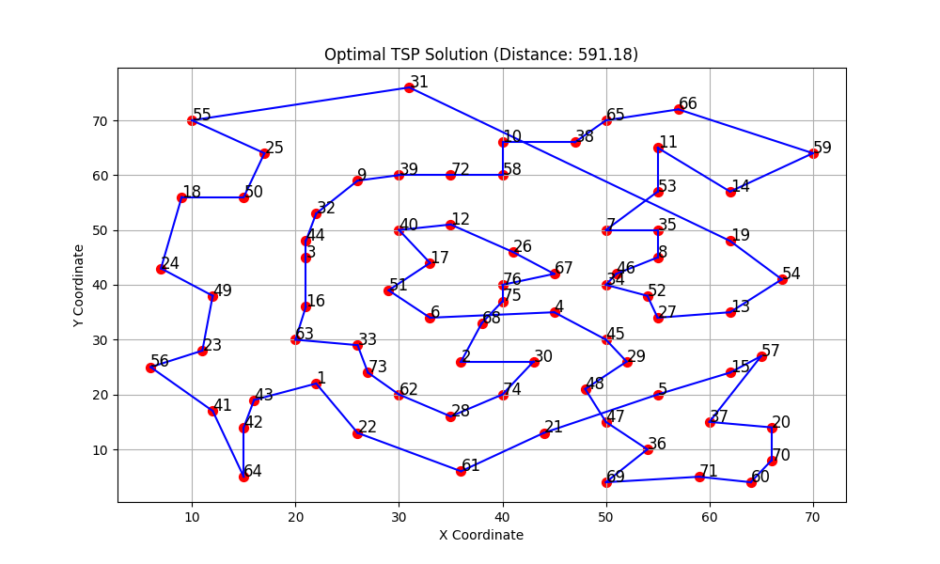
Hill climbing
Heuristic function: Manhattan distance
Optimal solution found :

Slide 5
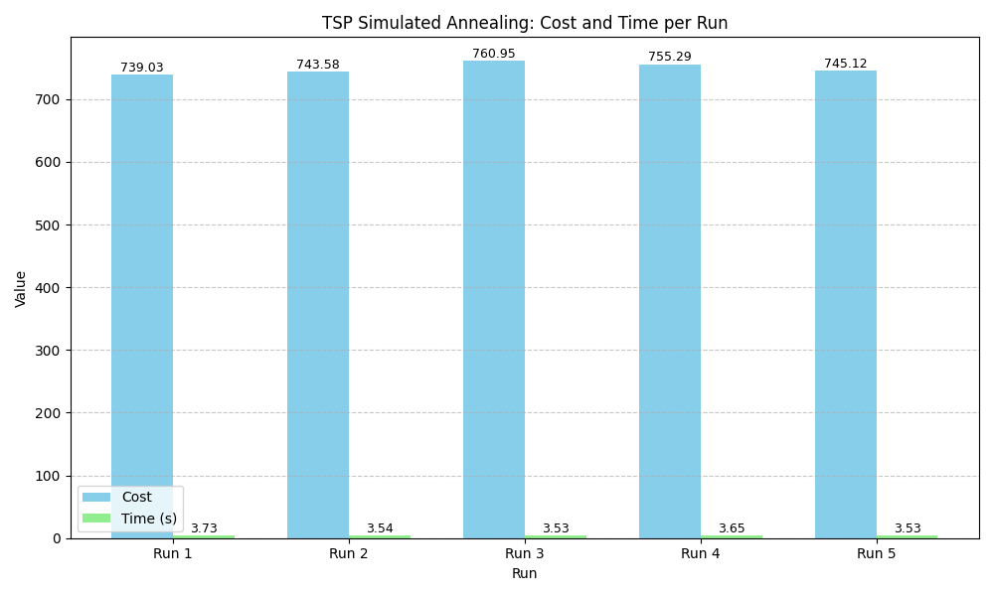
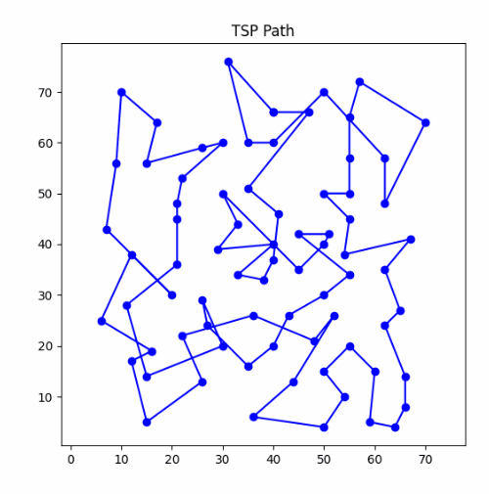
Simulated annealing
Optimal solution found :

Slide 6
Reasons
Hill Climbing:
Quickly finds a decent solution
Lacks exploration → gets stuck in local optima
Simulated Annealing:
Explores broader solution space using randomness
Accepts worse solutions to escape local optima
Slowly cools down to focus on exploitation

