Slide 1

Enhancing Rural Healthcare: An AI System for Lung Nodule Screening in Health ATMs
Guided by,
Dr Simi Surendran
Dinesh AM.EN.U4CSE22215
Kowshik AM.EN.U4CSE22245
Rahul AM.EN.U4CSE22257
Teja AM.EN.U4CSE22271

Slide 2
Outline
Introduction
Problem Definition
Literature Review Summary
Research Gap
Design/ Architecture
Algorithms (if any)
Result Analysis
Phase II plan
Reference
Approval from the Project Guide
Project title

Slide 3
Introduction
This project focuses on improving early lung cancer screening in remote and rural areas.
We developed a lightweight AI system that can detect and classify lung nodules directly on Health ATMs, even in low-power and low-connectivity settings.
To build trust and support decision-making, the system provides visual explanations using Grad-CAM and generates both technical and patient-friendly reports using an LLM.
With a simple interface and telemedicine support, this solution aims to make reliable lung cancer screening more accessible to underserved communities.

Slide 4
Problem Definition
Early lung cancer detection in rural India remains challenging due to a shortage of radiologists, poor connectivity, and inconsistent reporting standards. Although AI-based lung nodule systems show high sensitivity, they often fail to generalize across settings, struggle with false positives, and lack support for multilingual, clinically grounded reporting or FHIR/ABDM compliance. There is a need for a software-only, rural-ready Lung-CT solution that is accurate, explainable, offline-capable, and interoperable—bridging raw CT images to reliable clinical decisions and patient-friendly summaries.

Slide 5
Literature Review Summary
1. Systematic Review of DL for Pulmonary Nodules (European Radiology, 2024/25)
Highlights inconsistencies in datasets, metrics, and validation across nodule detection/segmentation studies.
Emphasizes need for external validation, standardized metrics (FROC, CPM, Dice, AUC), and bias assessment.
Limitation: purely a survey with no deployment or model evidence.
Relevance: Guides our unified evaluation strategy, calibration, and external hold-out testing.
2. DL for Benign/Malignant Nodule Detection in Routine CT (Communications Medicine – Nature, 2023)
Demonstrates clinically validated, two-stage detection + malignancy workflow on real hospital CT scans.
Provides realistic benchmarks for sensitivity vs false positives (~1 FP/scan).
Limitation: designed for high-resource hospital setups; no multilingual or FHIR/ABDM support.
Relevance: We adopt FP-reduction, uncertainty routing, and compression for edge/offline deployment.

Slide 6
3. LNDb v4 – Paired CT + Reports + Manual Nodule Masks (Scientific Data – Nature, 2024)
Supplies CT images aligned with reports, masks, and nodule attributes (count/size/lobe).
Enables factuality evaluation and image↔text grounding for reporting modules.
Limitation: small cohort, single-region, English-only.
Relevance: Used to validate our LLM-generated reports and cross-check segmentation outputs.
4. AI in Lung Cancer Screening: Detection to Prognosis (Cancer Medicine, 2024)
Summarizes end-to-end screening workflows and identifies key blockers:
generalization, explainability, workflow integration.
Limitation: narrative review with no low-resource deployment guidance.
Relevance: Motivates our focus on explainability (mask + Grad-CAM + uncertainty) and rural-ready FHIR/ABDM reporting.

Slide 7
Research gap
Existing models show good sensitivity but poor generalization due to limited external validation.
High false positives make current systems unsuitable for low-expertise rural settings.
Most solutions lack explainability and factual, multilingual reporting linked to actual nodule findings.
Current AI pipelines offer no FHIR/ABDM interoperability, limiting integration with national health systems.
Systems are designed for hospitals, not offline, low-resource deployment like Health ATMs.

Slide 8
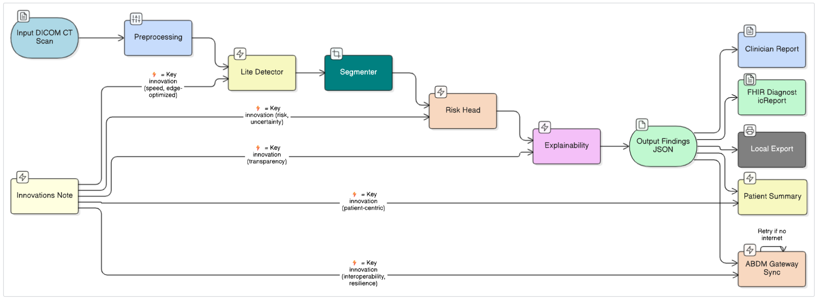
Block Diagram

Slide 9
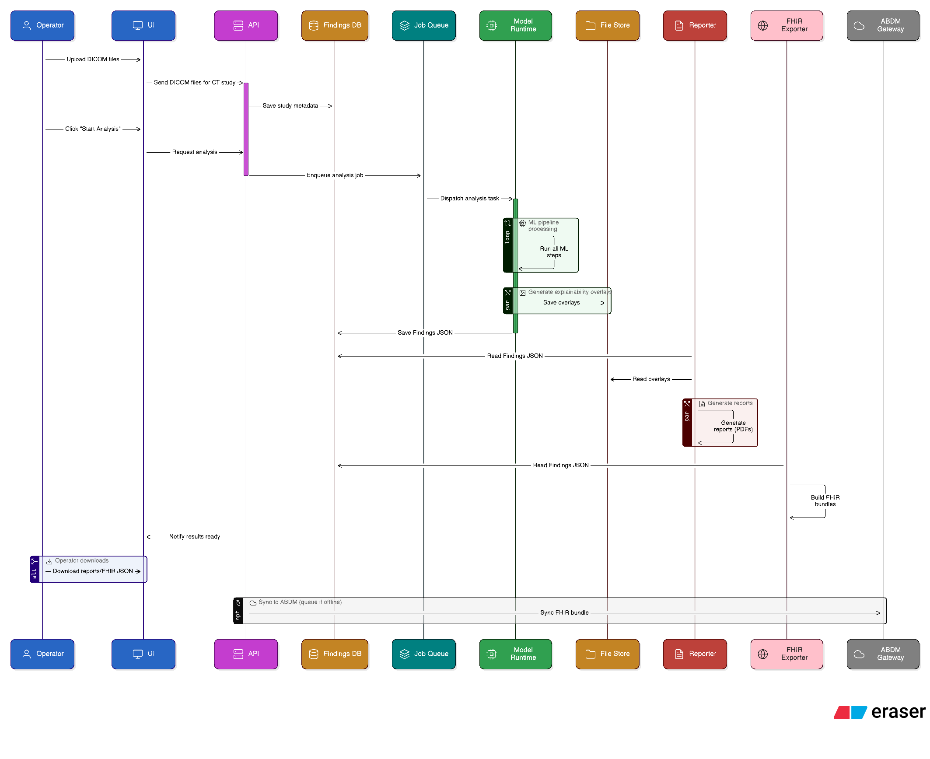
Flow Diagram

Slide 10
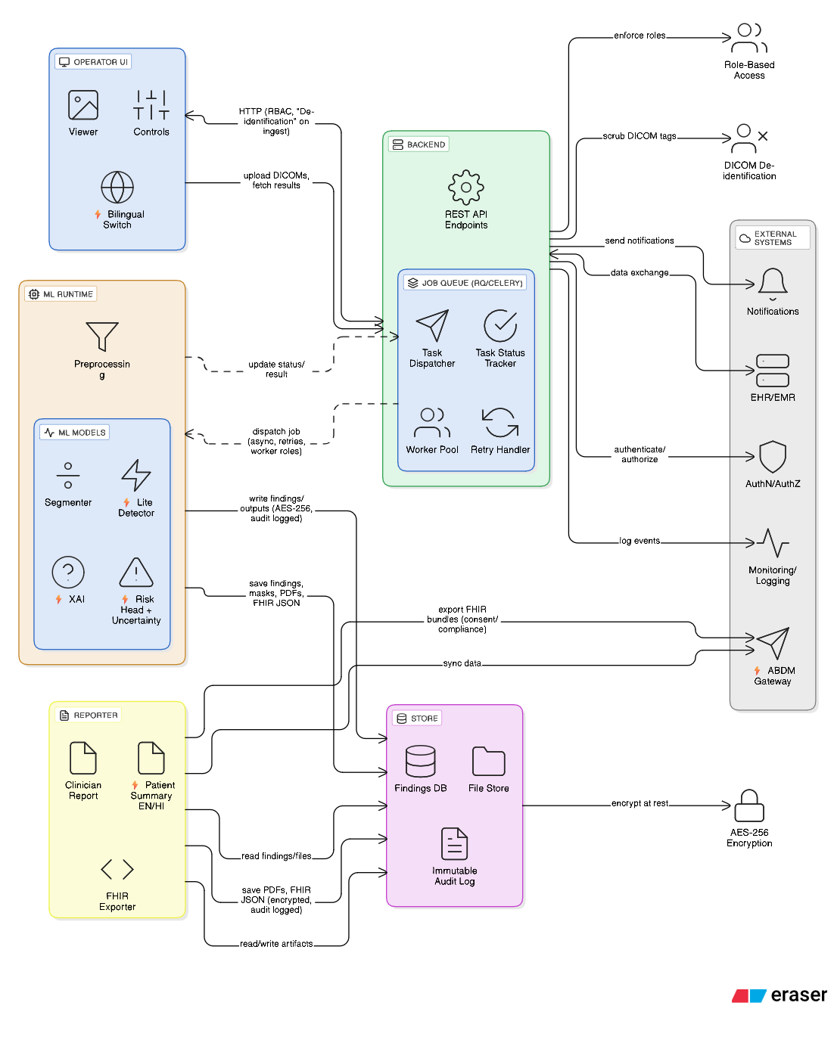
Architecture

Slide 11
Phase–1 Pipeline Validation & Backend Architecture
Core Functional Achievements
Complete Workflow: Successfully validated the path from DICOM Ingestion → Findings JSON → Reporting → FHIR Export.
Backend Reliability: The system (built on FastAPI & Redis Queue) demonstrated stable asynchronous task scheduling, artifact storage, and status polling.
Robust Data Handling: Verified correct metadata parsing, Hounsfield Unit (HU) normalization, and error handling for corrupted DICOM inputs.
The "Findings JSON" Standard
Established a definitive schema to serve as the single source of truth for the AI pipeline.
Structure: Encapsulates nodule metadata, anatomical info, segmentation references, and uncertainty scores.
Purpose: Decouples inference from reporting, ensuring consistent outputs for both the UI and PDF generators.

Slide 12
Multilingual Reporting & User Interface Results
Dual-Category Reporting
Clinician Reports: Technical, radiological focus with nodule-wise summaries and malignancy predictions.
Patient Summaries: Simplified, jargon-free explanations generated in English, Hindi, and native languages (via NLLB-200).
Zero Hallucination: All report content is strictly grounded in the Findings JSON to ensure factual accuracy.
Frontend & Standards Compliance
UI Prototype: Streamlit-based interface validated for slice navigation, mask overlays, and artifact downloading.
Interoperability: Successful generation of FHIR R4 bundles (DiagnosticReport & ImagingStudy) aligned with ABDM recommendations.

Slide 13
Explainability Integration & Performance Metrics
Explainability (XAI) Hooks
While full model training is scheduled for Phase–2, the architectural structure for XAI is complete.
Integration: JSON schema now reserves fields for Grad-CAM++ heatmaps, IoU scores, and uncertainty metrics (confidence levels/review flags).
Performance Profile (Phase–1)
Latency: The synthetic pipeline achieves an end-to-end execution time of < 1 second, with PDF generation completing in 300–500ms.
Stability: Functional testing confirmed stable execution without failures during schema validation or document rendering.
Conclusion: The system architecture is fully operational and optimized to support the quantitative deep learning models in the upcoming phase.

Slide 14
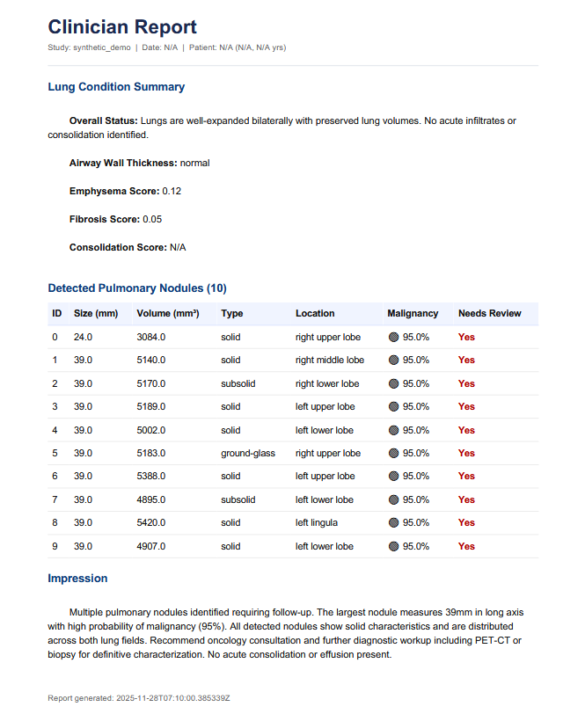
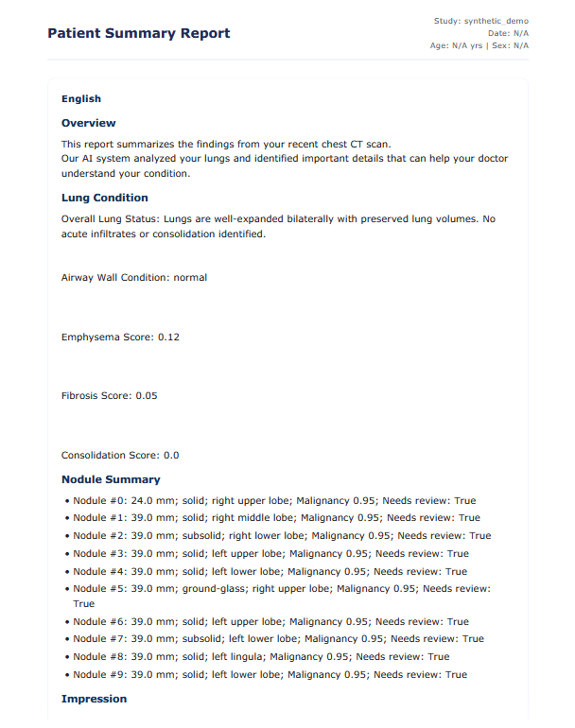
Generated Reports (Phase-I Output)

Slide 15
Phase II Plan
Edge Optimization: Improve INT8 quantization, profiling, and offline-first stability to achieve <60s analysis on mid-range GPUs.
Clinical & User Validation: Conduct a ~50-case radiologist study and patient usability testing for explainability and bilingual reports.
ABDM/FHIR Compliance: Finalize and validate DiagnosticReport and ImagingStudy exports in the ABDM sandbox.
Deployment & Publication: Prepare a release-ready software package with full documentation, reproducible pipelines, and a manuscript detailing system design and results.

Slide 16
Reference
Deep learning in pulmonary nodule detection and segmentation: a systematic review (European Radiology, 2024/25)
Deep learning for the detection of benign and malignant pulmonary nodules in non-screening chest CT (Communications Medicine, 2023)
LNDb v4: Pulmonary nodule annotation from medical reports with manual segmentation (Scientific Data, 2024)
Artificial intelligence in lung cancer screening: Detection, classification, prediction, and prognosis (Cancer Medicine, 2024)

Slide 17
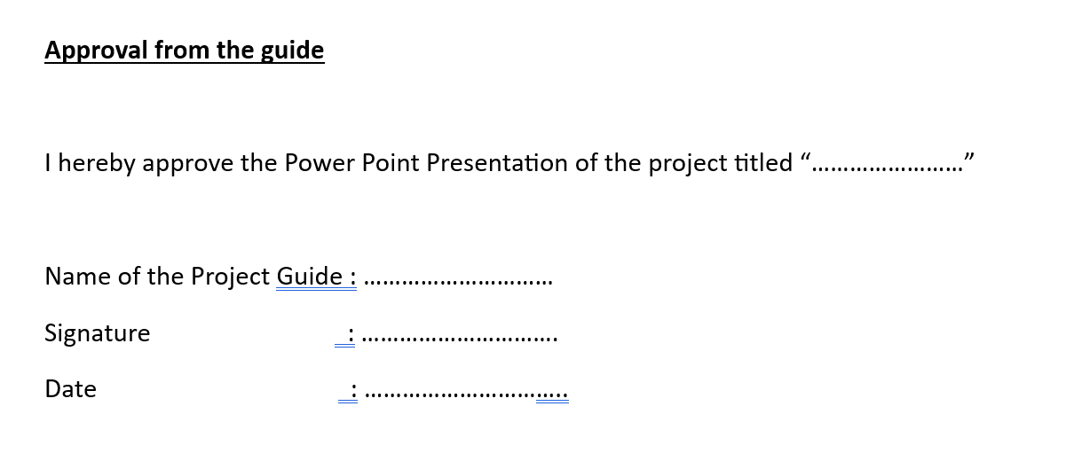
Approval from the project guide

