Slide 1
Analysis of Power Generation

Slide 2
Data Sets and Resources used
-Data of Power generation , Capacity and Demand for last 100 years (1920-2020).
Source - https://www.gov.uk/government/statistical-data-sets/historical-electricity-data
-Data of daily Power generation by fuel type
Source - https://www.bmreports.com/bmrs/?q=generation/fueltype
-Effects of Temperature on Solar generation (Comparison of two different plants)
Source - https://www.kaggle.com/datasets/anikannal/solar-power-generation-data
-World Statistics
Source - https://ourworldindata.org/worlds-energy-problem
-Country wide data
Source - https://ember-climate.org/

Slide 3
General Overview
Electricity is the elixir of modern society. It keeps us warm, cooks our food and in future drives us around(Hopefully!!)
Climate Change is the biggest threat to our society.
As we prepare to revamp our ways of living to more sustainable and environmental ways electricity plays a major role in it.
The electricity that we use now is mainly generated by fossil fuels like Coal, Oil and Natural gas, Which are non renewable and is destroying
our environment by producing millions of tons of CO2 and other green house gasses.
Renewable energy sources like Solar, Wind, Geo Thermal and Hydro should be developed at a rapid pace to combat the climate change and phase
out Non-Renewable

Slide 4
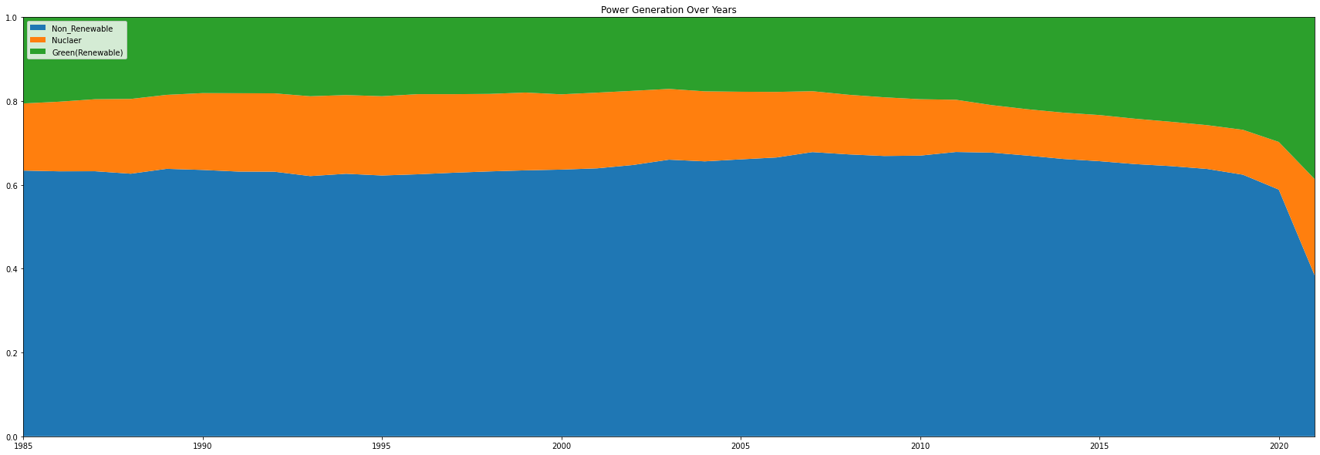
World Statistics
As of 2020 the energy generation ‘world-wide’ is as follows.
We can see the clear Trend here that Renewable is increasing at a rapid pace and Both Non_renewable and Nuclear
Is decreasing

Slide 5
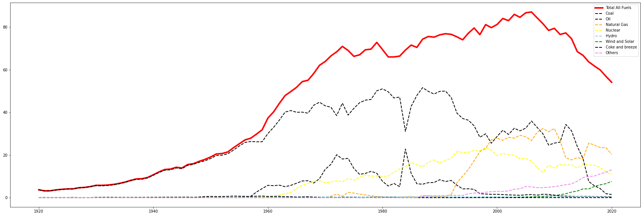
UK – Power Generation Analysis
Here is a snapshot of the UK power generation over years from different power sources

Slide 6
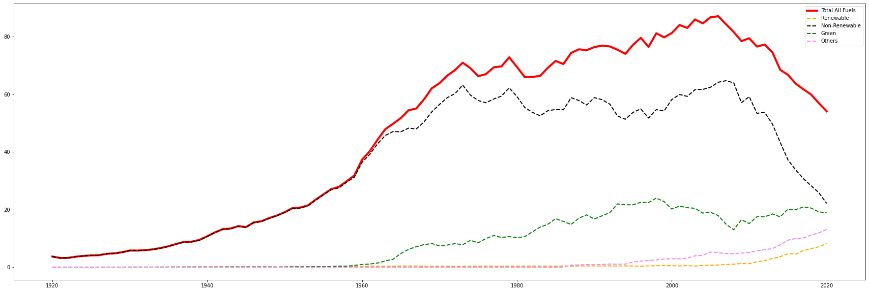
Here I have classified the different fuel types into Renewable , Non-Renewable , Green and Others
I am not sure about how to classify Nuclear, From what I have read it was considered as green but not renewable

Slide 7
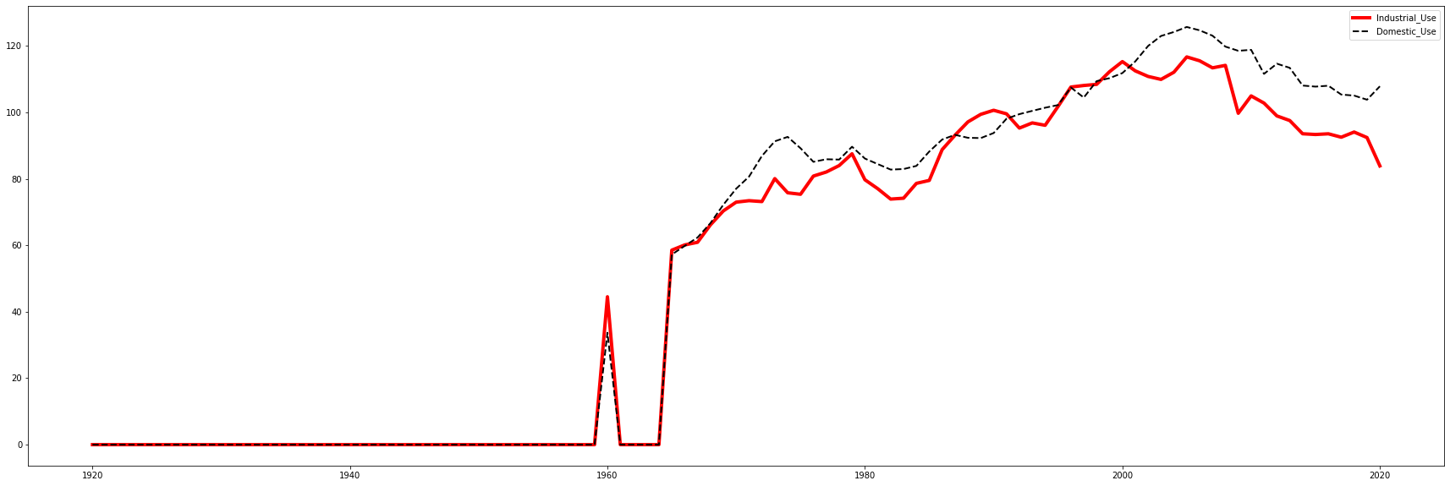
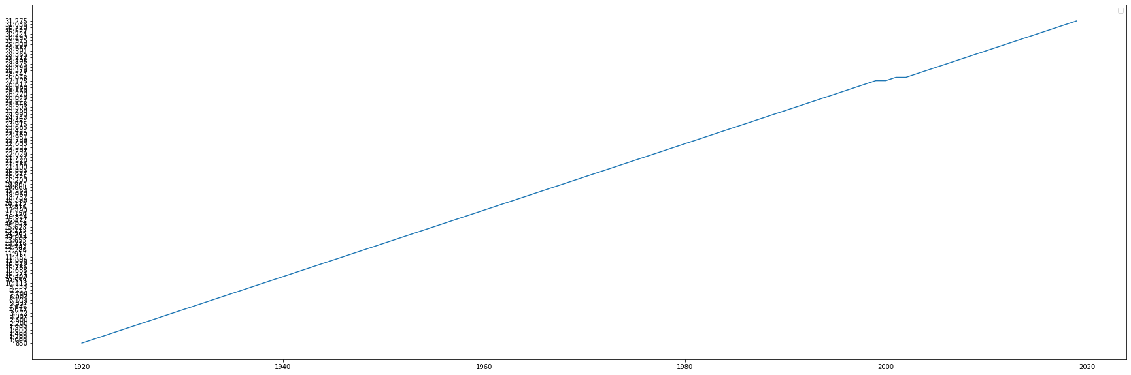
Demand Analysis
The below graph shows the electricity demand by sector Industrial Vs Domestic
The below graph shows the electricity Consumers

Slide 8
Model Description
Model used – Facebook prophet
“Prophet is a procedure for forecasting time series data based on an additive model where non-linear trends
are fit with yearly, weekly, and daily seasonality, plus holiday effects. It works best with time series that have
strong seasonal effects and several seasons of historical data. Prophet is robust to missing data and shifts in
the trend, and typically handles outliers well.” (Definition from https://facebook.github.io/prophet/)
It is a Uni Variate Time series forecasting frame work which usually works better with highly seasonal data
Pros of it include in Built handling of holidays and ability to forecast with less amount of data and also gives Higher limit and lower limit of the prediction
Follows the same flow of Sickit Learn so relatively easy to get started

Slide 9
Model Building
I have used Prophet Model for forecasting the future.
I have used two different data sets
1 . 100 Year data generation for each year
2. 2015-2022 Daily generation
As a first step I cleaned data and handled NA by replacing them with 0 as for some years that mode of generation
is not used.
Then for 100 years data I built the model.
I followed the same model and changed few parameters to use daily data.

Slide 10
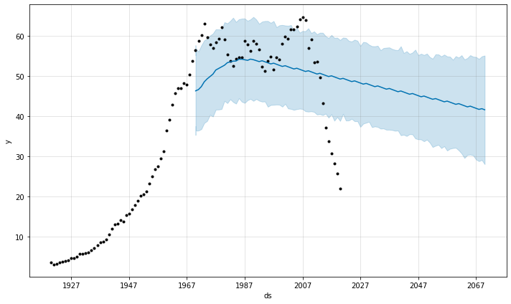
Forecasting results using 100 Year yearly data
This Graph Shows the prediction of Non-Renewable resources.
Here trend is going down wards, but the real trend would be much Steeper
The higher gap between the Lower prediction and Upper prediction
Also indicates the lack of confidence. This trend can be Observed across all the different predictions

Slide 11
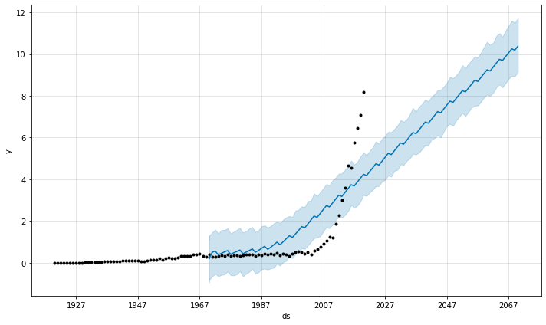
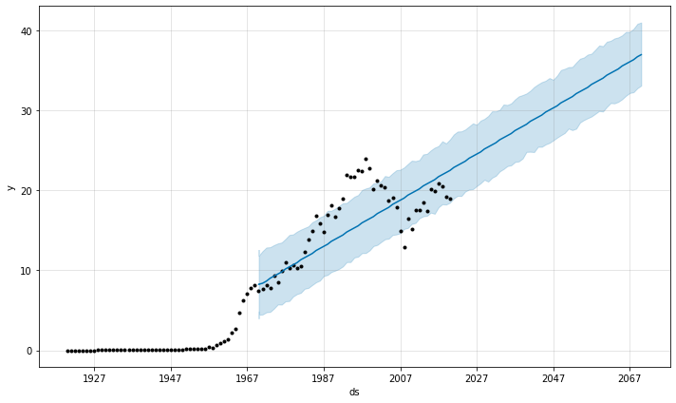
These Graph Shows the prediction of Renewable and Green .
Here trend is going Upwards

Slide 12
Forecasting results using Daily data
Data Preparation
Here Data set contains daily data of power generated splitted in 48 Settlement periods (One for every 30 Mins)
I have grouped the data by day to see trends and seasonality
Here we have data of energy imports as well, so the data is classified into Non-Renewables , Renewables , Nuclear, Others and Imports
Here we can also check for seasonality and trends at much more granular level

Slide 13
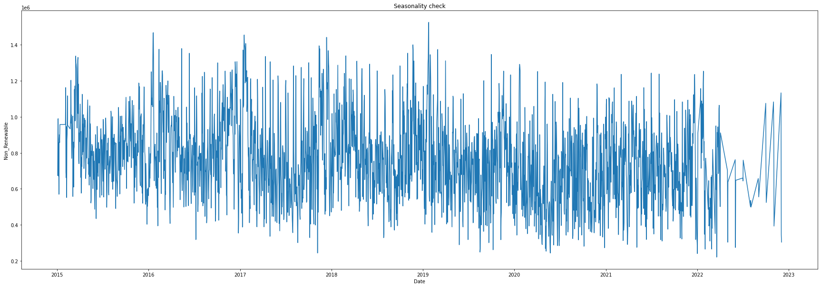
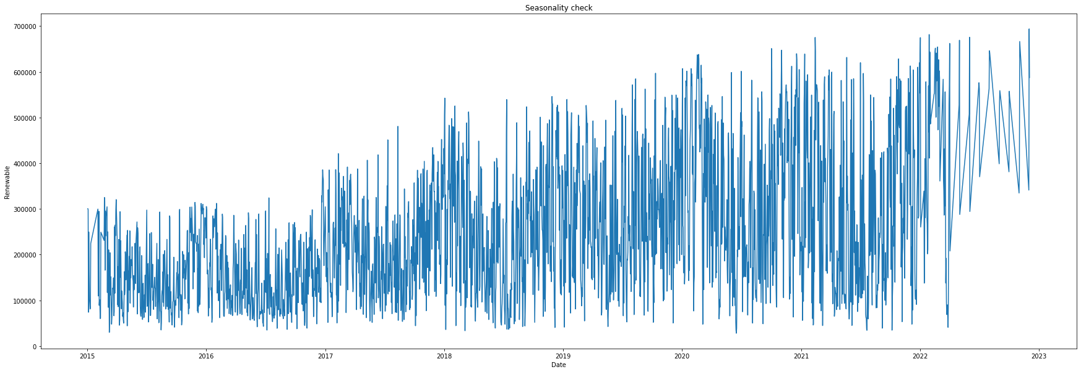
Daily plot of Non –Renewable and Renewable
Here we can observe that there is seasonality but the we cant observe it properly

Slide 14
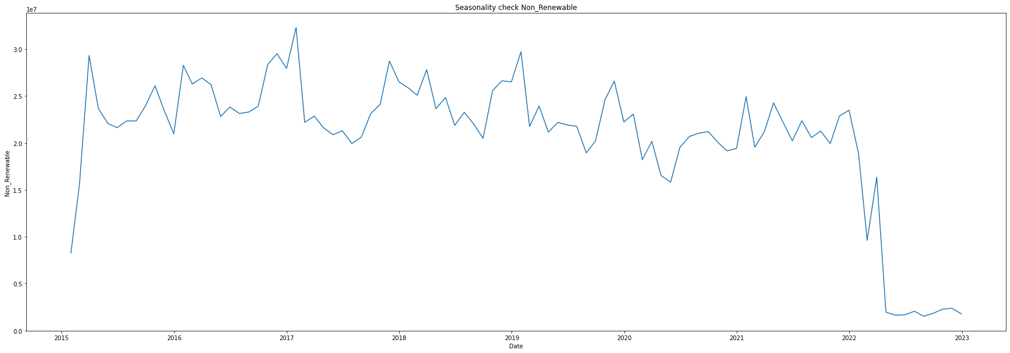
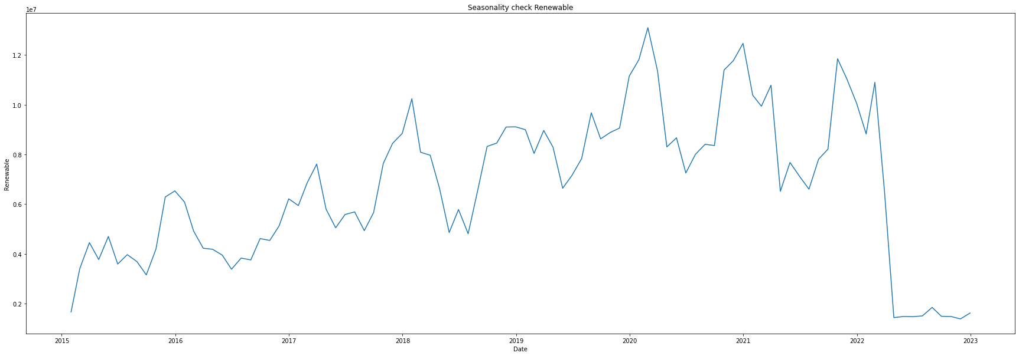
Here data is reformatted to monthly frequency to observe trends more eloquently
Non-renewable
Renewable

Slide 15
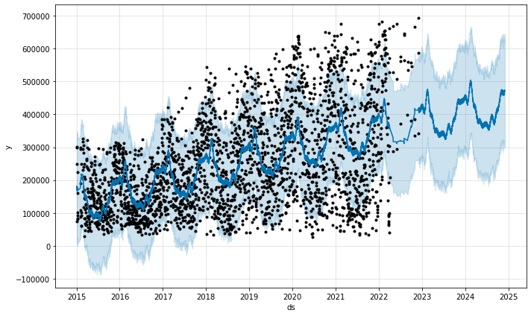
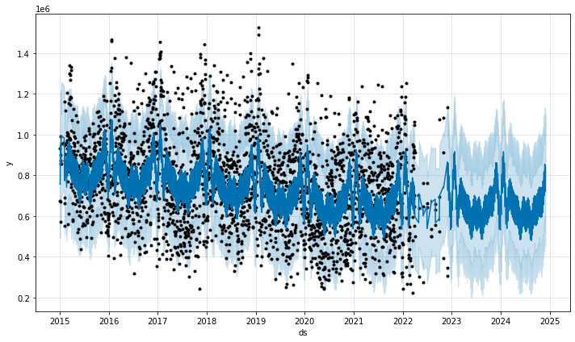
Model building for Daily Data
Here I have followed the same procedure as before but changed frequency parameter to day to forecast the features
This did give me better results which can be seen in the following plots

Slide 16
Analysis of Solar power plant generation
Data set used – Used data from Kaggle which has data of power generation of two different solar power plants and sensor data like
Ambient temperature and Irradiation
Here my goal is to analyse the seasonality and try to understand what factors co relate with each other
Data Cleaning
The data is very clean with just few NA values where it should be “0” and some type mis matches
Tools used –
I have mainly used Pandas Numpy for analysis and reformatting of data
Seaborn and Matplot lib for plots

Slide 17
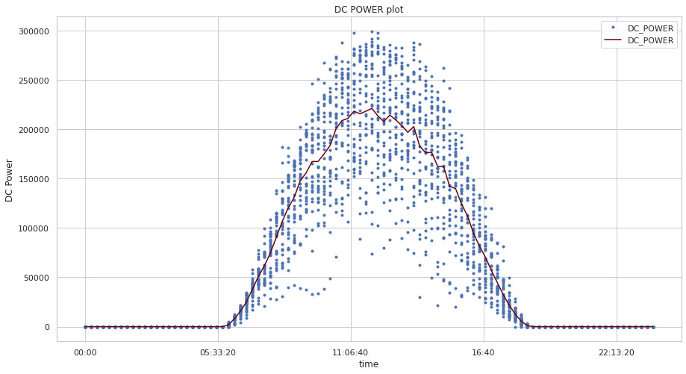
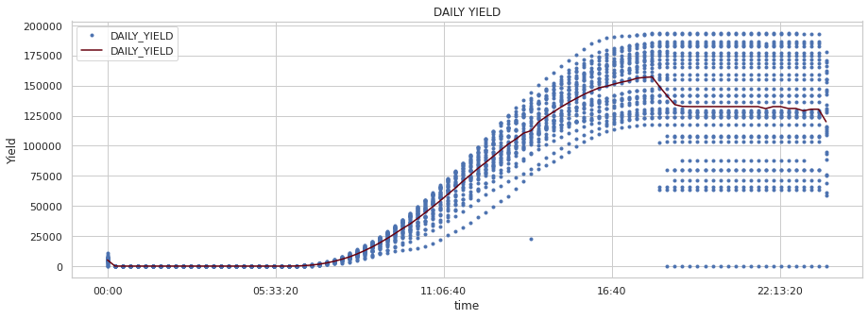
Plots and analysis
Here we can see the power generation and yield and we can see clear trends where the max yield can be found at around
Noon and gradual decrease from there
The data here is from an Indian solar power plant where length of days is relatively constant through out the year

Slide 18
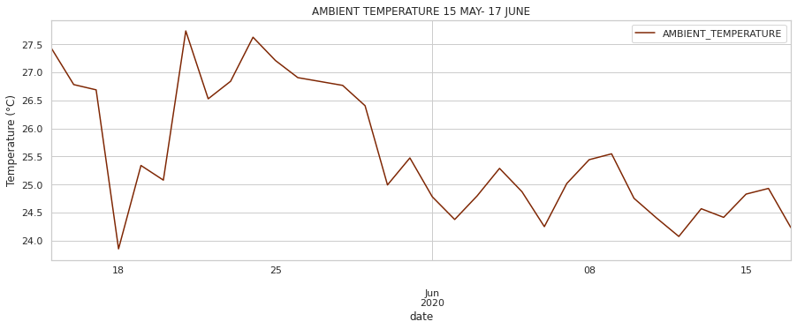
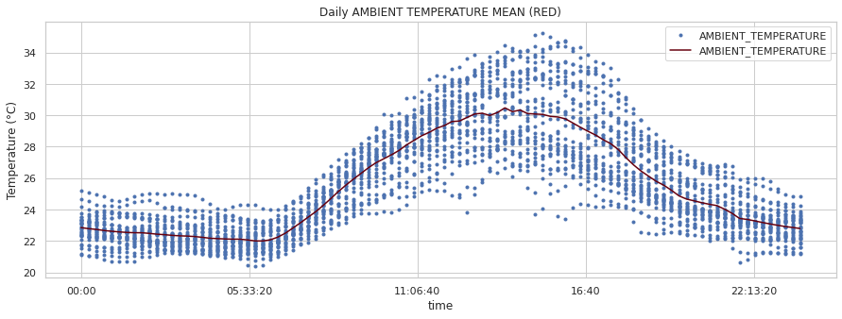
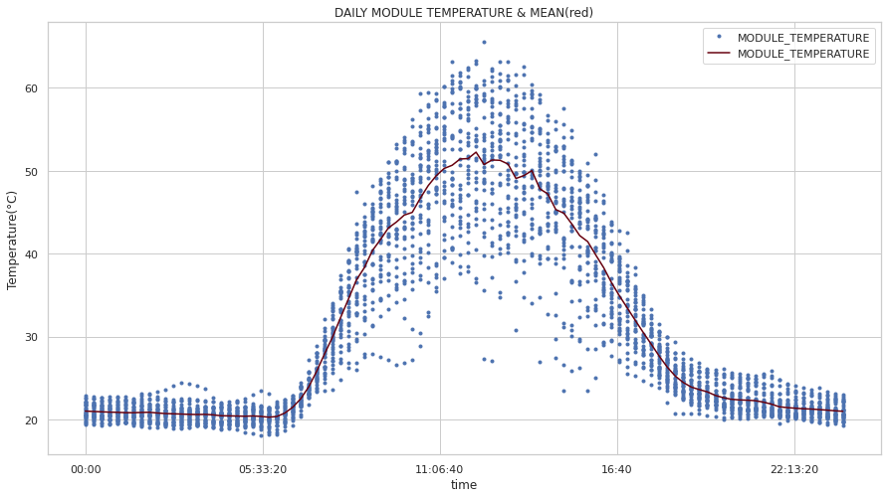
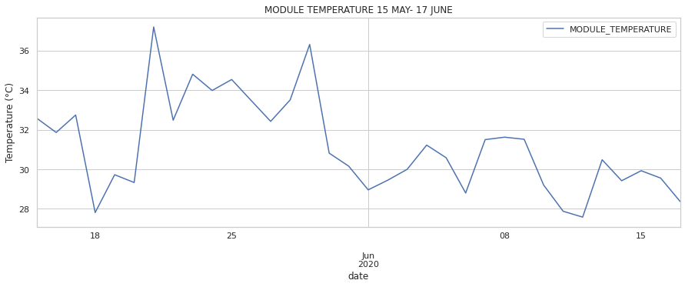
Here are the plots of Ambient temperature and Module temperature we can see May is significantly hotter than June

Slide 19
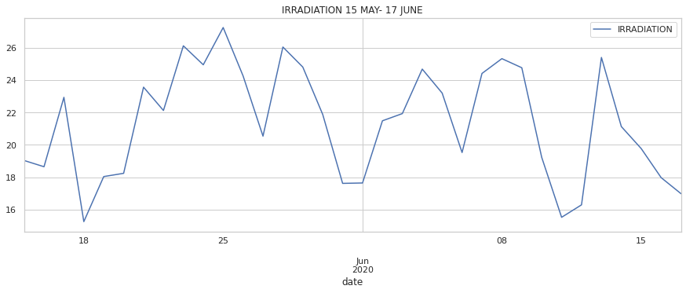
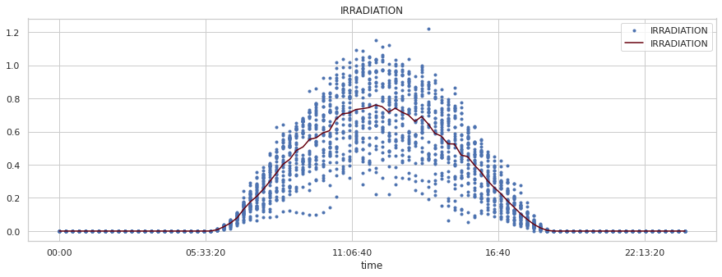
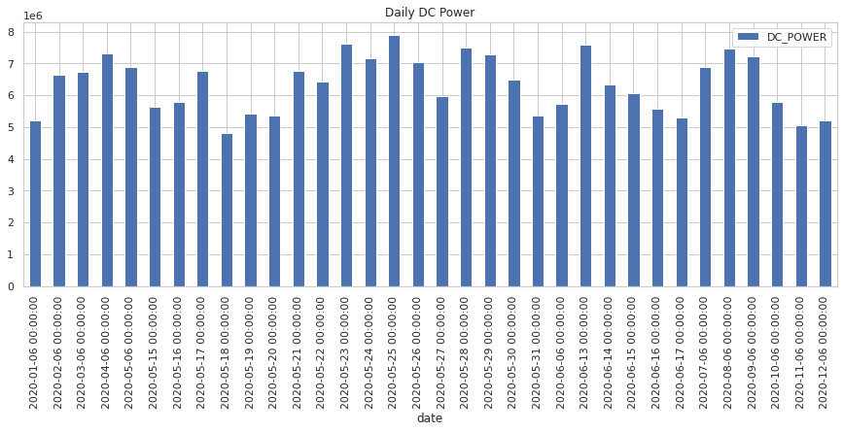
Here we can see even the temperature is high in May than in
June the power output tends to more relate to Irridiation
As long as the temperature Is within the range at which they
Are rated for, Usually from 25C to 65 C where 25-35 is the where
Solar panels are more effective

Slide 20
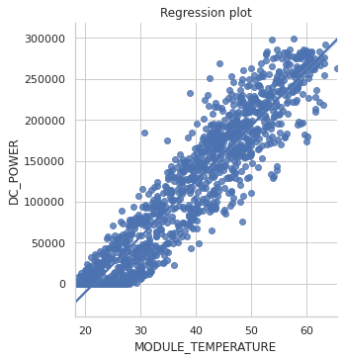
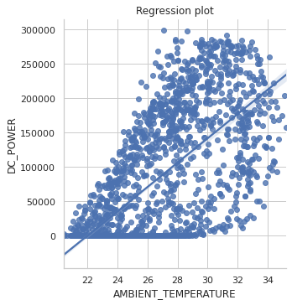
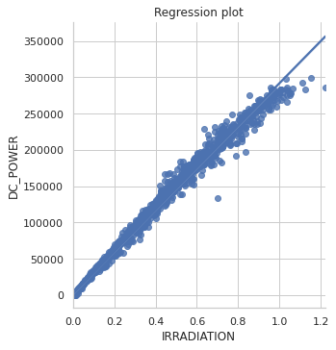
Here we can see regression plot between DC power and Module temperature , ambient temperature and Irradiation

Slide 21
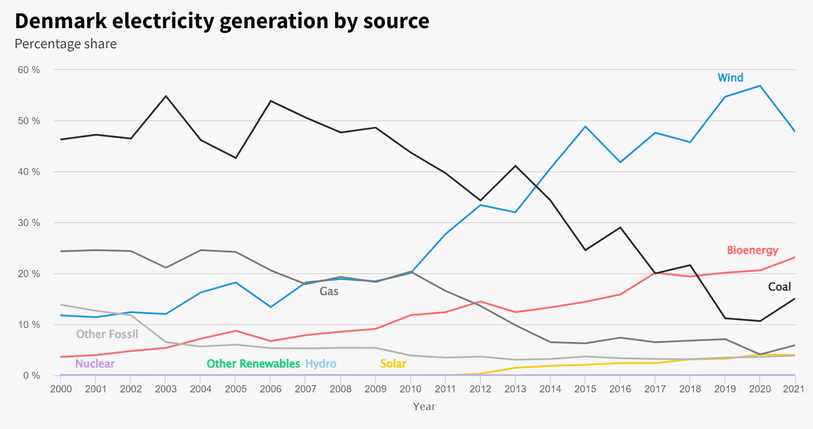
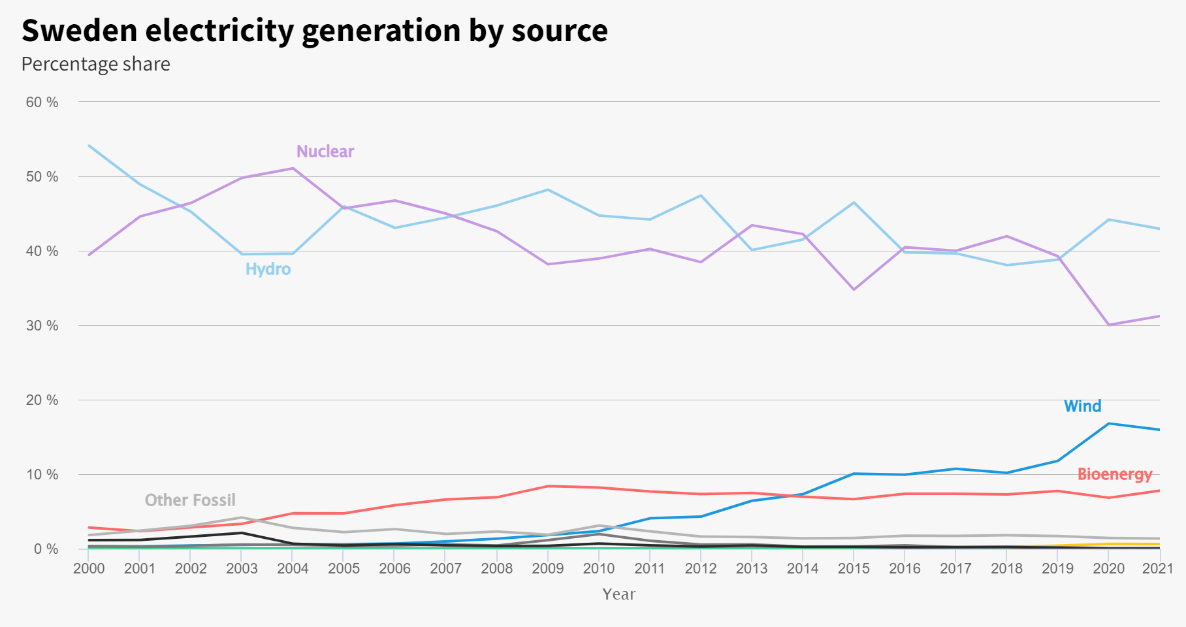
Conclusion
As the world transitions from Non-renewable to renewable forms of energy generation there are certain risks like
changing weather patterns, Change in seasonal patterns can effect the energy grid stability.
But this transition is possible and achievable as countries like Denmark and Sweden were able to produce more than
half of the energy is produced from Renewable sources
As the world transitions from Non-renewables to renewables there is a greater emphasis of energy storage as the Renwable
Energy sources can be Inteminent. (Sun only shines half a day)

Slide 22
Further comments
The model used (Prophet) is not the best model for this case as the data is and trend is highly biased . i.e, the descion
to be net neutral by 2030 or 2040 by several countries cant be predicted by using conventional models
RNN and transformers would be better for this application from my research as we can alter the weights and handle
biases more effectively
I am not able to do this as I am still learning RNN and other advanced techniques
From the research I did I was in general happy and became very optimistic that we can combat the climate change and
also get the world to a sustainable way of living (Not on Dino Juice)
The most interesting piece of information I am stumbled upon is the greenification of electric grid is not just being done
for economic reasons but building a solar plant or wind plant is much cheaper now than compared to Coal thermal plantor
Natural gas based thermal plant.
Micro grids will also play a huge role in stabilising the grid and helping achieving not just net neutral but net negative.
Finally I Hope we get our act together and save this beautiful rock we call HOME

Slide 23
Thank You .

