Slide 1
AI Assignment 2
Sai Kowshik
Guru Rohith
CS22B004
CS22B022

Slide 2
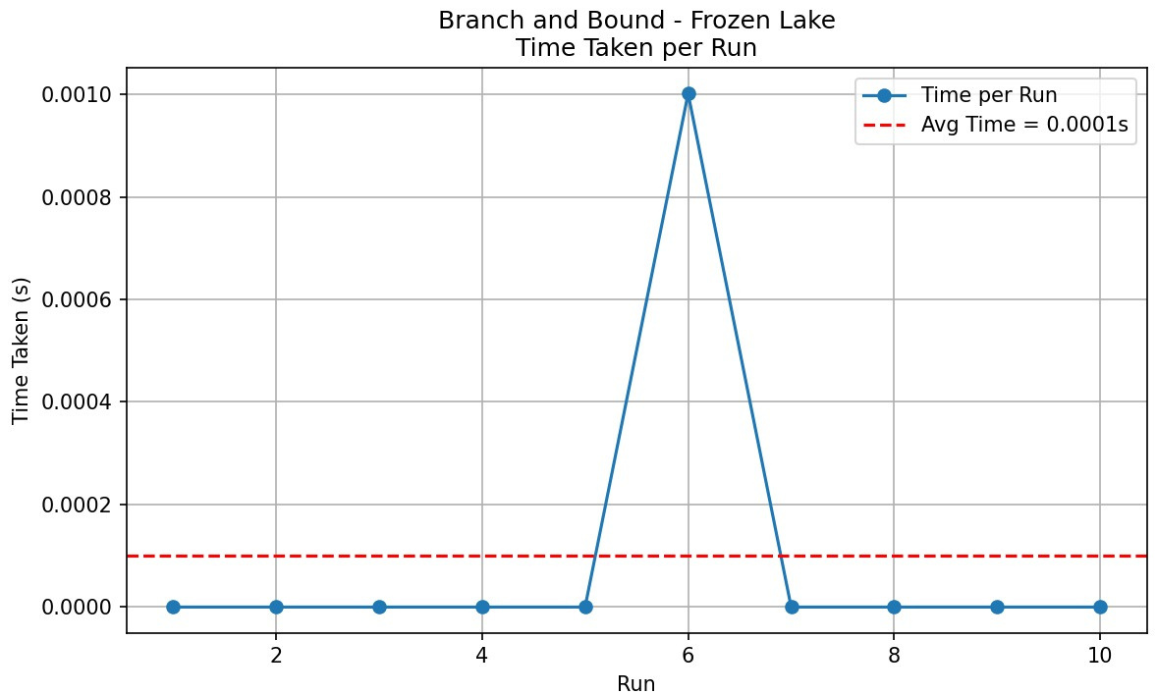
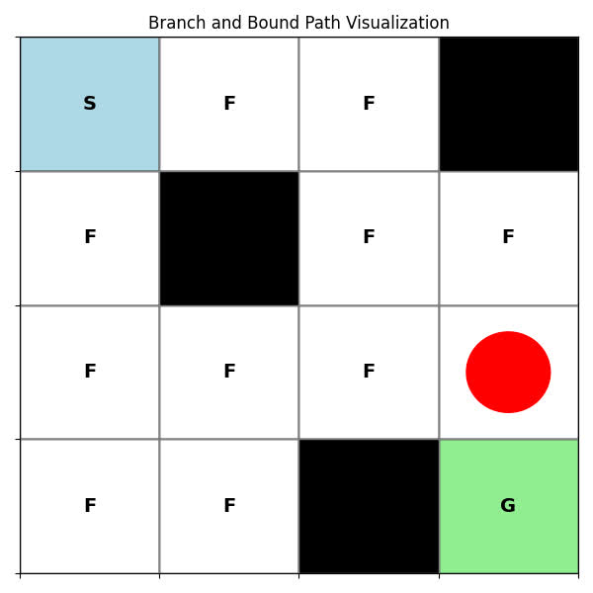
Branch and Bound ( frozen lake )
Heuristic function : Manhattan distance

Slide 3
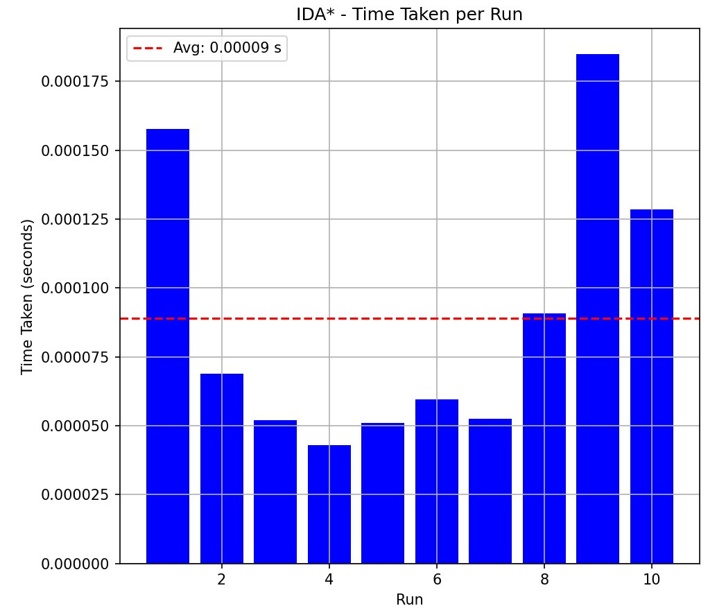
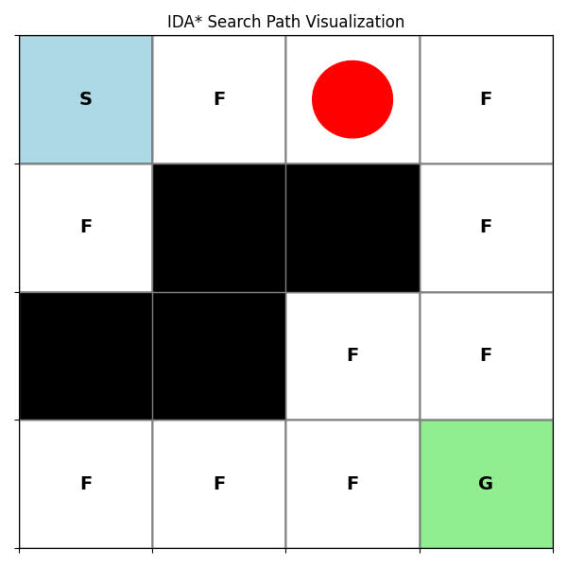
Iterative Deepening A*(frozen lake)
Heuristic function : Manhattan distance

Slide 4
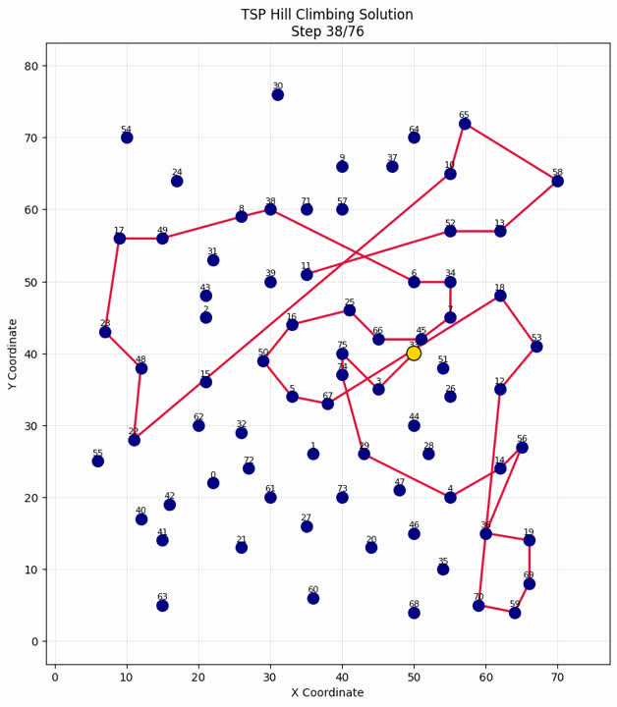
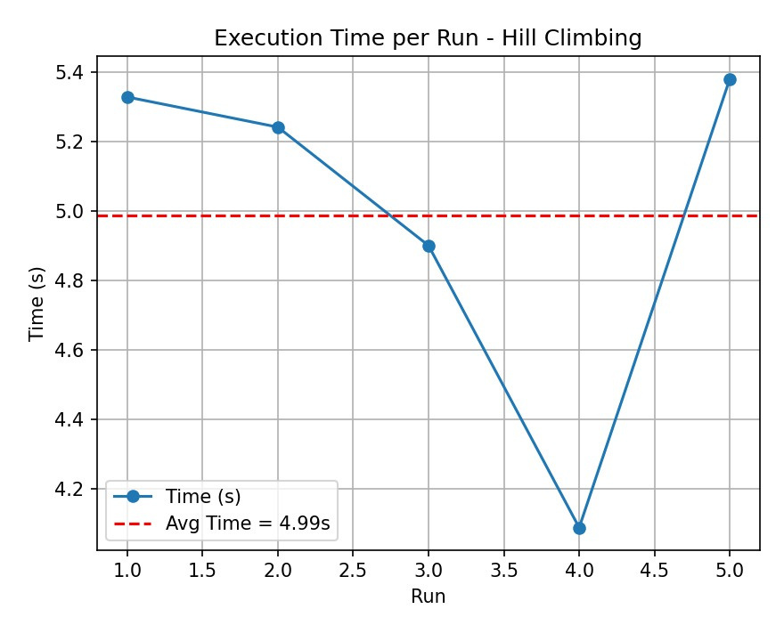
Hill Climbing (eli76 tsp)
def heuristic(tour, dist_matrix):
total_length = compute_length(tour, dist_matrix)
max_edge = max(dist_matrix[tour[i]][tour[i+1]] for i in range(len(tour)-1))
return total_length + 0.01 * max_edge

Slide 5
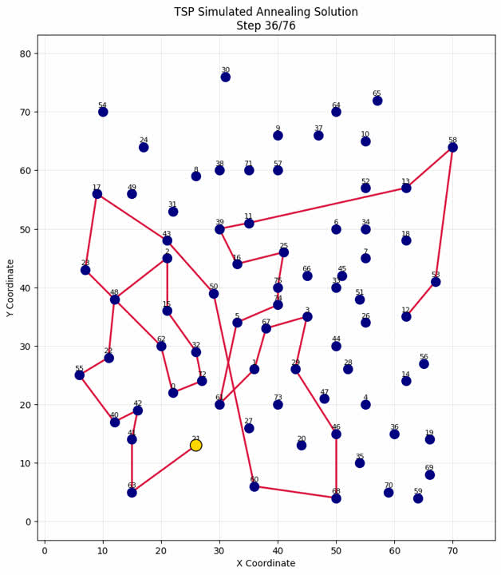
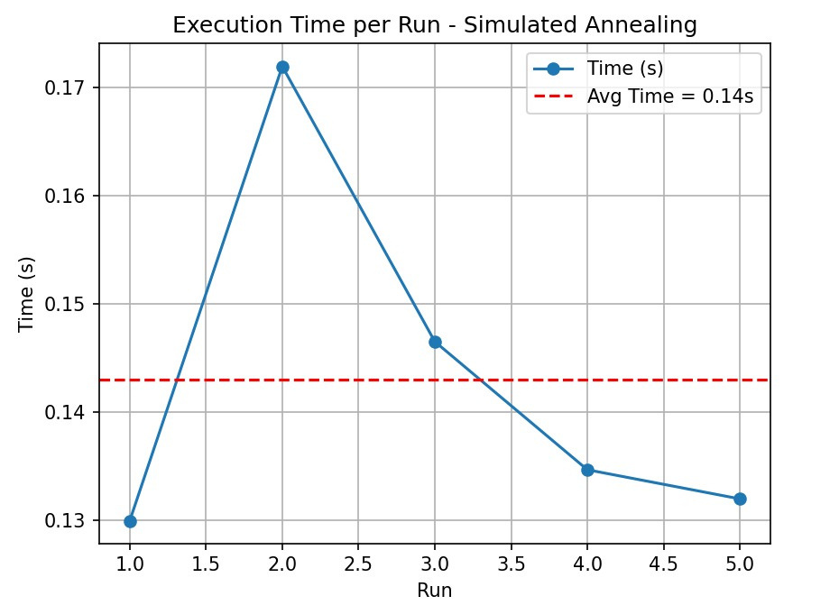
Stimulated Annealing (eli76 tsp)

Slide 6
1. Branch and Bound (Frozen Lake)
Performance: Ultra-fast (0.0001s avg)
Reasons:
1)Optimal for discrete grids: Perfect for Frozen Lake's 4x4 discrete state space
2)Early termination: Stops when first valid path is found
3)Manhattan heuristic: Perfectly admissible heuristic for grid movement
4)Small state space: Only 16 possible states in 4x4 grid
2. IDA* (Frozen Lake)
Performance: Very fast (0.00009s avg)
Reasons:
1)Depth-limited DFS: Avoids BFS memory overhead
2)Repeated depth increments: Efficient for shallow solutions
3)Same Manhattan heuristic: Perfectly guides search
4)No reopening costs: Unlike A*, doesn't maintain open/closed sets

Slide 7
3. Hill Climbing (TSP)
Performance: Slowest (4.99s avg)
Reasons:
1)Local search limitations: Gets stuck in local optima (especially in 76-city TSP)
2)No downhill moves: Cannot escape poor initial solutions
3)Costly neighbor evaluation: O(n²) neighbor generation for 2-opt swaps
4)Complex heuristic: Length + max-edge penalty requires full tour evaluation
4. Simulated Annealing (TSP)
Performance: Faster than HC (0.14s avg)
Reasons:
1)Controlled randomness: Occasional uphill moves escape local optima
2)Temperature schedule: Early exploration → later exploitation
3)Same neighborhood: 2-opt swaps but with probabilistic acceptance
4)Gradual refinement: Better solutions emerge over iterations

