Slide 1
FOOD DELIVERY MANAGEMENT SYSTEM
S.KARTHIKEYAN (56)
KOWSHIKA S (63)

Slide 2
TABLE OF CONTENTS
PROBLEM STATEMENT
EXTENDED EXPLORATION OF PROBLEM STATEMENT
REQUIREMENTS
ASSUMPTIONS
MODULE SPLIT UP
DATABASE DESIGN
SCHEMA DIAGRAM
PROCEDURES
TRIGGERS
OUTPUT SCREENSHOTS
NOVELTIES

Slide 3
PROBLEM STATEMENT
To design a Food Delivery Management system and analyse the data, which includes identifying the constraints among the attributes and the existence of dependencies among the attributes.

Slide 4
EXTENDED EXPLORATION OF THE PROBLEM STATEMENT
The Food Delivery Management System is a comprehensive framework designed to efficiently handle and manage the various aspects of food delivery services. This system integrates multiple key entities such as Customers, Drivers, and Restaurants, and meticulously details their interactions and dependencies.
It encompasses a wide range of functionalities, ensuring that each entity operates seamlessly within the overall system.

Slide 5
REQUIREMENTS

Slide 6
REQUIREMENTS
User Management:
Registration and authentication for customers, drivers, and restaurants.
Profile management for all users.
Order Management:
Browsing and searching restaurant menus.
Placing, tracking, and updating orders.
Order history and status notifications.
Restaurant Management:
Menu creation and updates.
Order processing and status updates.
Coordination with drivers for order pickups.
Driver Management:
Assignment of delivery tasks.
Update order status upon delivery.

Slide 7
ASSUMPTIONS

Slide 8
ASSUMPTIONS
The Customer entity stores information about the users of the service, including attributes such as name, customer ID (Cid), password, phone number, email, address, customer points (Cpoints), and membership ID (Mid). The constraints ensure data integrity, like the Cid and Mid following specific patterns, and unique constraints on phone numbers.
The Restaurant entity records details about partner restaurants, including restaurant ID (Rid), name, pin code (Rpin), address, phone number, ratings, cuisine type, additional descriptions, password, food category (Veg/Non-Veg), bank account details, and account name. Constraints ensure valid data entries, such as ratings between 1 and 5 and unique phone numbers.
Drivers capture details about delivery personnel, including driver ID (Did), Aadhaar number, password, name, phone number, availability status (Dstatus), location, pin code, email, date of birth, and ratings. Constraints enforce uniqueness and validity, such as unique Aadhaar numbers and ratings between 1 and 5.
Orders detail customer orders, including order ID (Oid), customer ID (Cid), restaurant ID (Rid), driver ID (Did), status, order and delivery date-times, order ratings, price, item ID (Iid), and quantity. Constraints ensure logical order progressions, like delivery times being after order times and positive prices and quantities.

Slide 9
ASSUMPTIONS
The Item entity captures menu items' details, such as item ID (Iid), name, description, price, category (Veg/Non-Veg), type (starter, main course, etc.), cuisine, item ratings, guilt-free status, and Jain food status. Constraints enforce logical data entries, such as positive prices and valid categories.
Menu maps restaurants to their menu items through restaurant ID (Rid), item ID (Iid), and item availability timings, ensuring the right items are available at the right times.
Payment records payment transactions with attributes like payment ID (Pid), order ID (Oid), payment status, and type (cash, online, card). Constraints ensure valid payment statuses and types.
Finally, Membership tracks customer memberships with membership ID (Mid), customer ID (Cid), membership type (Gold, Silver, Platinum), start and end dates, and active status. Constraints ensure membership dates are logical and statuses are valid.
Together, these entities and their constraints form a robust framework for managing a food delivery service, ensuring data integrity, and facilitating efficient data management and analysis.

Slide 10
MODULE SPLIT-UP

Slide 11
MODULE SPLIT-UP
In the context of a food delivery management system (FDMS), module split-up involves structuring the software into distinct components tailored to specific roles and functions: customers, restaurants, and drivers
Customer Module: Focuses on facilitating seamless order placement, customization, real-time tracking, feedback collection, secure payments, and participation in membership programs.
Restaurant Module: Manages menu items, inventory, order processing, sales analytics, and customer relationship management to ensure efficient operations and service.
Driver Module: Handles order assignments, navigation, delivery management, communication with dispatch and customers,.
This modular approach ensures that each stakeholder—customers, restaurants, and drivers—benefits from functionalities tailored to their specific needs, optimizing the overall efficiency and effectiveness of the food delivery service.

Slide 12
DATABASE DESIGN

Slide 13
CUSTOMER
The database schema consists of three tables:
customer_info: Stores customer details such as name, ID, password, phone number, email, loyalty points, and membership ID.
customer_address: Contains addresses associated with customers, including address ID, block, street, area, and pincode.
cust_add_map: Establishes a many-to-many relationship between customers and addresses, linking address IDs (AID) to customer IDs (CID).

Slide 14
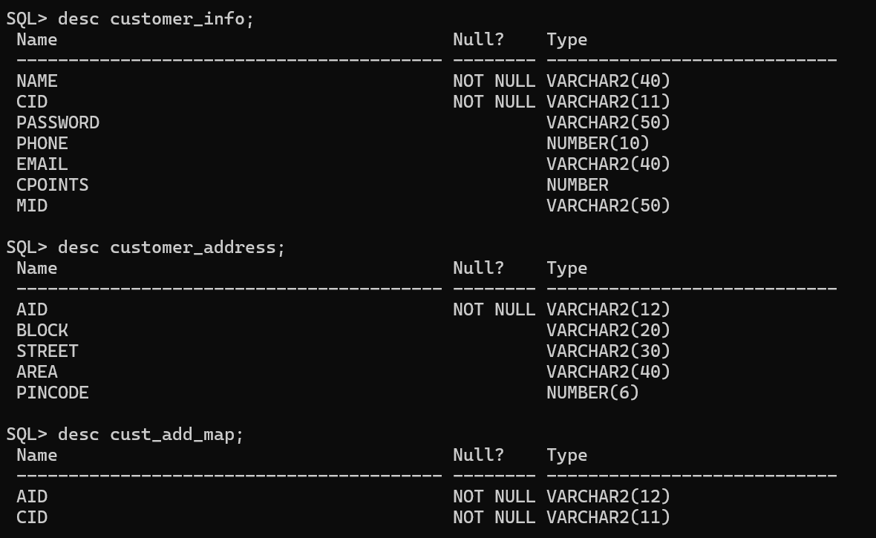
CUSTOMER

Slide 15
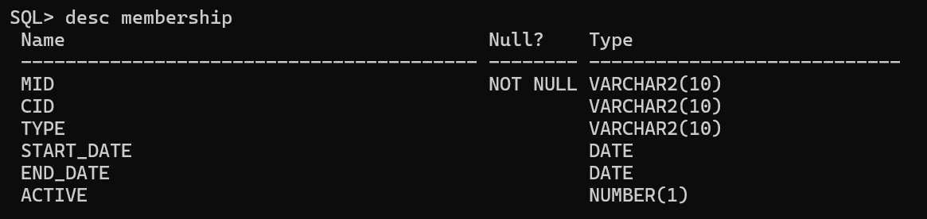
MEMBERSHIP
The MEMBERSHIP table manages customer memberships by associating unique IDs (Mid) with specific customers (Cid), tracking membership types (Gold, Silver, Platinum), start and end dates, and active status. It ensures organized management, personalized service offerings, and effective lifecycle tracking of memberships within the system.

Slide 16
RESTAURANT
The schema defines tables for managing restaurant information in a database:
RESTAURANT_INFO: Stores restaurant details like ID (Rid), name, phone number, ratings, cuisine, description, password, and category (Veg or Non-Veg).
RESTAURANT_CRED: Manages restaurant credentials with ID (Rid), account number (Raccount), and ensures referential integrity with RESTAURANT_INFO.
Restaurant_Acct: Contains account details associated with Raccount and account name, ensuring unique Raccount values.
RESTAURANT_ADDRESS: Stores address details linked to Rid, including block, street, area, and pincode, maintaining a relationship with RESTAURANT_INFO.

Slide 17
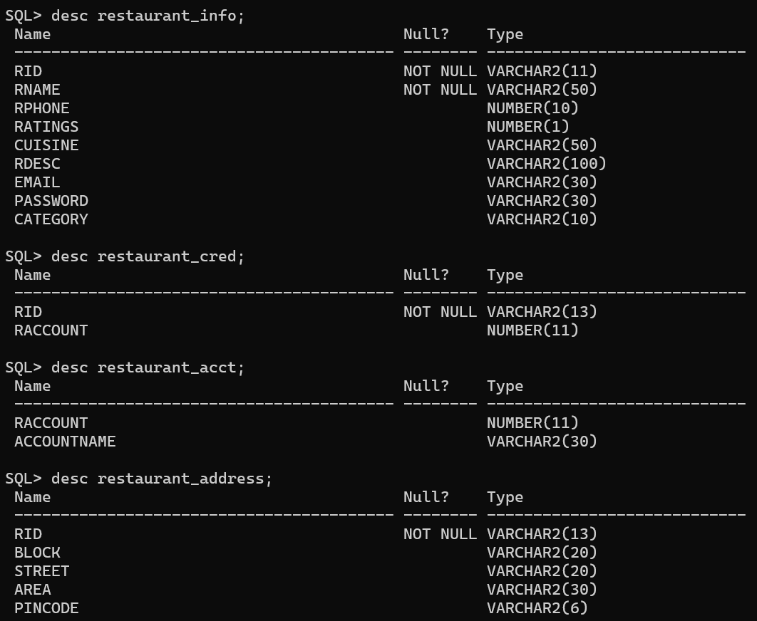
RESTAURANT

Slide 18
DRIVERS/DELIVERY PARTNERS
The schema manages driver information across multiple tables:
DRIVER_INFO: Stores details like driver ID (Did), Aadhar number (Daadhar), password, name (Dname), phone number, status (Dstatus), PIN code (Dpin), email, date of birth (dob), and ratings (Dratings).
DRIVER_ADD_MAP: Links driver IDs (Did) to address IDs (Aid) to map multiple addresses per driver, ensuring referential integrity with DRIVER_INFO.
DRIVER_ADDRESS: Stores specific address details (Aid, block, street, area) for drivers, with Aid as the primary key ensuring uniqueness.

Slide 19
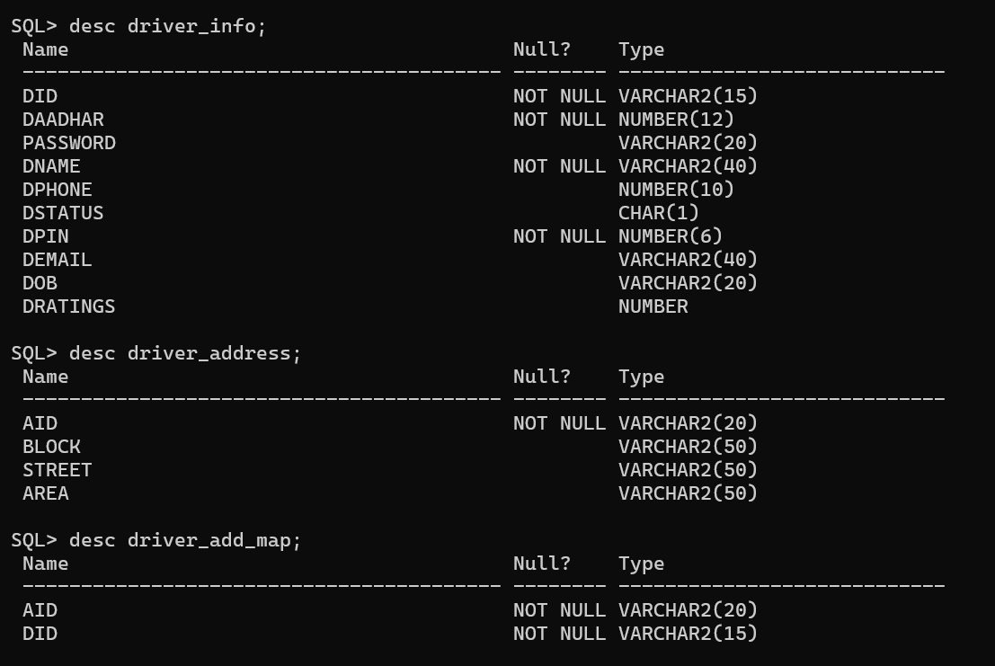
DRIVERS/DELIVERY PARTNERS

Slide 20
ITEM/MENU
The schema consists of two tables:
ITEM: Stores details about food items including ID (Iid), name (Iname), description (Idesc), price (price), category (Category), type (Type), cuisine (Cuisine), ratings (Iratings), guilt-free option (Guiltfree), and Jain dietary status (Jain). Constraints ensure Iid starts with 'I' and validates other fields accordingly.
MENU: Maps items (Iid) to restaurants (Rid) with additional timing information (Timings). Primary key (Rid, Iid) ensures uniqueness. Foreign keys maintain referential integrity with RESTAURANT_INFO and ITEM tables for restaurant IDs (Rid) and item IDs (Iid).

Slide 21
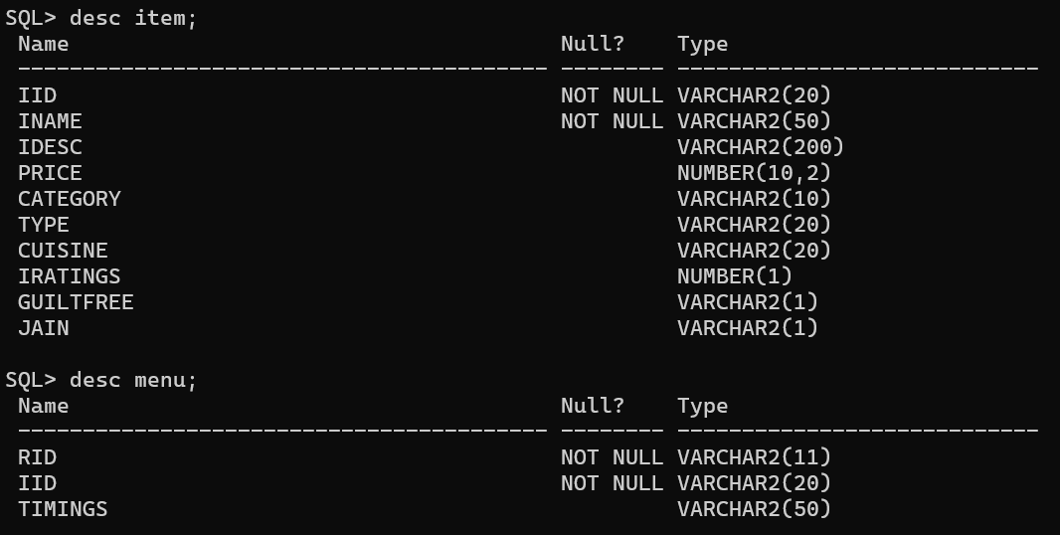
ITEM/MENU

Slide 22
ORDERS
The schema defines two tables:
ORDERS: Stores order information including order ID (Oid), customer ID (Cid), restaurant ID (Rid), driver ID (Did), status (status), order date and time (order_date_time), delivery date and time (del_date_time), order rating (Orating), and total price (price). Constraints ensure Oid starts with 'O', and validate statuses, ratings, and date-time relationships.
ORDER_DETAILS: Details specific to each order (Oid) and item (Iid) include item price (price), quantity (Qty), and constraints enforcing positive values for price and quantity. The primary key (Oid, Iid) ensures uniqueness per order-item pair, with additional checks on Oid format.

Slide 23
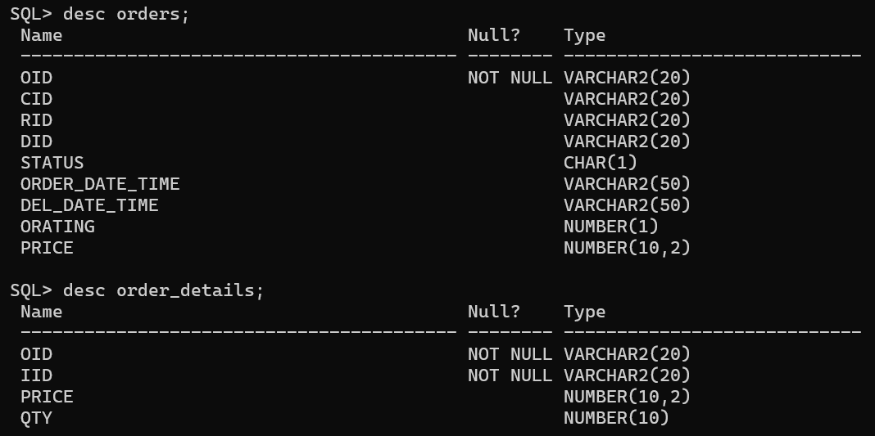
ORDERS

Slide 24
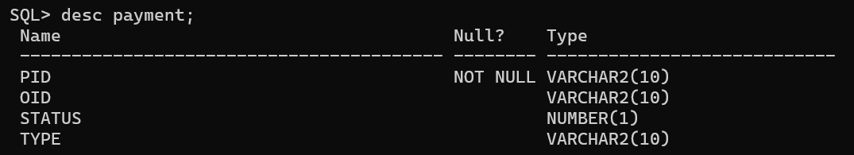
PAYMENT
The PAYMENT table manages payments linked to orders (Oid), tracking payment status (status) as either unpaid (0) or paid (1). It validates payment methods (Type) such as 'cash', 'online', or 'card', ensuring accurate recording and management of financial transactions within the system.

Slide 25
SCHEMA DIAGRAM

Slide 26
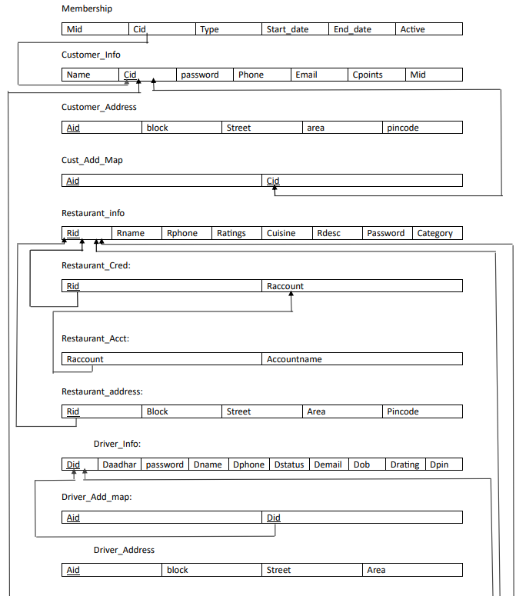
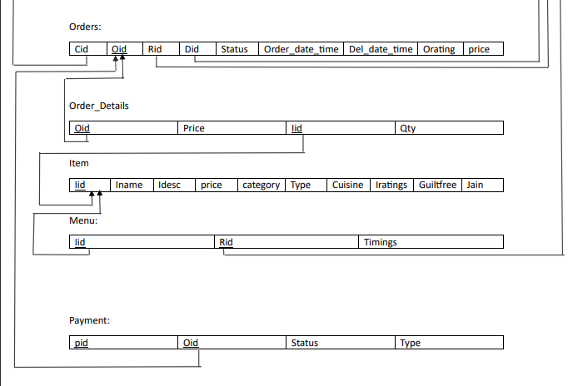

Slide 27
PROCEDURES

Slide 28
PROCEDURES
get_restaurant_address: Retrieves the address details (block, street, area, pincode) of a restaurant (p_rid) from the restaurant_address table.
get_restaurant_id: Finds the restaurant ID (p_rid) based on the restaurant name (p_name) from the restaurant_info table.
get_item_id: Retrieves the item ID (p_iid) based on the item name (p_iname) from the ITEM table.

Slide 29
PROCEDURES
GetItemPrice: Fetches the price (p_price) of an item (p_Iid) from the ITEM table.
calculate_total_price: Computes the total cost (p_total_price) of an order (p_oid) by summing the product of item price and quantity (Qty) from the ORDER_DETAILS table.
get_restaurant_name: Retrieves the restaurant name (p_name) based on the restaurant ID (p_rid) from the restaurant_info table.

Slide 30
TRIGGERS

Slide 31
INSERTION TRIGGERS
Calculate Order Total Trigger: Automatically computes and updates the total price of an order when new records are added to the ORDER_DETAILS table.
Update Restaurant Ratings Trigger: Adjusts the average ratings of a restaurant when new ratings are inserted into the ORDERS table.
Update Customer Points Trigger: Updates customer loyalty points when new orders are placed.

Slide 32
DELETE TRIGGERS
This trigger ensures that when an order is deleted from the ORDERS table, related records in the ORDER_DETAILS table are also deleted to maintain data integrity.

Slide 33
OUTPUT SCREENSHOTS

Slide 34
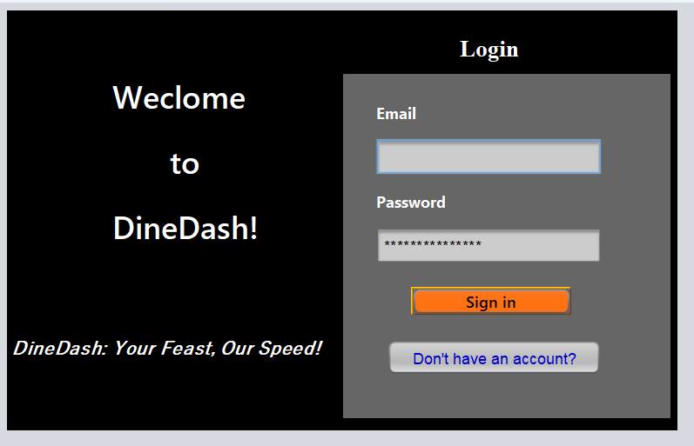
SIGN-IN / LOGIN

Slide 35
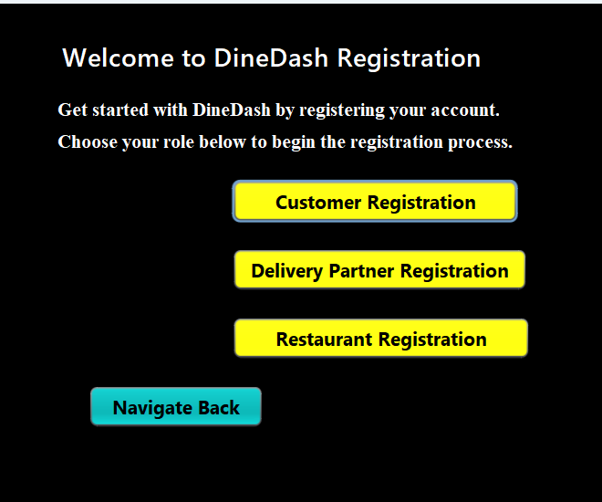
SIGN-UP

Slide 36
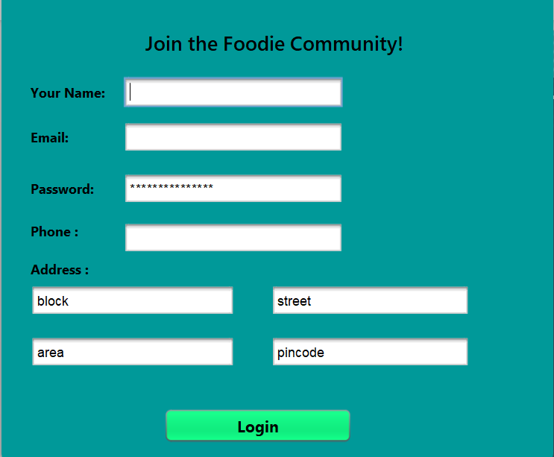
CUSTOMER SIGN-UP PAGE

Slide 37
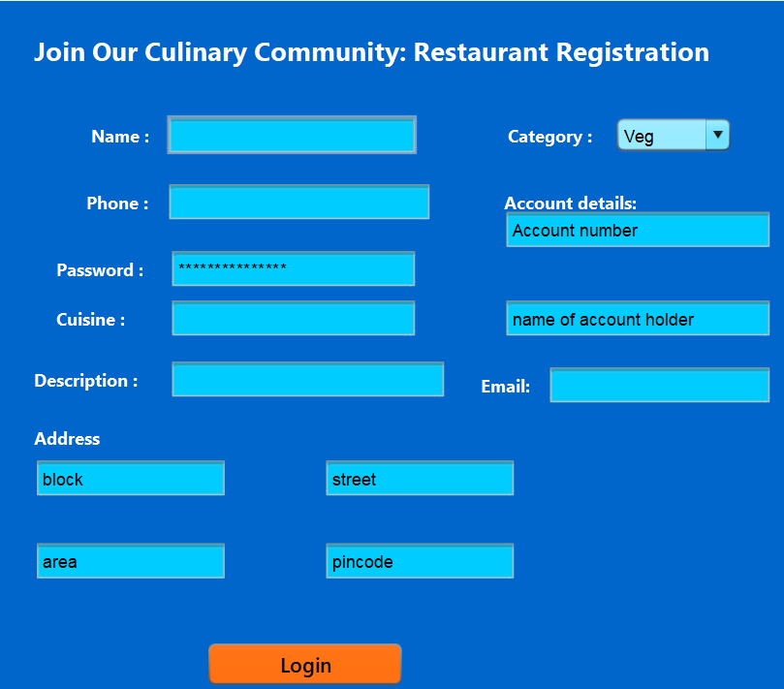
RESTAURANT SIGN-UP PAGE

Slide 38
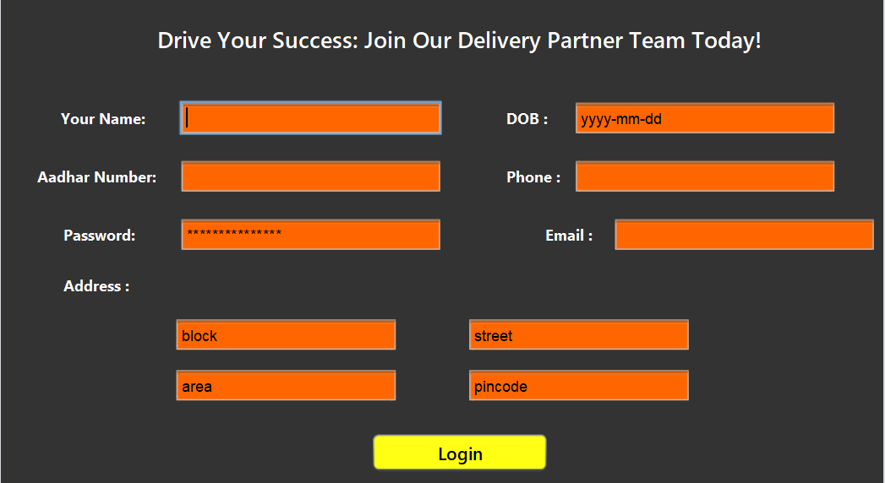
DRIVER/DELIVERY PARTNER SIGN-UP LOGIN PAGE

Slide 39
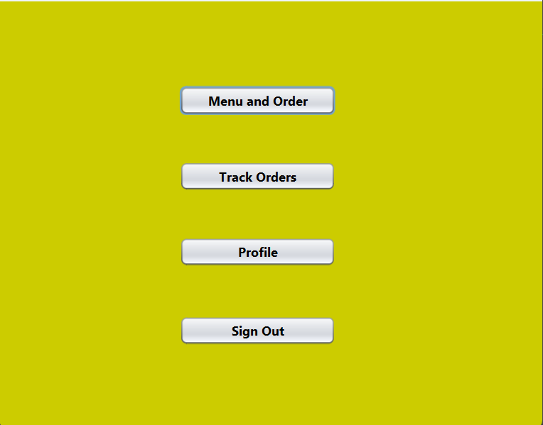
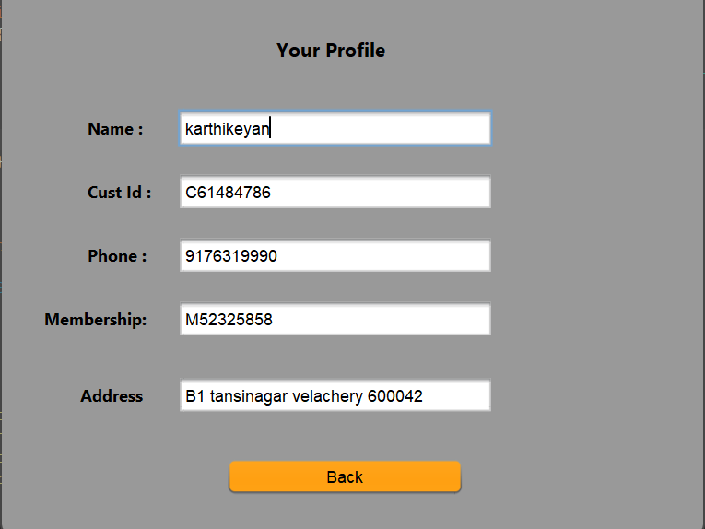
CUSTOMER PANEL AND USER PROFILE

Slide 40
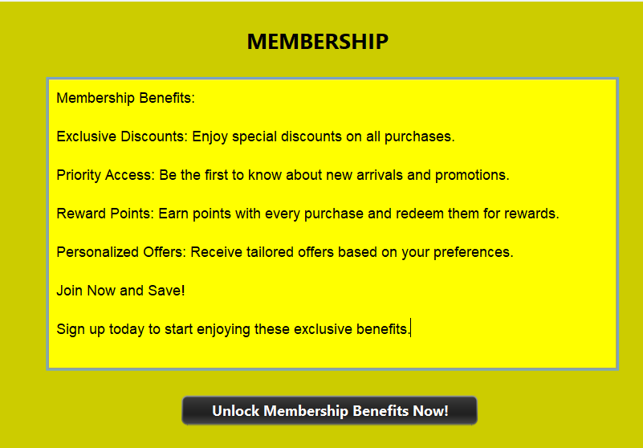
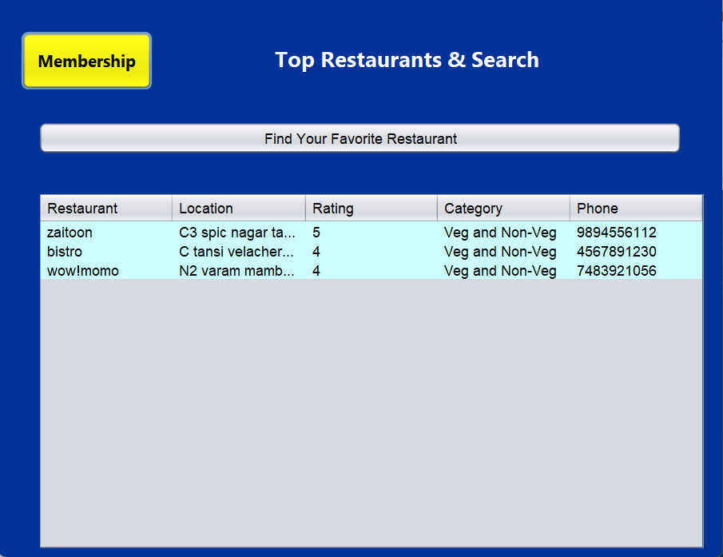
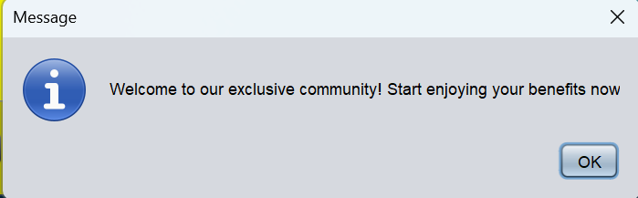
AVAILABLE RESTAURANTS AND CUSTOMER MEMBERSHIP

Slide 41
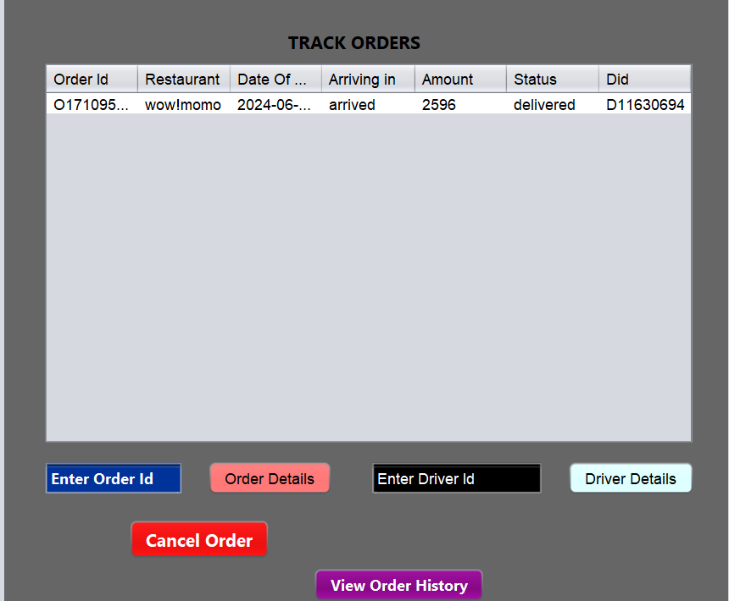
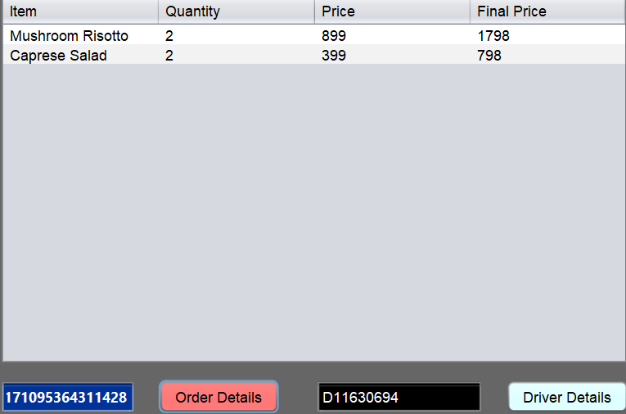
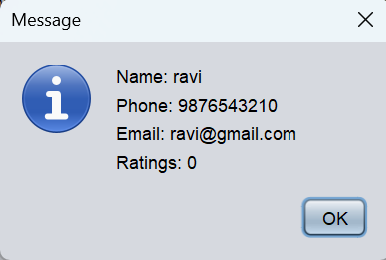
TRACK ORDERS AND ORDER DETAILS

Slide 42
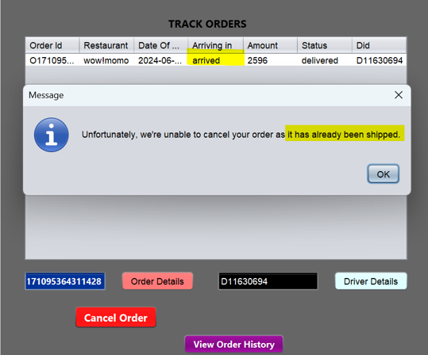
CANCELING A SHIPPED ORDER

Slide 43
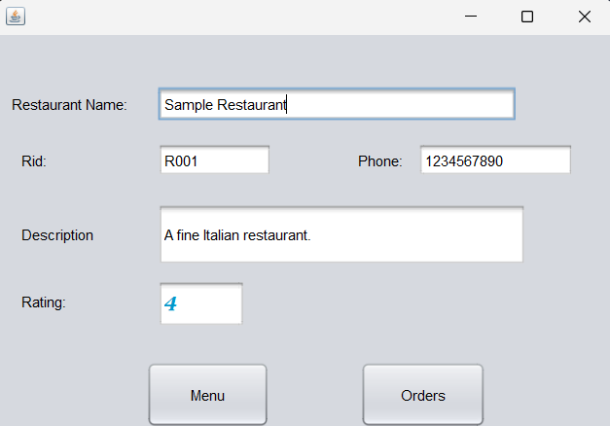
RESTAURANT HOMEPAGE

Slide 44
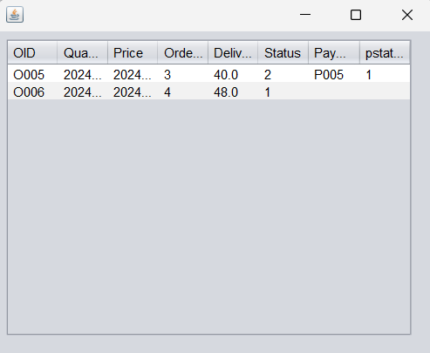
RESTAURANT – VIEW ORDERS

Slide 45
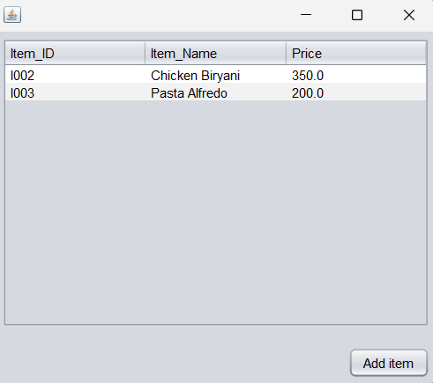
RESTAURANT MENU

Slide 46
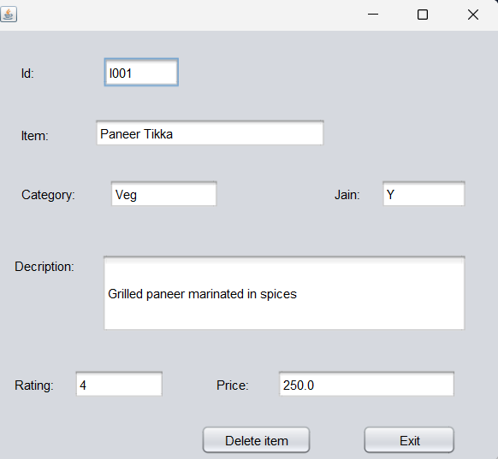
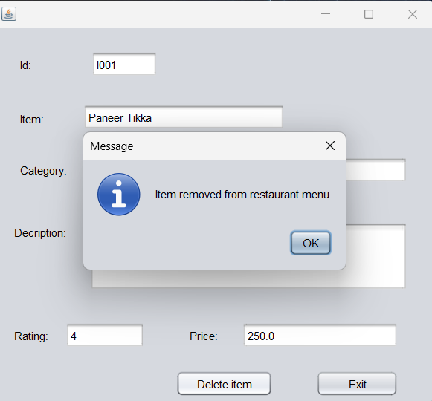
ADDING/REMOVING AN ITEM

Slide 47
NOVELTIES

Slide 48
NOVELTIES
User Registration and Authentication: Secure registration and login processes for customers, restaurants, and drivers.
Restaurant Listings: Comprehensive listings of restaurants, including details such as cuisine type, ratings, reviews, and menu items.
Order Placement: Easy-to-use interfaces for customers to browse menus, select items, customize orders, and place them securely.
Membership Tiers: Offer different membership tiers such as Gold, Silver, and Platinum, each with varying benefits like exclusive discounts, free deliveries, or priority service.

Slide 49
THANK YOU

