Slide 1

KNOWLEDGE INSTITUTE OF TECHNOLOGY DISSECTING THE DIGITAL LANDSCAPE: A COMPREHENSIVE ANALYSIS OF SOCIAL MEDIA
Presented by
KOWSHIKRAJ K 611220104077
MOHANA N 611220104086
NITHYAPRIYA V 611220104098
KESAVAN S 611220104071
MENTOR NAME : Mr.J.Murugesan, AP / IT
TEAM ID : NM2023TMID01923

Slide 2
OBJECTIVE :
To conduct a comprehensive analysis of social media data using IBM Cognos in order to gain insights into the digital landscape, with a focus on understanding user behavior, engagement patterns, and emerging trends.
By accomplishing these specific goals like data visualization and analysis within IBM Cognos, organizations can gain a deep understanding of the digital landscape, refine their social media strategies, and make data-driven decisions to improve their online presence and engagement.

Slide 3
ABSTRACT
"Dissecting the Digital Landscape: A Comprehensive Analysis of Social Media" provides a detailed and in-depth analysis of various social media platforms, including Facebook, Twitter, Instagram, YouTube, and LinkedIn.
The analysis covers a wide range of topics related to social media, such as the history and evolution of social media, the demographics of social media users, the impact of social media on communication and society, the role of social media in politics and activism, and the challenges and opportunities of social media for businesses and organizations.
The paper draws on a wide range of research studies, surveys, and data sources to provide a comprehensive overview of the digital landscape and its implications for individuals, organizations, and society as a whole.
Overall, the paper aims to provide a comprehensive and up-to-date understanding of the complex and dynamic world of social media(twitter as an example), and to inform future research, policy, and practice in this rapidly evolving field.

Slide 4
PROBLEM STATEMENT
Social media has transformed how we communicate and live. This research will examine social media platforms to understand how they have changed over time, their impact on our well-being and privacy. And, how they affect the information we see. We aim to provide insights for navigating the digital world more effectively

Slide 5
SOLUTION
Our research initiative, "Dissecting The Digital Landscape: A Comprehensive Analysis Of Social Media," aims to provide a thorough understanding of the ever-changing social media environment.
We gather data, assess psychological impacts, analyze algorithms, monitor trends, address ethical concerns, and explore opportunities and risks.
This research equips stakeholders with valuable insights for informed decision-making in the world of social media

Slide 6
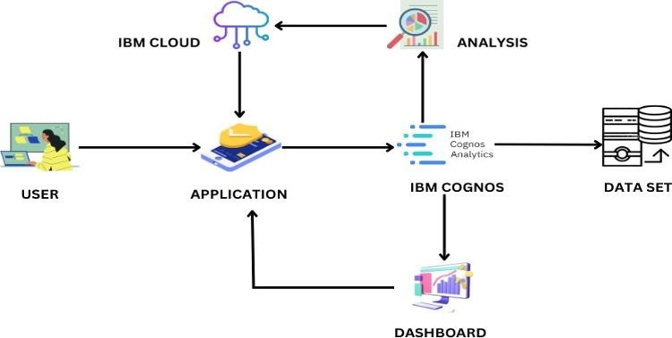
SOLUTION ARCHITECTURE

Slide 7
TOOLS USED
HARDWARE REQUIREMENS
Processor : Intel Core i3
RAM : 8 GB
Hard Disk : 500 GB
SOFTWARE REQUIREMENTS
Operating System : Windows
Language : HTML, CSS
Program – Tool : Visual Studio Code
TOOL REQUIREMENTS
Operating System : Windows 10
Disk Space : 256 MB
Processor : Intel atom processor
Version : 3.6.2

Slide 8
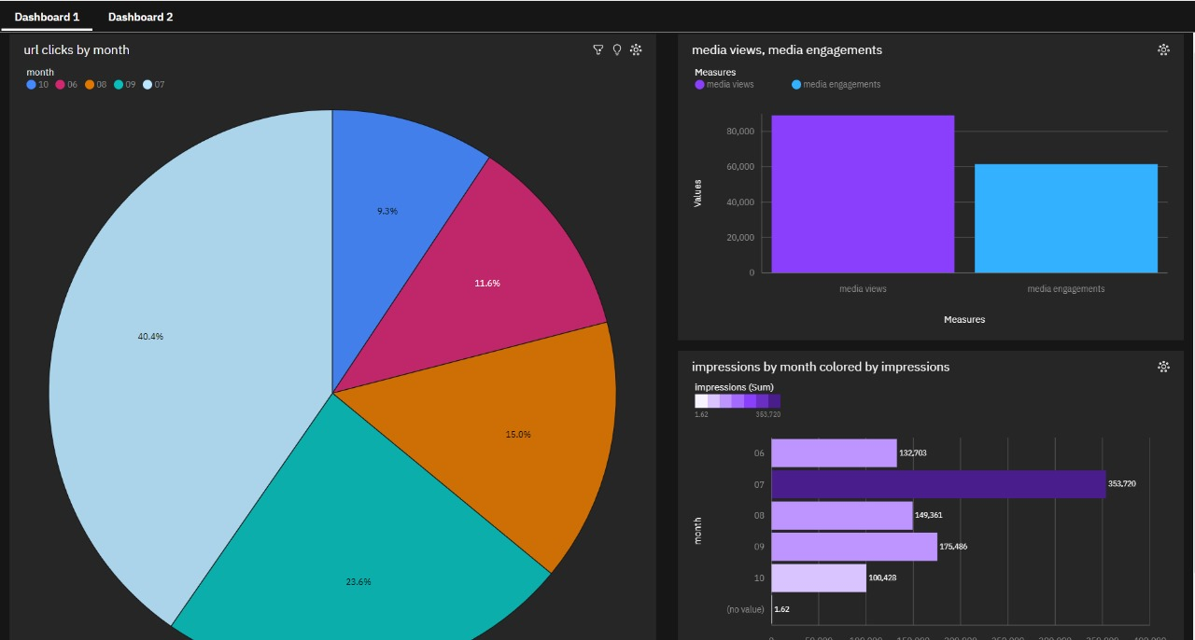
DASHBOARD

Slide 9
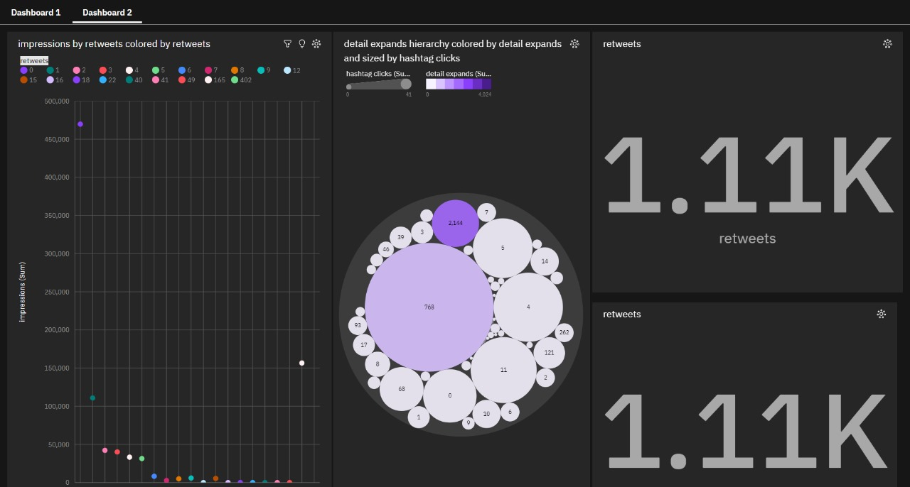
DASHBOARD

Slide 10
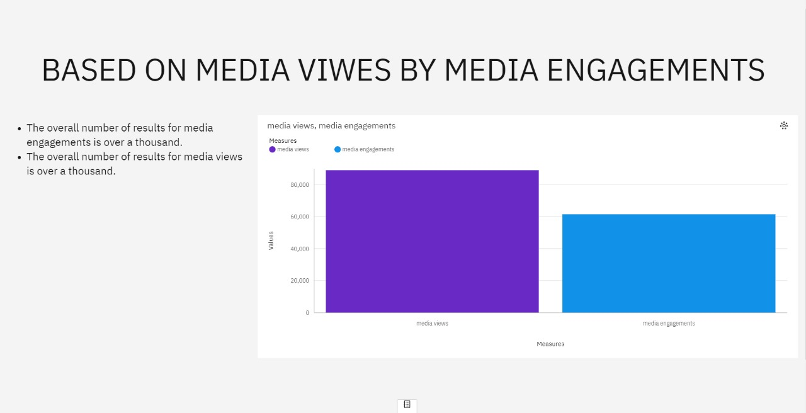
STORY

Slide 11
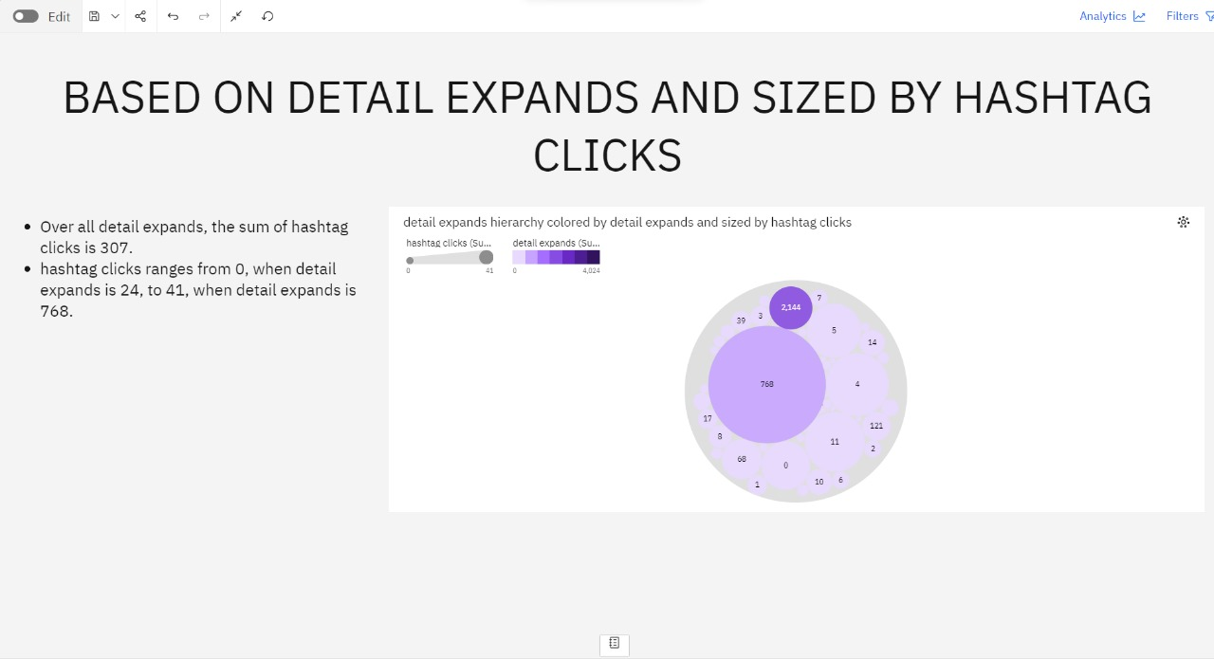
STORY

Slide 12
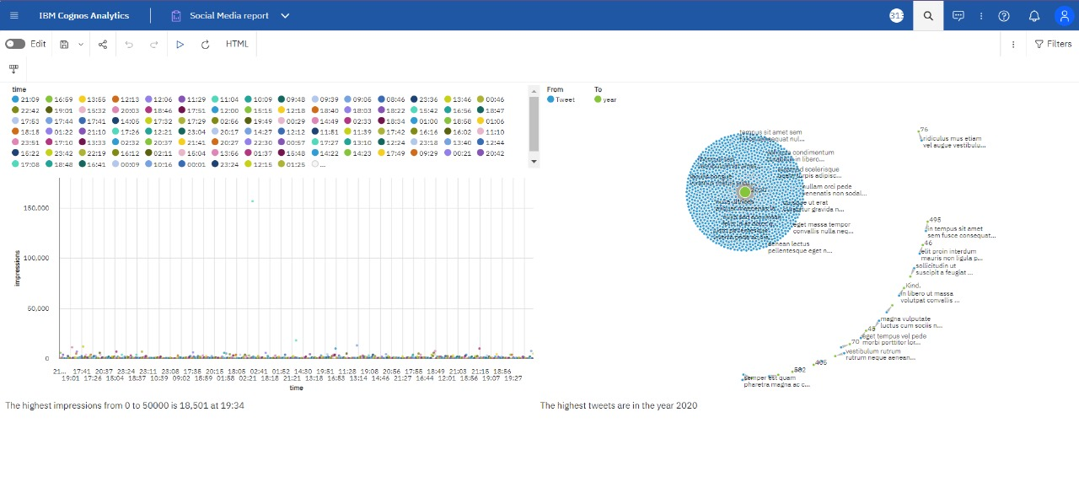
REPORT

Slide 13
THANK YOU

