Slide 1


MATHS MINI PROJECT
Chi-Square Analysis
By: Sakshi Gaonkar & Kowsya Mutkundu
MSc Artificial Intelligence
Goa Business School
Batch: 2025–26

Slide 2
CONTENT
Introduction
2. Objective
4. Literature Survey
3. Aim of the Study
4. Problem Statement
5. Hypothesis
6. Methodology
7. Data Collection
8. Results overview
9. Significance of the Study
10. Limitations and Future scope
11. Conclusion

Slide 3
INTRODUCTION
In today’s digital era, students spend significant time on screens — for online classes, entertainment, and social media. While digital learning has advantages, excessive screen exposure can impact attention span, sleep quality, and academic consistency.
Students frequently multitask while studying, leading to reduced focus and productivity.
This proposal explores how these daily habits — particularly screen time and sleep — may affect student performance, using a scientific statistical approach.

Slide 4
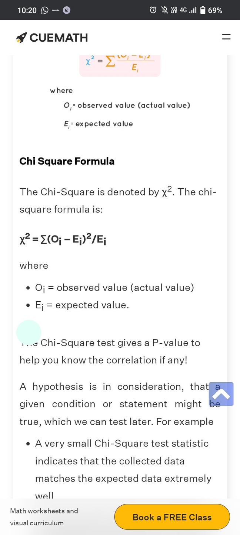
INTRODUCTION
Chi-Square Test:
Determines if there is a significant association between two categorical variables. Compares observed frequencies (O) with expected frequencies (E).
Formula:
O = Observed frequency
E= Expected frequency
Expected frequency = (row sum * column sum) / table sum

Slide 5
PROBLEM STATEMENT
Despite the widespread use of digital devices, little evidence-based analysis exists on how these habits influence academic outcomes.
Our study seeks to answer:
Do students who spend more time on screens tend to sleep less?
Does screen time affect how well students perform academically?
Are students’ study habits linked to their performance levels?
By applying a statistical method — the Chi-Square test — we aim to find out if these variables are related or independent.

Slide 6

LITERATURE SURVEY
Title of Study | Journal | Objective of the Study | Research Context | Methodology Used | Key Finding
Chi-Square Tests in Medical Research | Anesthesia & Analgesia | To demonstrate how categorical data can be analyzed statistically using the Chi-Square Test in a medical context. | Comparison of two drugs — norepinephrine and phenylephrine — to evaluate their influence on the occurrence of bradycardia (slow heart rate) in surgical patients. | - Collected categorical patient data (drug type vs occurrence of bradycardia). - Constructed contingency tables. - Applied Chi-Square Test of Independence. - Interpreted statistical significance based on p-value. | The Chi-Square test revealed that treatment type and patient outcome were not independent, confirming an association between the two variables.

Slide 7
Aim Of The Study
The main aim of this study is to examine and understand the relationships among three important lifestyle factors
— screen time, sleep, and study habits
— and their influence on student performance.
We aim to apply the Chi-Square Test of Independence to check for associations between these categorical variables and to interpret whether the relationships are significant.
By adapting the method from Schober & Vetter (2019), we bring a well-established statistical approach from medicine into an educational context.

Slide 8
OBJECTIVES
To understand how the Chi-Square test can be used to identify relationships between categorical variables.
To replicate a method originally used in medical research for educational data.
To collect primary data through surveys on screen time, sleep, and study behavior.
To test three key relationships using Chi-Square analysis:
Screen Time vs Sleep
Study Habits vs Performance
Screen Time vs Performance
To interpret and discuss findings that may guide better student practices.

Slide 9


HYPOTHESES
To verify our objectives, we have framed three pairs of hypotheses to be tested statistically using the Chi-Square Test of Independence.
Relationship
Null Hypothesis (H₀)
Alternative Hypothesis (H₁)
There is no relationship between screen time and sleep duration.
Screen time and sleep duration are related
Screen Time vs Sleep
Study habits have no effect on academic performance.
Study habits affect academic performance.
Study Habits vs Performance
Screen time does not influence academic performance.
Screen time influences academic performance.
Screen Time vs Performance
We will use a 95% confidence level (α = 0.05).
If the p-value obtained from the test is less than 0.05, we will reject the null hypothesis and conclude that there is a significant relationship.

Slide 10

METHODOLOGY
Survey Design
Data Analysis
We used Google Forms to collect responses from students about screen usage, sleep duration, and study habits.
Data will be organized into contingency tables and tested using the Chi-Square formula
Data Classification
Interpretation
Responses were categorized — for example, screen time as Low (≤4 hrs) or High (>4 hrs), performance as High/Medium/Low.
The calculated χ² value is compared with the critical value at 0.05 significance level to determine dependency.
Decision Rule:
p ≤ 0.05 → Relationship is significant
p > 0.05 → Independent variables

Slide 11


DATA COLLECTION
Tool: Google Forms
Total Responses: 39 students
Type of Data: Primary, categorical
Key Variables:
Average daily screen time
Sleep duration
Academic performance
Study hours per day
Study method preference (digital/books)
Multitasking while studying
Data collected anonymously

Slide 12
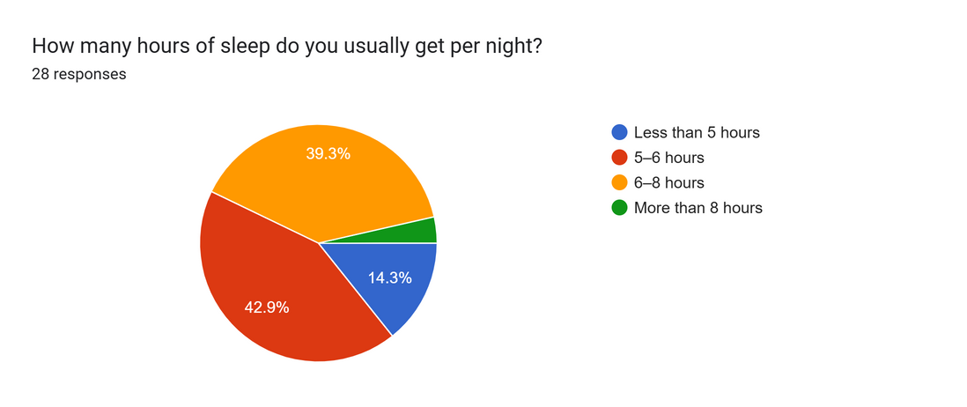
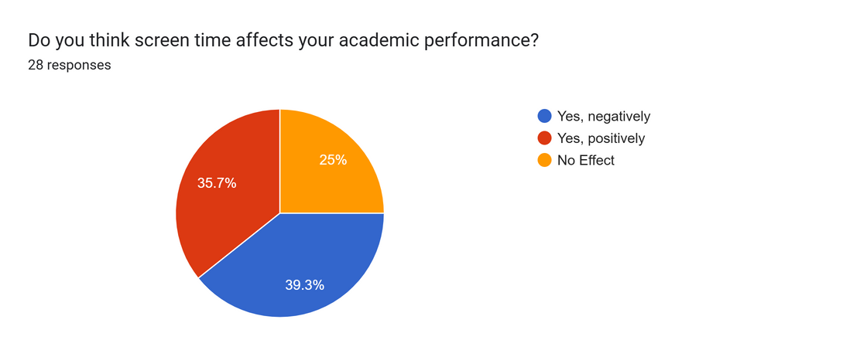
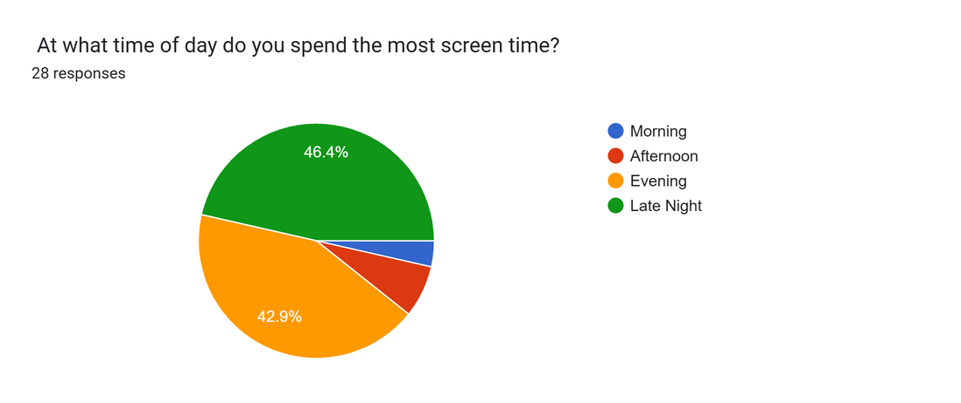
Sample Data Snapshot

Slide 13
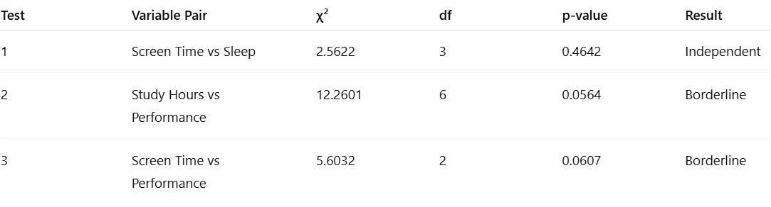
Results Overview
Interpretation:
All p-values > 0.05 → no significant relationships.
However, Tests 2 & 3 are close to significance, hinting at possible trends.

Slide 14
Result 1 – Screen Time vs Sleep Duration
Objective: Check if more screen time reduces sleep.
Findings:
χ² = 2.5622, p = 0.4642
Since p > 0.05, we fail to reject the null hypothesis.
Conclusion:
Screen time and sleep duration appear independent in this sample.
Late-night screen use may affect sleep for some, but statistically it’s not proven here.
Possible reason: variations in personal habits or small sample size.

Slide 15
Result 2 – Study Hours vs Academic Performance
Objective: Test if consistent study hours improve performance.
Findings:
χ² = 12.2601, p = 0.0564
Slightly above 0.05 → borderline result
Conclusion:
Evidence of a weak trend: more study hours → better performance, but not statistically strong.
Suggests that study quality and focus might matter more than total hours.
With more participants, this relationship might reach significance.

Slide 16
Result 3 – Screen Time vs Academic Performance
Objective: Test if high screen time lowers academic results.
Findings:
χ² = 5.6032, p = 0.0607
Slightly above 0.05 → borderline non-significant
Conclusion:
Students with lower screen time tended to have higher grades, but difference is not statistically strong.
Indicates a possible negative correlation, but needs more data to confirm.
Suggests moderation in screen use may help performance.

Slide 17
Significance of Study
Demonstrates that a statistical method used in medical research can also apply to education.
Encourages evidence-based academic and lifestyle improvements.
Highlights how simple tests like Chi-Square can identify behavioral patterns.
Provides insights for educators to design better digital balance strategies.

Slide 18
Limitations and Future Scope
Limitations:
Small sample size reduces accuracy.
Self-reported data may be biased.
Chi-Square test identifies association, not causation.
Future Scope:
Increase sample size to 150+ students.
Include more variables (device type, social media, physical activity).
Use advanced methods like ANOVA or Regression.
Conduct long-term (longitudinal) studies.

Slide 19
Conclusion
This proposal outlines a study connecting technology use with academic and lifestyle factors.
By applying the Chi-Square test, we aim to determine whether screen time, sleep, and study habits are statistically related to student performance.
The methodology is grounded in proven research and adapted to modern student behavior.
Results from this study can promote awareness about digital wellness and help improve academic performance.

Slide 20

References
Schober, P., & Vetter, T. R. (2019). Chi-Square Tests in Medical Research. Anesthesia & Analgesia, 129(5), 1193–1194.
Google Colab. (n.d.). Chi-Square Analysis Notebook. Retrieved November 10, 2025
Wikipedia. (n.d.). Chi-squared test. Retrieved October 10, 2025
GeeksforGeeks. (n.d.). Chi-Square Test. Retrieved November 10, 2025
https://docs.google.com/forms/u/3/d/e/1FAIpQLSdjNy5NJs53F8p3-vGOv3-6TIwWtiBaiskrxcLDvs7T9ARNCA/formResponse?pli=1
https://docs.google.com/spreadsheets/d/11L16rhrUaJ2gZXoRFdVGcpByCfS9Pq1AGxZjFxhiLX0/edit?usp=drivesdk

Slide 21
Thank You

