Slide 1



ADAPT-SHIELD
An End-to-End Scalable and Automated Machine Learning System for Intelligent Network Intrusion Detection
Team Members
Kowsya Mutkundu 25P0620007
Muskan Khatoon 25P0620012

Slide 2


ADAPT-SHIELD
Introduction
Modern organizations rely on digital systems such as cloud platforms, online banking, e-commerce websites, IoT networks, and remote work environments.
These systems generate large volumes of network traffic every second.
High network traffic increases the risk of cyber attacks and security threats.
Modern cyber attacks are becoming automated, distributed, AI-driven, and highly adaptive.
Therefore, organizations require intelligent and advanced security systems to detect and prevent attacks.

Slide 3

ADAPT-SHIELD
Presentation Outline
Problem Statement
Dataset — CIC-IDS-2017
System Architecture (4 Phases)
Implementation Steps (1–13)
Model Results & Comparison
Drift Detection & Monitoring
AWS EC2 Cloud Deployment — Live at 65.0.185.101
Tools & Technologies
Limitations & Future Scope
Conclusion

Slide 4


ADAPT-SHIELD
Problem Statement
CORE RESEARCH QUESTION
How can we design, deploy, and maintain a scalable, continuously learning, monitored Machine Learning system that detects malicious network traffic in real-time and adapts to new attack patterns using MLOps principles?

Slide 5
ADAPT-SHIELD
Proposed Solution
We propose ADAPT-SHIELD, an intelligent intrusion detection system that uses:
Machine Learning for attack detection
Automated deployment using MLOps
Continuous monitoring and retraining
The system analyzes incoming traffic and classifies it as:
Normal traffic
Malicious traffic
Malicious traffic is blocked before reaching the main website.

Slide 6


ADAPT-SHIELD
Dataset Overview — CIC-IDS2017
Data Volume:
2,313,810 total records.
78 columns: 77 engineered network flow features + 1 class label.
Total Size: 261.3 MB across 8 Parquet files.

Slide 7
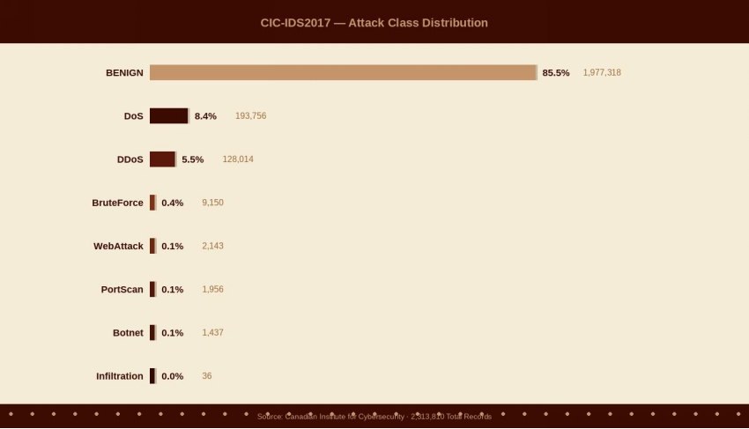
ADAPT-SHIELD
Class Distribution & Decision Mapping

Slide 8
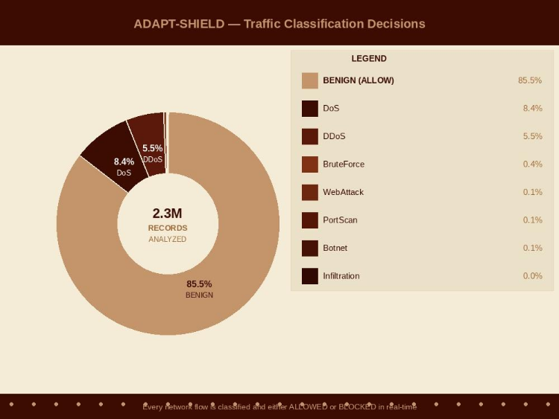
ADAPT-SHIELD
Class Distribution & Decision Mapping

Slide 9

ADAPT-SHIELD
Data Challenges & Preprocessing
Extreme Class Imbalance:
The ratio between the majority (BENIGN) and minority (Infiltration) is 54,925:1.
Solution: Handled via class_weight="balanced" and stratified splitting to ensure all classes appear in training/testing sets.
Data Cleaning:
Identified and removed 82,004 duplicate rows during validation.
Handled suspicious negative values in features like Flow Duration and Flow Bytes/s.
Consistency: A StandardScaler is saved as scaler.pkl to ensure identical preprocessing during both training and real-time inference.

Slide 10
ADAPT-SHIELD
Data Validation & Integrity
The system executes 7 automated checks before training begins:
Schema Check: Confirms 2.3M rows and 78 columns.
Null/Infinite Detection: Verified zero missing or infinite values.
Label Verification: Confirms the presence of all 8 distinct attack classes.
Drift Readiness: Reference distributions are stored to enable Kolmogorov-Smirnov (KS) tests in production.

Slide 11

System Architecture
DATA PHASE
TRAINING PHASE
SERVING PHASE
OPS PHASE
Data Ingestion
Model Training
FastAPI REST API
CI/CD (GitHub Actions)
Data Validation
Hyperparameter Tuning
Docker Containerization
Drift Detection
Feature Engineering
MLflow Tracking
AWS CloudWatch
Model Registry
Auto-Retrain Trigger

Slide 12
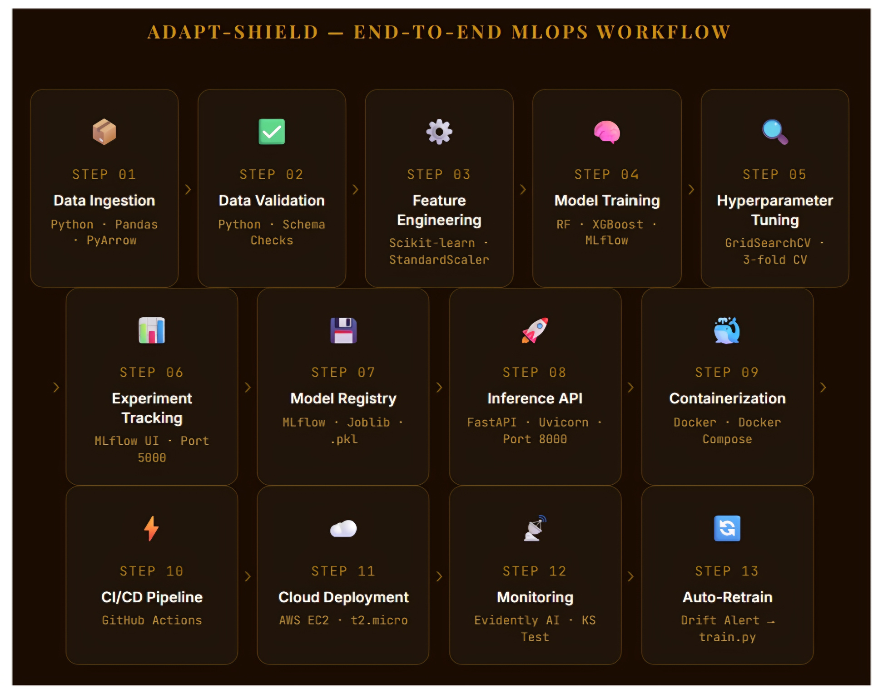

Slide 13
ADAPT-SHIELD
Implementation Steps

Slide 14
ADAPT-SHIELD
Phase 1: Data & Training (Steps 1–7) Steps
Environment Setup: Create a virtual environment and configure PowerShell execution policies.
Dependency Install: Install core libraries including MLflow, FastAPI, XGBoost, and Scikit-Learn.
Data Ingestion: Merge raw CIC-IDS2017 CSVs into a single 2.3M row Parquet file for optimized processing.
Data Validation: Execute automated quality checks for missing values, duplicates (82,004 removed), and class imbalance.
MLflow Server: Launch a local tracking server with a SQLite backend to log all experimental metadata.
Train Random Forest: Establish a baseline ensemble model (Macro F1 = 0.8552).
Train XGBoost: Implement Gradient Boosting, achieving a superior Macro F1 of 0.9018.

Slide 15
Phase 2: Serving & Ops (Steps 8–13)
8. Model Selection: Automatically promote the winning XGBoost model and export it as a production-ready .pkl file.
9. Hyperparameter Tuning: Refine model performance via GridSearchCV (27 combinations) to maximize accuracy.
10. FastAPI Inference API: Deploy a RESTful API with endpoints for real-time traffic prediction (/predict) and system health.
11. Docker Containerization: Package the security layer (1.89 GB) and frontend (216 MB) into isolated, portable containers.
12. CI/CD — GitHub Actions: Automate the pipeline to run unit tests and rebuild Docker images on every code push.
13. Drift Detection: Implement continuous monitoring using KS tests; detect feature drift and trigger alerts via AWS CloudWatch

Slide 16
ADAPT-SHIELD
Model Results & Comparison
Performance Metrics Summary
XGBoost (Winner): Achieved a Macro F1-Score of 0.9018, demonstrating superior handling of complex attack patterns.
Random Forest: Achieved a Macro F1-Score of 0.8552, serving as a strong but less precise baseline.
Post-optimization via GridSearchCV improved the Random Forest CV F1-Score to 0.9010.

Slide 17
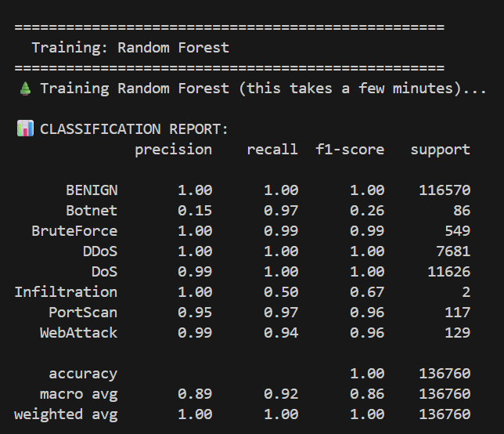
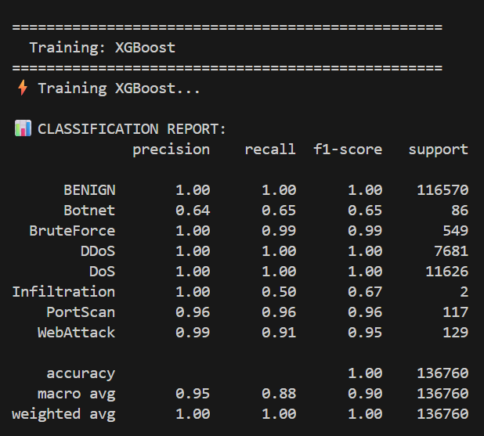
ADAPT-SHIELD
Model Results & Comparison

Slide 18
ADAPT-SHIELD
FastAPI Inference API
Deployment: Runs via Uvicorn on port 8000 for high-concurrency handling.
Key Endpoints:
POST /predict: Classifies 77 features into ALLOW or BLOCK actions.
GET /health: Ensures the service is alive for Docker orchestration.
Output Details:
Returns the specific attack class (e.g., BENIGN, DoS).
Provides a confidence score and processing time
Operational Role: Serves as Step 10 in the pipeline, linking the XGBoost model to the live environment

Slide 19
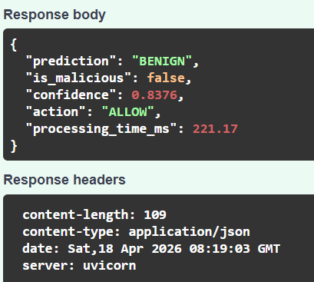
ADAPT-SHIELD
FastAPI Inference API

Slide 20
MLflow Experiment Tracking & Hyperparameter Tuning
Centralized Logging: Utilized MLflow on localhost:5000 with a SQLite backend to track all model parameters, metrics, and artifacts.
Model Comparison: Enabled side-by-side performance analysis, leading to the selection of XGBoost (Macro F1: 0.9018) over Random Forest.
Hyperparameter Optimization: Conducted via GridSearchCV, testing 27 different combinations with 3-fold cross-validation.
Automated Selection: The system identifies the "winner" based on F1-score and automatically exports the best model.pkl for deployment.

Slide 21
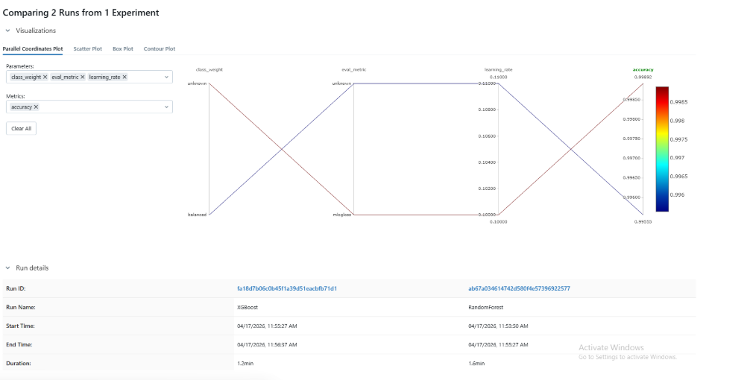
MLflow Experiment Tracking & Hyperparameter Tuning

Slide 22
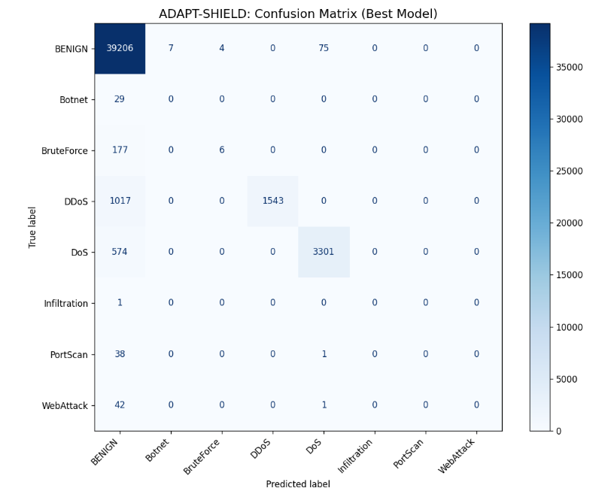
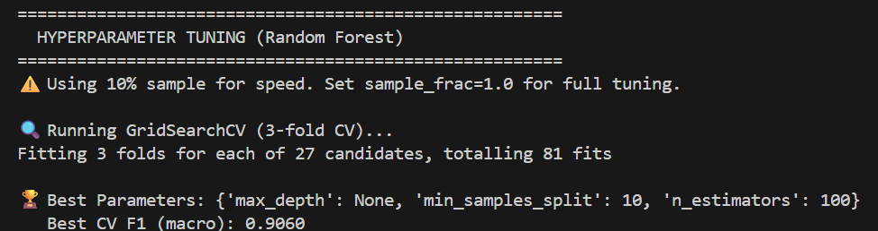
MLflow Experiment Tracking & Hyperparameter Tuning

Slide 23
ADAPT-SHIELD
Drift Detection & Cloud Monitoring
Dual-Layer Monitoring Strategy:
Layer 1 (API Health): Polls the /health endpoint to monitor uptime, request volume, and real-time block rates.
Layer 2 (Statistical Drift): Compares 66 numeric features against the training baseline using the Kolmogorov-Smirnov (KS) test.
Drift Logic & Thresholds:
Any feature with a KS p-value < 0.05 is flagged as drifted.
In production, detecting drift in 9/66 features (13.6% rate) triggers a retraining alert.

Slide 24
ADAPT-SHIELD
Drift Detection & Cloud Monitoring
Alerting & Reporting:
Drift incidents are logged to monitoring/drift_log.json and synchronized with AWS CloudWatch.
Evidently AI automatically generates an interactive drift_report.html for deep-dive analysis.
The Retraining Loop:
Drift detection runs on a cron schedule.
Once the threshold is exceeded, the system initiates src/train.py to update the model with fresh data.

Slide 25
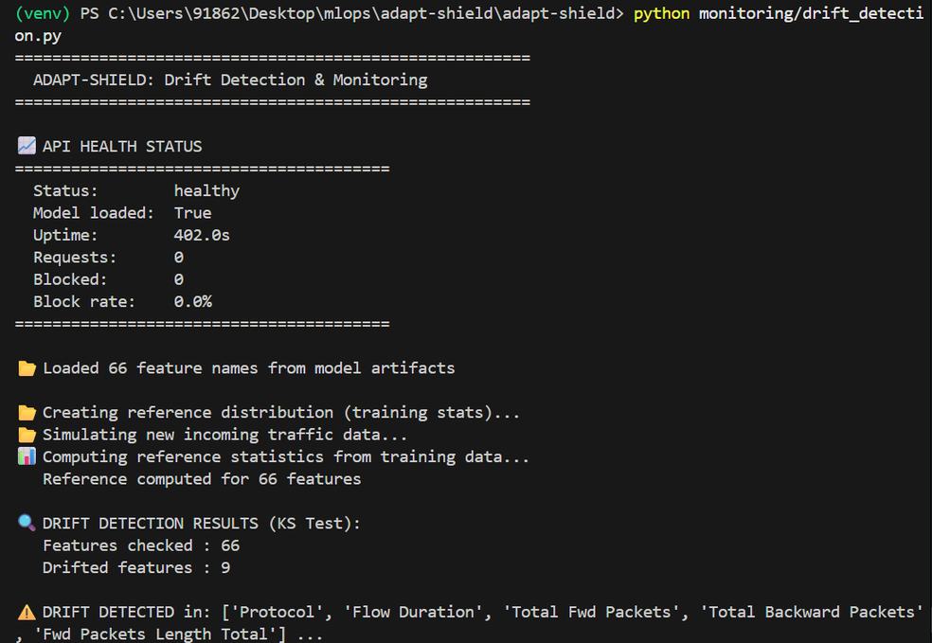
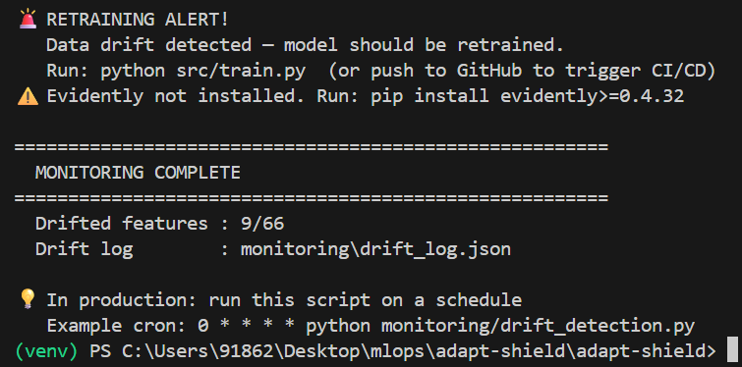
ADAPT-SHIELD
Drift Detection & Cloud Monitoring

Slide 26
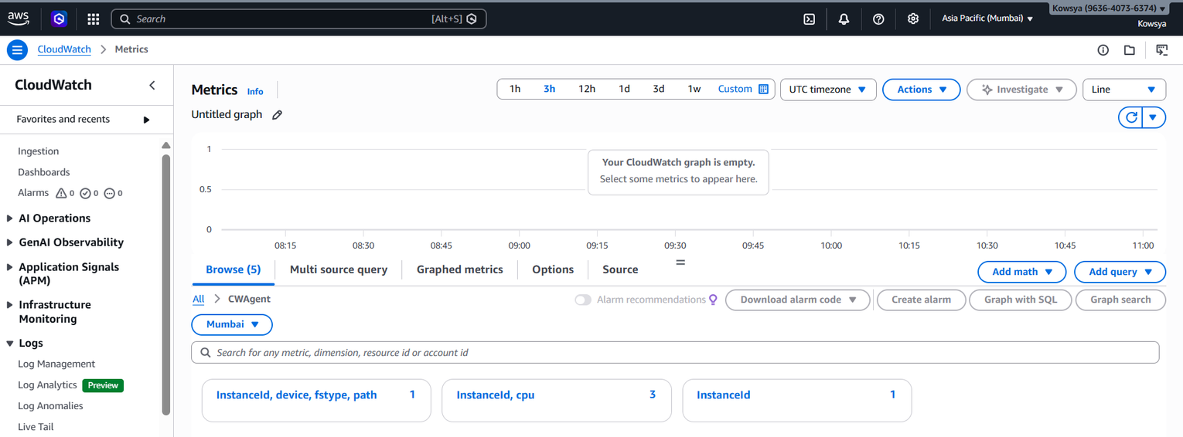
ADAPT-SHIELD
Drift Detection & Cloud Monitoring

Slide 27
Docker Containerization — Two-Container Architecture
Architecture Strategy: Implements a modular system using Docker Compose to isolate the security engine from the application server.
Container Breakdown:
Security Layer (docker-security-layer): A 1.89 GB container (port 8000) housing the ML model and FastAPI server to enforce ALLOW/BLOCK decisions.
Main Website (docker-main-website): A 216 MB container (port 9000) that only processes traffic classified as BENIGN.
Networking: Both containers communicate over a private adapt-shield-network using internal DNS, replacing static IP addresses with service names.
Resource Efficiency: In production, the system maintains a low footprint with approximately 0.66% CPU and 281MB RAM usage

Slide 28
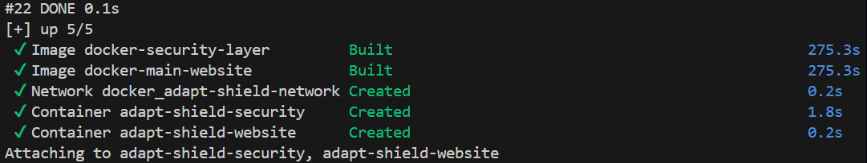
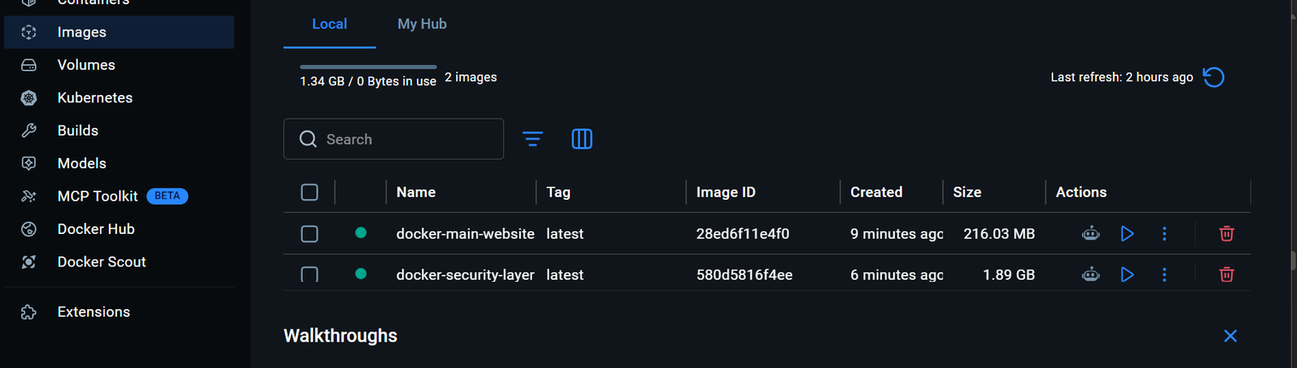
Docker Containerization — Two-Container Architecture

Slide 29
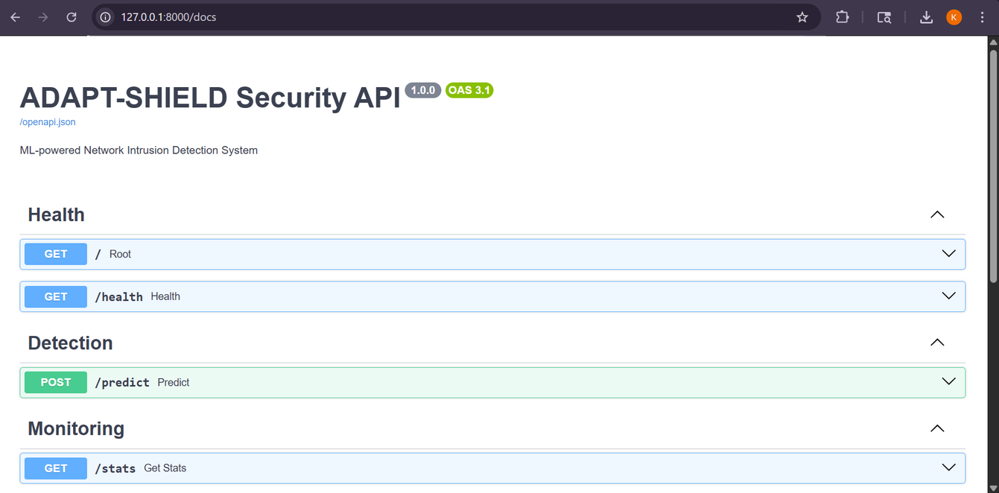
Docker Containerization — Two-Container Architecture

Slide 30
GitHub Actions CI/CD — Automated Pipeline
Trigger Mechanism: The .github/workflows/ci-cd.yml pipeline initiates automatically upon every push to the main branch.
Pipeline Workflow:
Job 1 (Unit Tests): Sets up Python 3.11 and executes the pytest suite to ensure code integrity.
Job 2 (Build & Push): Builds the Docker images and pushes them to Docker Hub only if all tests pass.
Performance: The entire pipeline completes in just 1 minute 37 seconds, ensuring every commit is verified and deployable

Slide 31
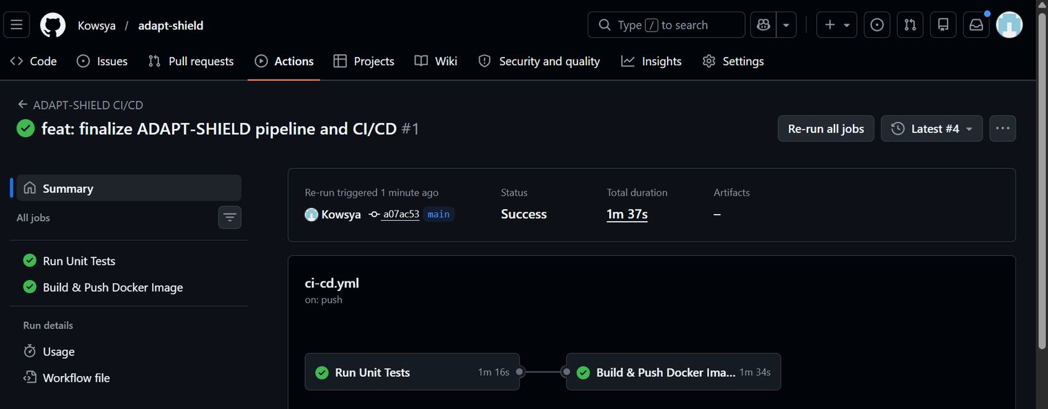
GitHub Actions CI/CD — Automated Pipeline

Slide 32
AWS EC2 Cloud Deployment — Live at 65.0.185.101
Host: Deployed on AWS EC2 t2.micro (Mumbai region) using the Free Tier.
Method: Uses Docker Compose to run both the Security Layer and Website in detached mode.
Connectivity: Inbound rules open Port 9000 (Website), Port 8000 (API), and Port 22 (SSH).
Monitoring: AWS CloudWatch tracks CPU, Network I/O, and container logs in real-time.
Live Status: Accessible at 65.0.185.101, providing a fully functional, cloud-native security environment

Slide 33
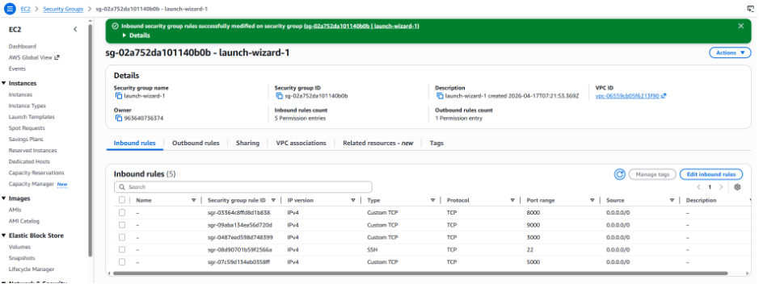
AWS EC2 Cloud Deployment — Live at 65.0.185.101

Slide 34
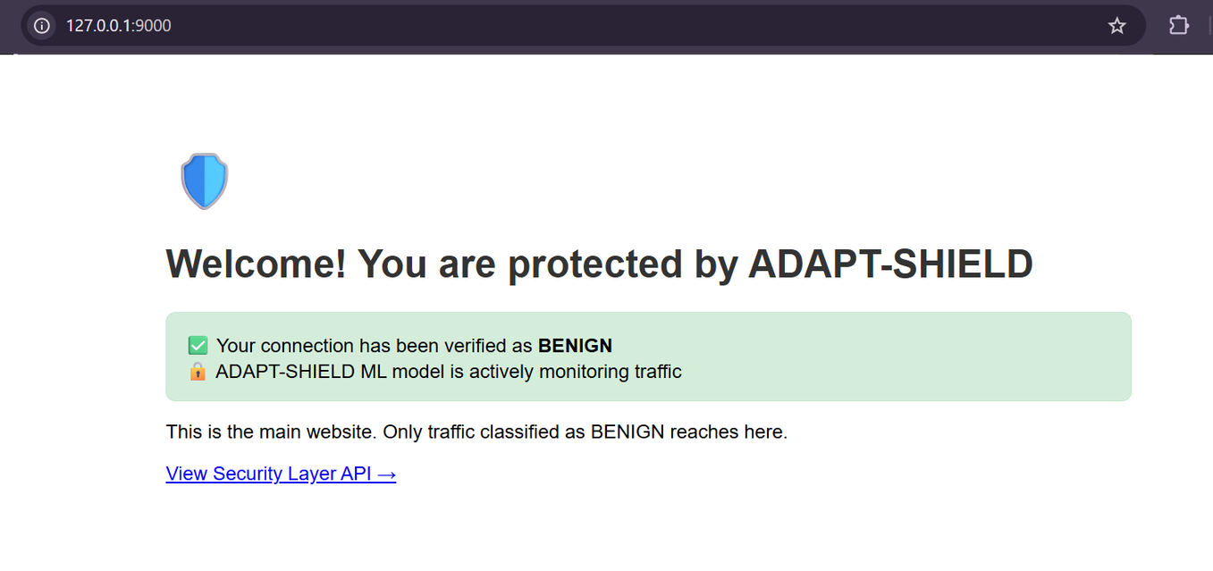
AWS EC2 Cloud Deployment — Live at 65.0.185.101

Slide 35
Tools & Technologies
Tool | Purpose | Version | Category
Python | All ML and backend code | 3.12 | Language
Scikit-learn | RandomForest, StandardScaler, GridSearchCV | 1.8.0 | ML
XGBoost | Gradient boosted multi-class classification | 3.2.0 | ML
Pandas | DataFrame operations and parquet I/O | 2.3.3 | Data
PyArrow | Parquet file reading (8 source files) | 23.0.1 | Data
MLflow | Experiment tracking, model registry, and artifacts | 3.11.1 | Tracking
FastAPI | REST API with automatic Swagger UI | 0.136.0 | API

Slide 36
Tools & Technologies
Tool | Purpose | Version | Category
Uvicorn | ASGI server for FastAPI | 0.44.0 | API
Pydantic | Request/response schema validation | 2.13.2 | API
Joblib | Saving and loading .pkl model files | 1.5.3 | ML
Docker | Container images for reproducibility | Desktop | DevOps
Docker Compose | Multi-container orchestration | Latest | DevOps
GitHub Actions | Automated test → build → push pipeline | CI/CD | DevOps
AWS EC2 | Free Tier cloud deployment (ap-south-1) | t2.micro | Cloud

Slide 37
Tools & Technologies
Tool | Purpose | Version | Category
AWS CloudWatch | CPU, network, and log monitoring via IAM | Free | Cloud
Evidently AI | HTML data drift report generation | 0.7.21 | Monitoring
SciPy | Kolmogorov-Smirnov statistical drift test | 1.17.1 | Monitoring
Matplotlib | Confusion matrix visualization | 3.10.8 | Viz
Pytest | Unit tests for CI/CD pipeline | 9.0.3 | Testing
Git + GitHub | Version control and CI/CD trigger | Latest | VCS

Slide 38
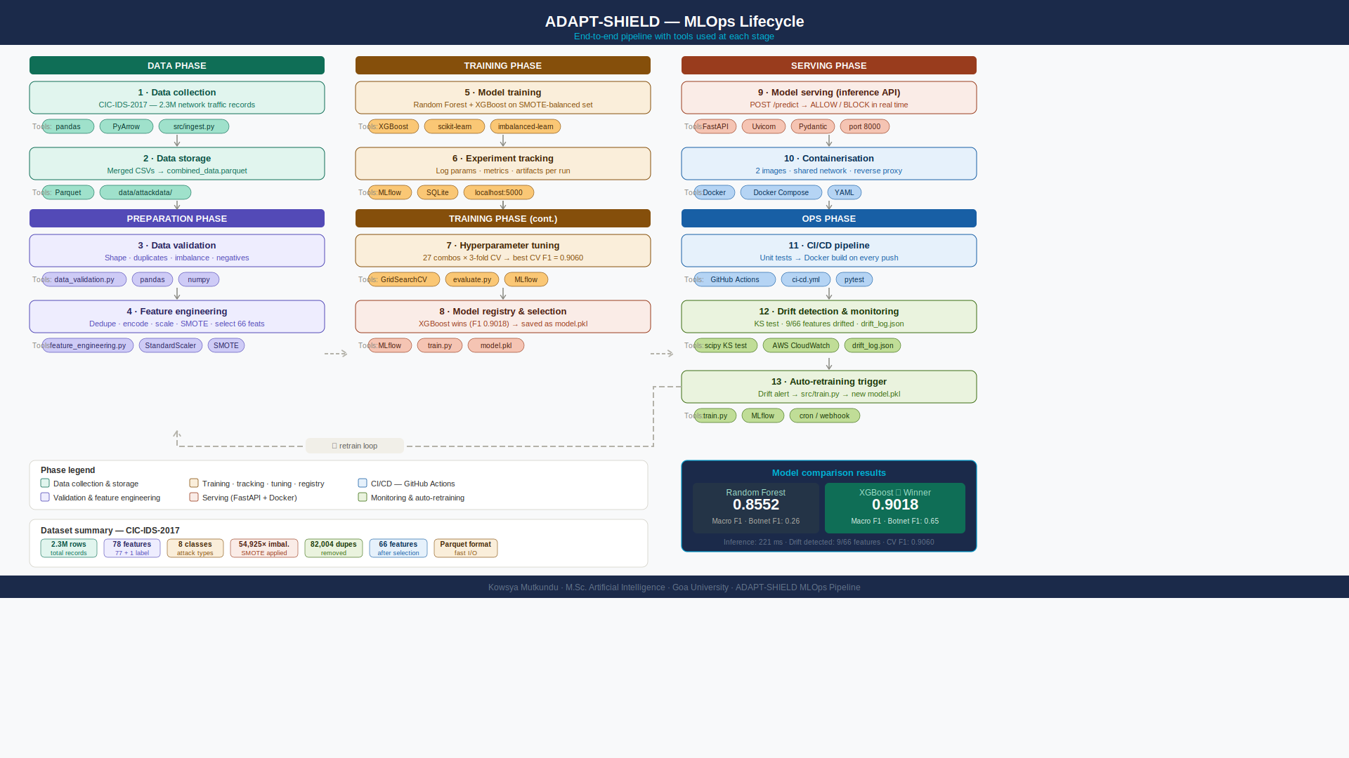
System Workflow with tools

Slide 39
Limitations
Computing Constraints: The deployment uses an AWS EC2 t2.micro instance, which provides limited CPU and RAM (1GB), potentially restricting throughput during high-traffic bursts.
Feature Sensitivity: The model relies on 77 specific network features from the CIC-IDS2017 dataset; performance may degrade if live network traffic formats vary significantly from this baseline.
Static Thresholds: Drift detection relies on a fixed KS p-value of 0.05, which may require periodic manual adjustment to avoid false-positive retraining alerts.
Retraining Latency: While drift detection is automated, the actual retraining process (triggered by src/train.py) requires time to process 2.3M rows, creating a temporary lag before the new model is live.

Slide 40
Future Scope
Auto-Scaling Architecture: Migrate from a single EC2 instance to AWS ECS or Kubernetes (EKS) to handle fluctuating traffic loads dynamically.
Enhanced Drift Intelligence: Incorporate Evidently AI more deeply to include "Concept Drift" monitoring, tracking the model's target accuracy over time rather than just feature distribution.
GPU Acceleration: Implement GPU-based training using XGBoost's CUDA support to reduce retraining time from minutes to seconds.
Real-time Dashboarding: Integrate a live Grafana dashboard with the FastAPI /stats endpoint for visual, real-time threat monitoring and system health metrics.

Slide 41

ADAPT-SHIELD
Conclusion
Robust Detection: Achieved a 0.9018 Macro F1-Score using XGBoost, providing high-accuracy classification across diverse attack types.
Production-Ready: Deployed a modular Docker architecture on AWS EC2, isolating security logic from the application for maximum stability.
Fully Automated: Streamlined the development lifecycle with GitHub Actions, enabling sub-2-minute automated testing and deployment.
Adaptive Intelligence: Integrated statistical drift detection using the KS test to trigger alerts and retraining when network patterns shift.
End-to-End Visibility: Leveraged MLflow for experiment tracking and AWS CloudWatch for live cloud infrastructure monitoring.

Slide 42
ADAPT-SHIELD
Thank You

